Slide 1
The Interface to Software 2.0: Programming Training Data with Snorkel
Alex Ratner
Stanford University
Notes:
Hi, my name is Alex Ratner and I’m a 5th year PhD student working with Chris Re.
Today, I’m going to give an update on Snorkel, our system for rapidly generating large training sets, and on our broader vision in this area of work.

Slide 2
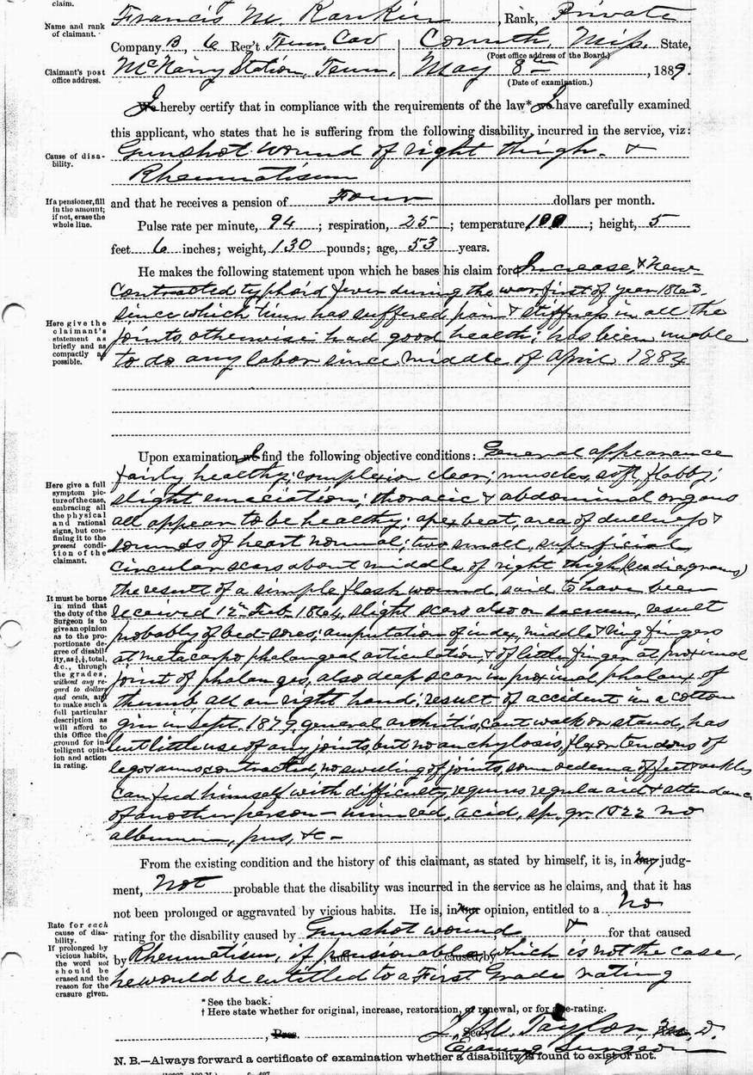
Outline
Dark Data Extraction
The Problem of Training Data
Snorkel: A Framework for Weak Supervision

Slide 3
Dark Data Extraction

Slide 4
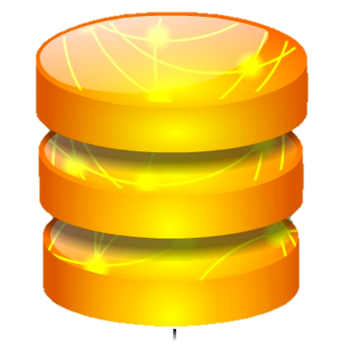
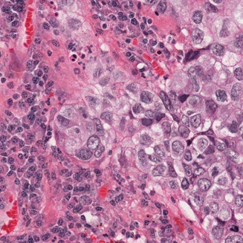
Structured Data
Data easy to process by machines
Dark Data
Medical Images
Scientific articles & government reports.
Valuable & hard to process.

Slide 5
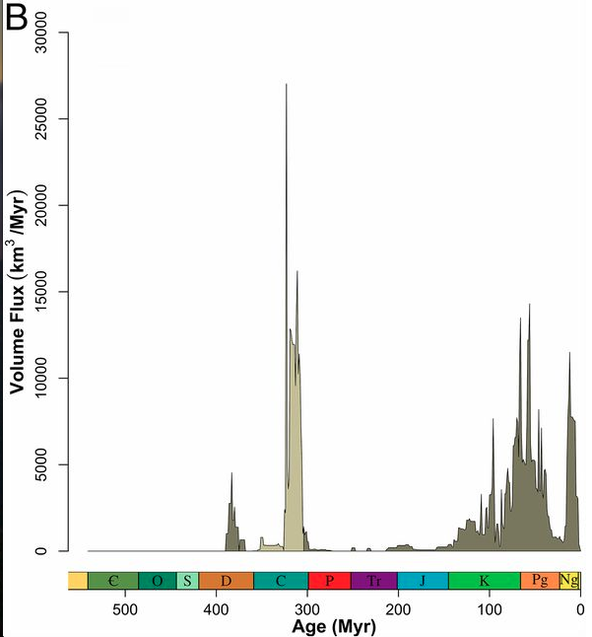
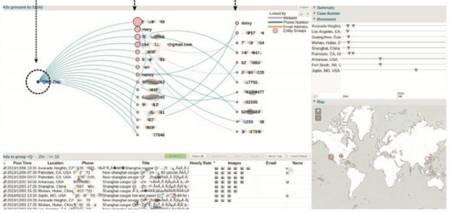
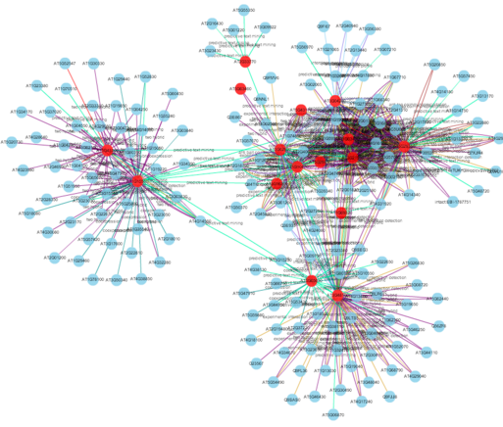
Dark Data Extraction (DDE)
Dark Data: Text, Tables, Images, Diagrams, etc.
Structured Data: Enables analyses, interfaces, etc.
A critical and difficult step in many analysis pipelines

Slide 6
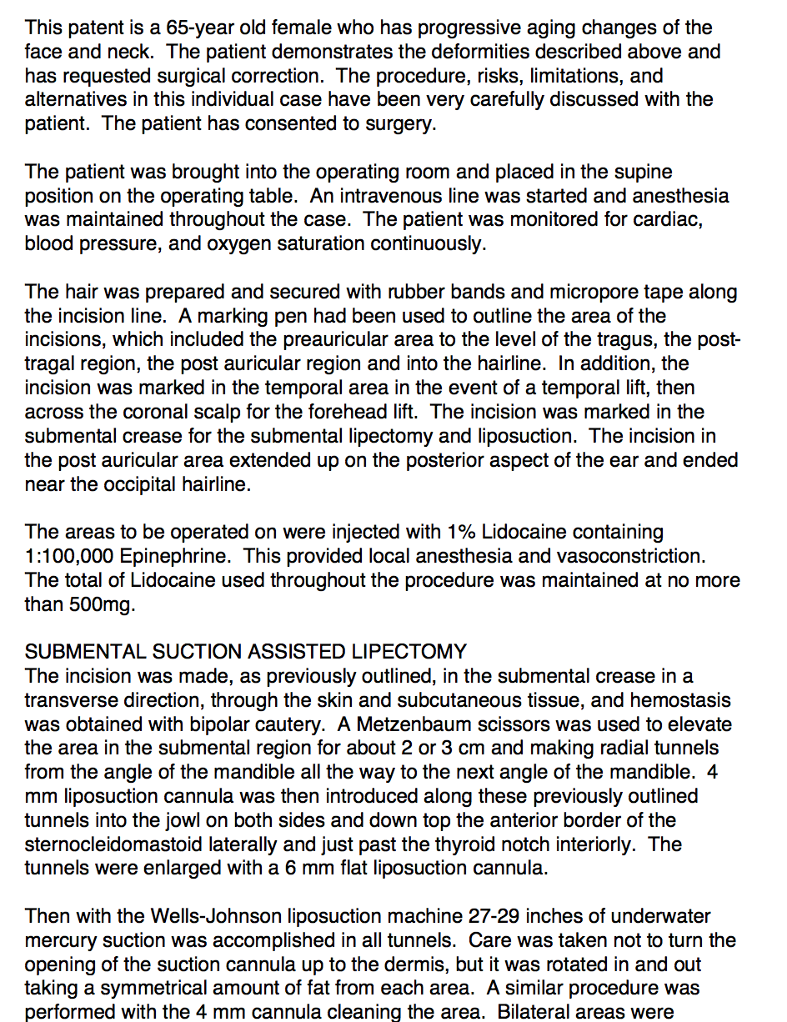
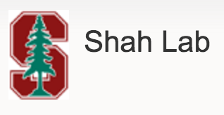
Extraction from Clinical Records
What catheters are optimal for treating different types of DVT?
What are signs and causes of post-implant surgery issues?
Critical data goes un-coded!

Slide 7
Extraction from the Scientific Literature
What drugs may have unsafe reaction with which gut bacteria?
Which genes are associated with which phenotypes?
Scientific data accessible, but not readable

Slide 8
Extraction for Defense & Law Enforcement
What causes insurgency fighters to join insurgencies? Leave them?
Which online sexual ads suggest that someone is a trafficked individual?
Models & interfaces built on top of structured data

Slide 9
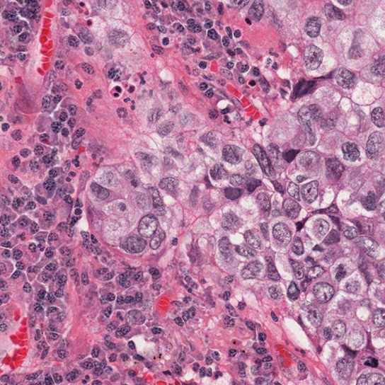
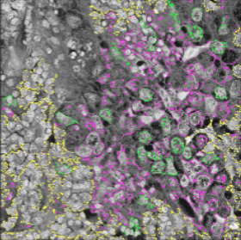
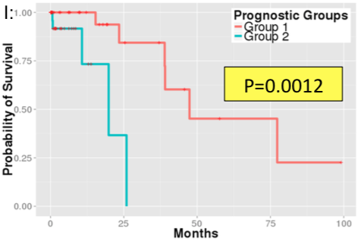
Dark Data Extraction: Beyond Text!
Example: Tumor grade & stage classification from histopathology slides (Nature Comm., Hsing-Yu et. al.)
Pathlogy Images
Visual Features
Probability of
Survival
Cleanly separated
Pathology Reports
Text Extractions
Images + patient data outperform expert pathologists at prognosis
A.
Histologic type:
Adenocarcinoma
Histologic grade:
Moderately
differentiated
... ...
A.
Histologic type:
Adenocarcinoma
Histologic grade:
Moderately
differentiated
... ...

Slide 10
The Need for Lightweight Extraction
Dark data extraction systems still take months or years to build using state-of-the-art machine learning (ML) systems
We need to be able to build systems that answer questions in hours to days to be useful
What is holding us back?

Slide 11
Example: Chemical-Disease Relation Extraction from Text
We define candidate entity mentions:
Chemicals
Diseases
Goal: Populate a relational schema with relation mentions
ID | Chemical | Disease | Prob.
00 | magnesium | Myasthenia gravis | 0.84
01 | magnesium | quadriplegic | 0.73
02 | magnesium | paralysis | 0.96

Slide 12
Relation Extraction with Machine Learning
Annotated as true relations
Possible (“candidate”) relations
Example binary features:
PHRASE_BTWN[“presenting as”]
WORD_BTWN[“after”]
TODAY:
Candidate Extraction
Training Set
Feature Extraction
Learning & Inference
Used to be: Feature engineering is the bottleneck

Slide 13
The Advent of Representation Learning
Deep learning is achieving state-of-the-art results without hand-tuned features
Feature engineering by hand is dead!

Slide 14
Relation Extraction with Machine Learning
Annotated as true relations
For a basic real-world use case:
Candidate Extraction
Training Set
Feature Extraction
Learning & Inference
…If we have massive training sets.

Slide 15
Training Data Creation: $$$, Slow, Static
Expensive & Slow:
Especially when domain expertise needed
Static:
Real-world problems change; hand-labeled training data does not.
GRAD STUDENT LABELER, 238 B.C.E.
Training data is THE ML dev bottleneck today

Slide 16
Can we use noisier training data and still train high-performance models?

Slide 17
“Best Of” Award
A System for Rapidly Generating Training Data with Weak Supervision
snorkel.stanford.edu

Slide 18
Snorkel: A System for Rapidly Creating Training Sets
Natural Language
“Chemicals of type A should be harmless…”
External KBs
Subset A
Subset B
Subset C
Patterns & dictionaries
“causes”, “induces”, “linked to”, “aggravates”, …
Expert Developers
Pattern(“{{0}} reacts with”)
END MODEL
EXPERT KNOWLEDGE & DATA
Goal: Bring all sources to bear to program ML systems in a radically faster and easier way

Slide 19
The Snorkel Pipeline
def lf1(x):
return 1 if cid in KB else 0
$$Y_{1}$$
def lf1(x):
return 1 if cid in KB else 0
$$Y_{2}$$
$$Y$$
def lf1(x):
return 1 if cid in KB else 0
$$Y_{3}$$
USER
def lf1(x):
return 1 if cid in KB else 0
PROBABILISTIC TRAINING DATA
$$Y_{4}$$
LABELING FUNCTIONS
LABEL MODEL
END MODEL
1
2
3
Users write labeling functions to generate noisy labels
Snorkel models and combine these labels
We use the resulting probabilistic training labels to train a model
Key point: Input is labeling functions– No hand-labeled training sets
Notes:
Besides a small evaluation set, there’s no hand-labeled data

Slide 20
Step 1: Writing Labeling Functions
def lf1(x):
return 1 if cid in KB else 0
$$Y_{1}$$
def lf1(x):
return 1 if cid in KB else 0
$$Y_{2}$$
$$Y$$
def lf1(x):
return 1 if cid in KB else 0
$$Y_{3}$$
def lf1(x):
return 1 if cid in KB else 0
PROBABILISTIC TRAINING DATA
$$Y_{4}$$
LABEL MODEL
END MODEL
LABELING FUNCTIONS
1
Users write labeling functions to generate noisy labels

Slide 21
Jupyter Interface

Slide 22
Labeling Functions
Users give Snorkel labeling functions that label data points
def LF_1(x):
m = re.match('.*caused.*', x.sentence)
return 1 if m is not None else 0
Example types:
Domain heuristics
Distant supervision
Crowdsourcing
Weak classifiers

Slide 23
Labeling Functions
“In our study, administering Chemical A caused Disease B under certain conditions…”
def LF_1(x):
m = re.match('.*caused.*', x.sentence)
return 1 if m is not None else 0
Label = TRUE
This is likely to be correct, but…

Slide 24
Labeling Functions
“A recent study found no evidence that Chemical A caused Disease B …”
def LF_1(x):
m = re.match('.*caused.*', x.sentence)
return 1 if m is not None else 0
Label = TRUE
…sometimes incorrect!

Slide 25
Step 2: Model, Combine, Iterate
def lf1(x):
return 1 if cid in KB else 0
$$Y_{1}$$
def lf1(x):
return 1 if cid in KB else 0
$$Y_{2}$$
$$Y$$
def lf1(x):
return 1 if cid in KB else 0
$$Y_{3}$$
def lf1(x):
return 1 if cid in KB else 0
PROBABILISTIC TRAINING DATA
$$Y_{4}$$
LABEL MODEL
END MODEL
LABELING FUNCTIONS
RAPID FEEDBACK & ITERATION
1
2
Users write labeling functions to generate noisy labels
Snorkel models and combine these labels

Slide 26
Step 3: Train End Model
def lf1(x):
return 1 if cid in KB else 0
$$Y_{1}$$
def lf1(x):
return 1 if cid in KB else 0
$$Y_{2}$$
$$Y$$
def lf1(x):
return 1 if cid in KB else 0
$$Y_{3}$$
def lf1(x):
return 1 if cid in KB else 0
PROBABILISTIC TRAINING DATA
$$Y_{4}$$
LABEL MODEL
END MODEL
LABELING FUNCTIONS
RAPID FEEDBACK & ITERATION
1
2
3
Users write labeling functions to generate noisy labels
Snorkel models and combine these labels
We use the resulting probabilistic training labels to train a model

Slide 27
How do we model and combine LFs?
def lf1(x):
return 1 if cid in KB else 0
$$Y_{1}$$
def lf1(x):
return 1 if cid in KB else 0
$$Y_{2}$$
$$Y$$
def lf1(x):
return 1 if cid in KB else 0
$$Y_{3}$$
def lf1(x):
return 1 if cid in KB else 0
PROBABILISTIC TRAINING DATA
$$Y_{4}$$
LABEL MODEL
END MODEL
LABELING FUNCTIONS
Core Technical Challenge: How to best reweight and combine the noisy supervision signal?

Slide 28
A Generative Model of the Training Data Labeling Process
Labels w.p. $β$
Labeling Function (LF)
$$X$$
Correct w.p. $α$
Core Technical Challenge: How to estimate these parameters without any ground-truth labels?

Slide 29
A Generative Model of the Training Data Labeling Process
$Y_{i}∈$ {NORMAL, ABNORMAL}
Learned Accuracies
Probabilistic Training Labels
LF 1
90%
$$X_{1}$$
LF 2
80%
$$X_{2}$$
LF 3
60%
$$X_{3}$$
Intuition: Learn the accuracies from the overlaps
Notes:
Labels data points as abnormal / normal, where the X_i are radiology cases from our previous example
How to deal with the fact that we have conflicting labels, including tie votes?
Intuition is that LFs that tend to be in the majority should be more accurate, and vice-versa; we learn corresponding accuracies
These then give us probabilistic training labels---ie training labels with confidence scores---for the data points

Slide 30
Modeling Correlated LFs is Crucial
def LF_1(X):
if subfn_A(X) > 0.5:
return 1
LF 1
$$X_{1}$$
def LF_2(X):
if subfn_A(X) > 0.7:
return 1
LF 2
$$X_{2}$$
LF 3
$$X_{3}$$
We can learn dependency structure using statistical and/or static analysis techniques [ICML ’17, NIPS ‘17]
Notes:
There’s another important twist to our problem however: What if the labeling functions are not really independent voters, but are correlated. For example, they might share a subfunction or use the same data resource; or they might even be duplicates of each other submitted by two different engineers, which we’ve seen happen!

Slide 31
Conclusion
Many motivating applications can be built with dark data extraction systems—if they are lightweight.
The key bottleneck in ML is training data
We can get around this by generating noisier training data that we then model
Thank you!

Slide 32
DAY 2 – SECOND SET
JACKIE’S BOOKMARK

Slide 33
Snorkel: Future Research Directions
MTL & Beyond

Slide 34
Higher-level, declarative interfaces to Snorkel
Programming Stack
Supervision Stack
Users can provide supervision via higher-level interfaces such as…
Writing LFs over unsupervised features [NIPS’17]
Saying natural language explanations [ACL’18]
Providing observational signals (e.g. eye trackers)
High-level
Application Interfaces
LFs Auto-Generated
from User Behavior
Automated
Declarative Language
LFs Compiled from
Natural Language
High-Level Language
LFs Built on
Advanced Primitives
Assembly Language
LFs Coded Directly
Machine Language
Individual Labels
Low-level
Manual
Goal: Make ML radically easier to program

Slide 35
Snorkel MeTaL
A New Framework for Managing Multi-Task Supervision
https://github.com/HazyResearch/metal

Slide 36
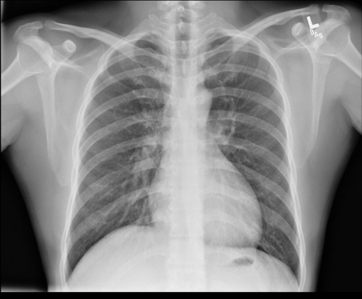
Challenge & Opportunity: Training Signal at Multiple Levels of Granularity
Coarse-grained
Report has negative sentiment
“Indication: Chest pain. Findings: Focal consolidation and pneumothorax…”
Diagnosis is abnormal
Patient has focal consolidation
Fine-grained
How can we bring all these diverse signals to bear?

Slide 37
Challenge & Opportunity: Training Signal at Multiple Levels of Granularity
Coarse-grained
Report has negative sentiment
$$Y_{1}$$
Task 1
“Indication: Chest pain. Findings: Focal consolidation and pneumothorax…”
Diagnosis is abnormal
$$Y_{2}$$
Task 2
$$Y_{3}$$
Patient has focal consolidation
Task 3
Fine-grained
View each source as labeling one more related tasks

Slide 38
Snorkel MeTaL for Multi-Task Supervision
Multi-Task Supervision
$$Y_{1}$$
$$\left[\begin{aligned}λ_{1,1} \\ λ_{1,2} \\ λ_{1,3}\end{aligned}\right]$$
Label Model
End Model
$$s_{1}$$
$$Y_{2}$$
Unlabeled Data
$$λ$$
$$\tilde{Y}$$
$$s_{2}$$
$$\left[\begin{aligned}λ_{2,1} \\ λ_{2,2} \\ λ_{2,3}\end{aligned}\right]$$
$$P_{μ}(Y|λ)$$
$$Y_{3}$$
$$s_{3}$$
Task Graph
$$\left[\begin{aligned}λ_{3,1} \\ 0 \\ λ_{3,3}\end{aligned}\right]$$
USER

Slide 39
Intuition: We can observe overlaps across tasks for extra signal
$$Y_{1}$$
Diagnosis is normal
Given the task structure, this is an observable form of disagreement!
Task 2
$$Y_{2}$$
Patient has focal consolidation
$$Y_{3}$$
Task 3
We can use our new matrix approximation approach to learn the accuracies of these multi-task sources!

Slide 40
Example: Chemical-Disease Relation Extraction from Text
ID | Chemical | Disease | Prob.
00 | magnesium | Myasthenia gravis | 0.84
01 | magnesium | quadriplegic | 0.73
02 | magnesium | paralysis | 0.96
Goal: Populate a relational schema with relation mentions
KNOWLEDGE BASE (KB)
Notes:
Work on flow here!

Slide 41
Example: Chemical-Disease Relation Extraction from Text
Task 3: CAUSES(C, D)?
Task 1: DISEASE?
Task 2: CHEM?
How do we build a “Software 2.0” system for this?
Notes:
In previous talks about Snorkel, we had focused on just the end Chemical-disease relation extraction task as an example… but really, this task involves at least three tasks (and, three types of labels)
And, could involve even more tasks (sub-types of chem/dis; specific hierarchies of types of relationships; etc) and more different *types* of labels
= MTS + MTL
TODO: Need to make the point then that people have done MTL / joint inference before, people have done WS before (previous section), but how do we combine them??

Slide 42
Existing approaches for this problem
Weak supervision:
Quickly train each model and pipeline them!
Problems:
Cascading errors
No pooling of sparse signal
Messy deployment
Multi-Task / Joint Learning:
Share learned representations within a single joint model
Problem:
For T tasks, still need T large hand-labeled training sets!
Can we combine these two approaches?

Slide 43
Snorkel MeTaL
A First End-to-End System for Multi-Task Supervision and Learning

Slide 44
Multi-Task Supervision in Snorkel MeTaL
$$λ_{1,1}$$
LABELING FUNCTIONS
(LFs)
$$λ_{2,1}$$
$$λ_{3,1}$$
Label Model
End Multi-Task Model
UNLABELED DATA
$$y_{1}$$
TASK GRAPH
$$y_{2}$$
$$y_{3}$$
$$y_{4}$$
Goal: Reweight and combine the noisy labels
Goal: Generalize beyond the noisy labels
Notes:
Add: “We show in the paper that both of these phases are necessary for high quality”
Need to have a less weak way of presenting this slide- not just “oh, what we did before with some modifications”…

Slide 45
Step 1: Inputs
$$y_{1}$$
$$y_{2}$$
$$y_{3}$$
$$y_{4}$$
Label Model
End Model
$$λ_{1,1}$$
$$λ_{2,1}$$
$$λ_{3,1}$$

Slide 46
Specifying a Simple Task Relationship Graph
Task 3: CAUSES(C, D)?
!D => !C(D,C)
!C => !C(D,C)
Task 1: DISEASE?
Task 2: CHEM?
Simple way to specify known logical structure

Slide 47
Expressing Multi-Task Weak Supervision as Labeling Functions
Example Labeling Functions:
def disease_in_KB(x):
if x.arg[0] in DISEASES:
return DISEASE
else:
return None
def pretrained_chem_tagger(x):
seq = chem_tagger.tag(x.sent)
tag = seq[x.arg[1].pos]
if tag == ’CHEM’:
return CHEMICAL
else:
return None
def cause_pattern_match(x):
if re.find(r’cause.*’, x.sent):
return CAUSES
return None

Slide 48
Step 2: Modeling Multi-Task Weak Supervision
$$y_{1}$$
$$y_{2}$$
$$y_{3}$$
$$y_{4}$$
Label Model
End Model
$$λ_{1,1}$$
$$λ_{2,1}$$
$$λ_{3,1}$$

Slide 49
Modeling Multi-Task Supervision
Input: noisy, overlapping and conflicting labels from LFs of unknown accuracies
Goal: learn the accuracies of the LFs, without labeled data, to reweight and combine their labels
A classic technical challenge, but with several fundamental twists…
Small # of labelers, each with large coverage
Correlated labelers
Multi-task labelers
Label Model
$$Y_{prob}$$
First step: Represent the problem…

Slide 50
Modeling LFs as Noisy Voters
We model each labeling function as having an accuracy $α$ and a labeling propensity $β$:
And can be correlated with other LFs…
$$y_{t}∈\{−1,1\}$$
$$y_{t} w.p. β_{j}α_{j}$$
$$λ_{j}\left(x\right)=$$
$${−y}_{t} w.p. β_{j}{(1−α}_{j})$$
$$0 w.p. {1−β}_{j}$$

Slide 51
Modeling Multi-Task Supervision
Task 3: CAUSES(C, D)?
Unobserved multi-task labels with given structure
Observed labeling function outputs
Correlations between labeling functions
y₃
Task 1: DISEASE?
Task 2: CHEM?
$$λ_{7}$$
$$λ_{8}$$
y₁
y₂
$$λ_{1}$$
$$λ_{2}$$
$$λ_{3}$$
$$λ_{4}$$
$$λ_{5}$$
$$λ_{6}$$
ICML 2017
Problem: How to learn without any observed ground-truth labels??
Notes:
Points to make: - Different tasks may have different amounts of LFs / density of labels (for example, Causes may have far less supervision)
- We can still learn from disagreements!
OUTLINE:
Basic idea / overview slide
FG / PGM representation: (i) Y / task graph, (ii) LFs, (iii) deps → Solve this using gibbs sampling + gradient descent
Preview: New matrix completion approach (better scaling!!!)
Theory + recap

Slide 52
Intuition: Learning from LF Overlaps
Task 3: CAUSES(C, D)?
If two LFs disagree on average, we know one (or both) must have lower accuracy
Problem: What if LFs are too sparse for a task?
We can learn from cross-task agreements too!
y₃
Task 1: DISEASE?
Task 2: CHEM?
$$λ_{7}$$
$$λ_{8}$$
y₁
y₂
$$λ_{1}$$
$$λ_{2}$$
$$λ_{3}$$
$$λ_{4}$$
$$λ_{5}$$
$$λ_{6}$$
We can then learn this model using Gibbs sampling + SGD
Notes:
Points to make: - Different tasks may have different amounts of LFs / density of labels (for example, Causes may have far less supervision)
- We can still learn from disagreements!
OUTLINE:
Basic idea / overview slide
FG / PGM representation: (i) Y / task graph, (ii) LFs, (iii) deps → Solve this using gibbs sampling + gradient descent
Preview: New matrix completion approach (better scaling!!!)
Theory + recap

Slide 53
Full Label Model Procedure
Apply LFs to unlabeled data X = {x₁,…,x_{n}}
For each data point x, get noisy labels $λ_{1}\left(x\right),…,λ_{m}(x)$
Learn model: Estimate the LF accuracies, labeling propensities $α,β$
Apply model to output probabilistic training labels $\tilde{Y}$
These can then be used to train any discriminative model!

Slide 54
Step 3: Dynamically-Compiled MTL Network
$$y_{1}$$
$$y_{2}$$
$$y_{3}$$
$$y_{4}$$
Label Model
End Model
$$λ_{1,1}$$
$$λ_{2,1}$$
$$λ_{3,1}$$

Slide 55
Dynamically-Compiled MTL Network
User-Provided Task Graph
Dynamically-Compiled MTL End Model
Task 3: CAUSES(C, D)?
Task heads
Intermediate layers
[shared]
Task 1: DISEASE?
Task 2: CHEM?
Input module
[shared]

Slide 56
Step 2: Training a Noise-Aware Model
In a supervised learning setting, we would learn from ground-truth labels:
Here, we learn from the noisy labels:
$$\hat{w}={\text{argmin}}_{w}\frac{1}{N}\sum_{i=1}^{N}{\sum_{t=1}^{T}{σ_{t}}l_{t}(w,x^{\left(i\right)},{y_{t}}^{\left(i\right)})}$$
$$\hat{w}={\text{argmin}}_{w}\frac{1}{N}\sum_{i=1}^{N}{\sum_{t=1}^{T}{σ_{t}}𝔼_{\tilde{y}\sim p_{θ}}[l_{t}\left({w,x}^{\left(i\right)},\tilde{y} \right)]}$$
Only requires simple tweak to loss function works over many models including Logistic Regression, SVMs and LSTMs.

Slide 57
Putting it all back together…
$$y_{1}$$
TASK GRAPH
$$y_{2}$$
$$y_{3}$$
$$y_{4}$$
Label Model
End Model
$$λ_{1,1}$$
LABELING FUNCTIONS
$$λ_{2,1}$$
$$λ_{3,1}$$
UNLABELED DATA
1
2
3
Users write multi-task labeling functions and specify a task graph
We model the labeling functions’ behavior to de-noise them
We use the resulting prob. labels to train a model
Notes:
Add: “We show in the paper that both of these phases are necessary for high quality”

Slide 58
Real-World Experiments

Slide 59
Real-World Experiments: Accuracy
 | Ontonotes (Fine-grained NER) | TACRED (Relation Extraction) | OpenI (Document Classification) | Average
Gold Labels (n=300) | 63.7 $±$ 2.1 | 28.4 $±$ 2.3 | 62.7 $±$ 4.5 | 51.6
Majority Vote | 76.9 $±$ 2.6 | 43.9 $±$ 2.6 | 74.2 $±$ 1.2 | 65.0
Pipelined Snorkel | 78.4 $±$ 1.2 | 49.0 $±$ 2.7 | 75.8 $±$ 0.9 | 67.7
Snorkel MeTaL | 82.2 $±$ 0.8 | 56.7 $±$ 2.1 | 76.6 $±$ 0.4 | 71.8
Avg. over Traditionally Supervised: + 20 points
Avg. over Majority Vote: + 7 points
Avg. over Pipelined Snorkel: + 4 points

Slide 60
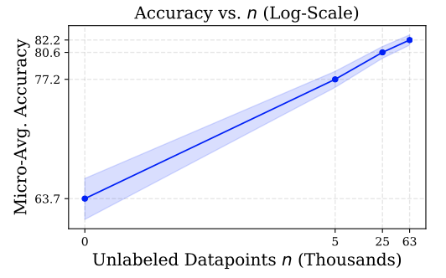
Scaling with Unlabeled Data
Theory:
Given at least three LFs
And dependent on the number of LFs and the structure of their dependencies & tasks
➔ end model accuracy should scale neg-exponentially with # of unlabeled data points n
Empirically: We indeed see this scaling with unlabeled data!

Slide 61
High-Level Takeaways
Big need: Systems that handle emerging end-to-end ML pipelines while being open to slot in arbitrary models
Take advantage of the commoditization of ML models!
Software 2.0 is eating the world… And training data is the key interface
We can “program” training data as code, with the proper techniques
Handling multiple related tasks is critical for real-world problems
For more check out snorkel.stanford.edu
Thank you!
snorkel.stanford.edu

