Slide 1
Sensitivity analyses – ACL
1. Only prestretch application
Run simulations only applying ACL prestretch values 0.75 to 1.25.
Prestretch values on the x-axis.
When no value is given, the model did not converge for this prestretch value.

Slide 2
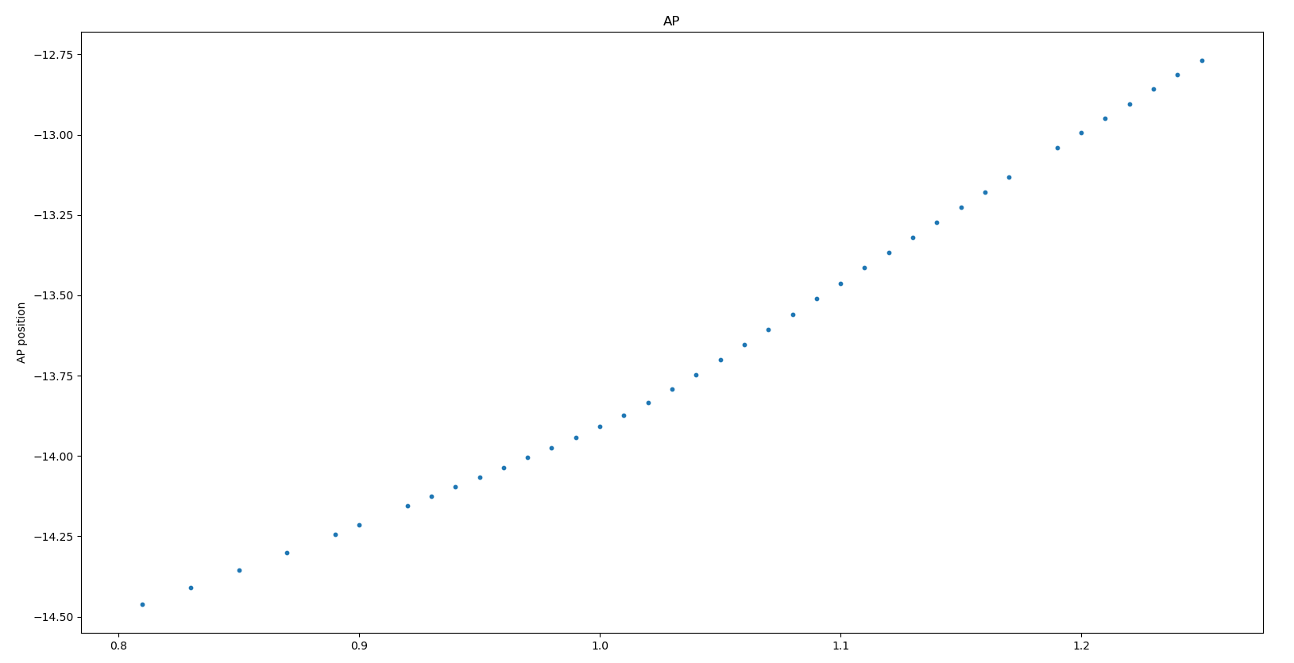
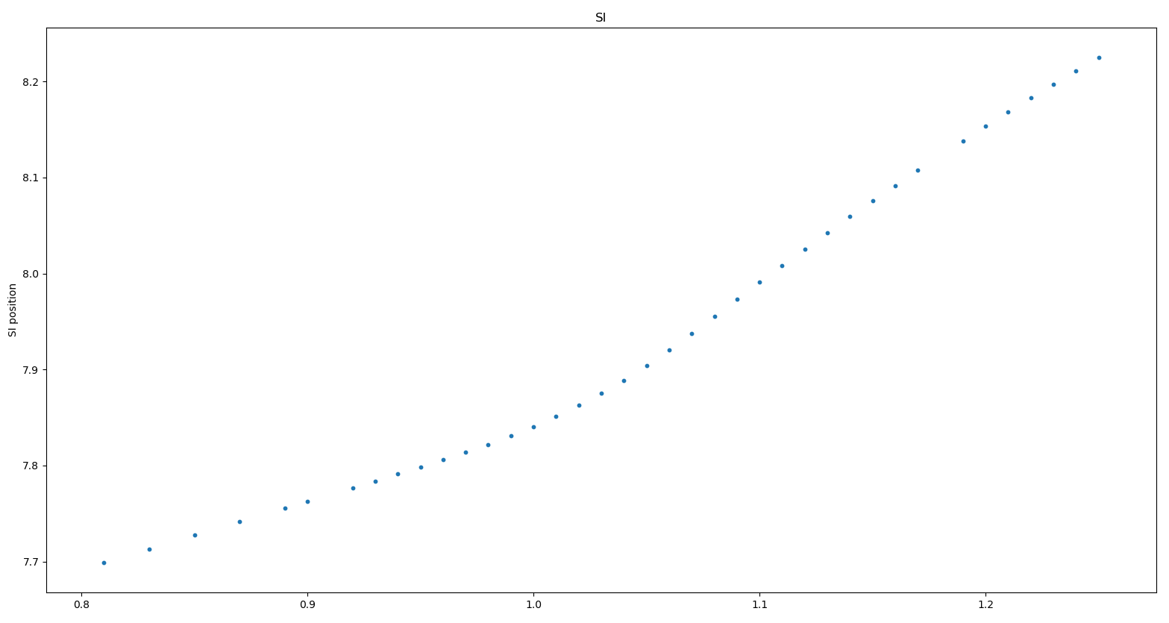
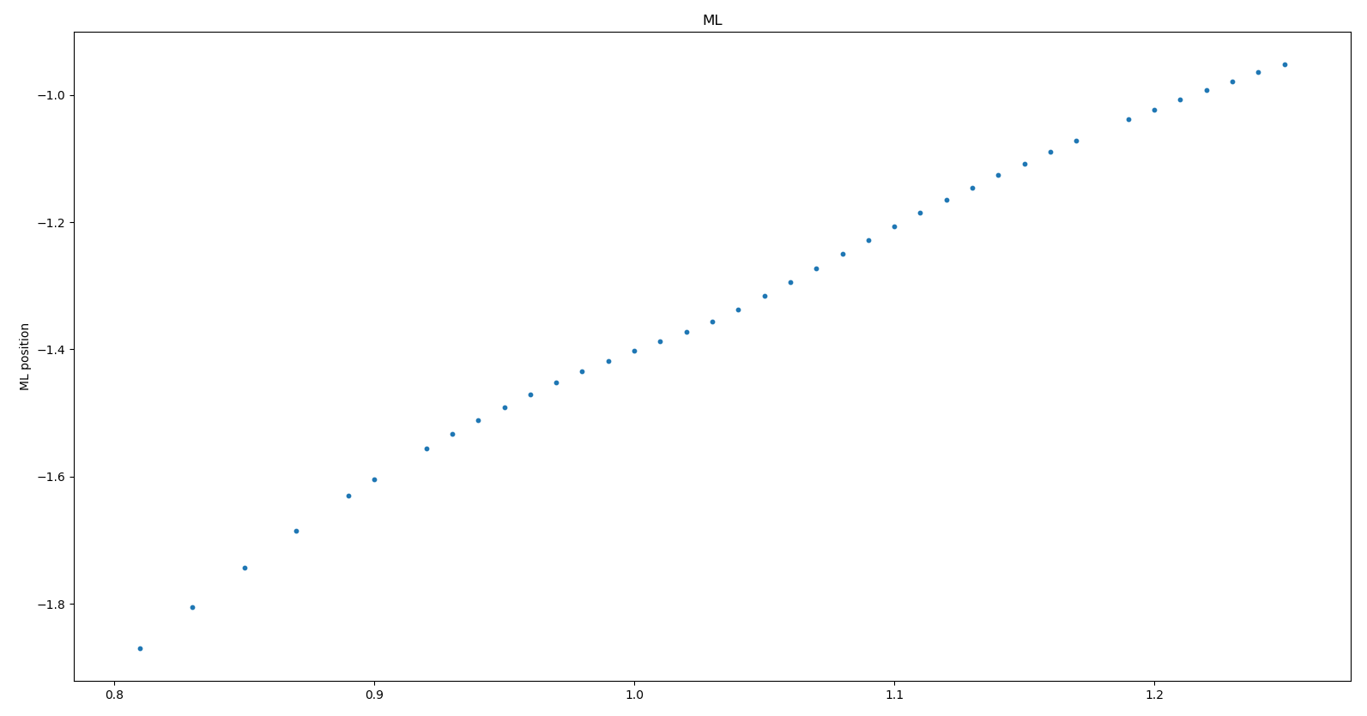
ACL prestretch factor
ACL prestretch factor
ACL prestretch factor

Slide 3
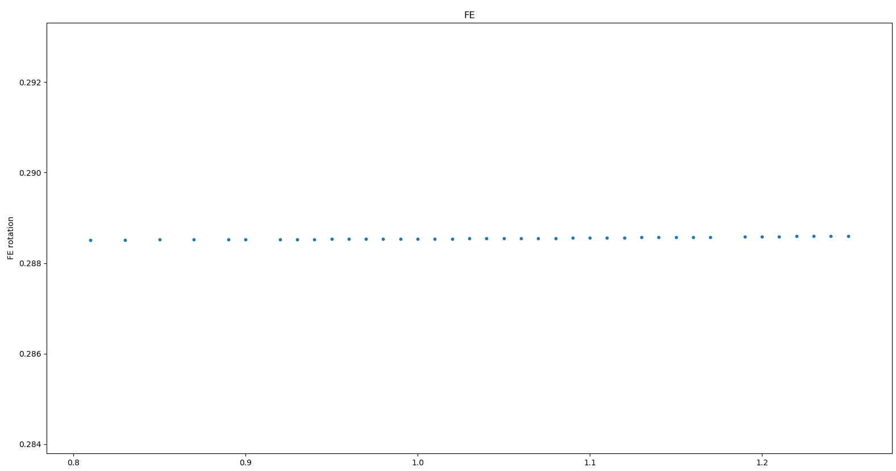
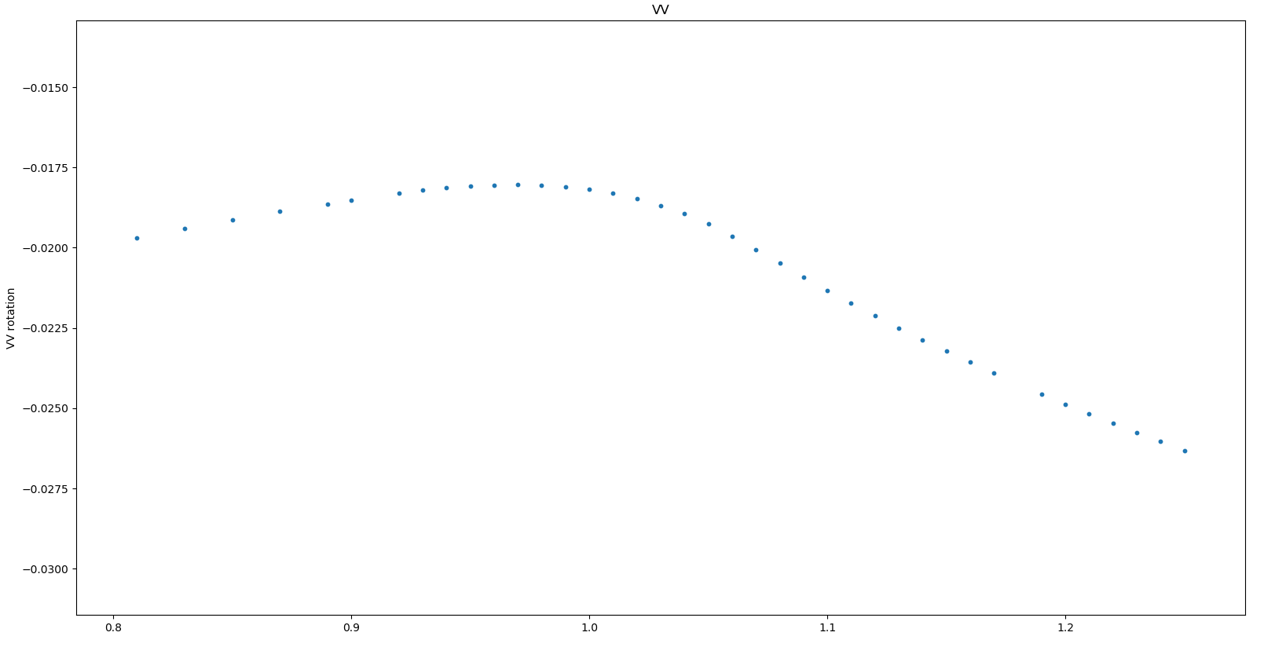
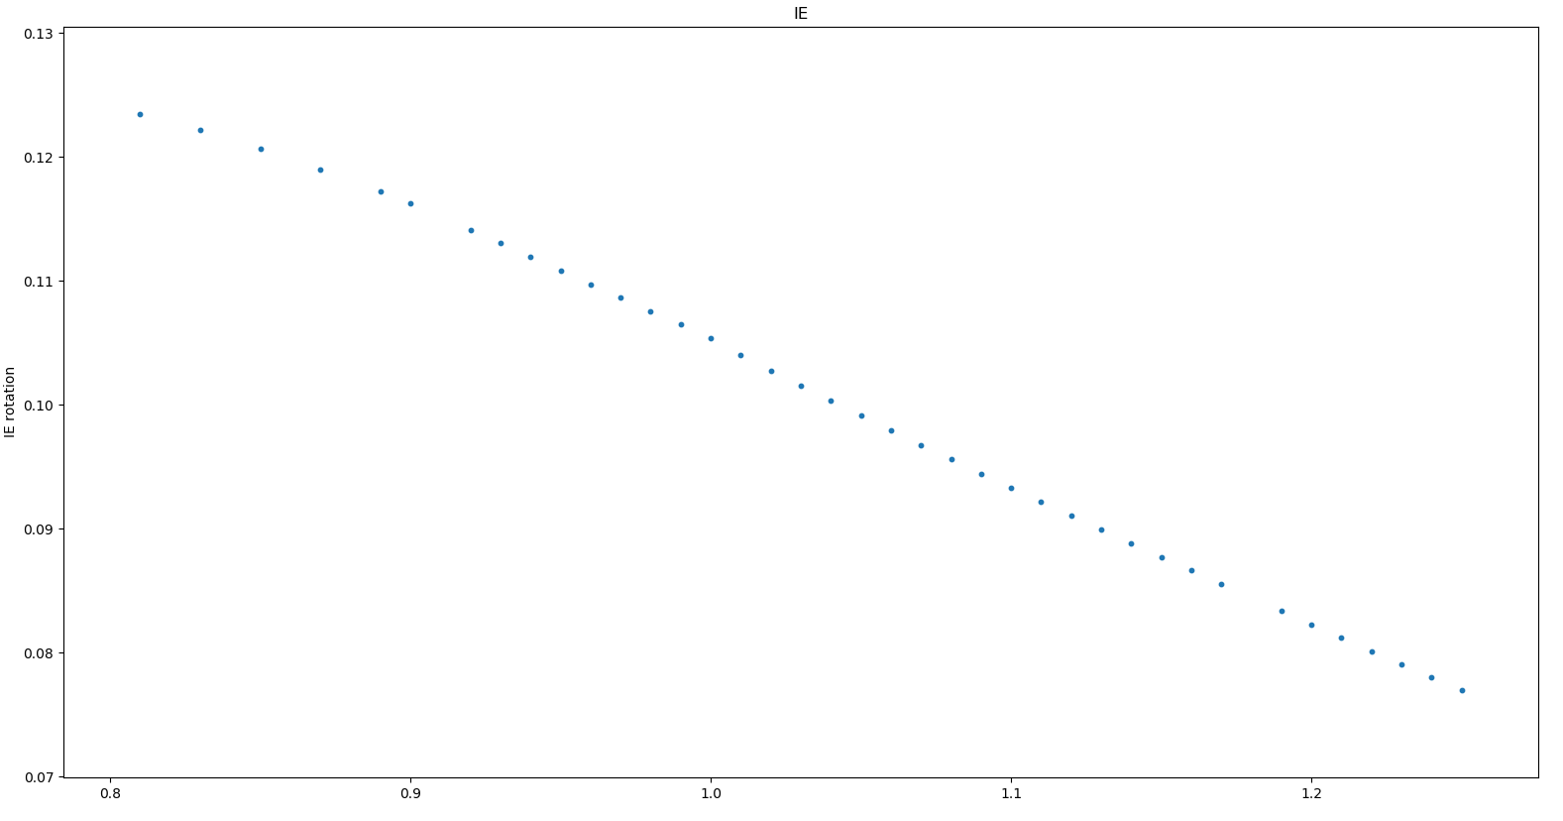
ACL prestretch factor
ACL prestretch factor
ACL prestretch factor

Slide 4
Sensitivity analyses – ACL
2. Prestretch application + flexion rotation (max. reformations 25)

Slide 5
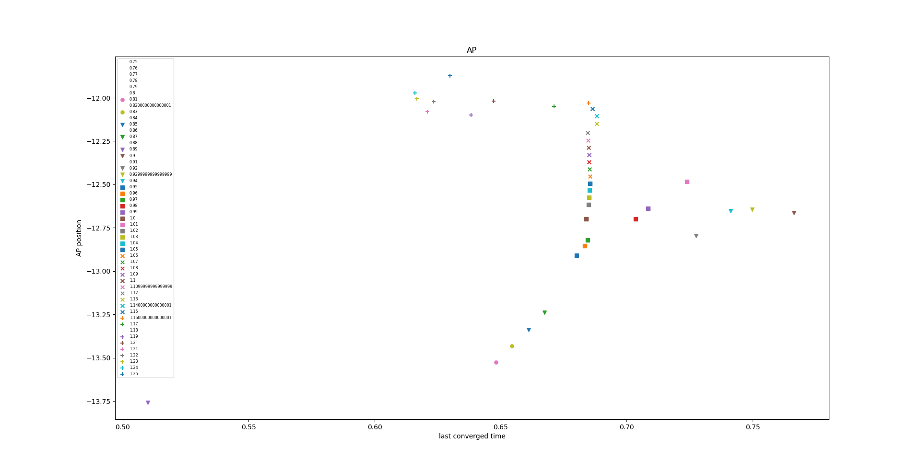
ACL prestretch factors

Slide 6
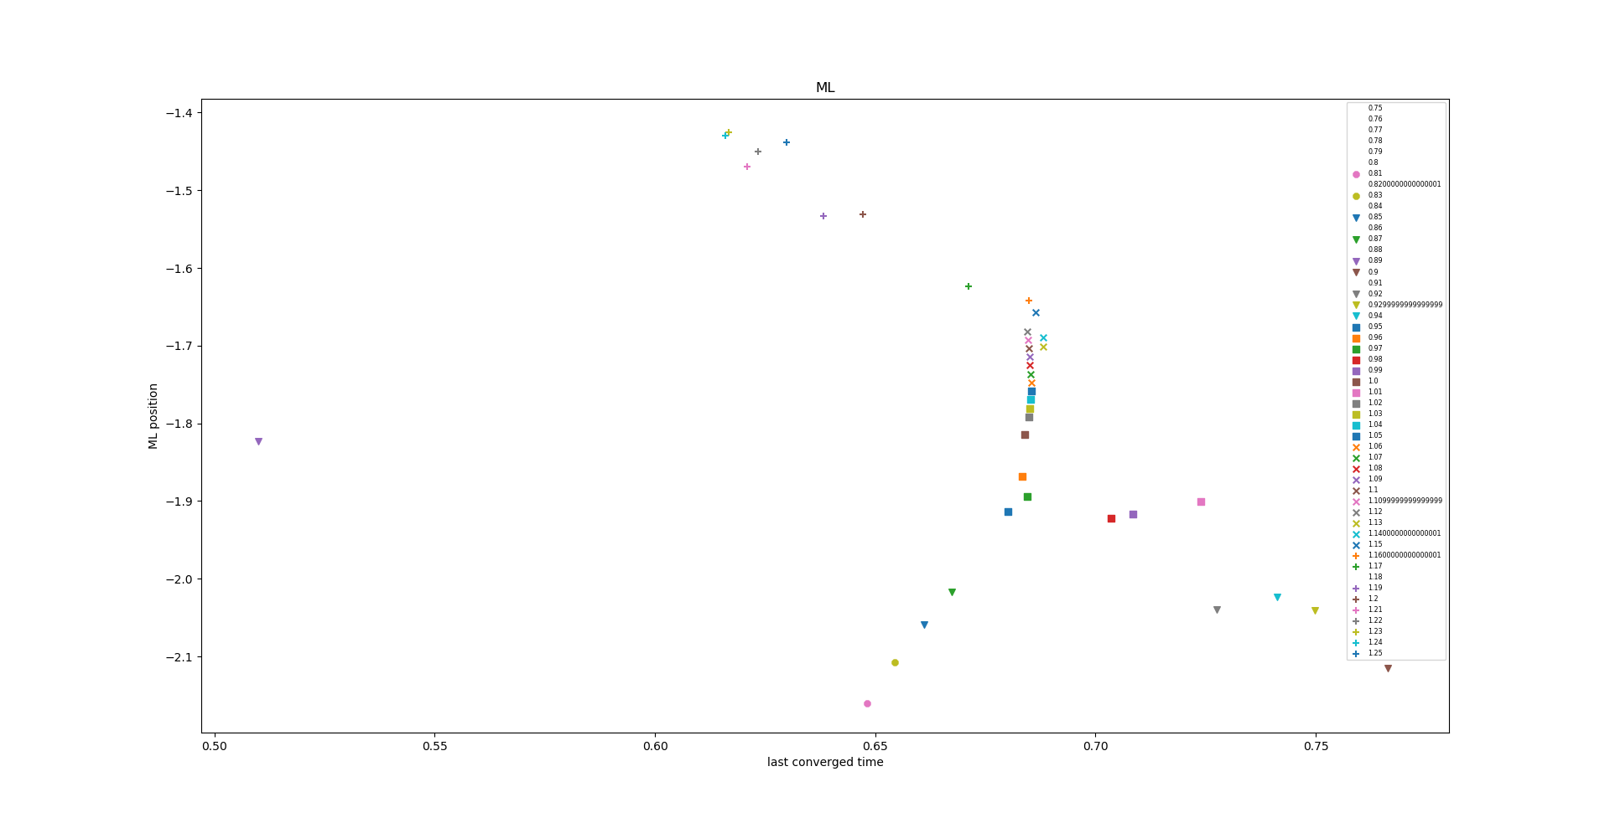
ACL prestretch factors

Slide 7
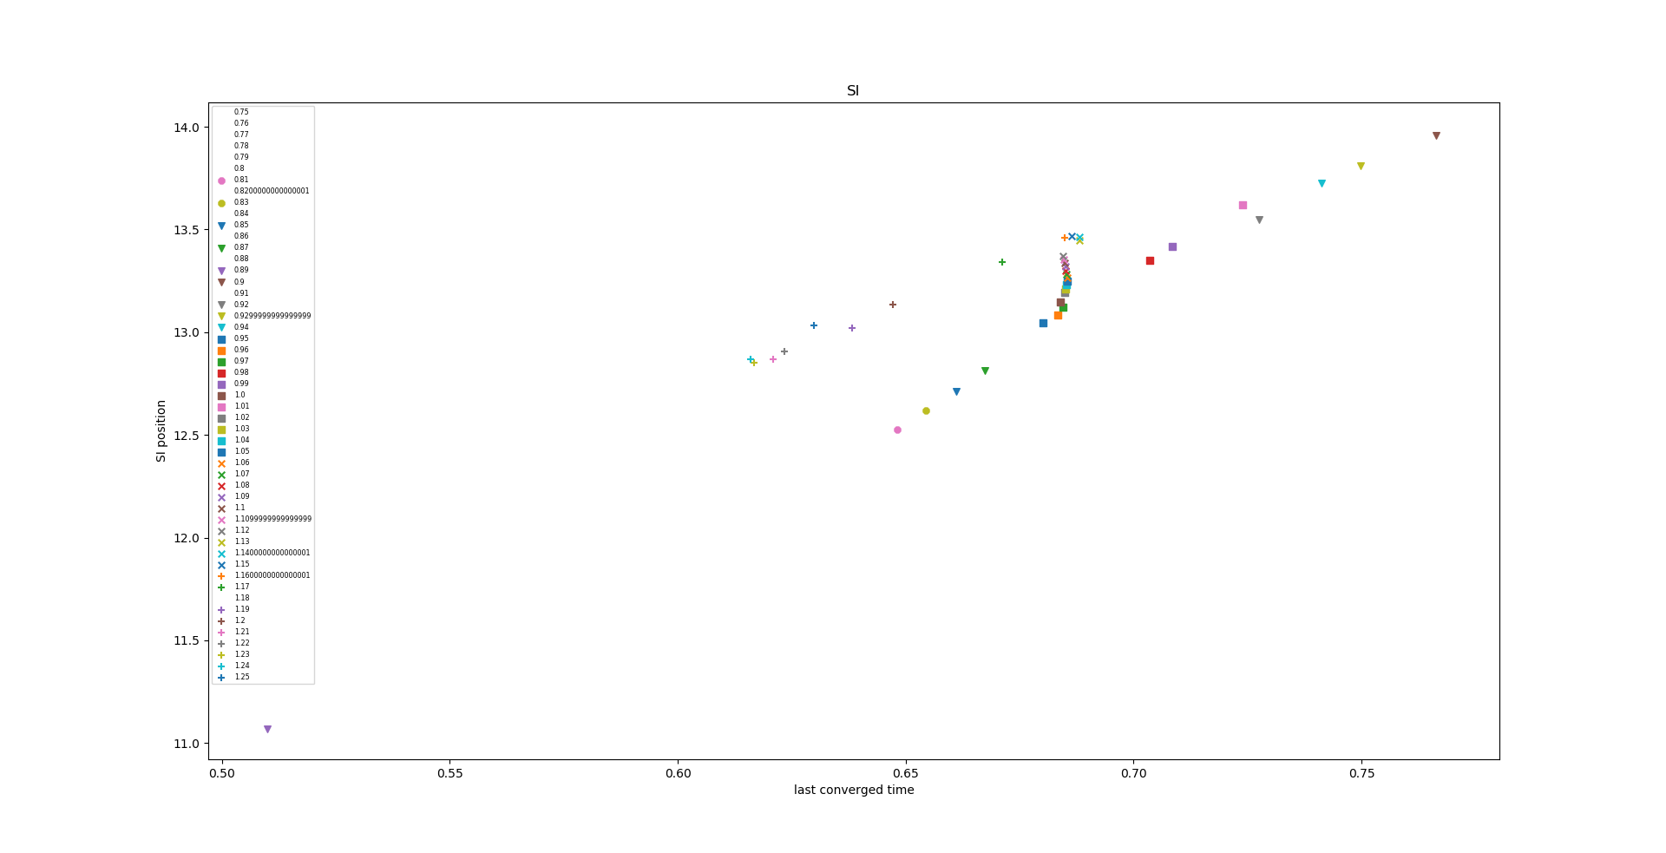
ACL prestretch factors

Slide 8
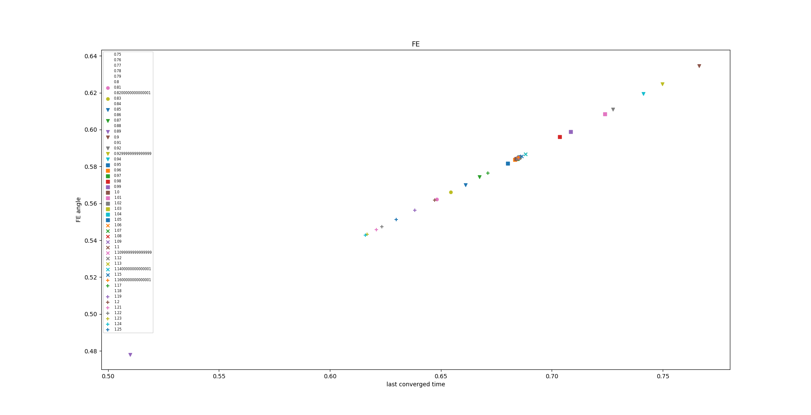
ACL prestretch factors

Slide 9
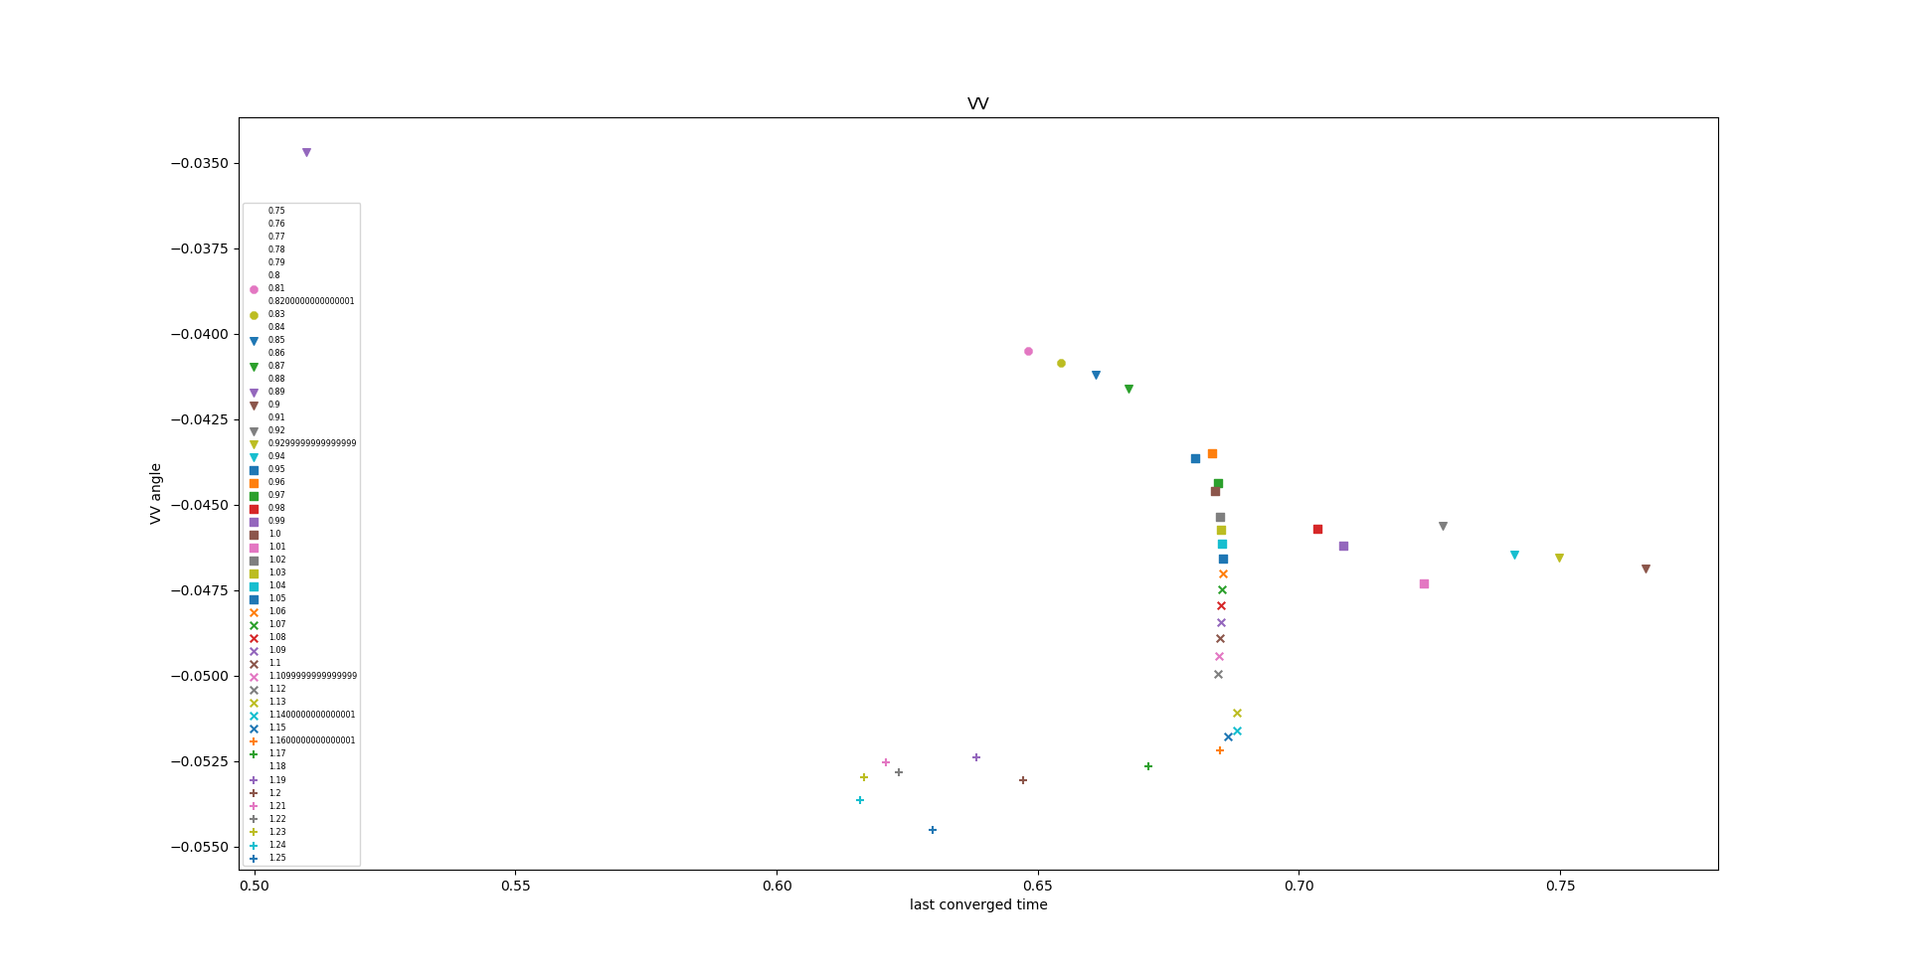
ACL prestretch factors

Slide 10
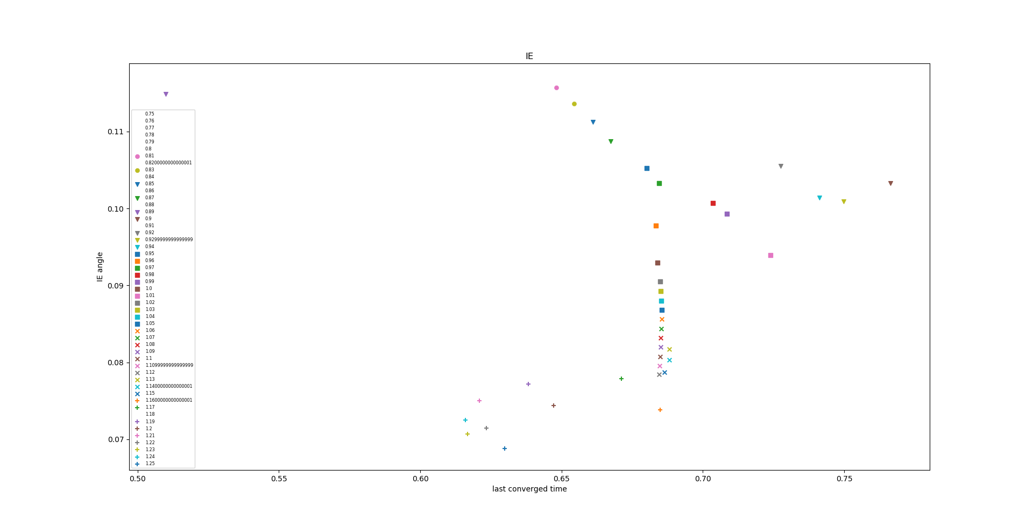
ACL prestretch factors

Slide 11
Sensitivity analyses – ACL
3. Prestretch application + flexion rotation (max. reformations 100)

Slide 12
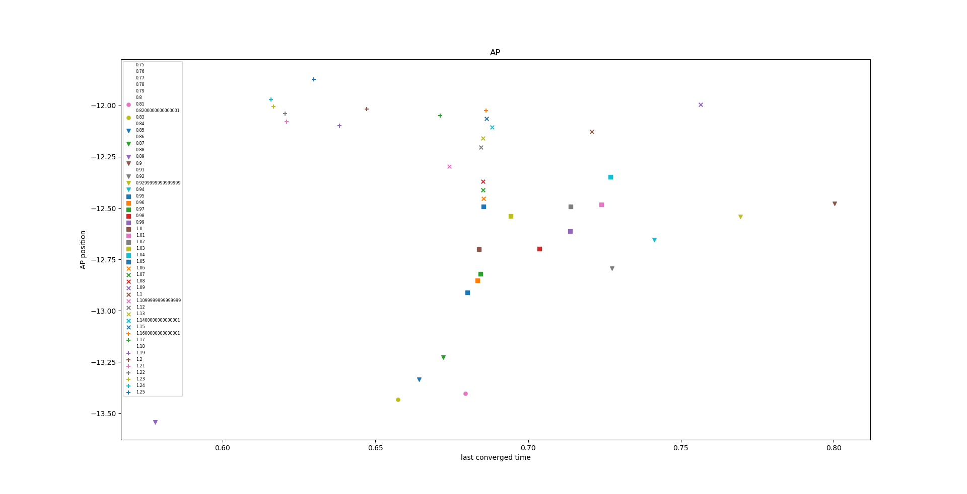
ACL prestretch factors

Slide 13
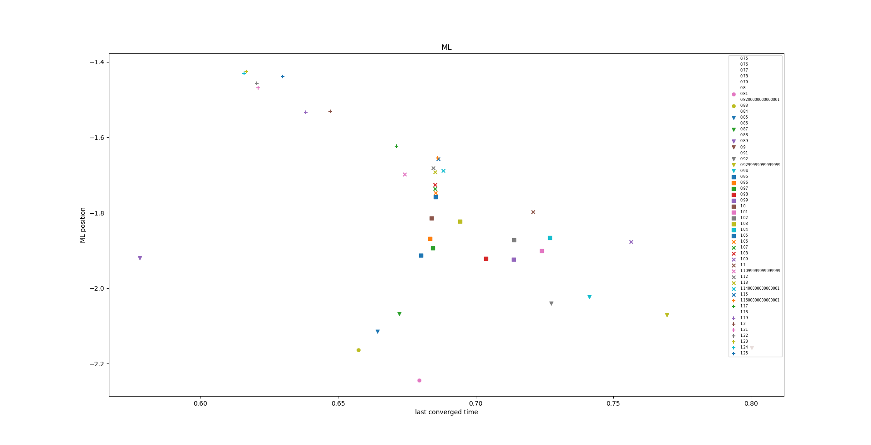
ACL prestretch factors

Slide 14
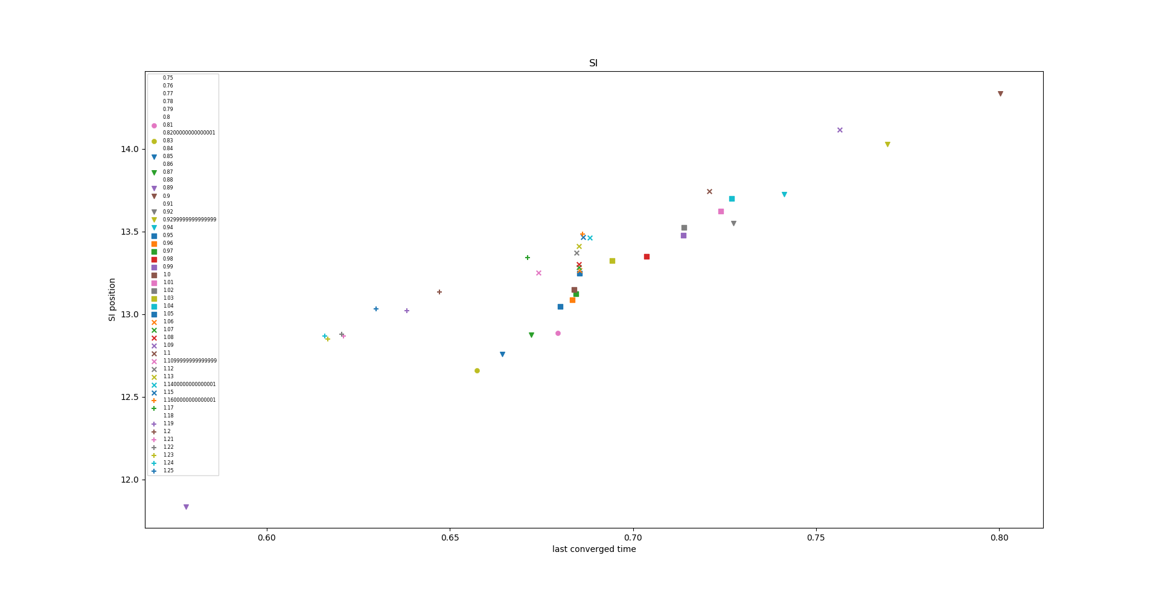
ACL prestretch factors

Slide 15
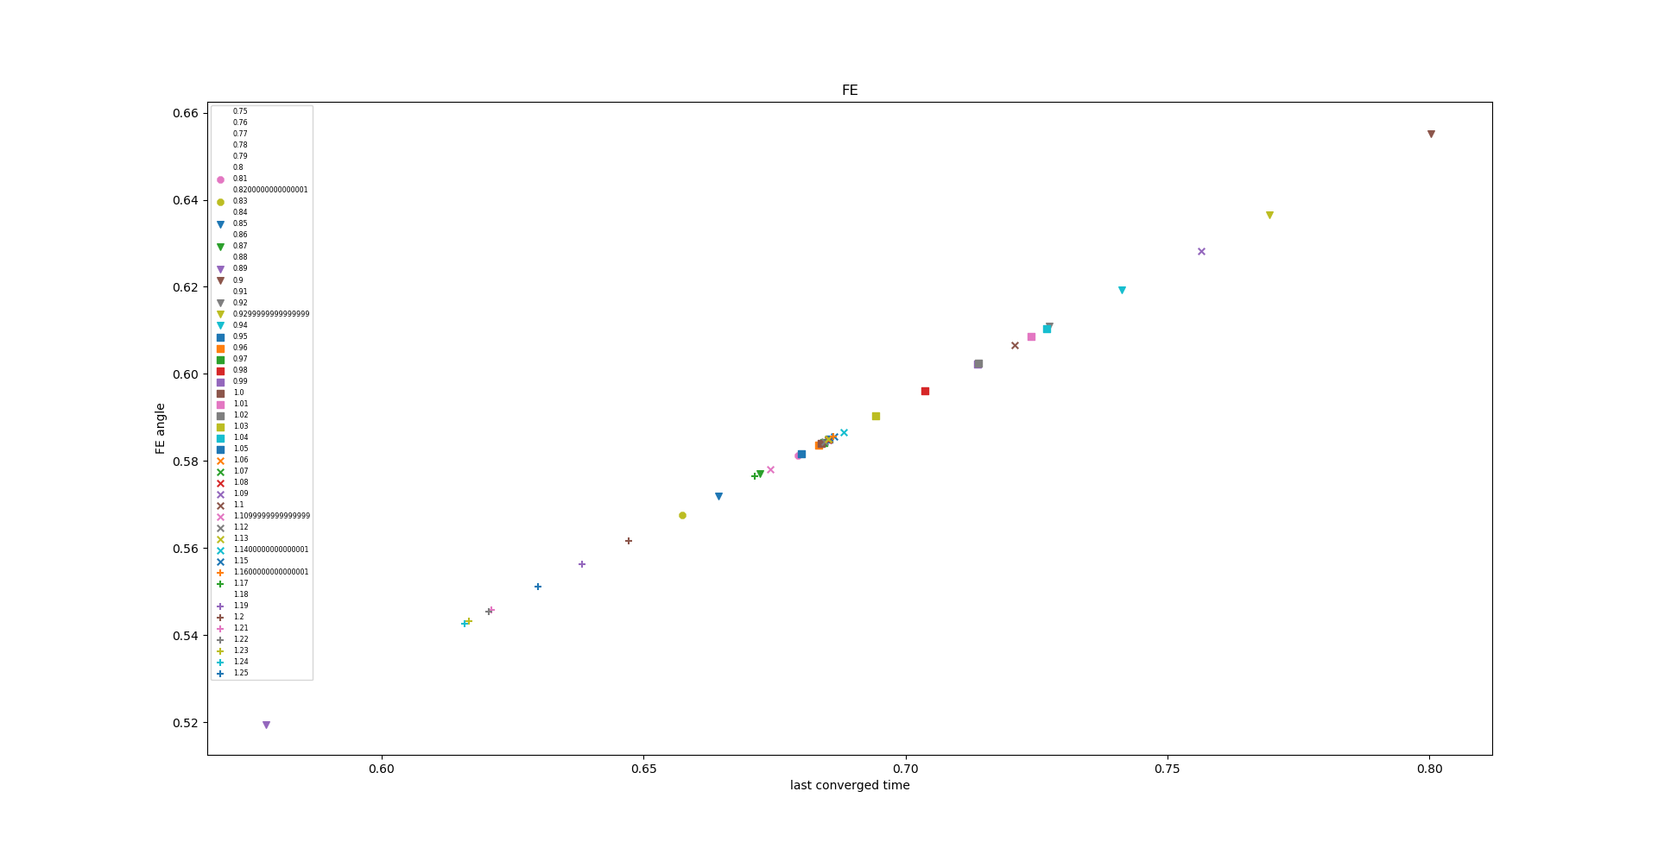
ACL prestretch factors

Slide 16
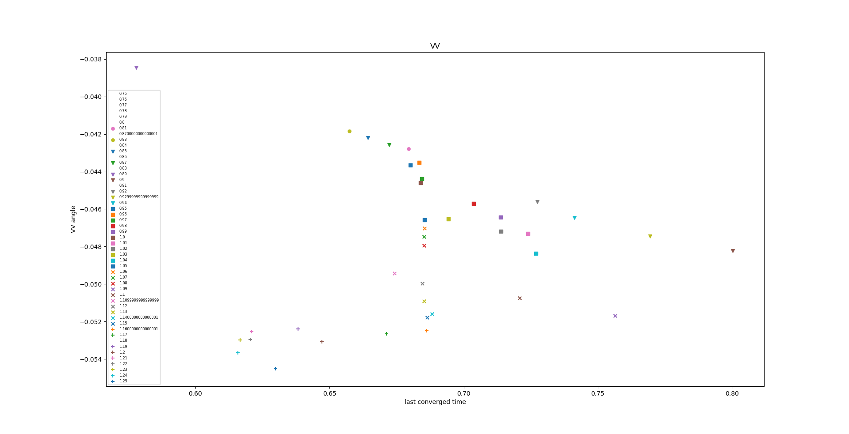
ACL prestretch factors

Slide 17
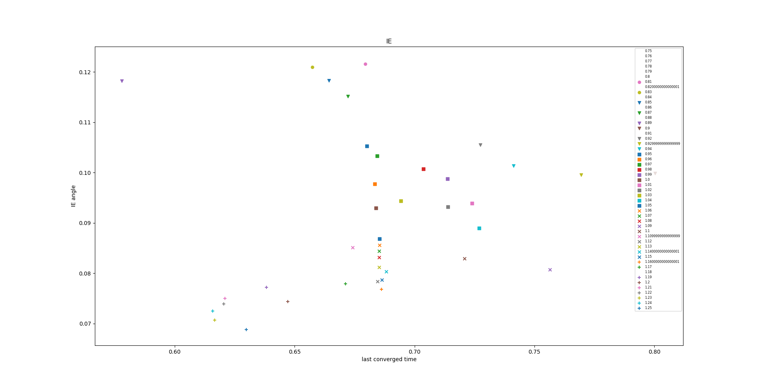
ACL prestretch factors

Slide 18
Sensitivity analyses – ACL
4. Prestretch in a smaller range + flexion rotation to 1 radian flexion angle.

Slide 19
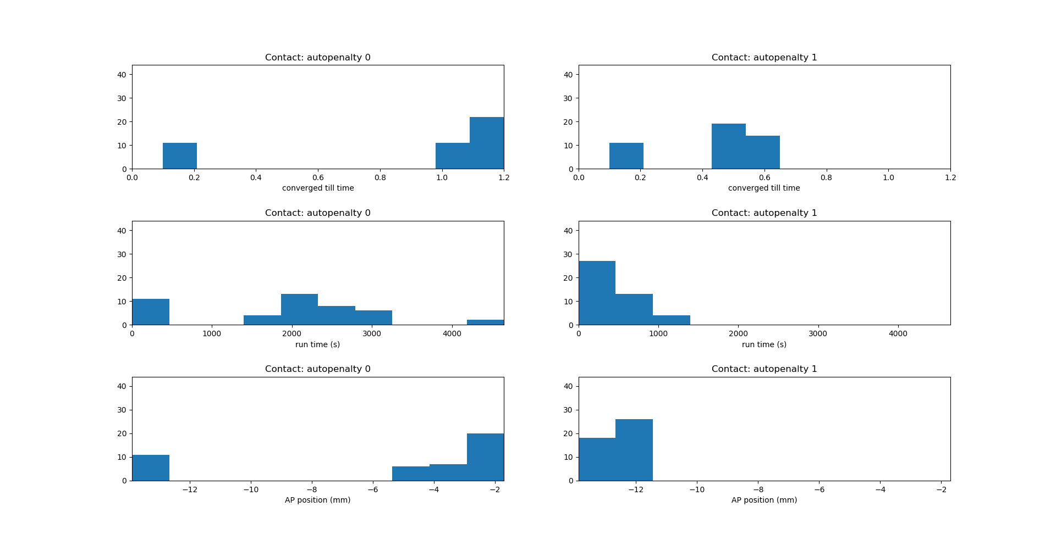
Number of simulations
Number of simulations
Number of simulations
Number of simulations
Number of simulations
Number of simulations

Slide 20
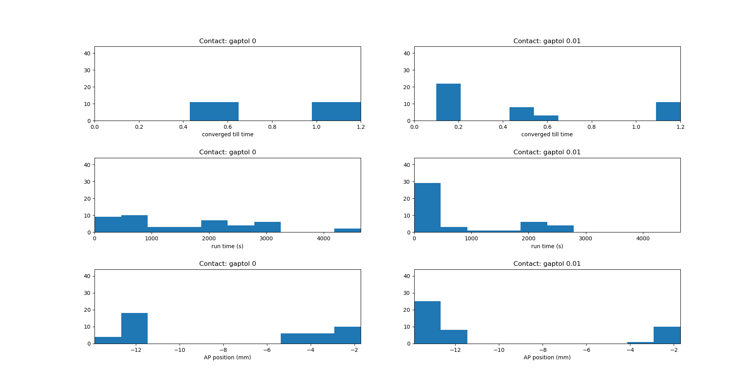
Number of simulations
Number of simulations
Number of simulations
Number of simulations
Number of simulations
Number of simulations

Slide 21
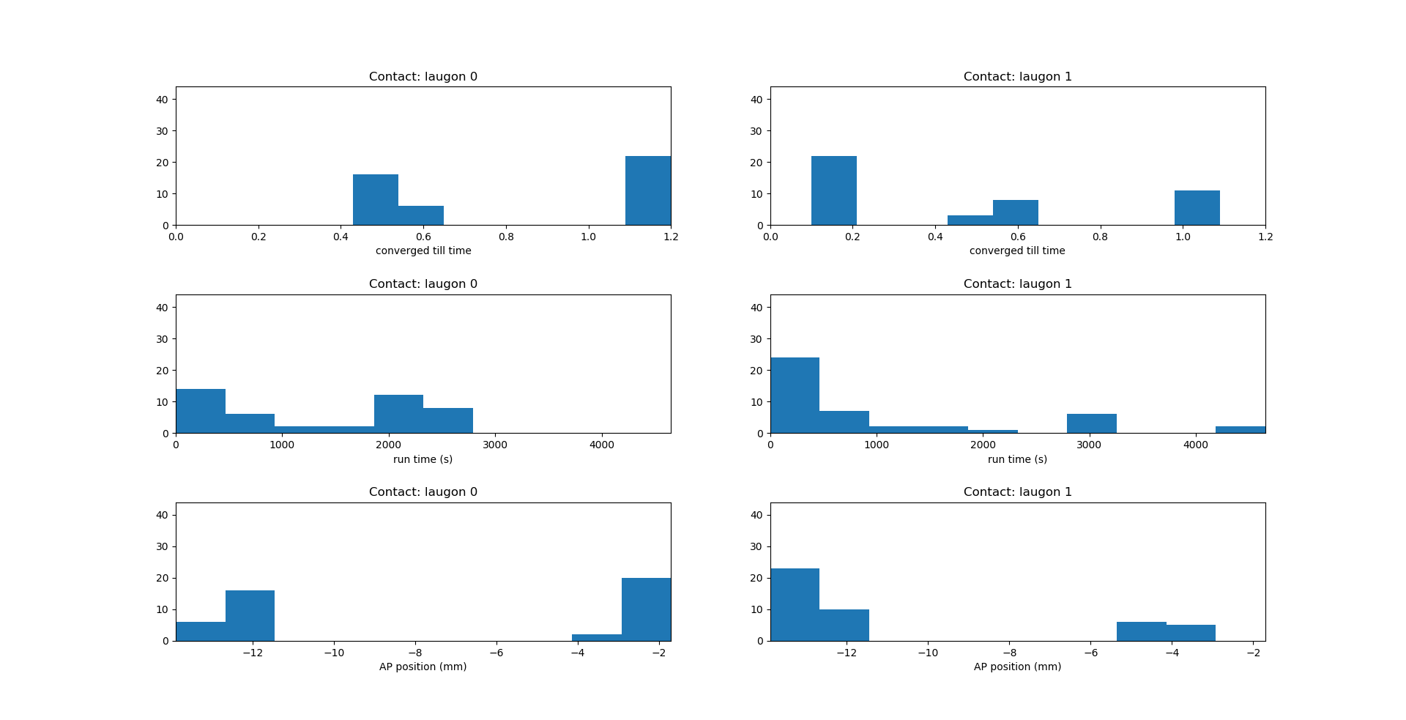
Number of simulations
Number of simulations
Number of simulations
Number of simulations
Number of simulations
Number of simulations

