Slide 1
1: Young’s Modulus and prestretch tests for all ligaments
For all ligaments: Prestretch 0.8 to 1.05 in steps of 0.01
Young’s modulus literature + and – 60:
ACL: 63 – 183 in steps of 20 literature = 123
PCL: 108 – 228 in steps of 20 literature = 168
MCL: 164 – 284 in steps of 20 literature = 224
LCL: 220 – 340 in steps of 20 literature = 280
Simulations: All ligaments: 0.5 rad flexion (FE)
ACL: AP in the anterior direction (tib relative to fem) → 5 mm
PCL: AP in the posterior direction (tib relative to fem) → 5 mm
MCL: VV into valgus (-VV) → 3° (0.05235 rad)
LCL: VV into varus (+VV) → 3° (0.05235 rad)
Prestretch applied between step 0.1 and 0.2, full simulation until 1.0

Slide 2
ACL - AP simulations
Tibia moving anterior with respect to the femur
5mm

Slide 3
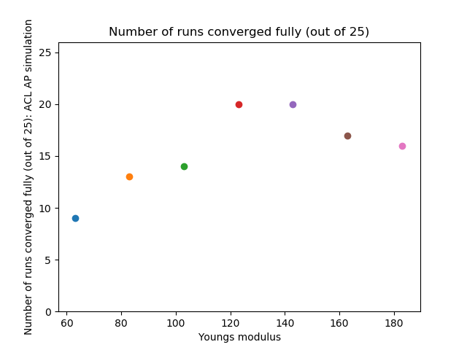
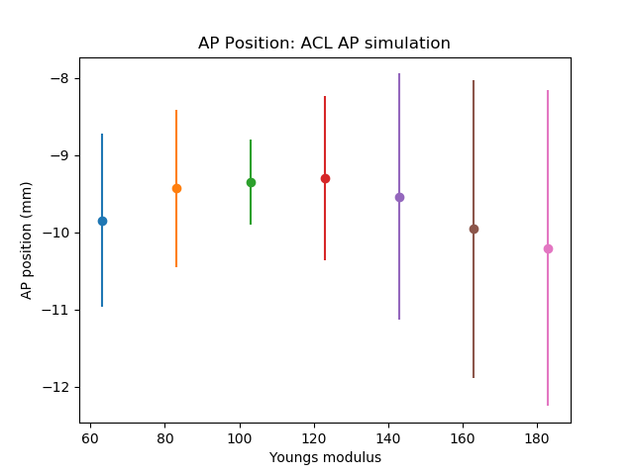
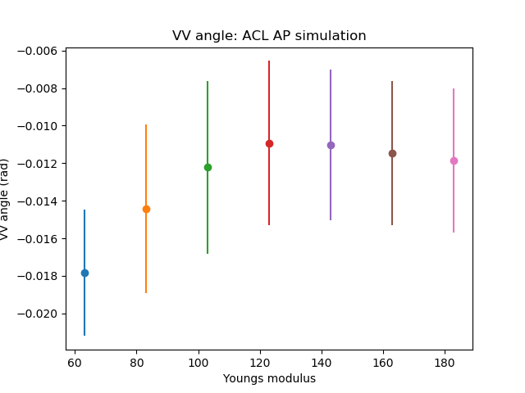
ACL – AP simulations: Young’s modulus

Slide 4
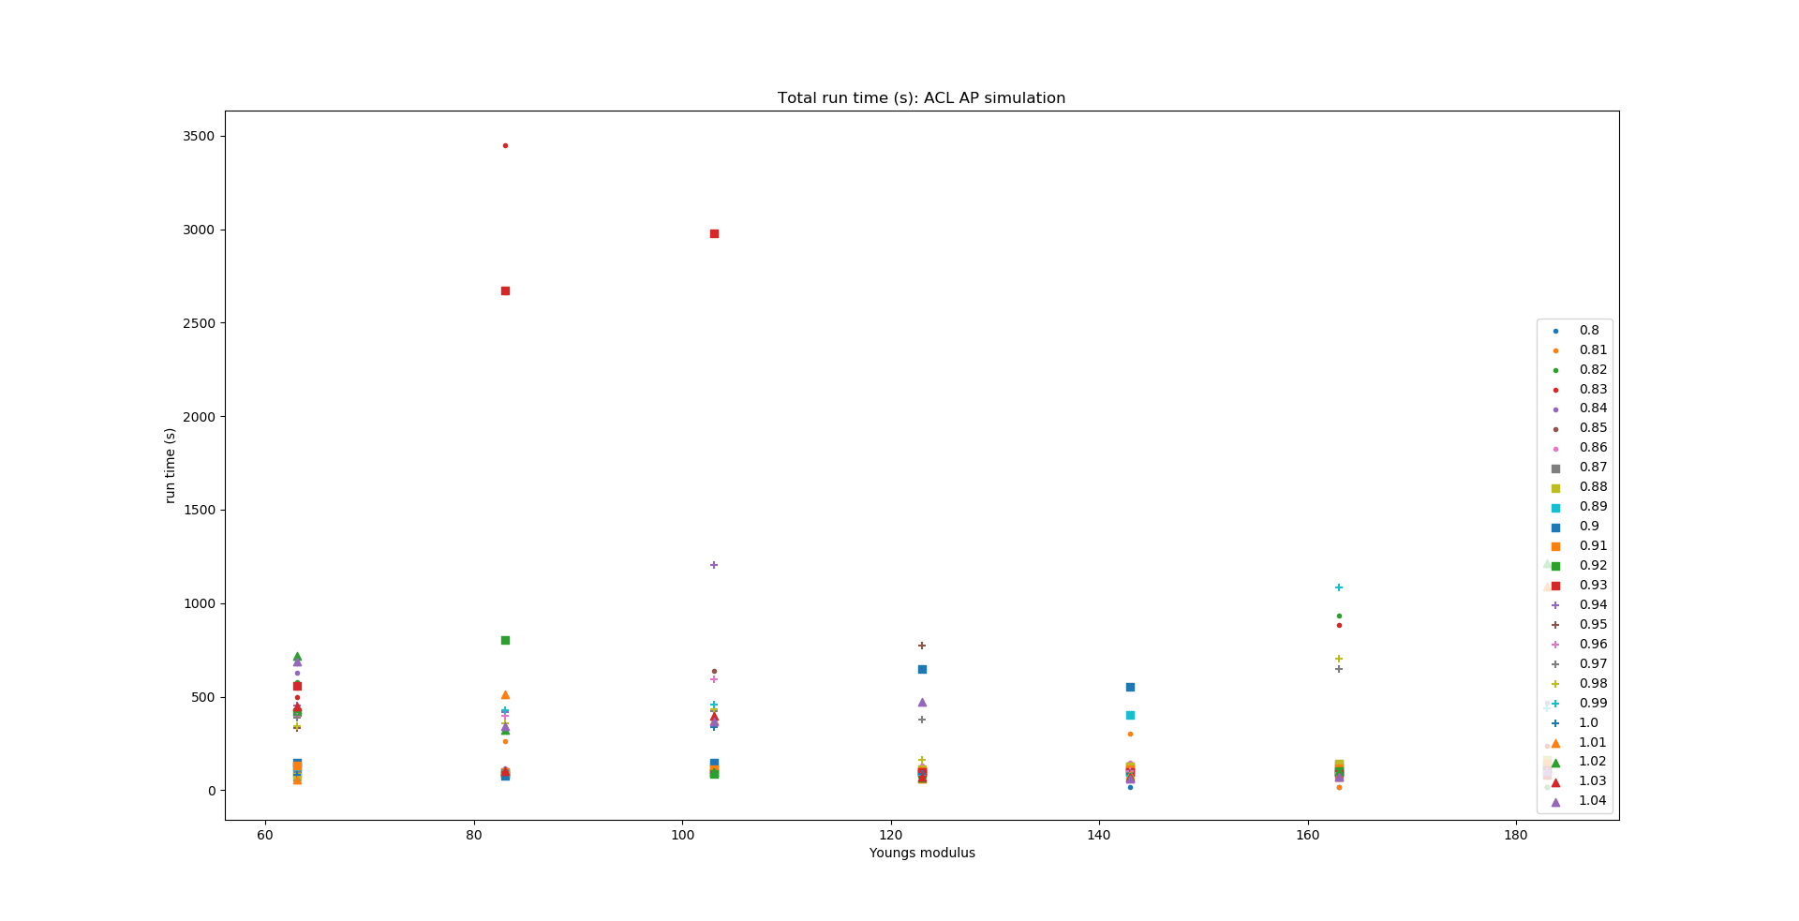
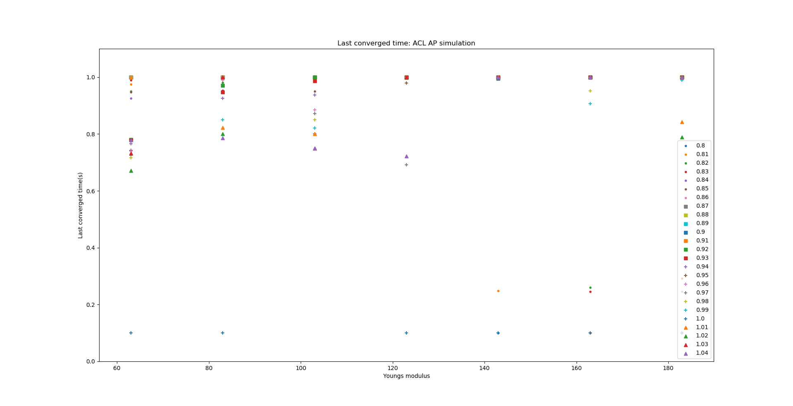
ACL – AP simulations: Young’s modulus

Slide 5
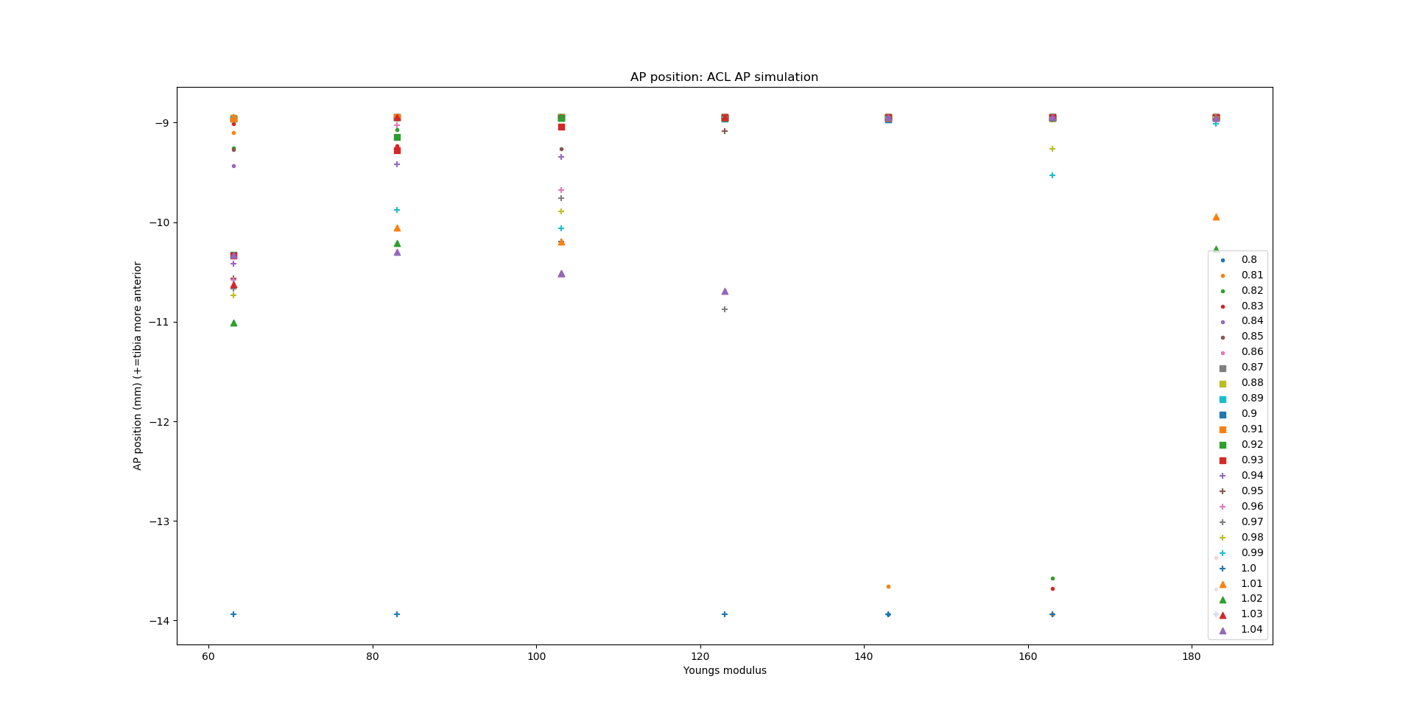
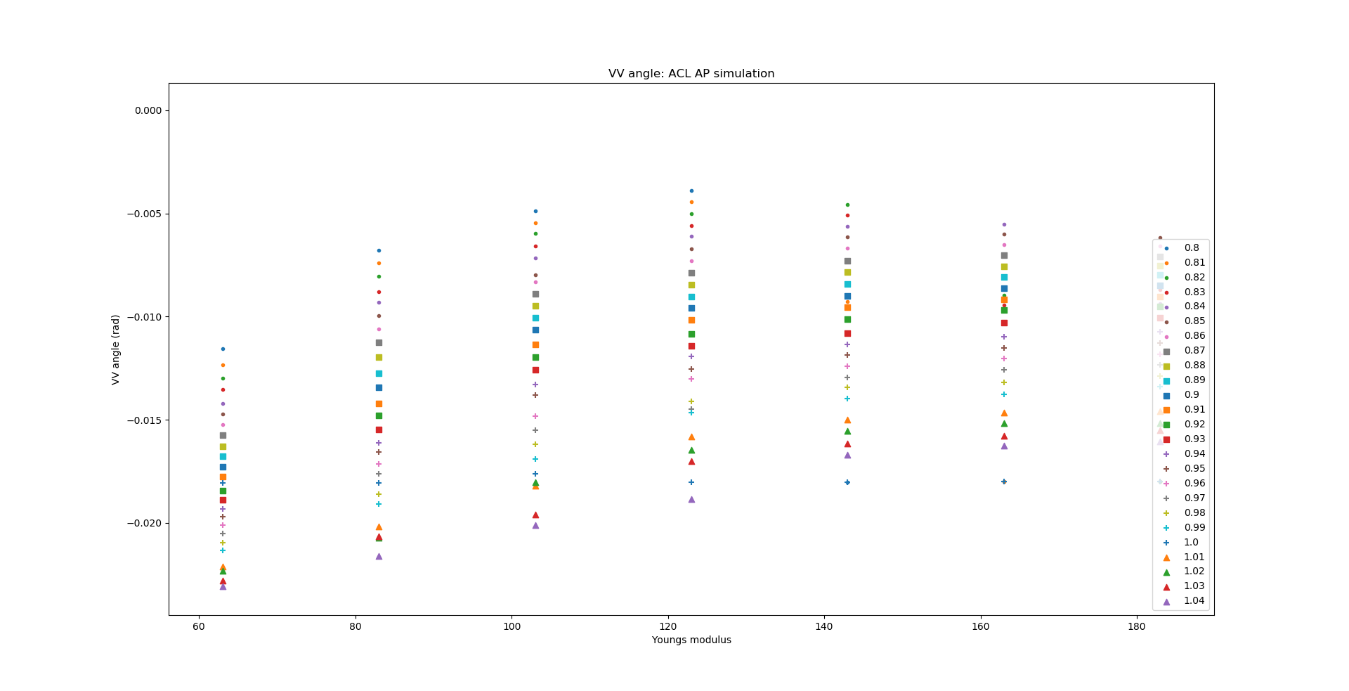
ACL – AP simulations: Young’s modulus

Slide 6
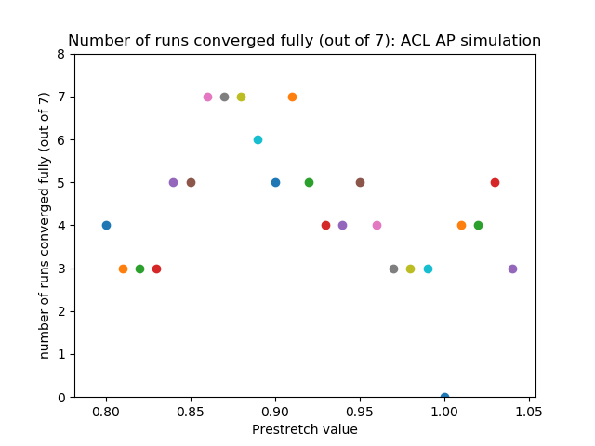
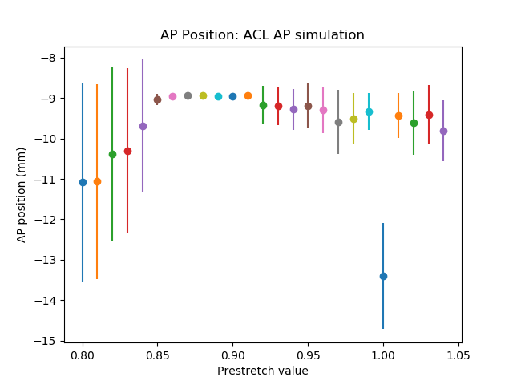
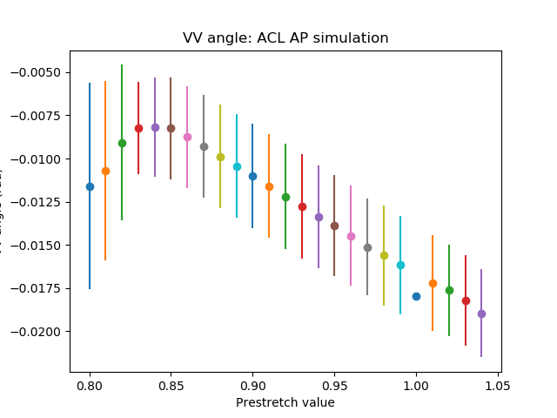
ACL – AP simulations: Prestretch value

Slide 7
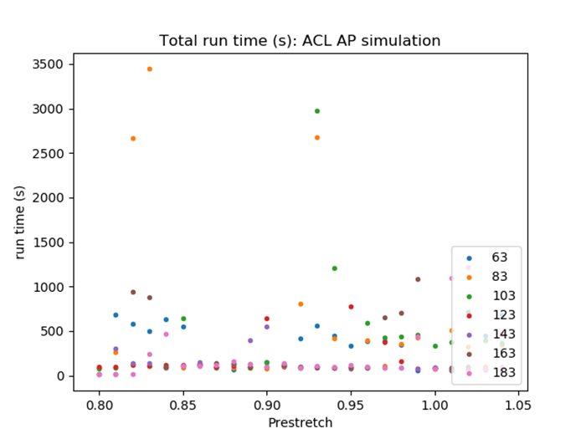
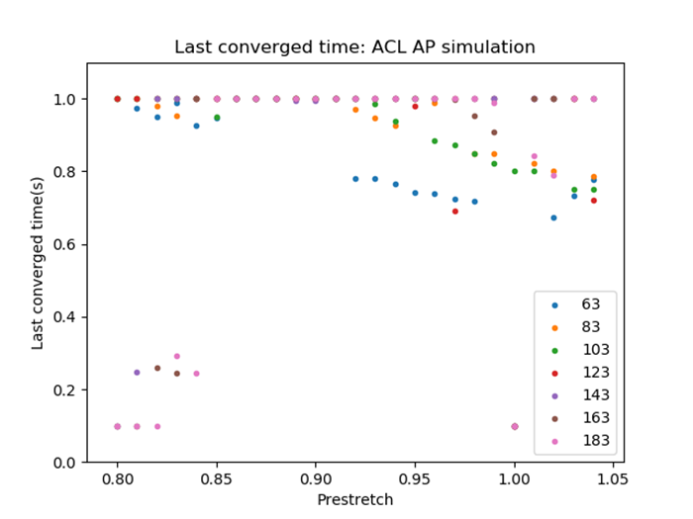
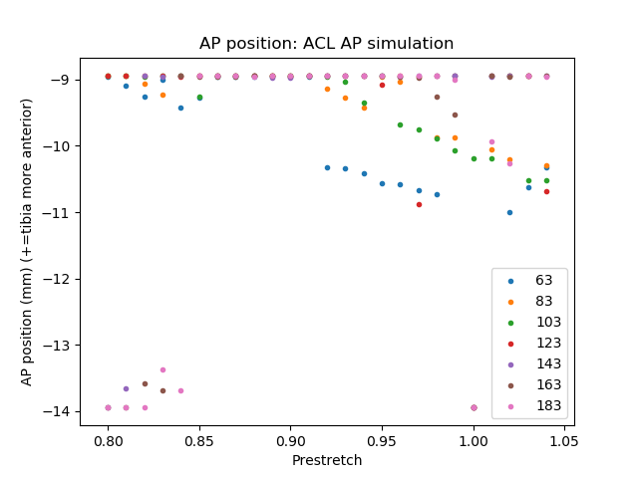
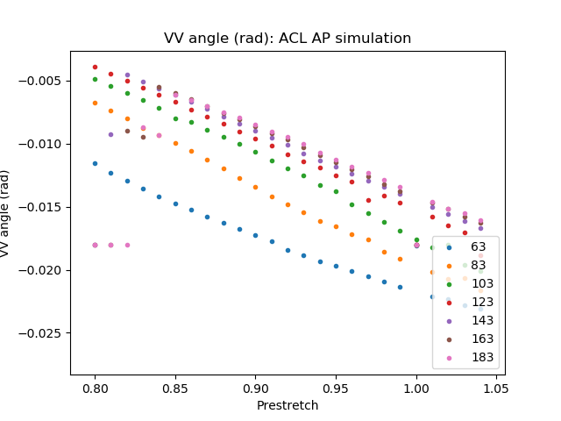
ACL – AP simulations: Prestretch value

Slide 8
ACL - FE simulations
0.5 rad flexion rotation

Slide 9
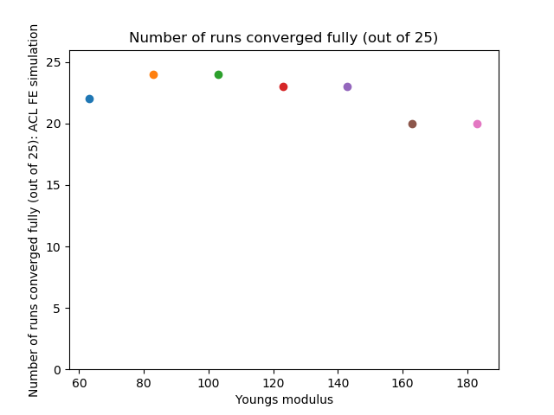
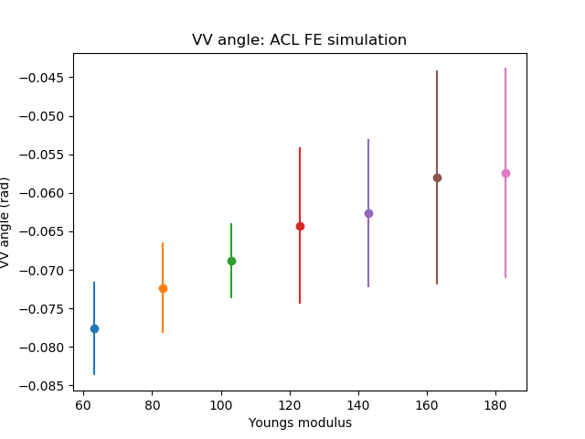
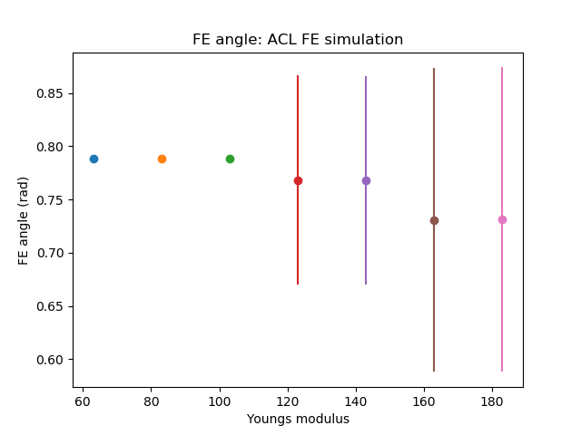
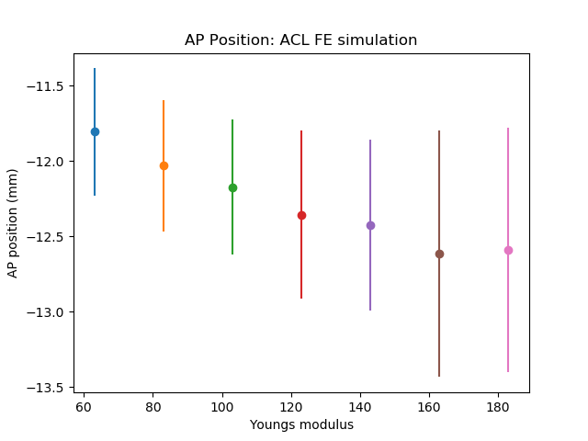
ACL – FE simulations: Young’s modulus

Slide 10
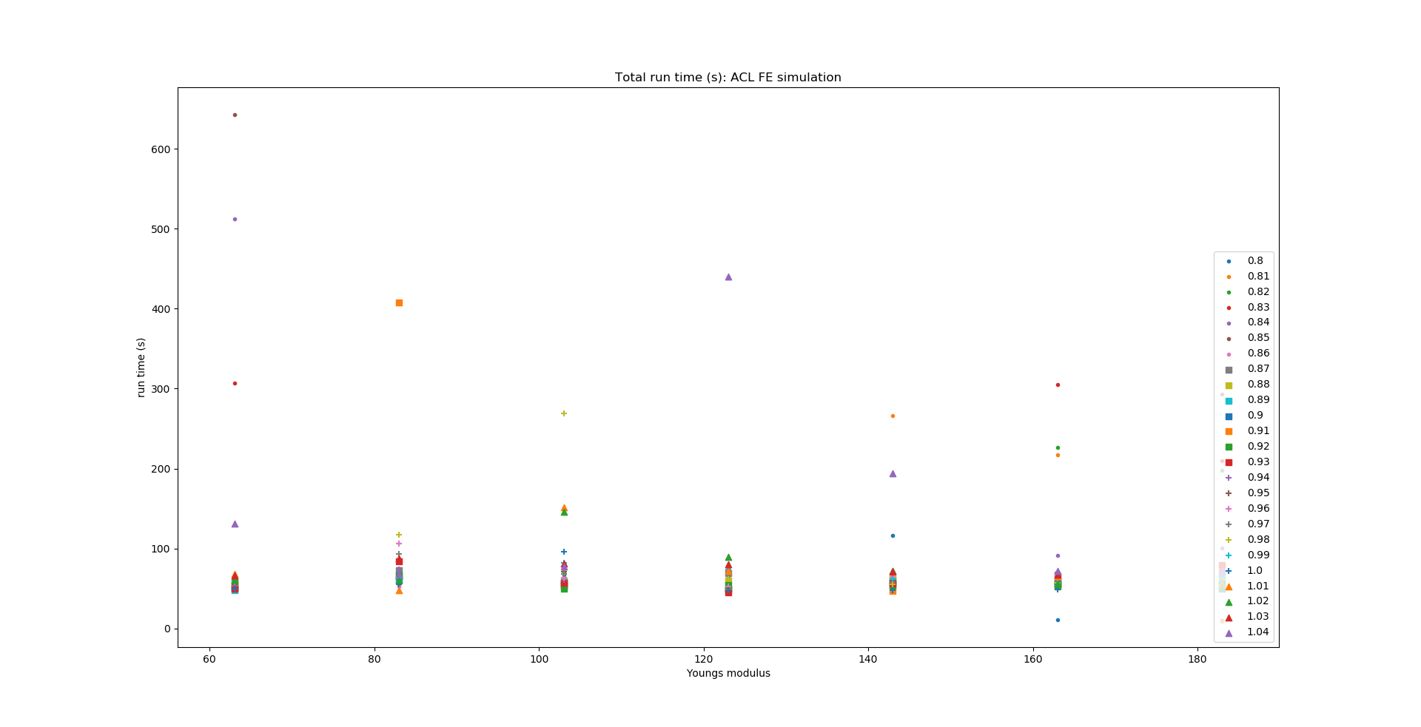
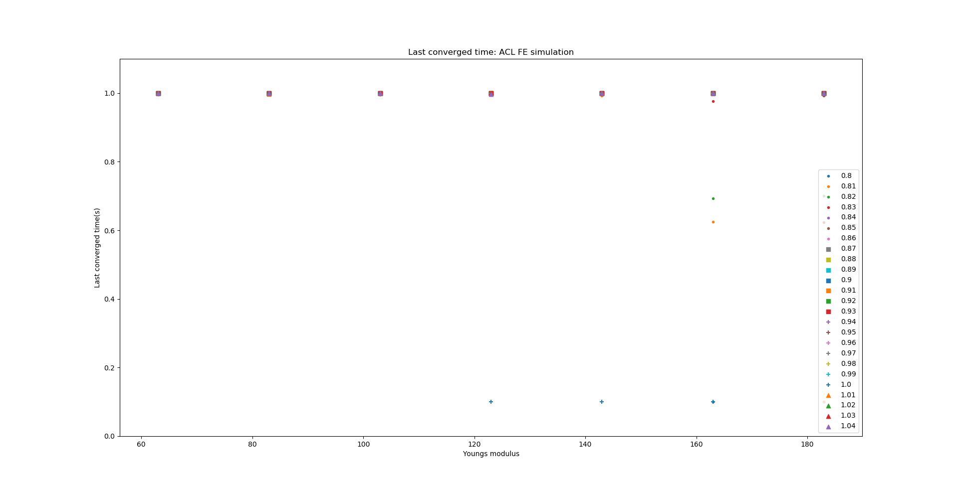
ACL – FE simulations: Young’s modulus

Slide 11
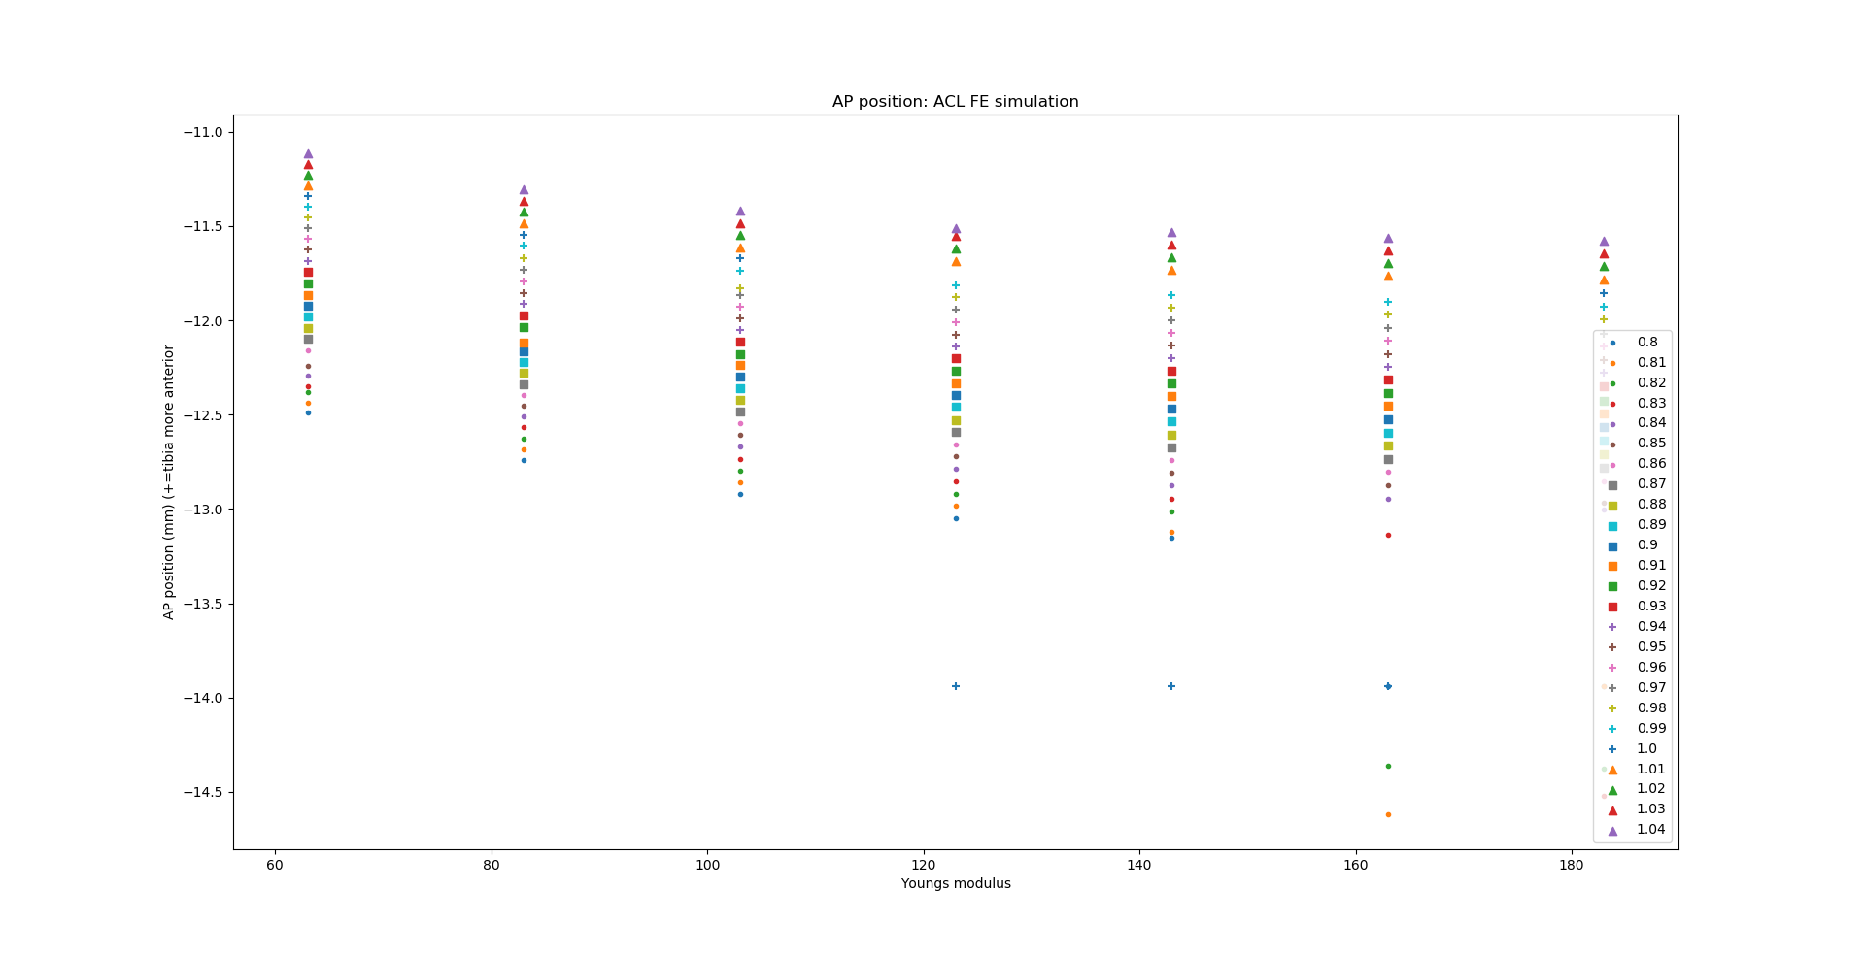
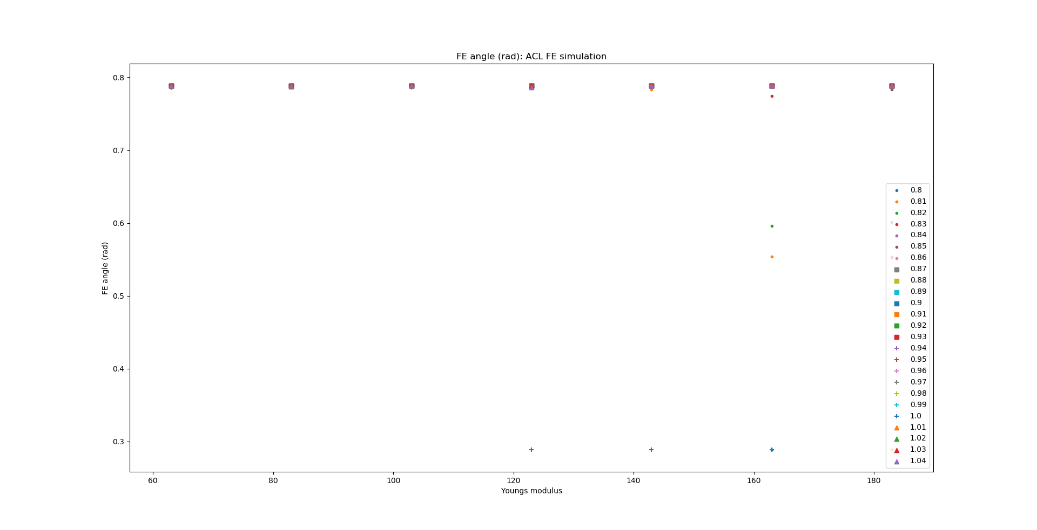
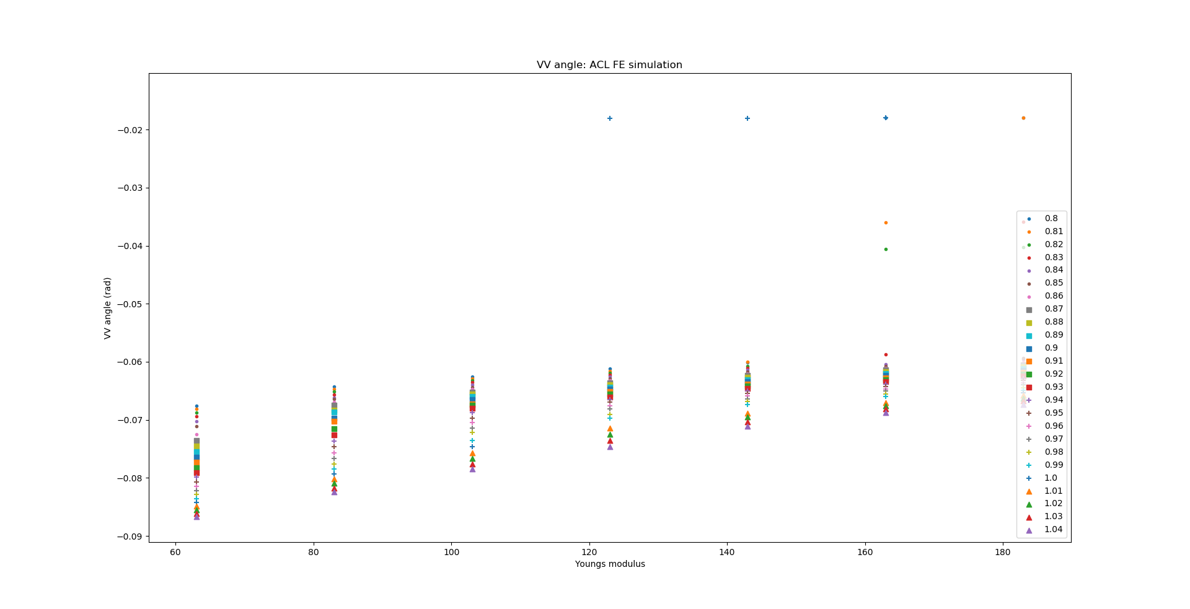
ACL – FE simulations: Young’s modulus

Slide 12
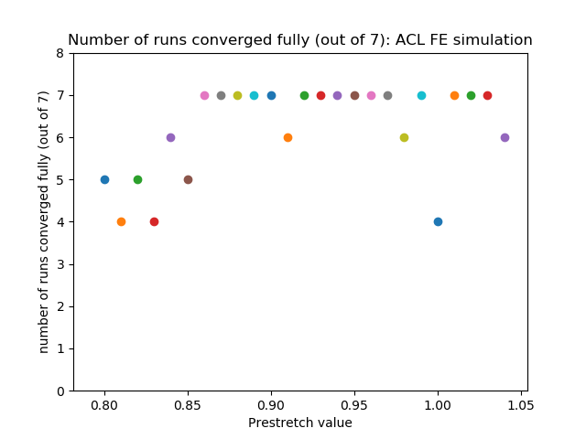
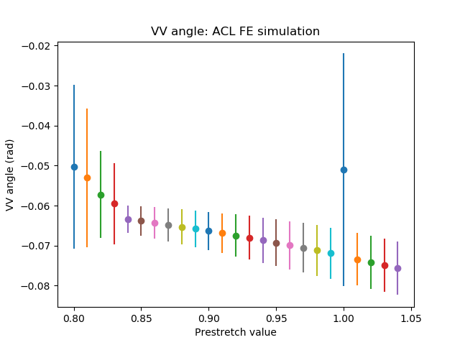
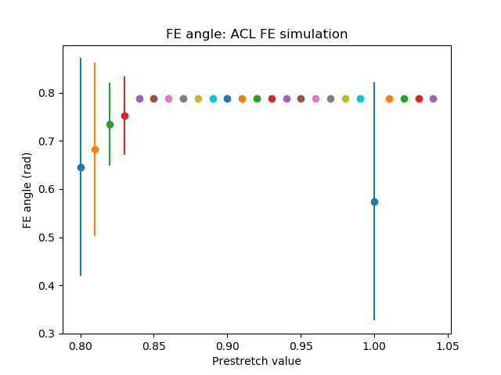
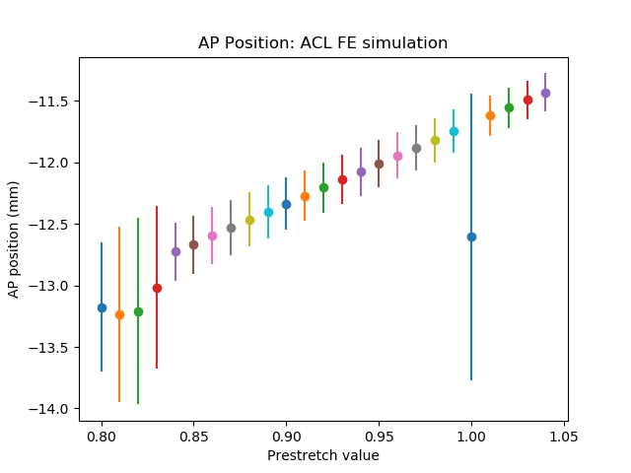
ACL – FE simulations: Prestretch value

Slide 13
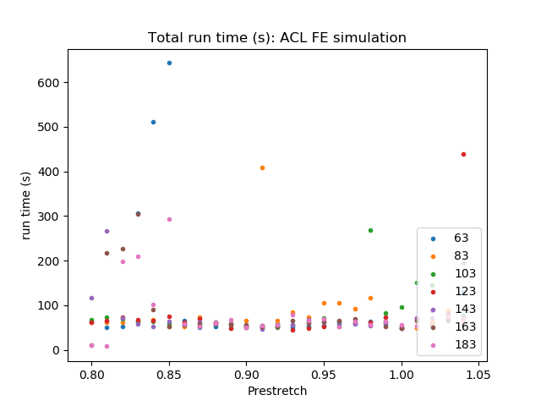
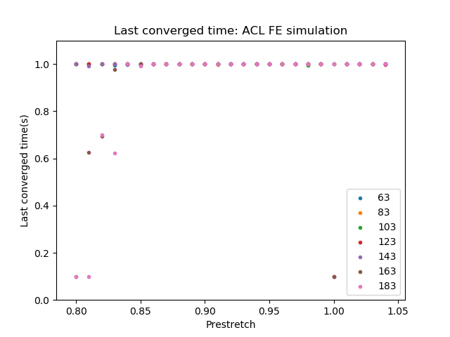
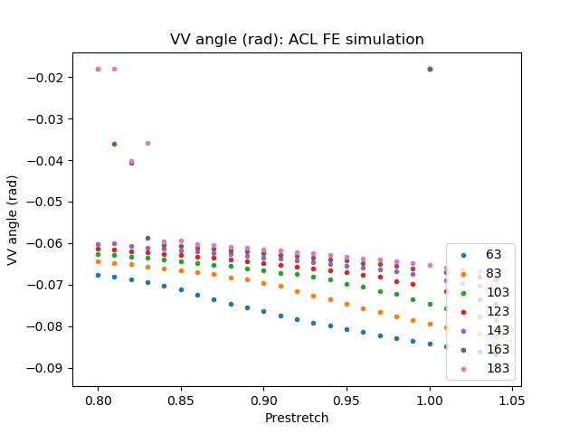
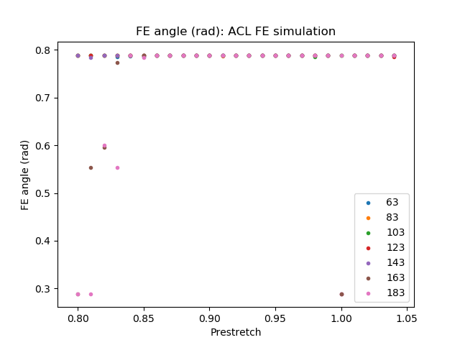
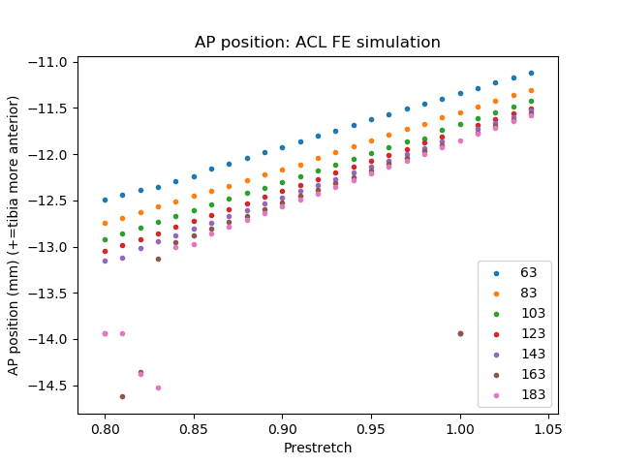
ACL – FE simulations: Prestretch value

Slide 14
PCL - AP simulations
Tibia moving posterior with respect to the femur
5mm

Slide 15
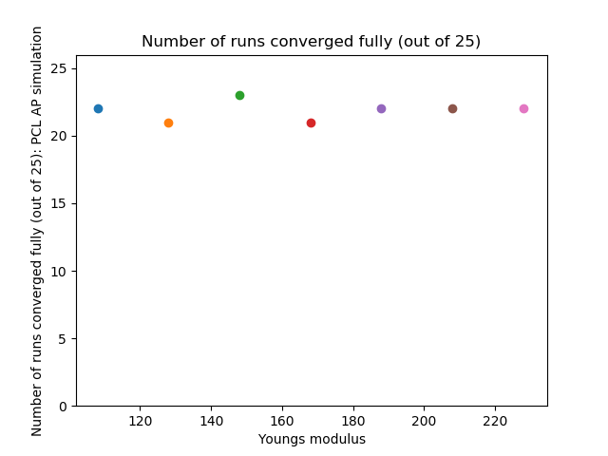
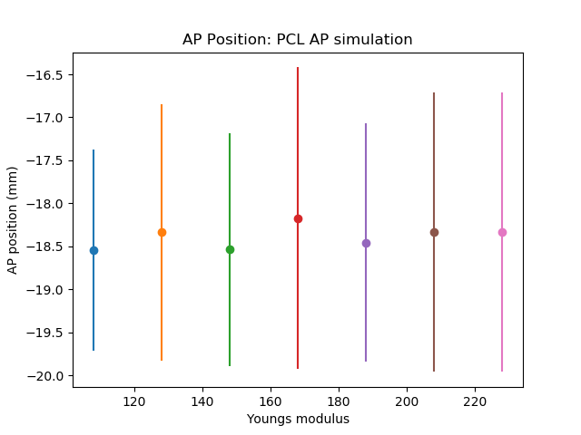
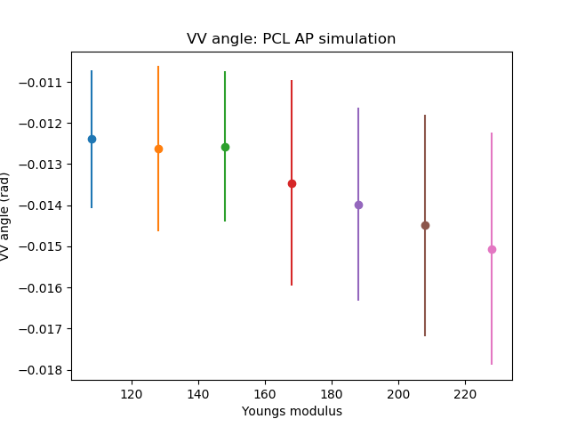
PCL - AP simulations: Young’s modulus

Slide 16
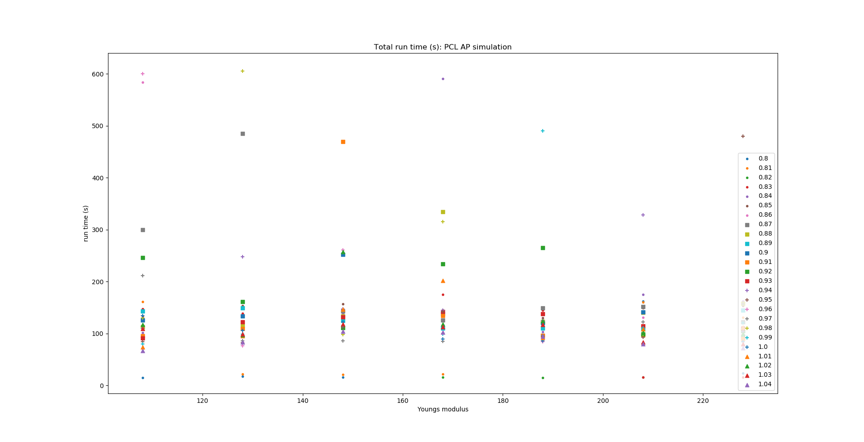
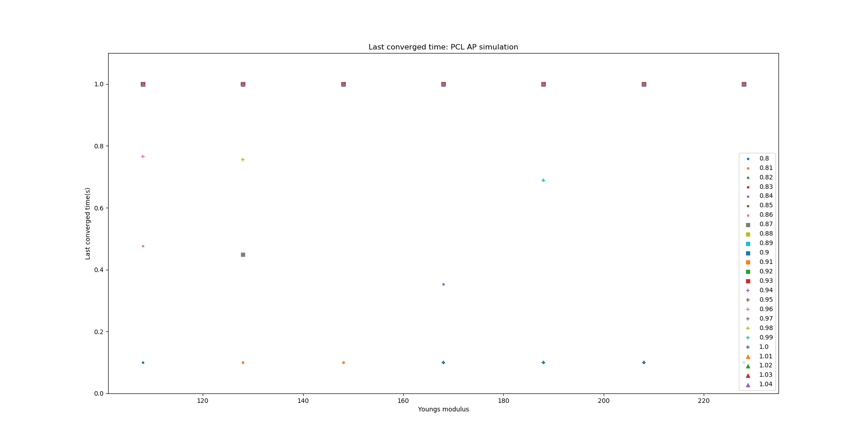
PCL - AP simulations: Young’s modulus

Slide 17
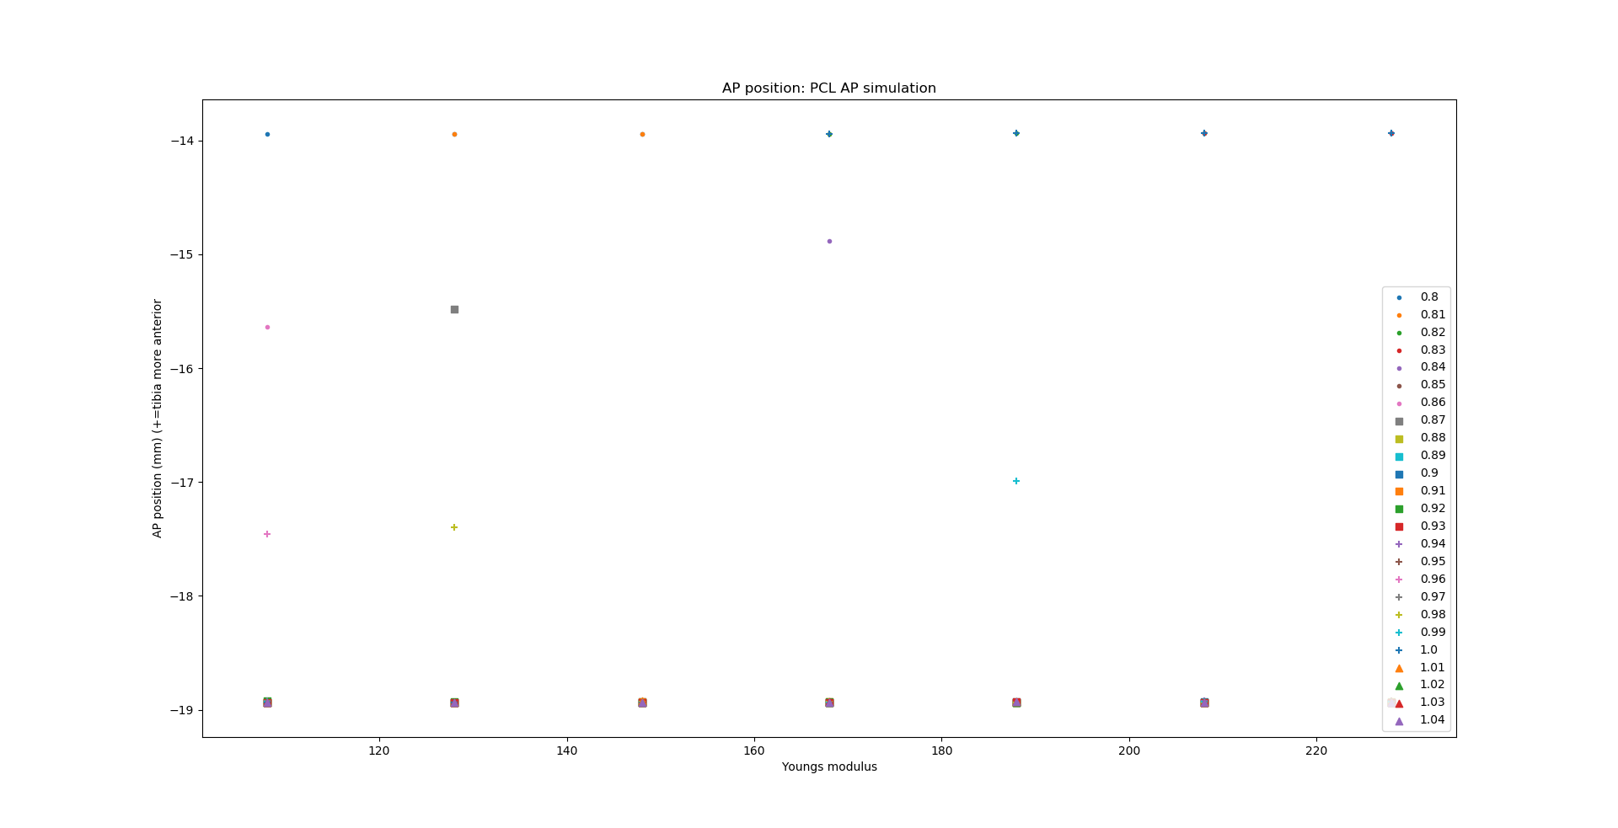
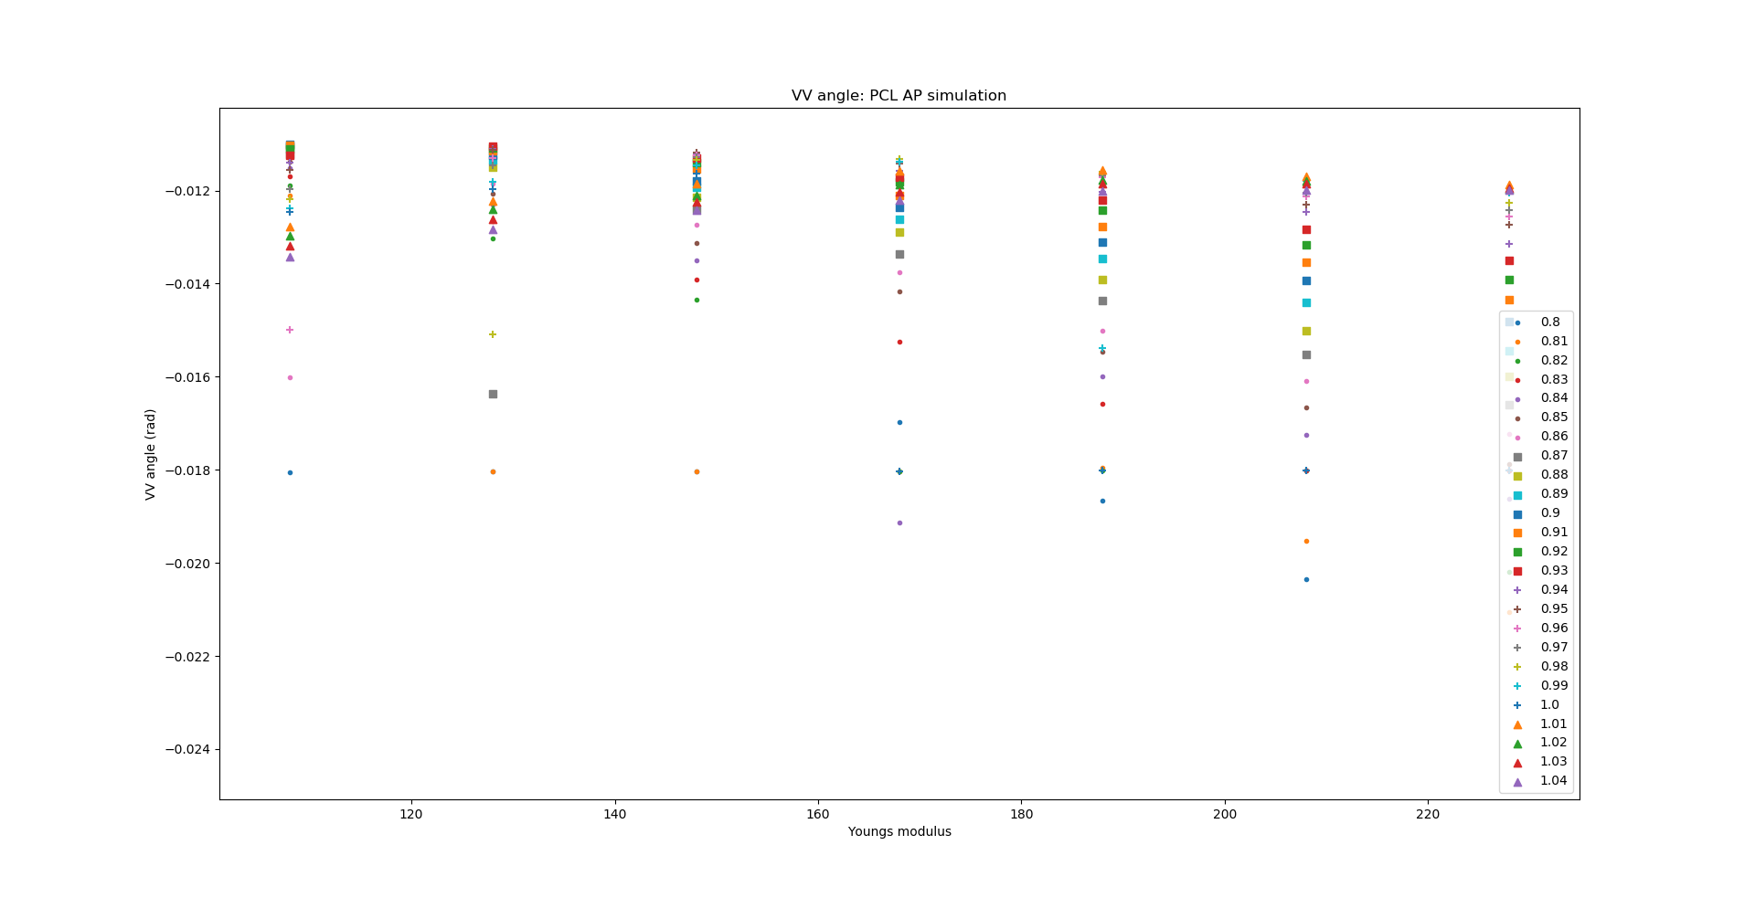
PCL - AP simulations: Young’s modulus

Slide 18
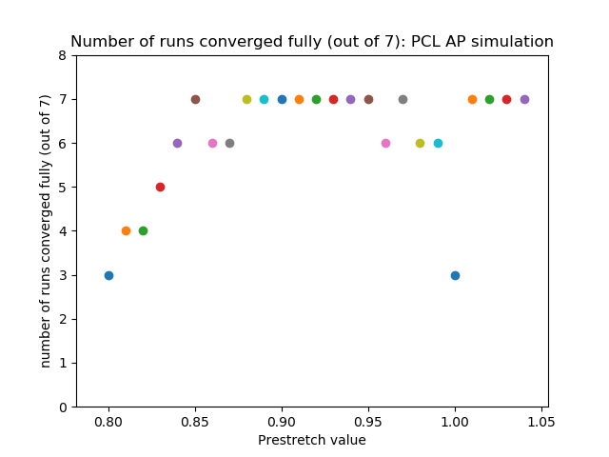
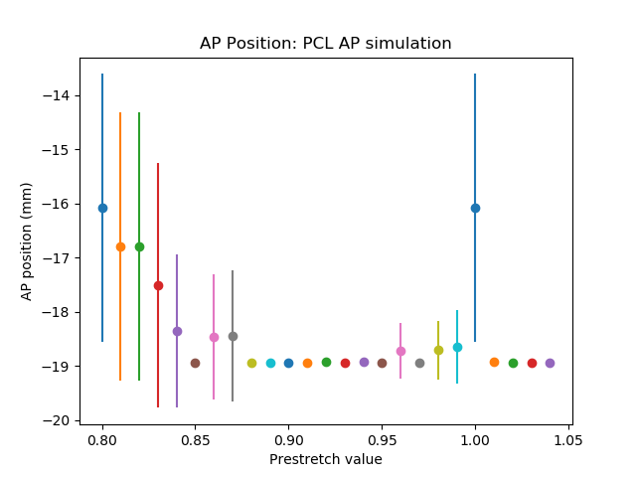
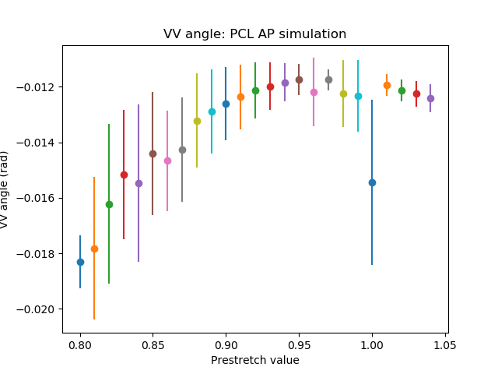
PCL - AP simulations: Prestretch value

Slide 19
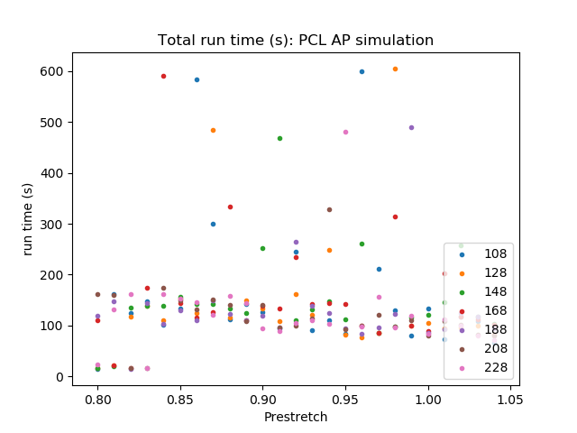
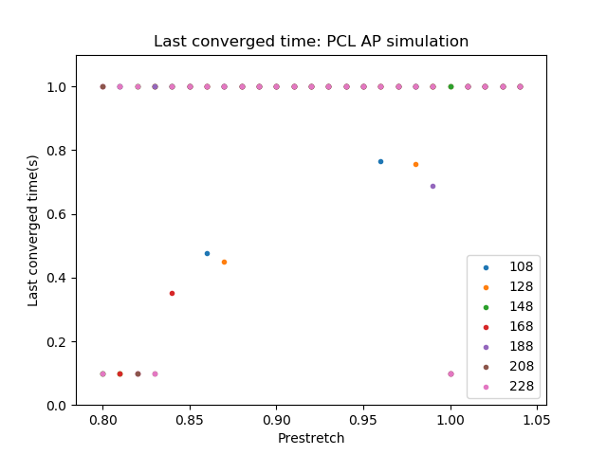
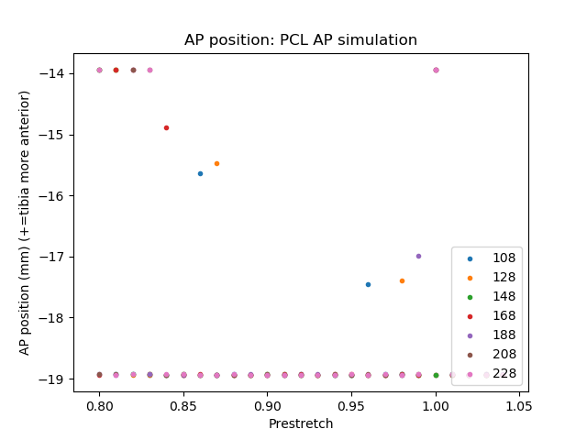
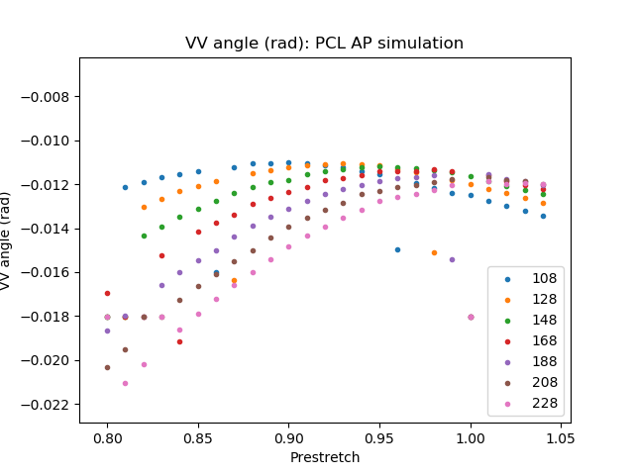
PCL - AP simulations: Prestretch value

Slide 20
PCL - FE simulations
0.5 rad flexion rotation

Slide 21
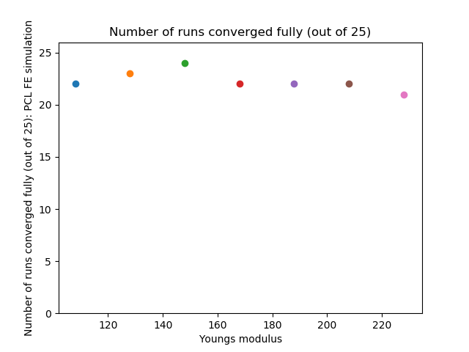
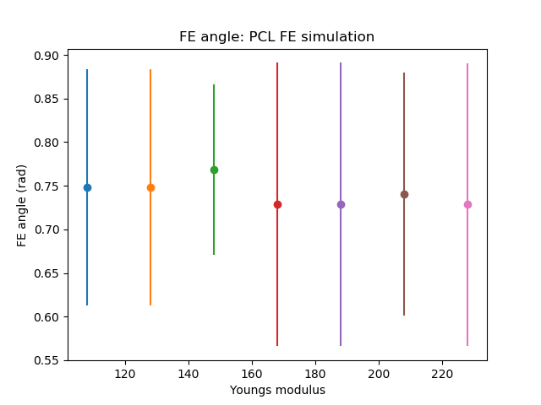
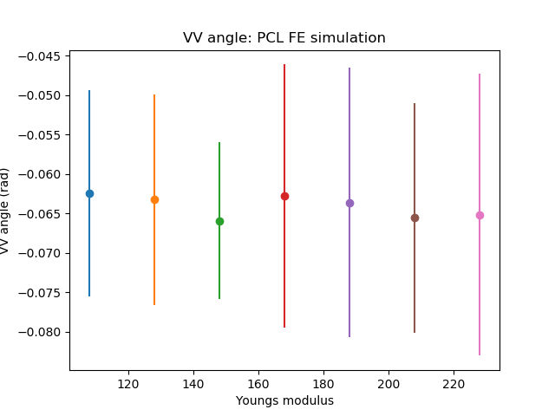
PCL - FE simulations: Young’s modulus

Slide 22
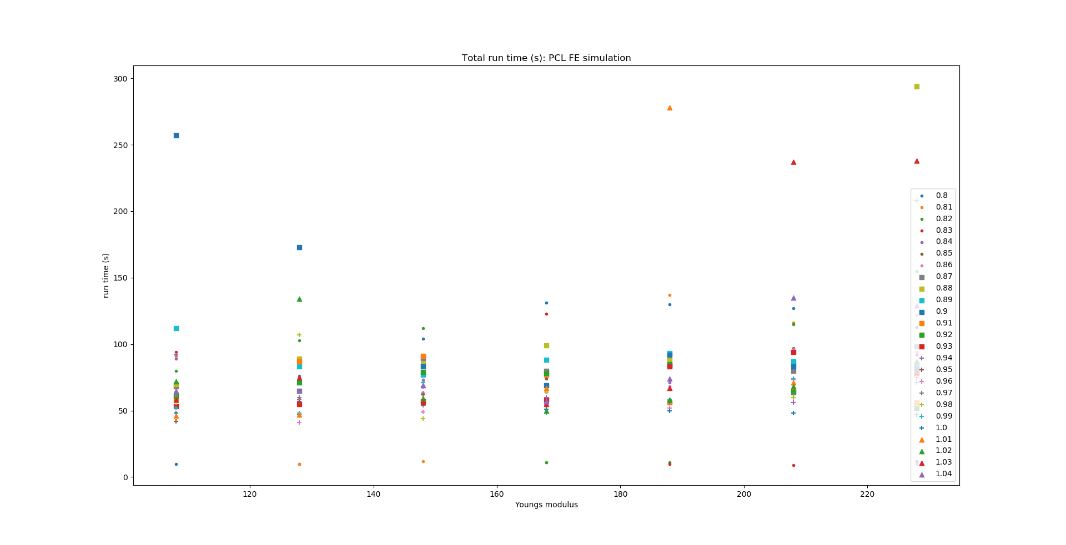

PCL - FE simulations: Young’s modulus

Slide 23



PCL - FE simulations: Young’s modulus

Slide 24




PCL - FE simulations: Prestretch value

Slide 25





PCL - FE simulations: Prestretch value

Slide 26
MCL - VV simulations
Rotation in the valgus direction
3 degrees: 0.05235 rad

Slide 27



MCL - VV simulations: Young’s modulus

Slide 28


MCL - VV simulations: Young’s modulus

Slide 29


MCL - VV simulations: Young’s modulus

Slide 30



MCL - VV simulations: Prestretch value

Slide 31




MCL - VV simulations: Prestretch value

Slide 32
MCL - FE simulations
0.5 rad flexion rotation

Slide 33




MCL - FE simulations: Young’s modulus

Slide 34


MCL - FE simulations: Young’s modulus

Slide 35



MCL - FE simulations: Young’s modulus

Slide 36




MCL - FE simulations: Prestretch value

Slide 37





MCL - FE simulations: Prestretch value

Slide 38
LCL - VV simulations
Rotation in the varus direction
3 degrees: 0.05235 rad

Slide 39



LCL - VV simulations: Young’s modulus

Slide 40


LCL - VV simulations: Young’s modulus

Slide 41


LCL - VV simulations: Young’s modulus

Slide 42



LCL - VV simulations: Prestretch value

Slide 43




LCL - VV simulations: Prestretch value

Slide 44
LCL - FE simulations
0.5 rad flexion rotation

Slide 45




LCL - FE simulations: Young’s modulus

Slide 46


LCL - FE simulations: Young’s modulus

Slide 47



LCL - FE simulations: Young’s modulus

Slide 48




LCL - FE simulations: Prestretch value

Slide 49





LCL - FE simulations: Prestretch value

