Slide 1
5. Prestretch ACL and PCL combinations
ACL prestretch on x-axis PCL prestretch values in legend

Slide 2
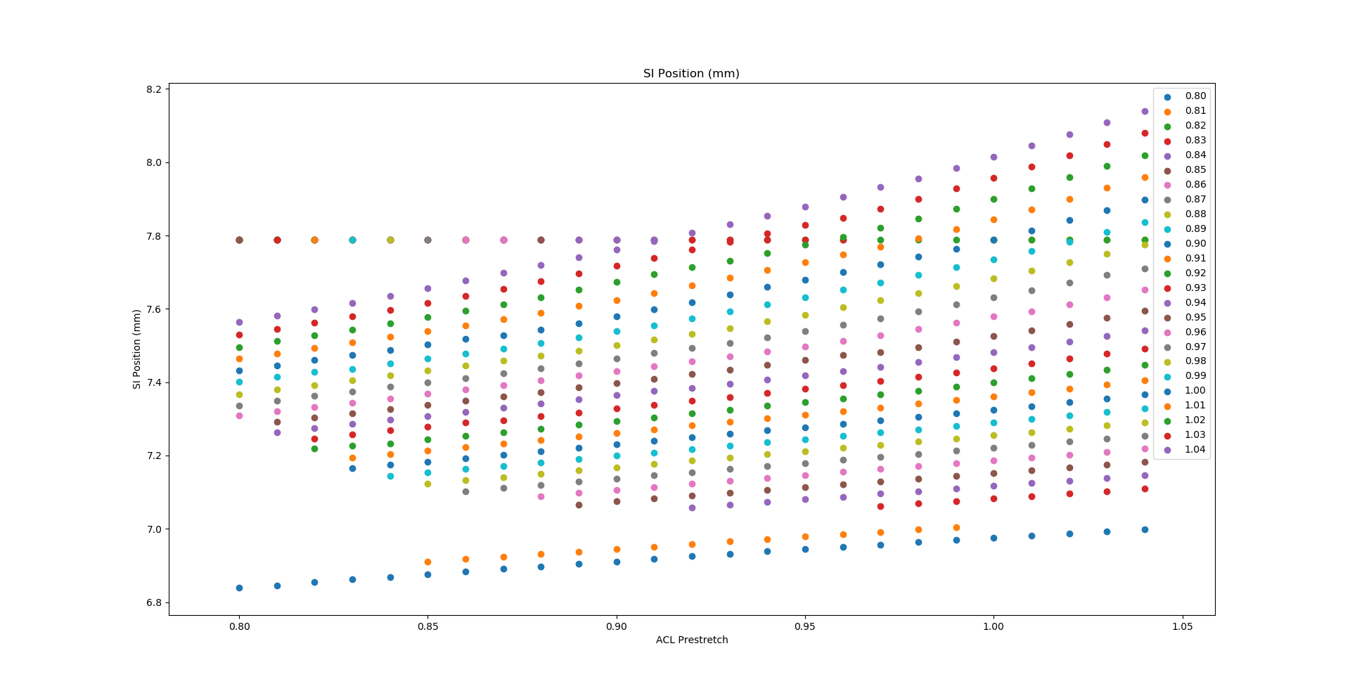

Slide 3
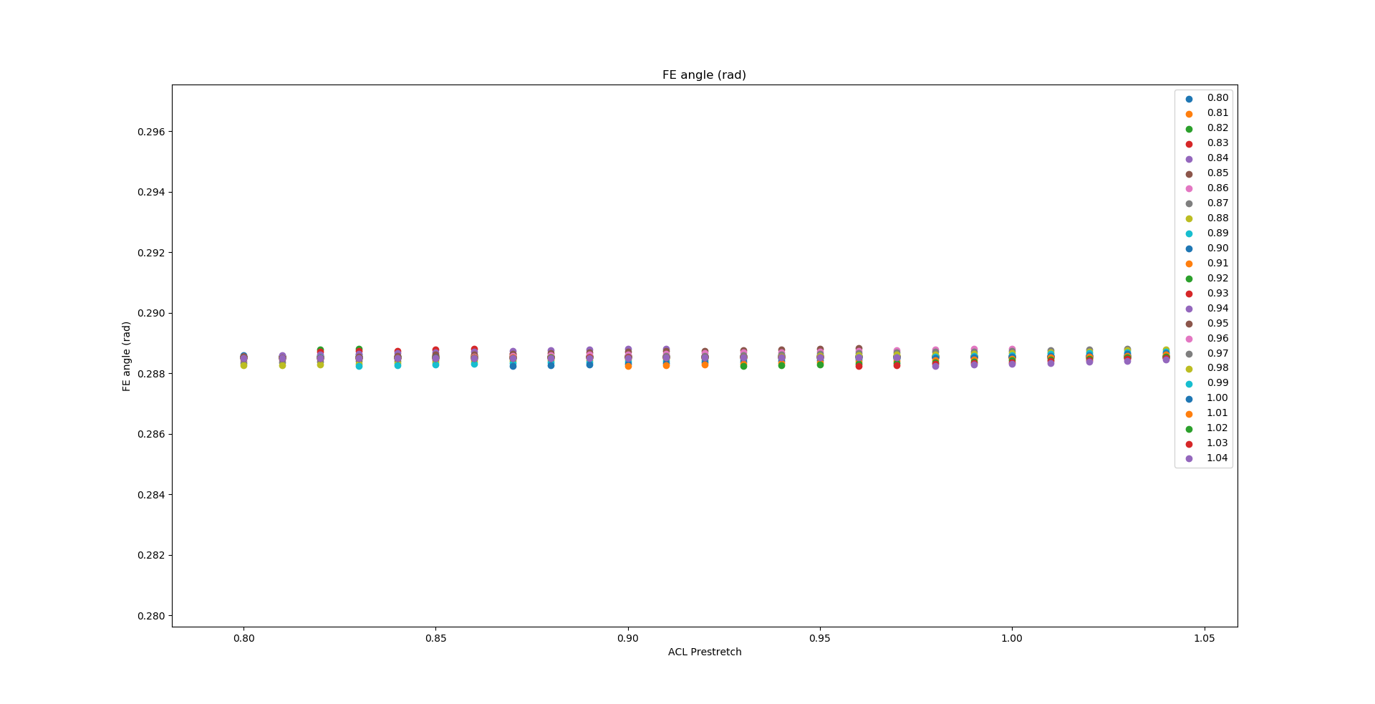

Slide 4
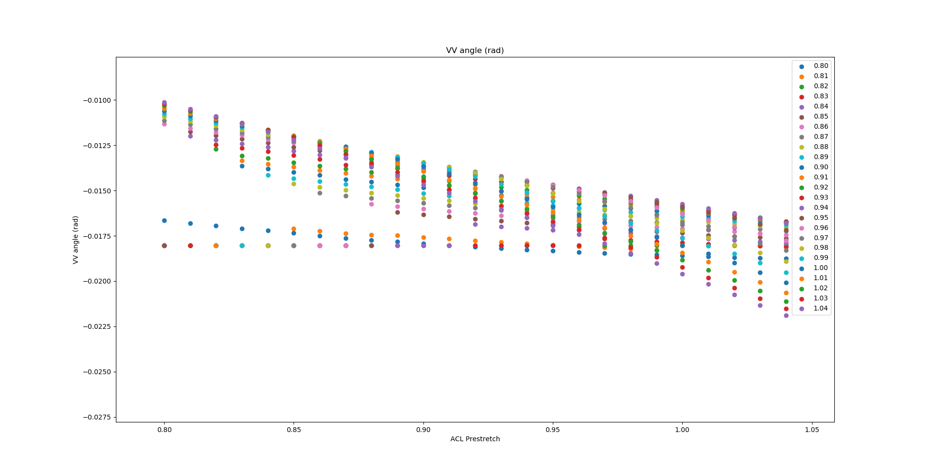

Slide 5
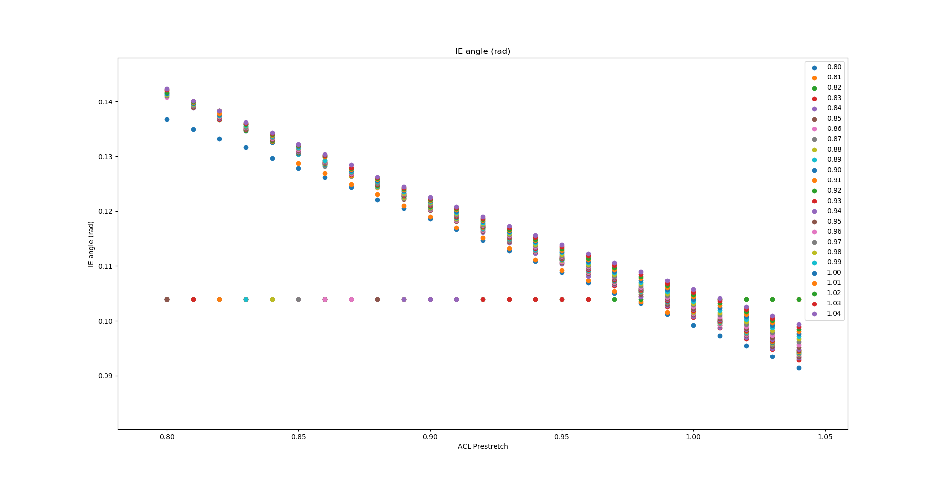

Slide 6
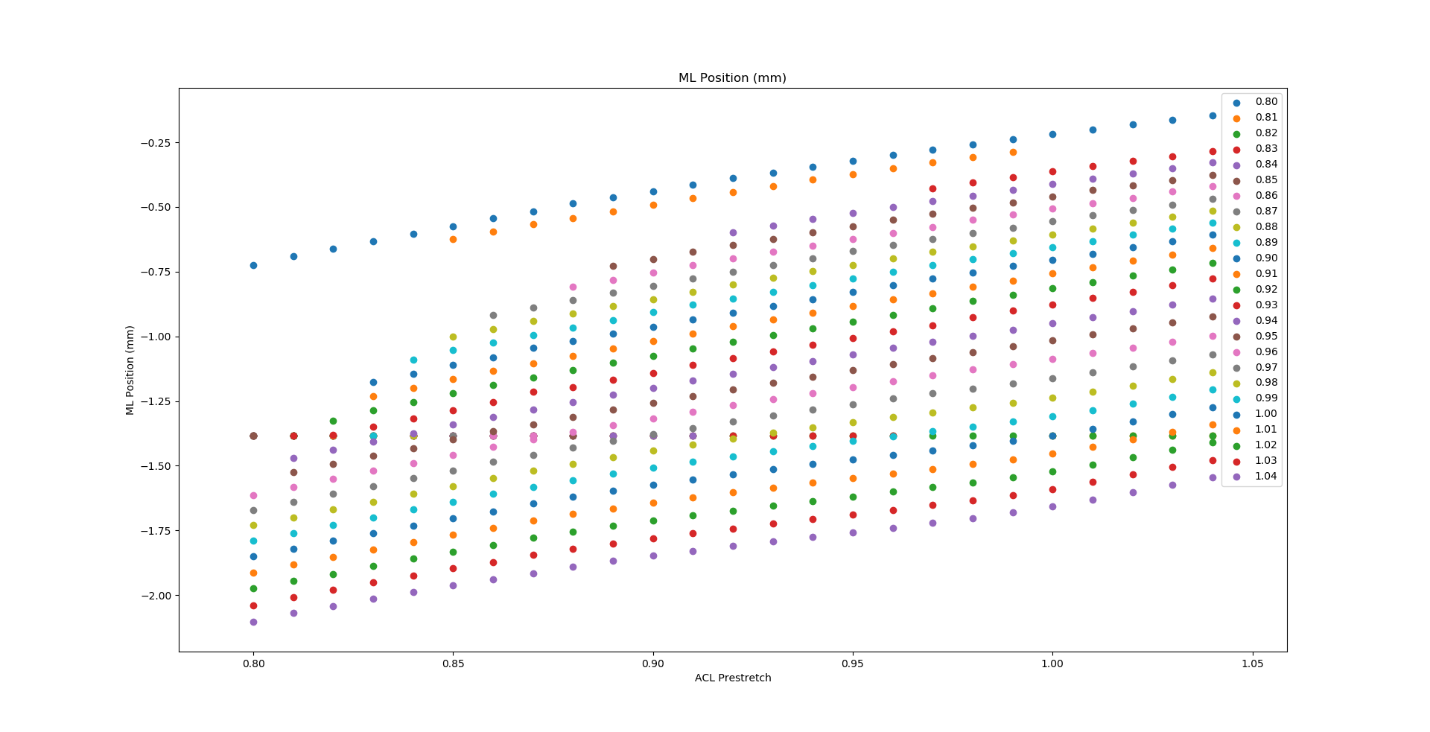

Slide 7
