Slide 1
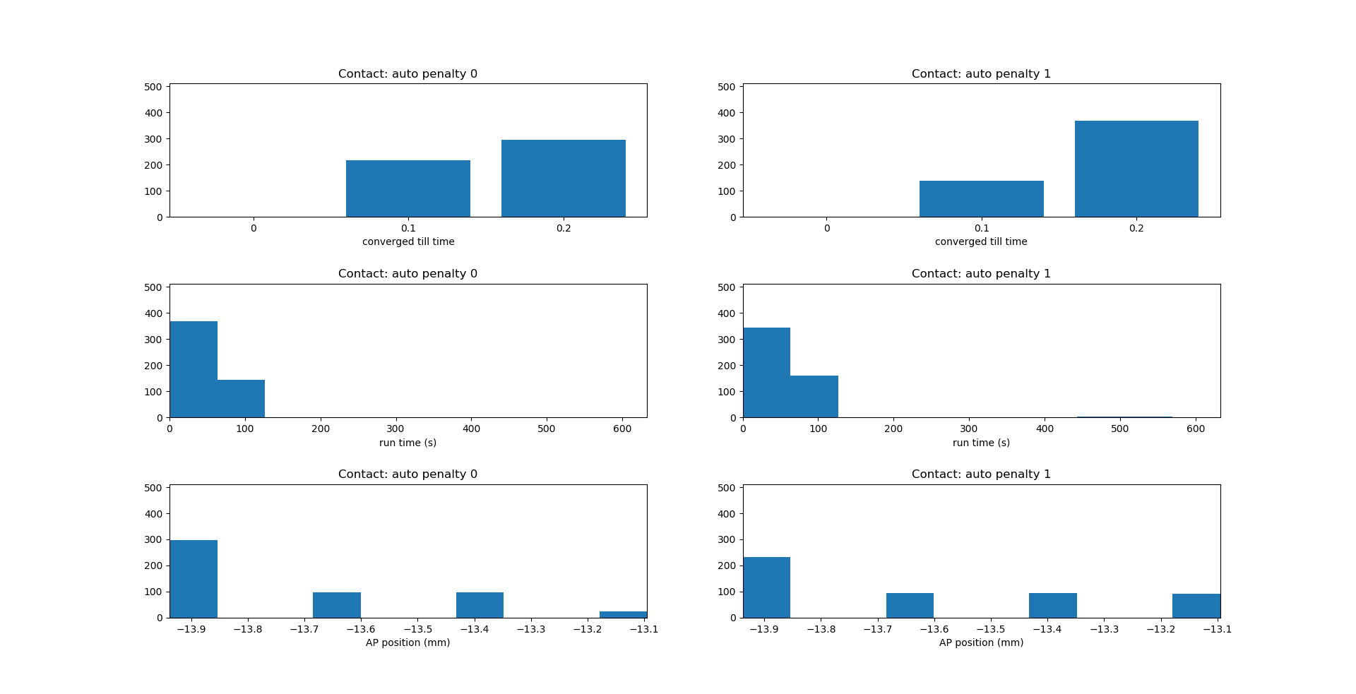
Number of simulations
Number of simulations
Number of simulations
Number of simulations
Number of simulations
Number of simulations

Slide 2
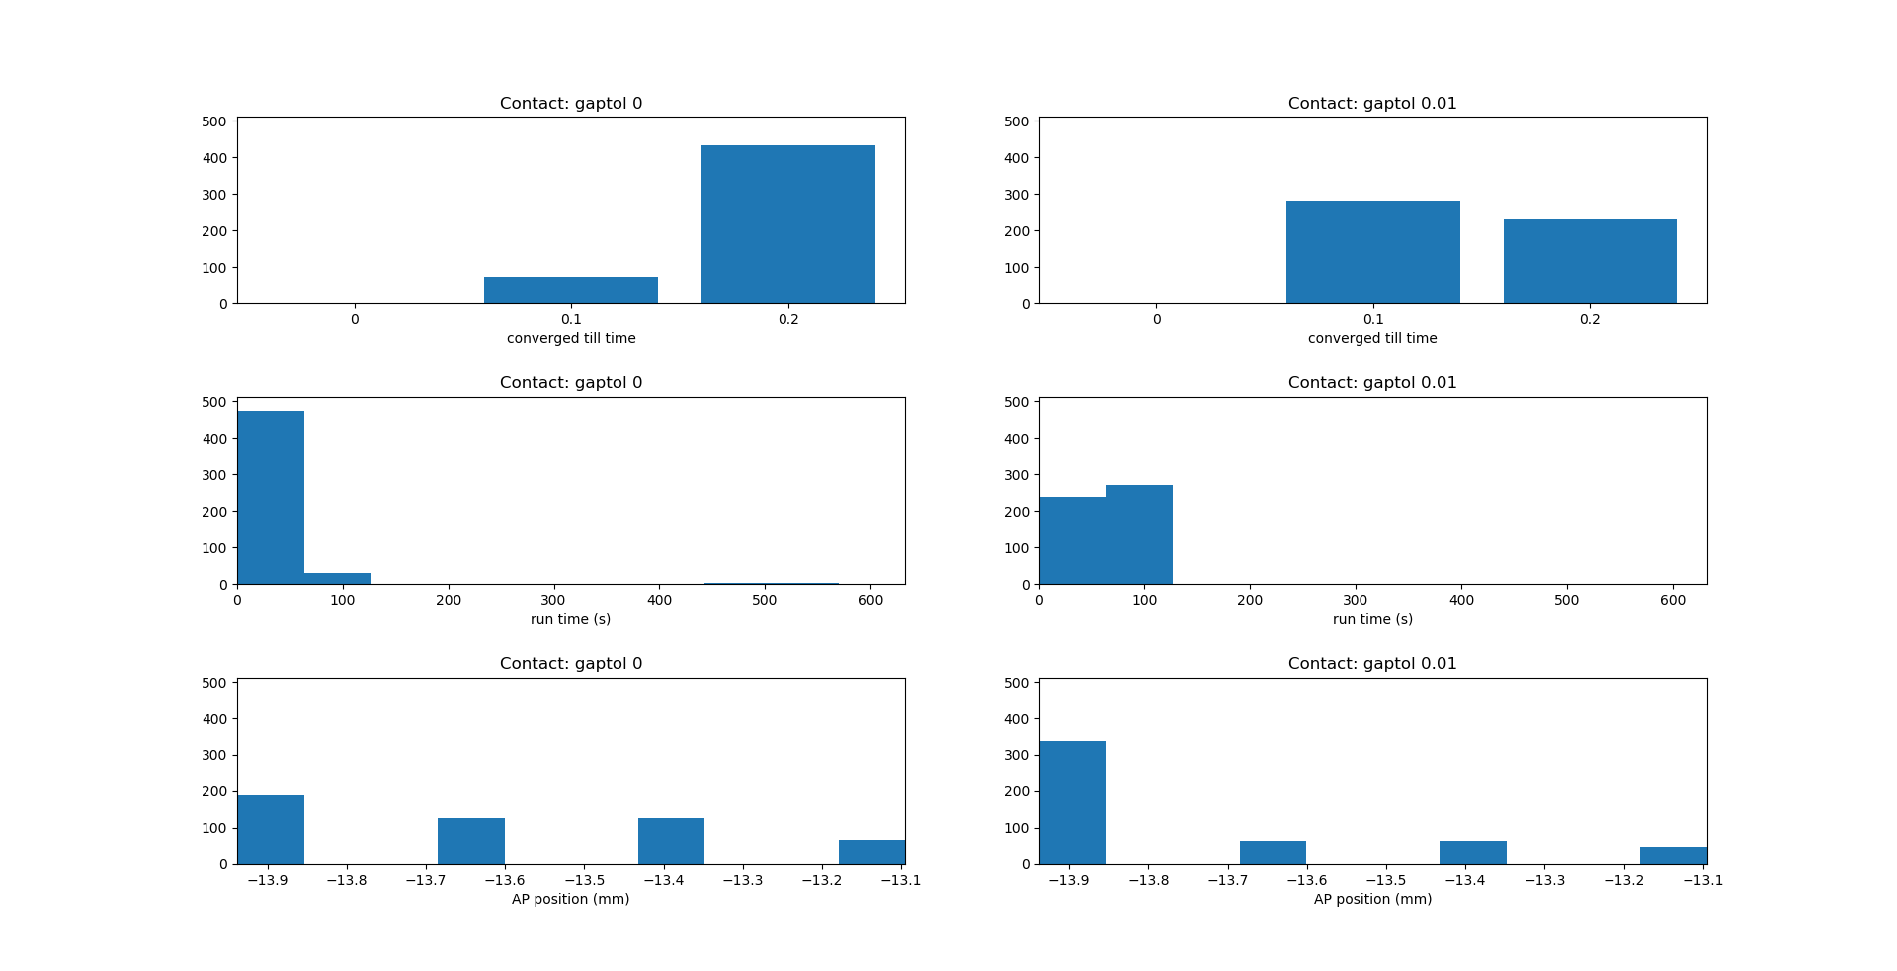
Number of simulations
Number of simulations
Number of simulations
Number of simulations
Number of simulations
Number of simulations

Slide 3
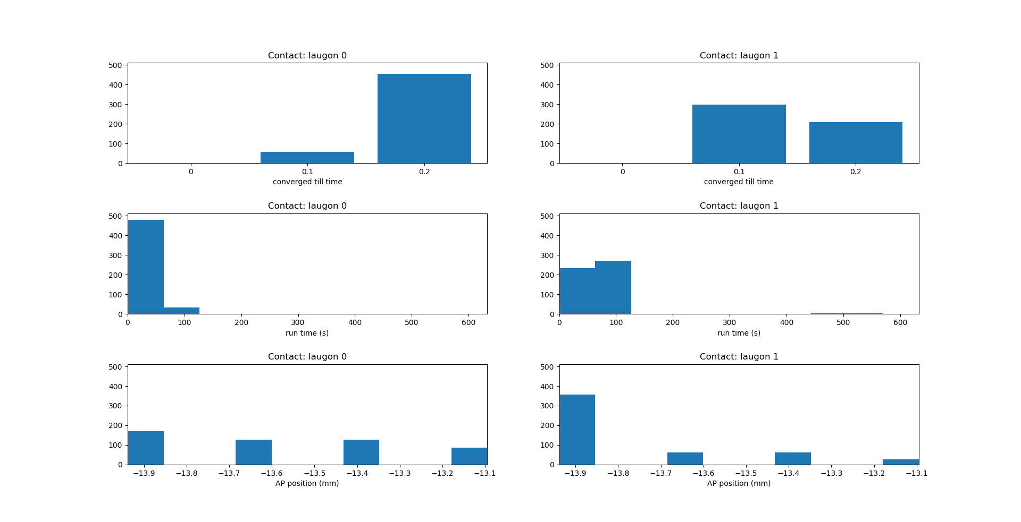
Number of simulations
Number of simulations
Number of simulations
Number of simulations
Number of simulations
Number of simulations

Slide 4
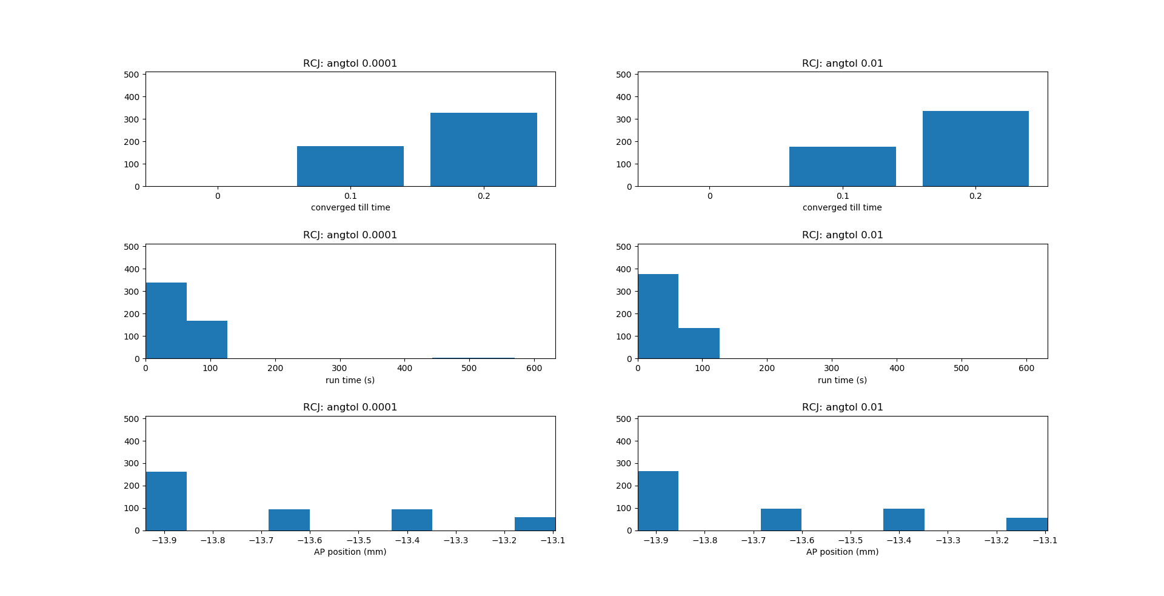
Number of simulations
Number of simulations
Number of simulations
Number of simulations
Number of simulations
Number of simulations

Slide 5
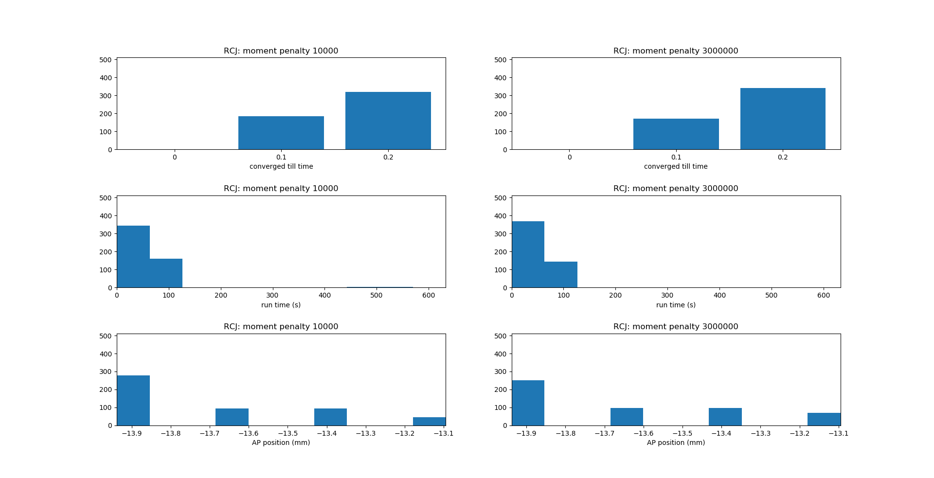
Number of simulations
Number of simulations
Number of simulations
Number of simulations
Number of simulations
Number of simulations

Slide 6
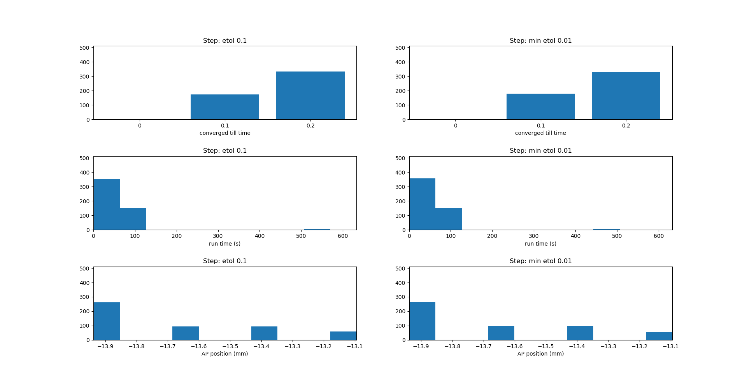
Number of simulations
Number of simulations
Number of simulations
Number of simulations
Number of simulations
Number of simulations

Slide 7
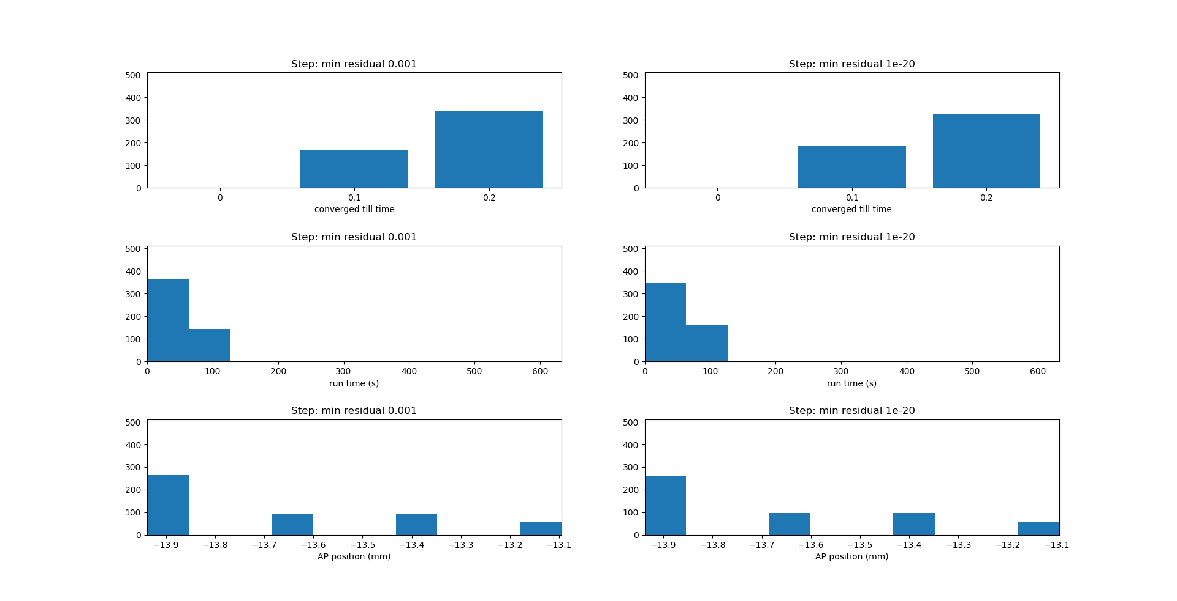
Number of simulations
Number of simulations
Number of simulations
Number of simulations
Number of simulations
Number of simulations

Slide 8
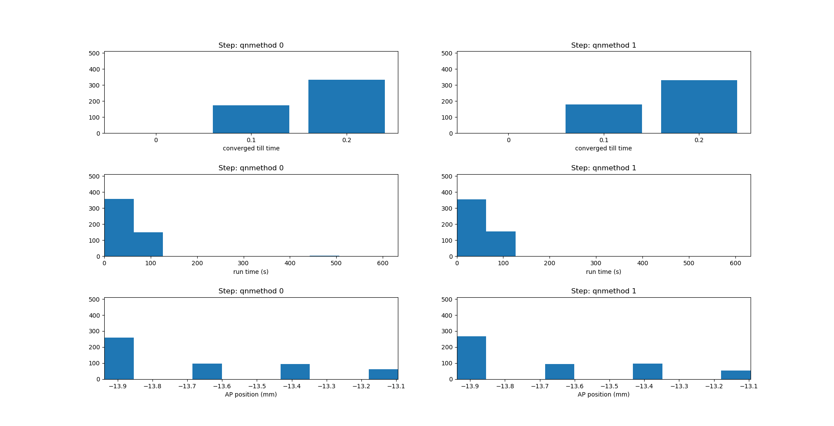
Number of simulations
Number of simulations
Number of simulations
Number of simulations
Number of simulations
Number of simulations

