Slide 1
Sensitivity study on model control parameters 2
ACL prestretch values: 1, 1.1 & 1.2

Slide 2
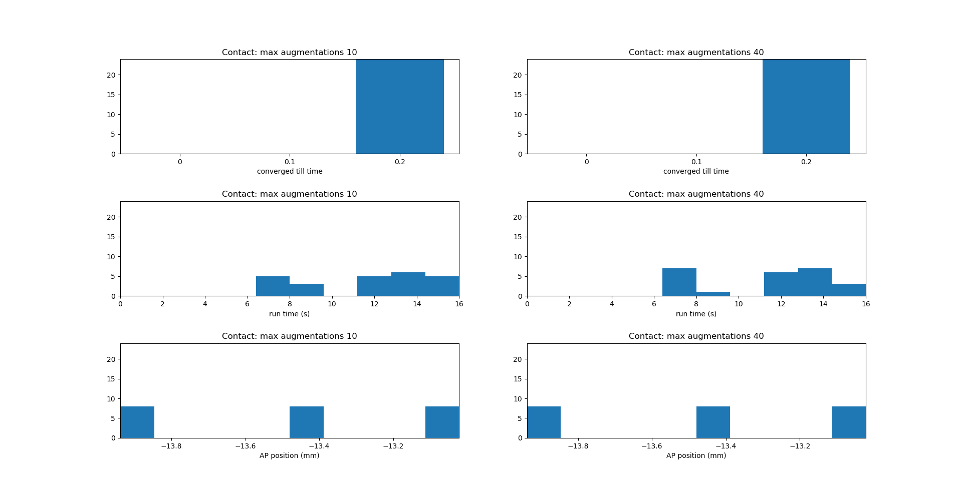
Number of simulations
Number of simulations
Number of simulations
Number of simulations
Number of simulations
Number of simulations

Slide 3
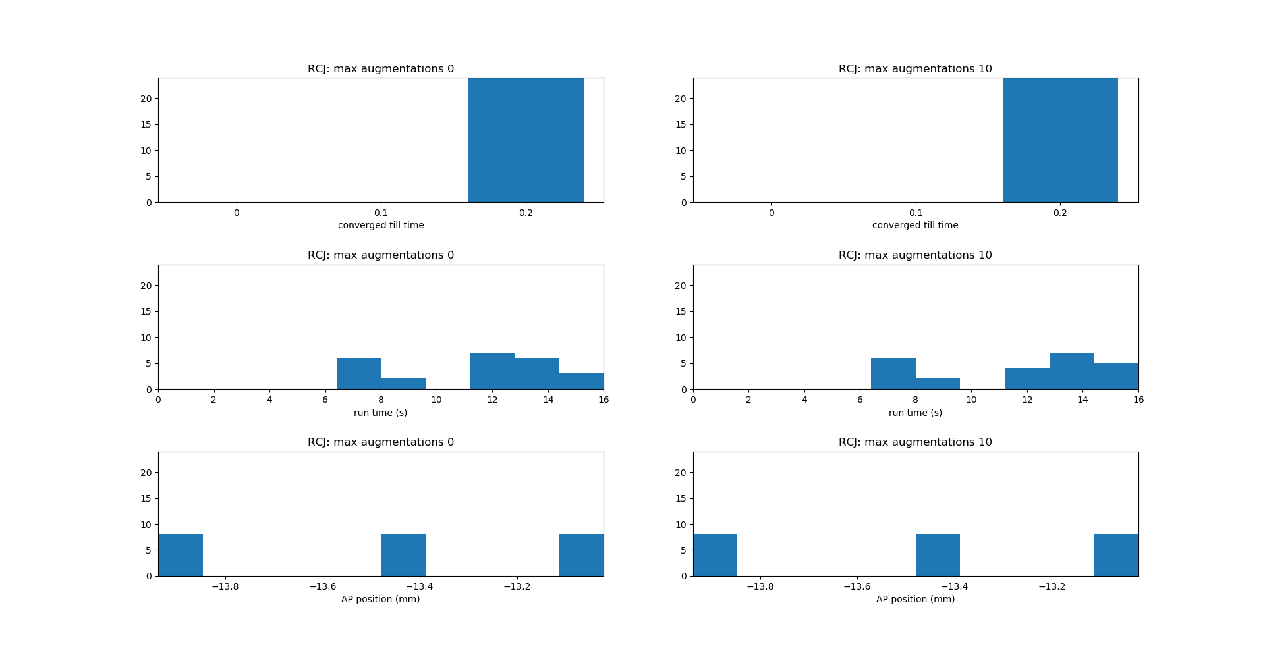
Number of simulations
Number of simulations
Number of simulations
Number of simulations
Number of simulations
Number of simulations

Slide 4
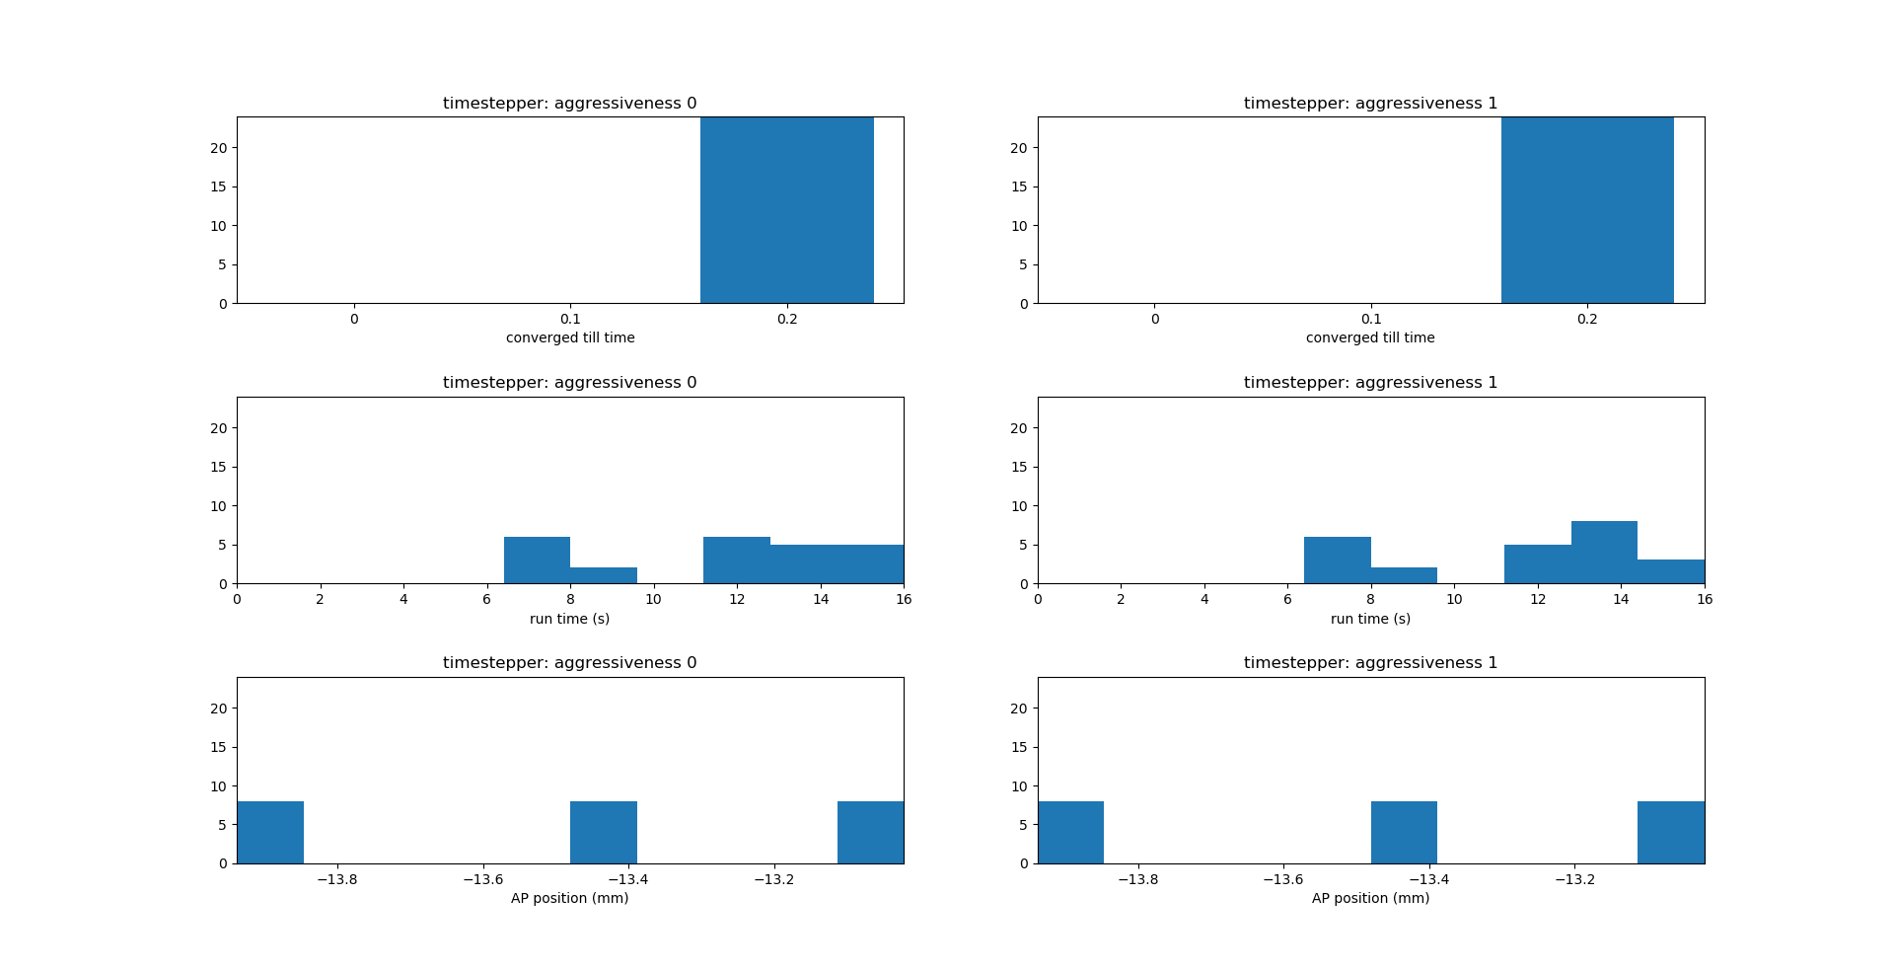
Number of simulations
Number of simulations
Number of simulations
Number of simulations
Number of simulations
Number of simulations

Slide 5

Number of simulations
Number of simulations
Number of simulations
Number of simulations
Number of simulations
Number of simulations

Slide 6
Sensitivity study on model control parameters 2
ACL prestretch values: 0.7, 0.8 & 0.9

Slide 7
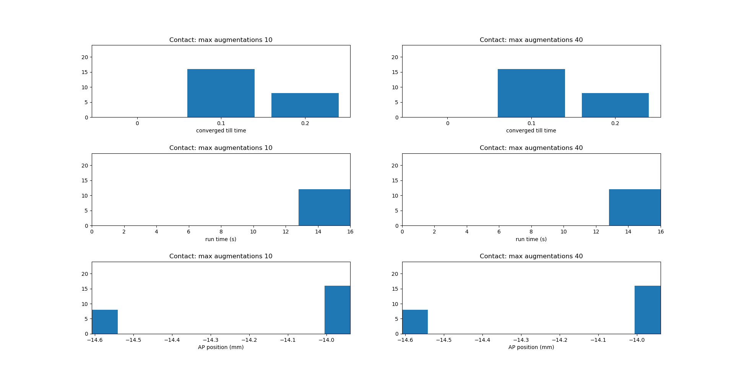
Number of simulations
Number of simulations
Number of simulations
Number of simulations
Number of simulations
Number of simulations

Slide 8

Number of simulations
Number of simulations
Number of simulations
Number of simulations
Number of simulations
Number of simulations

Slide 9

Number of simulations
Number of simulations
Number of simulations
Number of simulations
Number of simulations
Number of simulations

Slide 10

Number of simulations
Number of simulations
Number of simulations
Number of simulations
Number of simulations
Number of simulations

