Slide 1
2. Check prestretch range for force driven simulations
Try prescribed forces/moments:
ACL & PCL:
1. AP -50N
2. AP +50N
3. AP -100N
4. AP +100N
MCL & LCL:
1. VV -500N/mm
2. VV +500N/mm
3. VV -1000 N/mm
4. VV +1000 N/mm
ACL, PCL, MCL & LCL:
1. IE -500N/mm
2. IE +500N/mm
3. IE -1000 N/mm
4. IE +1000 N/mm
For prestretch range 0.8 – 1.04 for each ligament separately
Prestretch applied between step 0.1 and 0.2, full simulation until 1.0

Slide 2
ACL - AP simulation

Slide 3
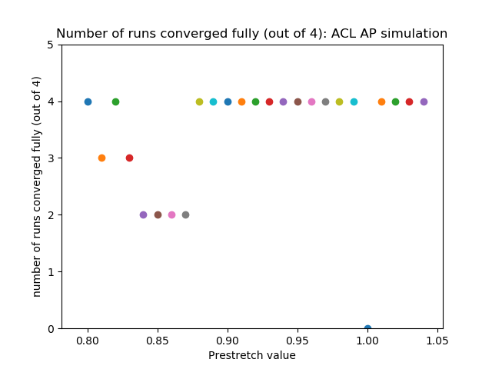
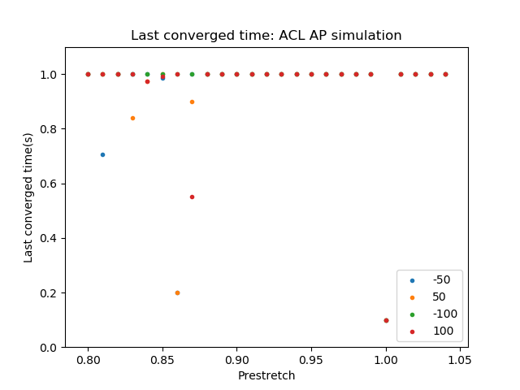
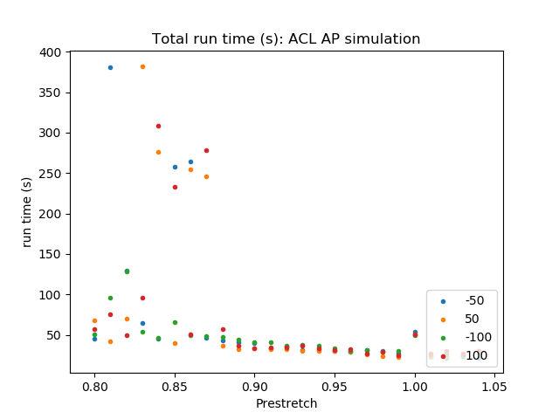
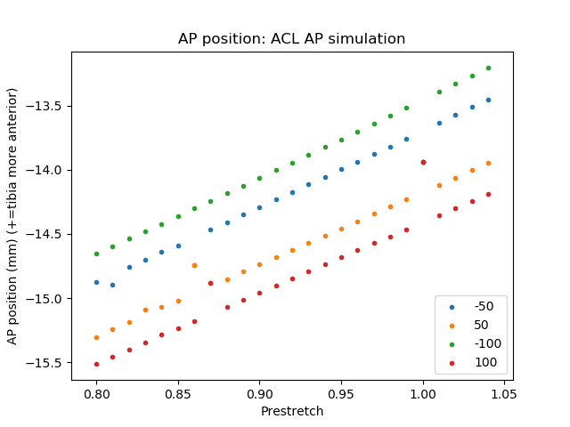
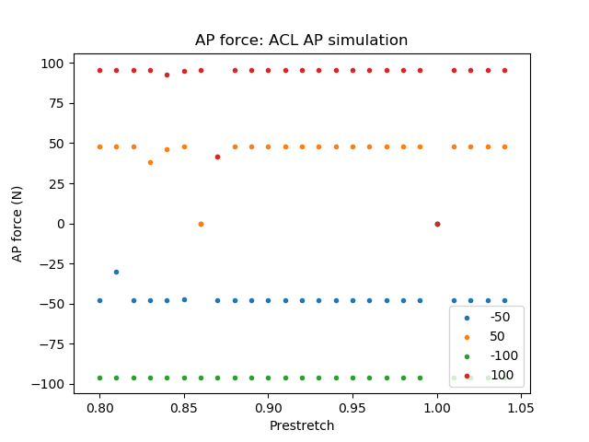
ACL - AP simulation

Slide 4
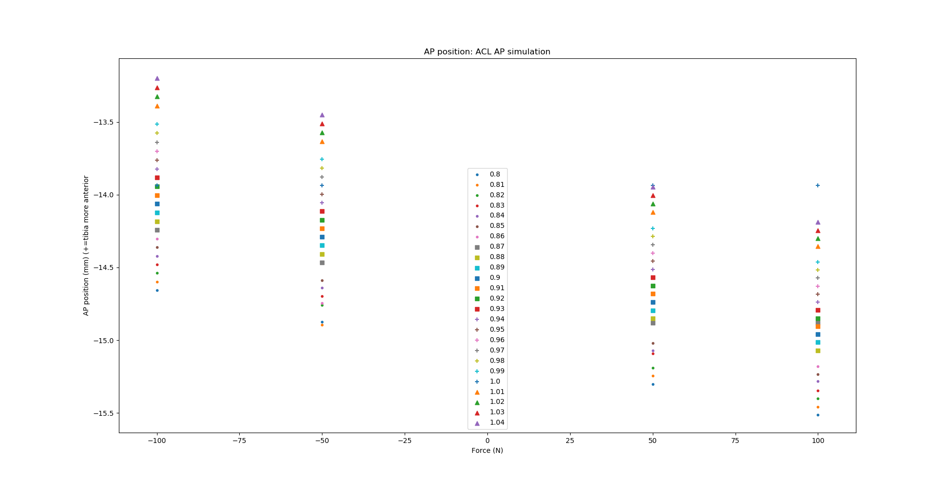
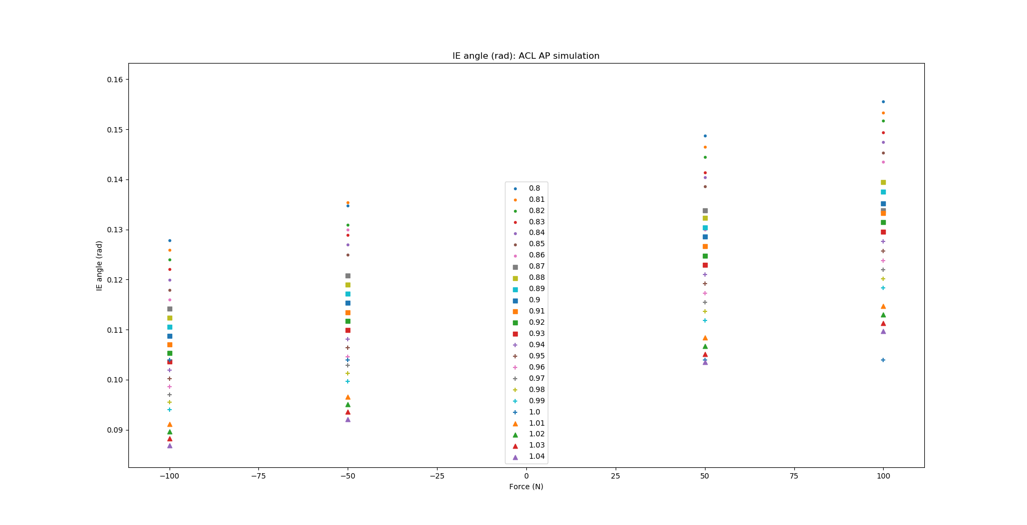
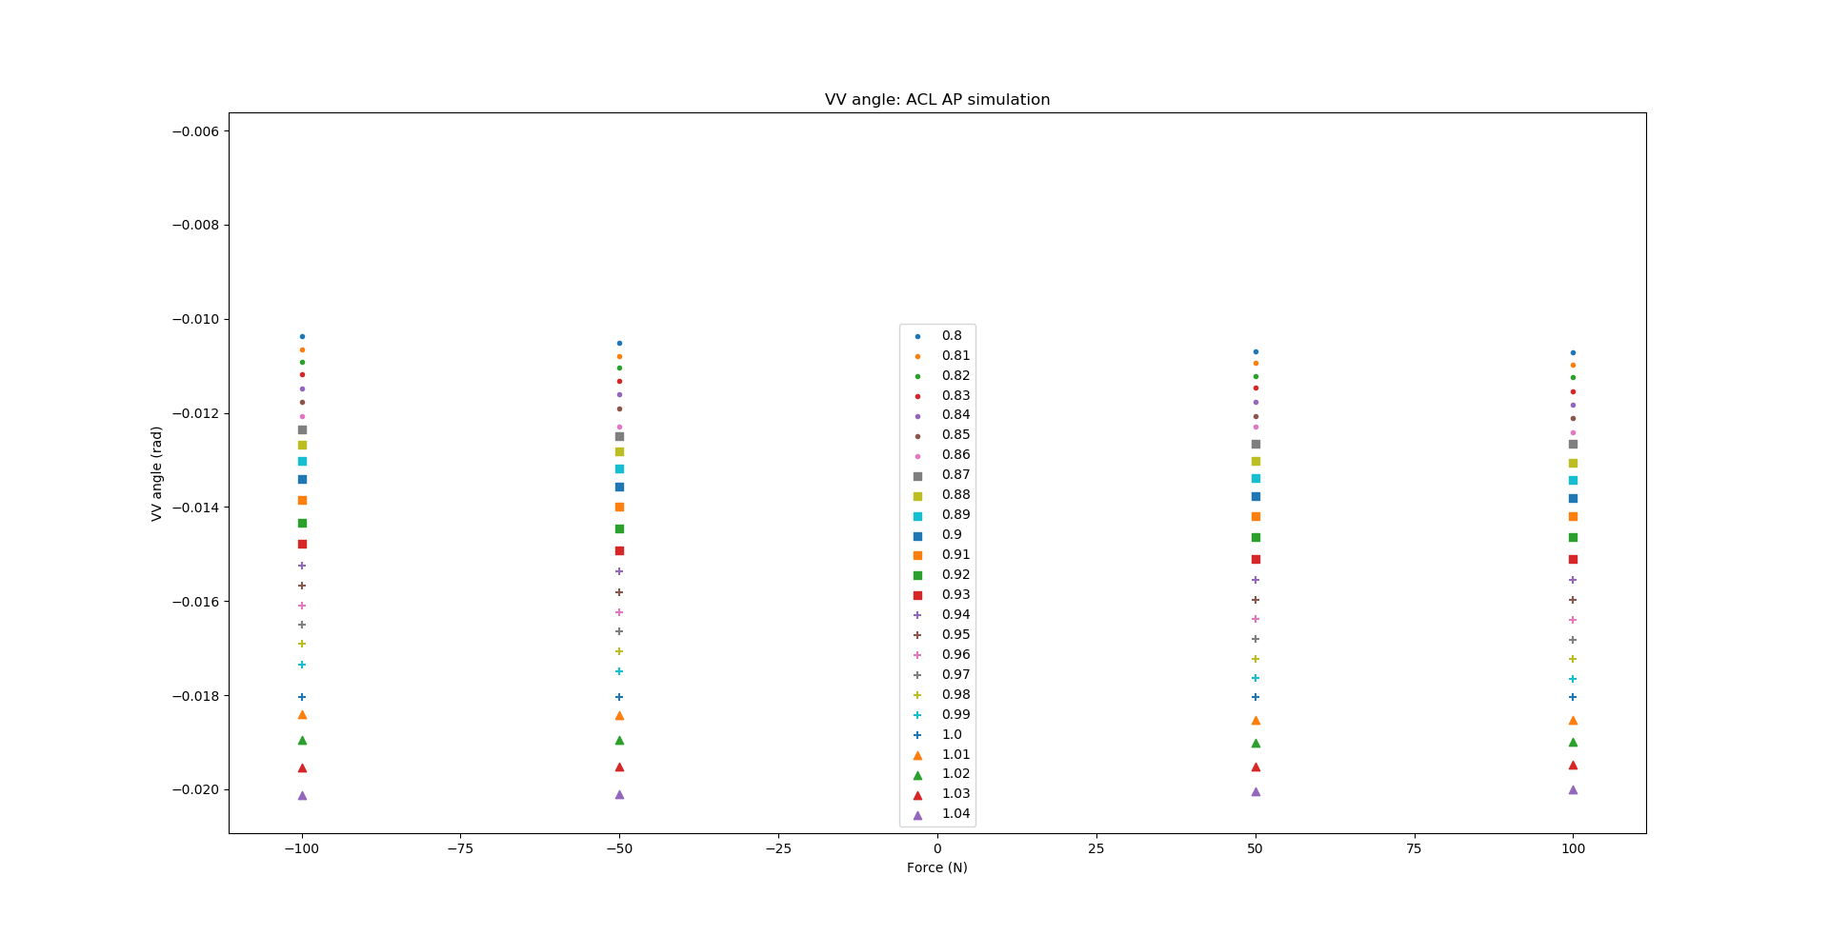
ACL - AP simulation

Slide 5
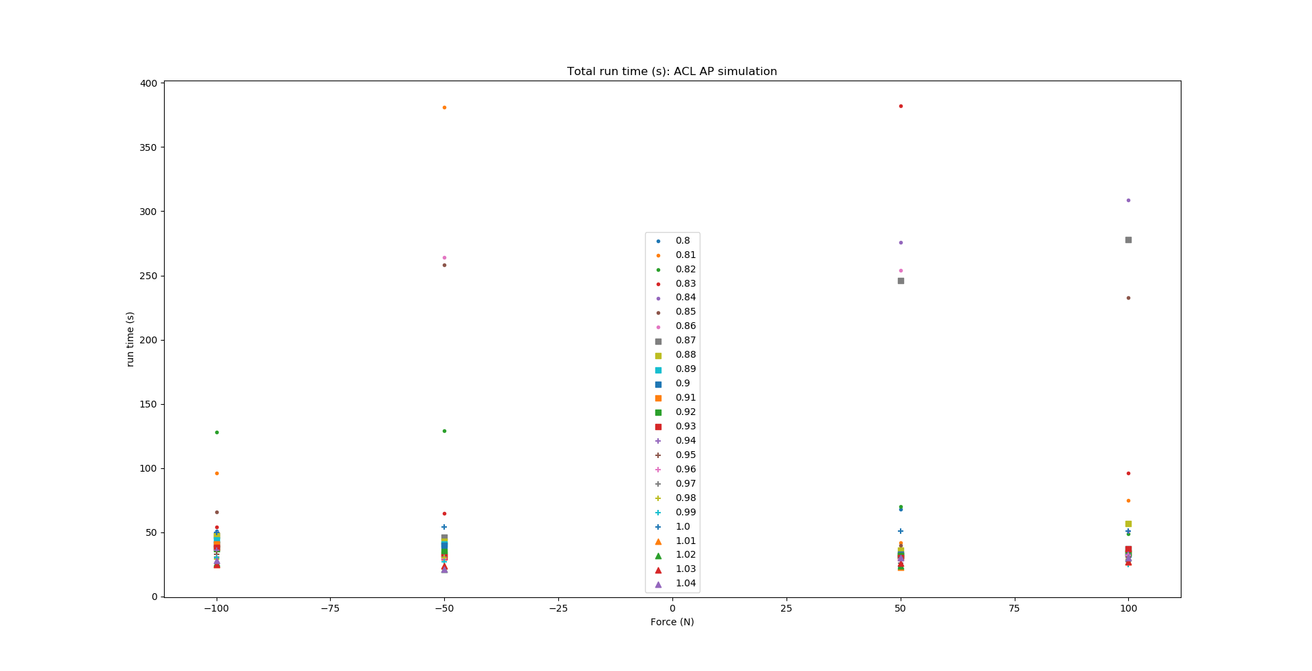
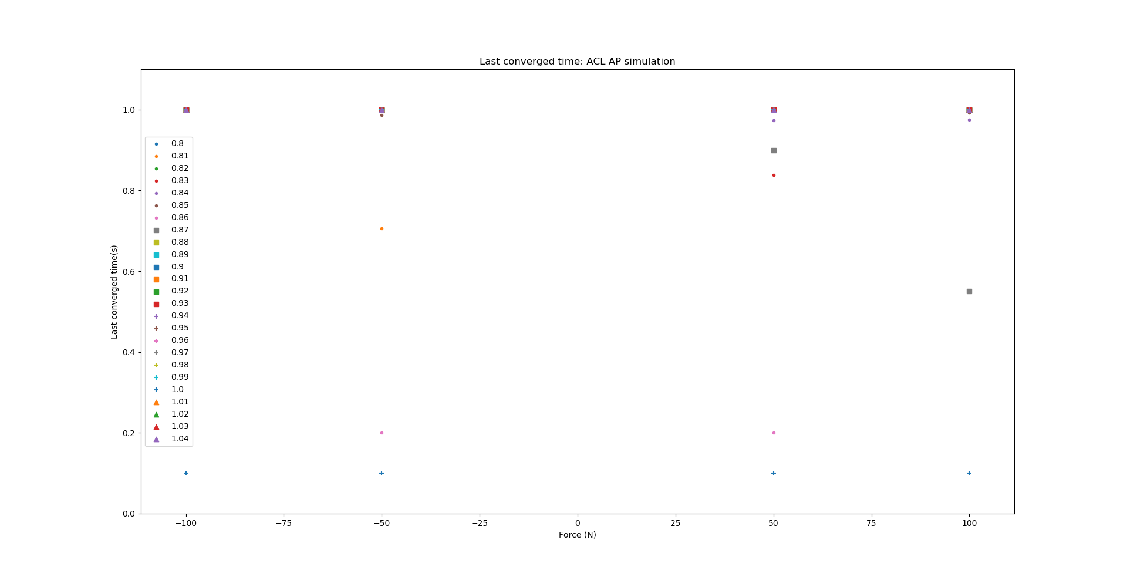
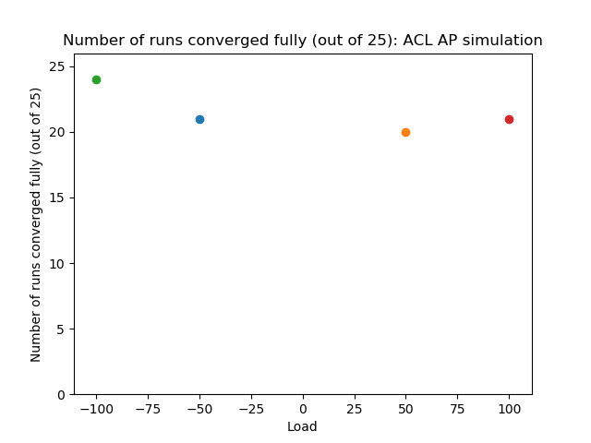
ACL - AP simulation

Slide 6
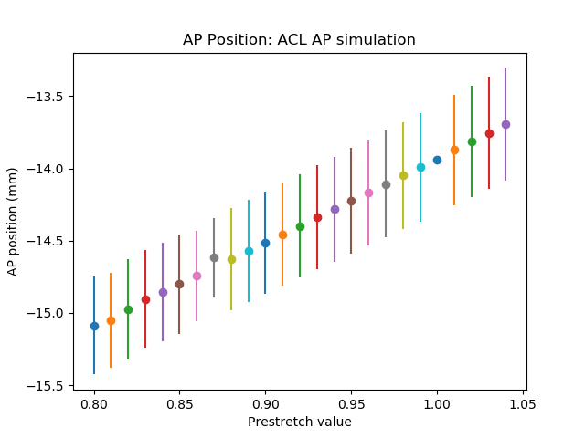
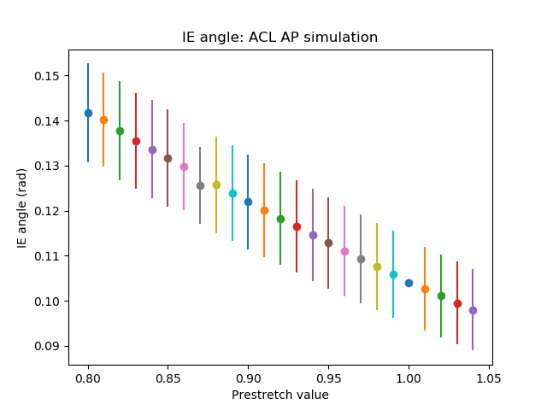
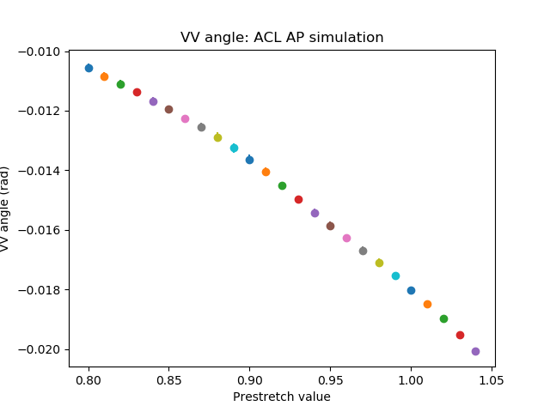
ACL - AP simulation

Slide 7
ACL - IE simulation

Slide 8
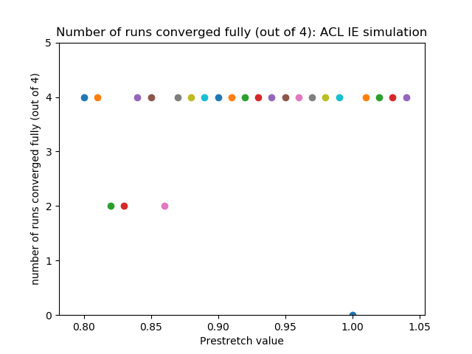
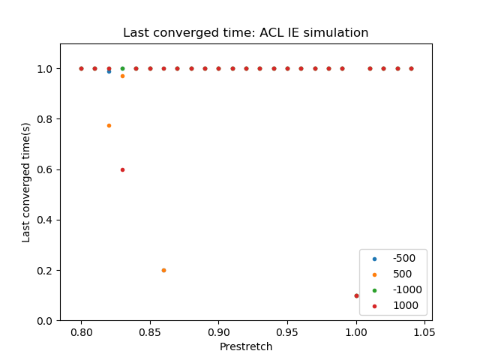
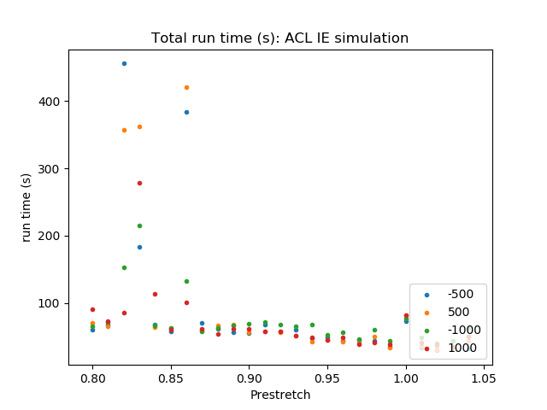
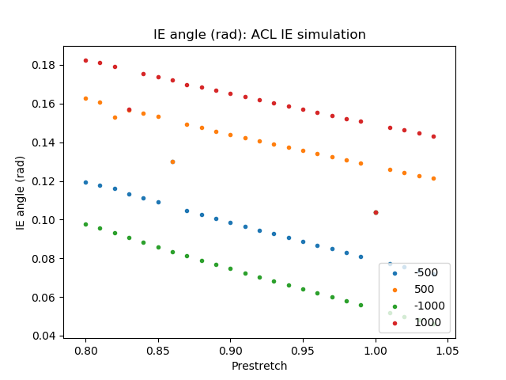
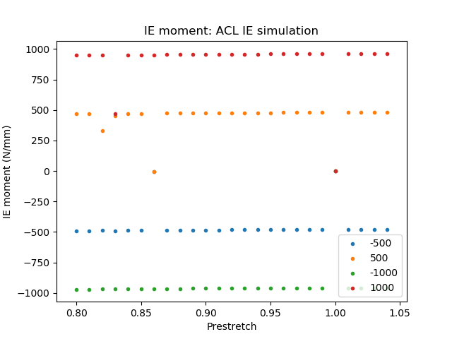
ACL - IE simulation

Slide 9
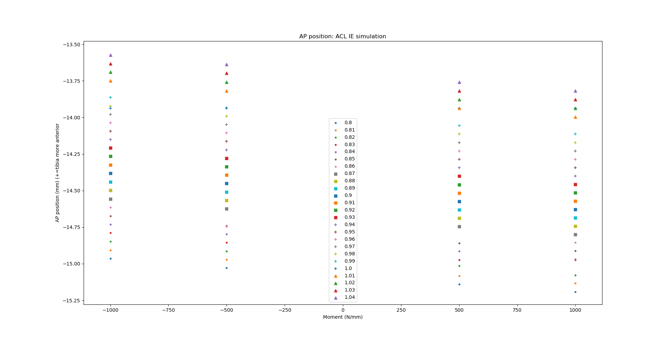
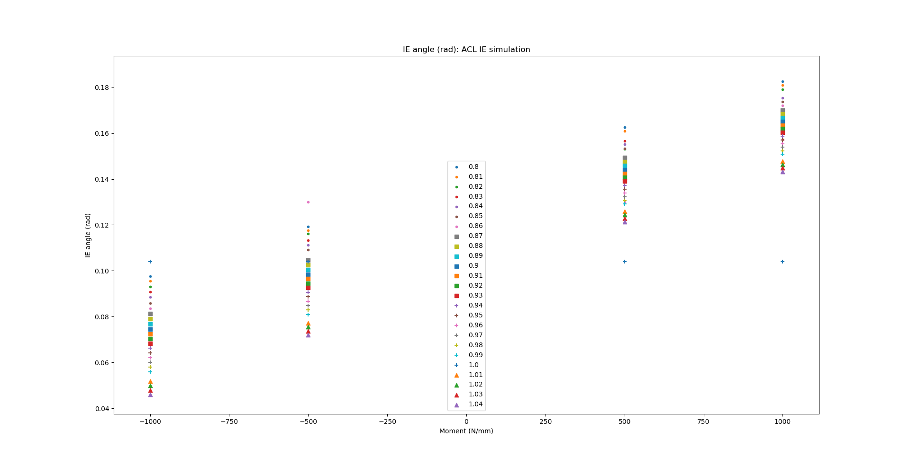
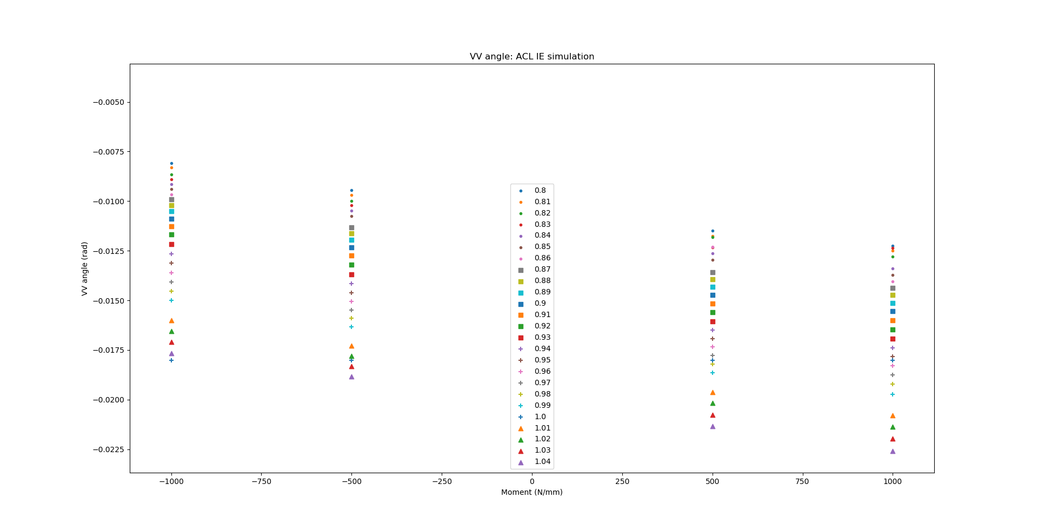
ACL - IE simulation

Slide 10
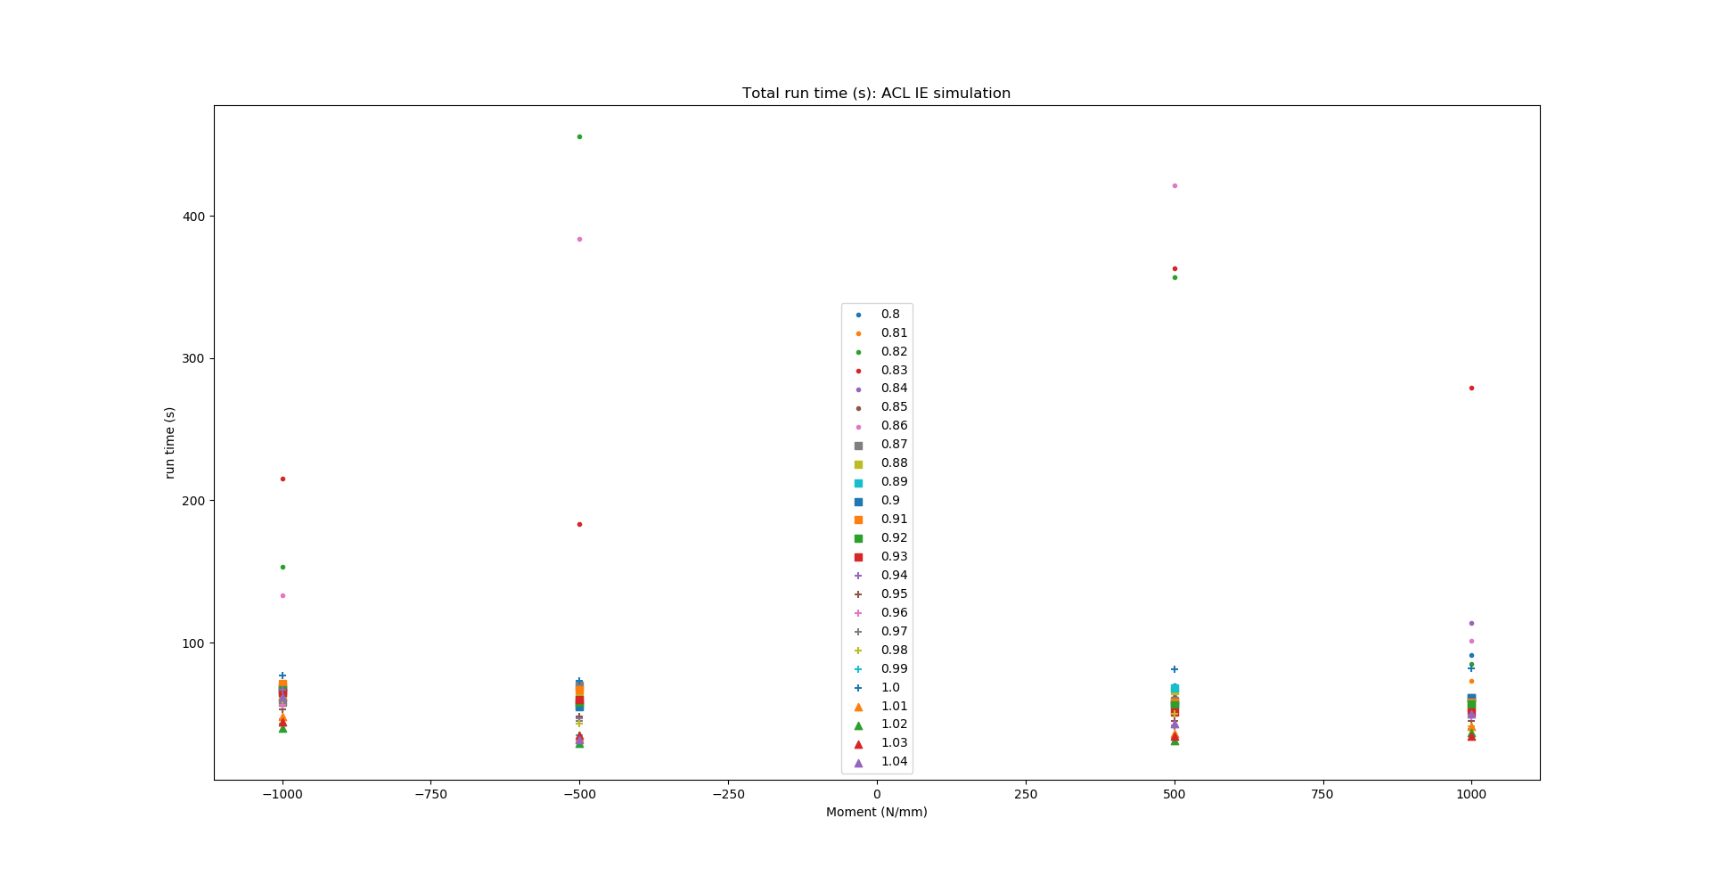
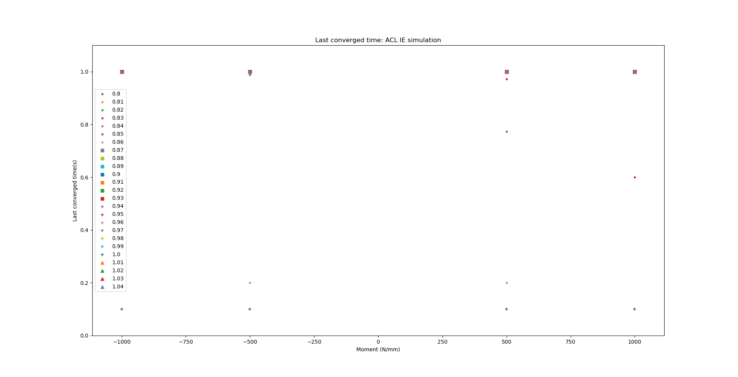
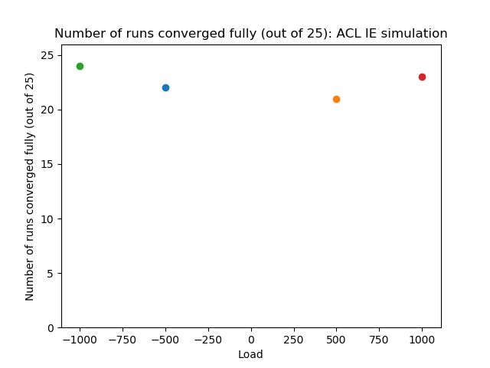
ACL - IE simulation

Slide 11
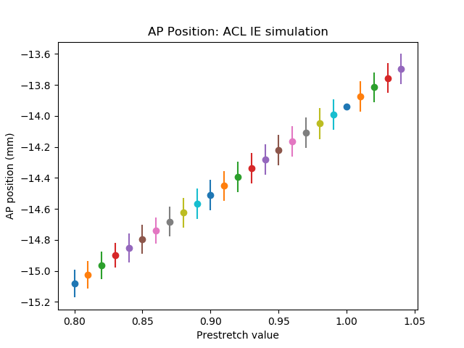
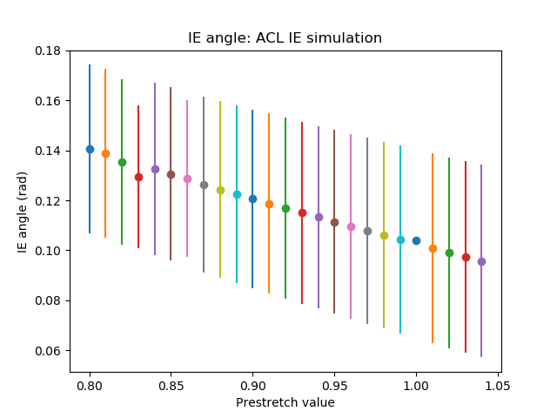
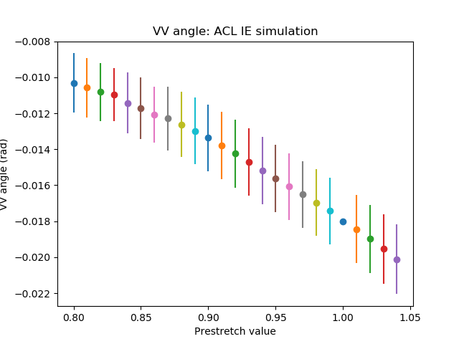
ACL - IE simulation

Slide 12
PCL - AP simulation

Slide 13
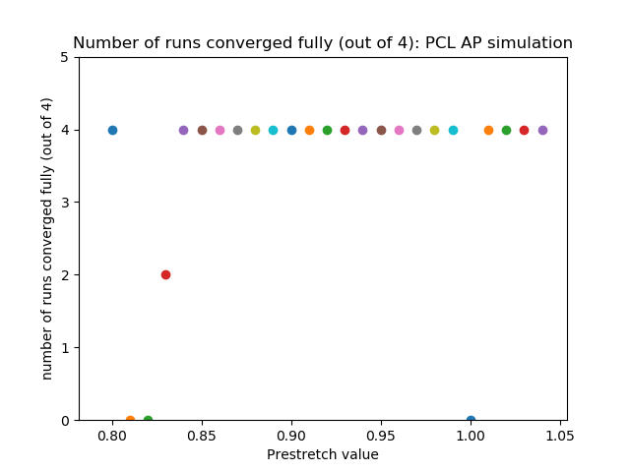
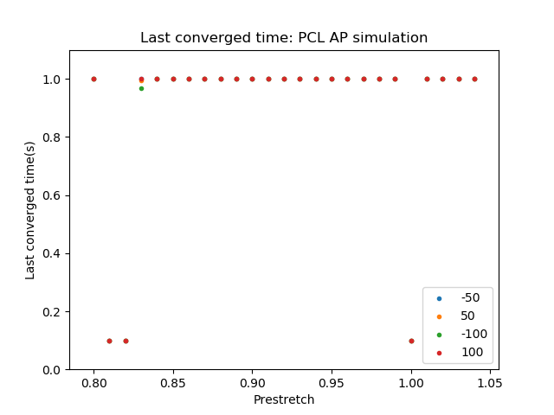
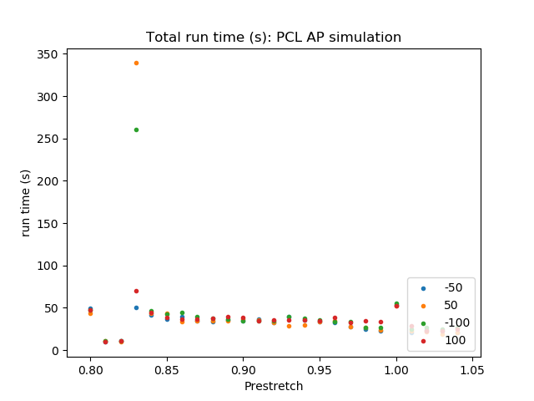
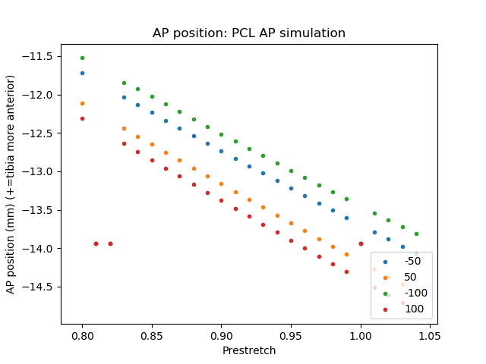
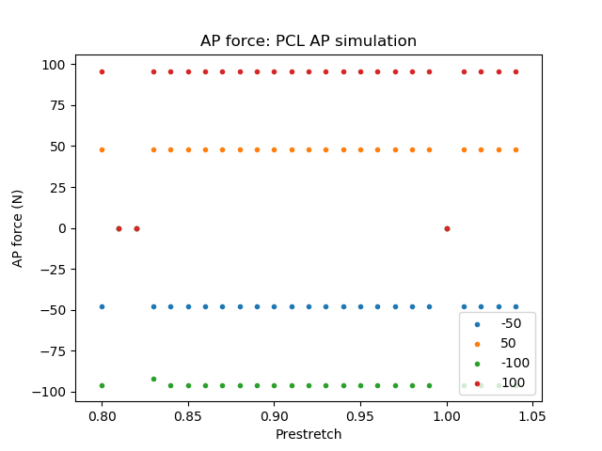
PCL – AP simulation

Slide 14
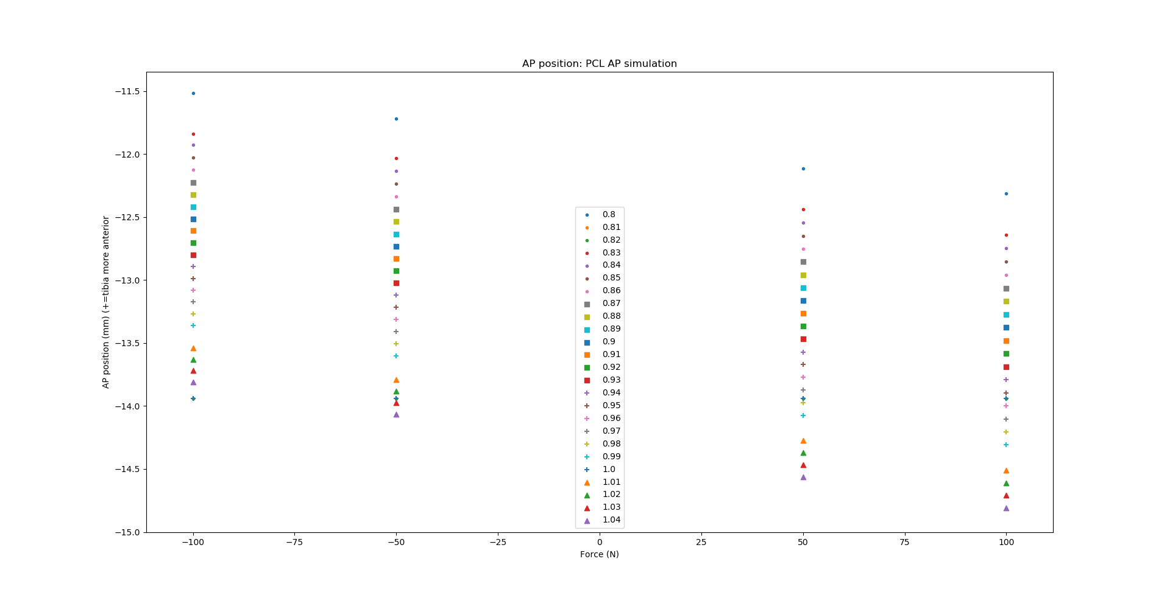
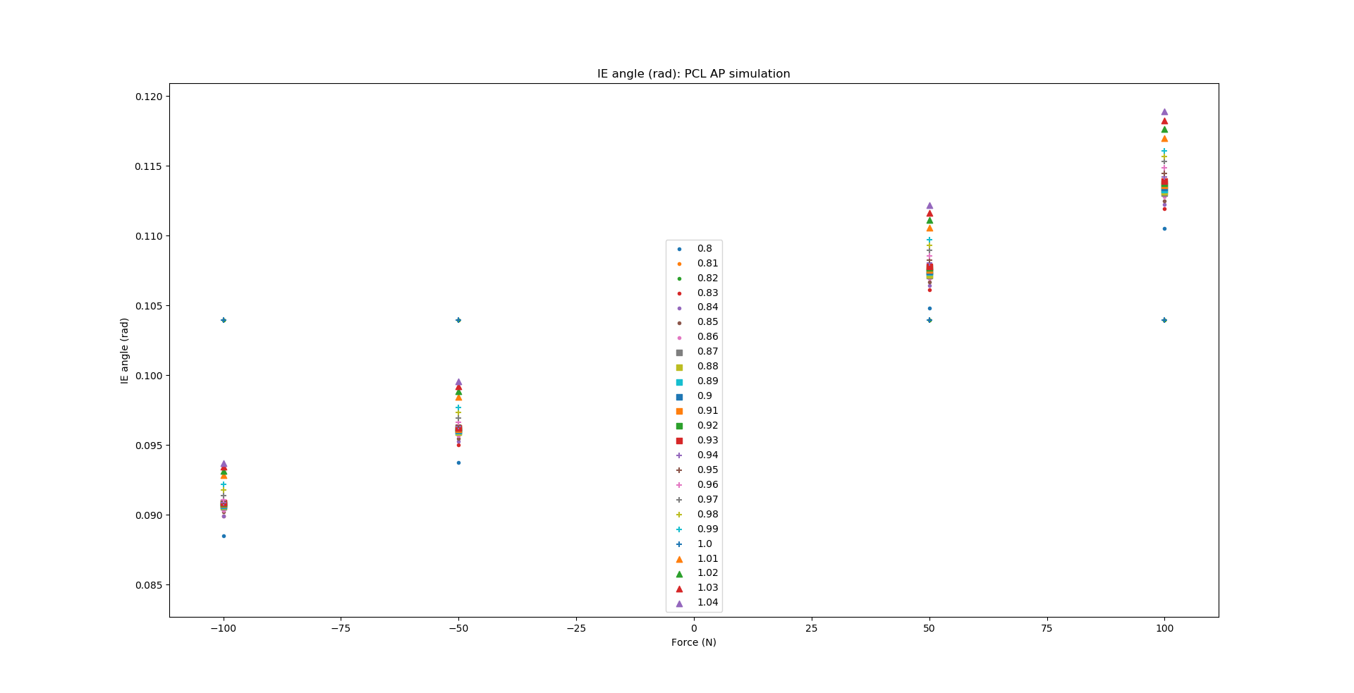
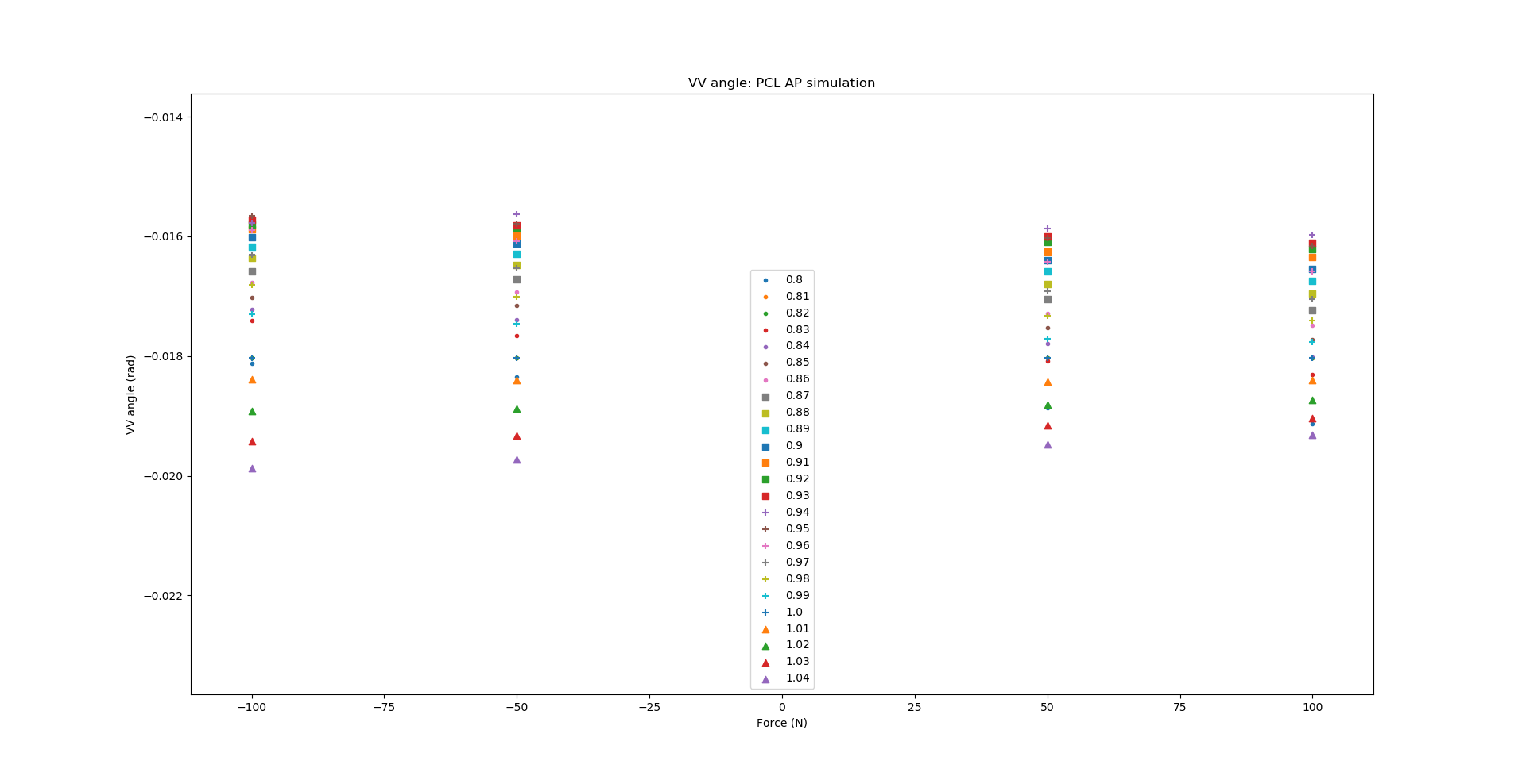
PCL – AP simulation

Slide 15
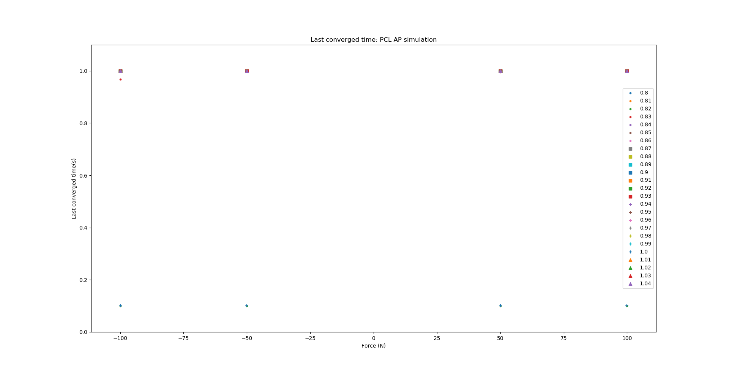
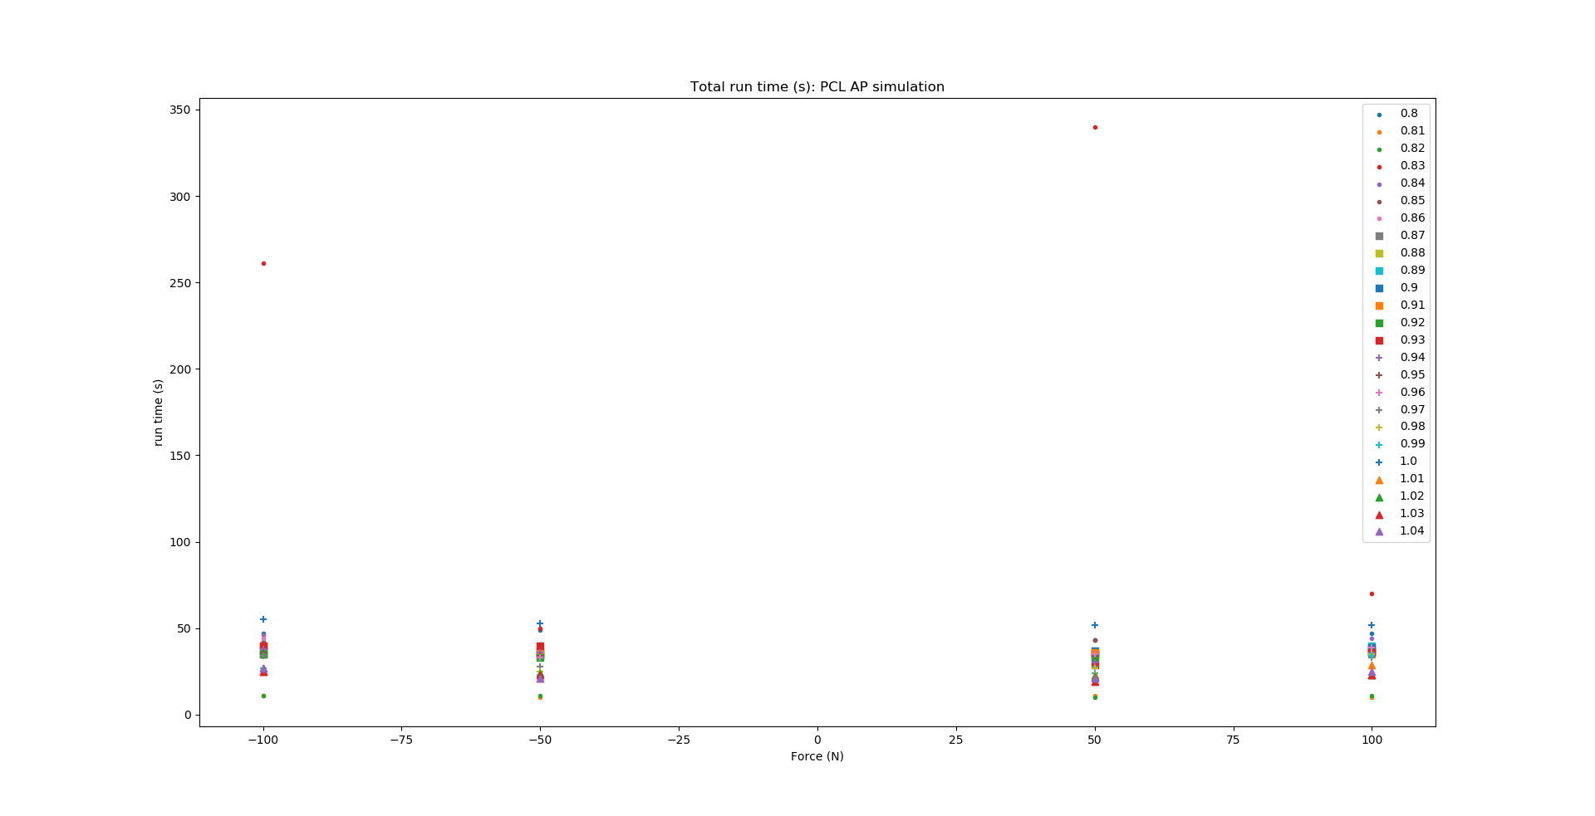
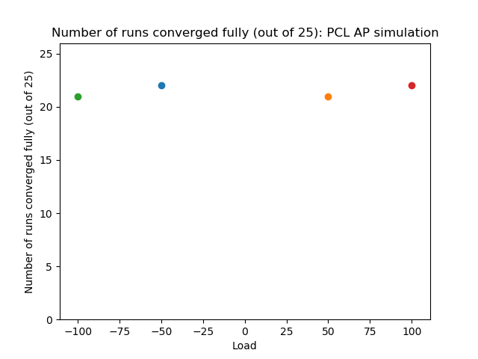
PCL – AP simulation

Slide 16
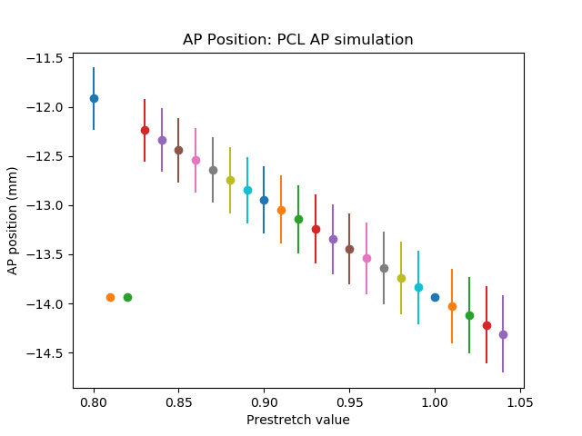
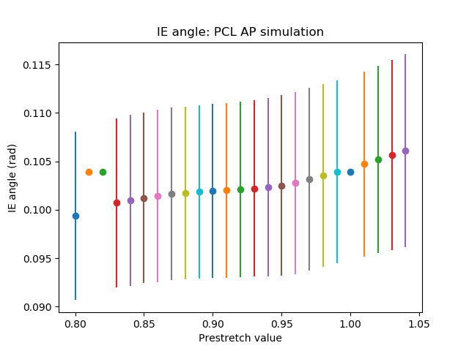
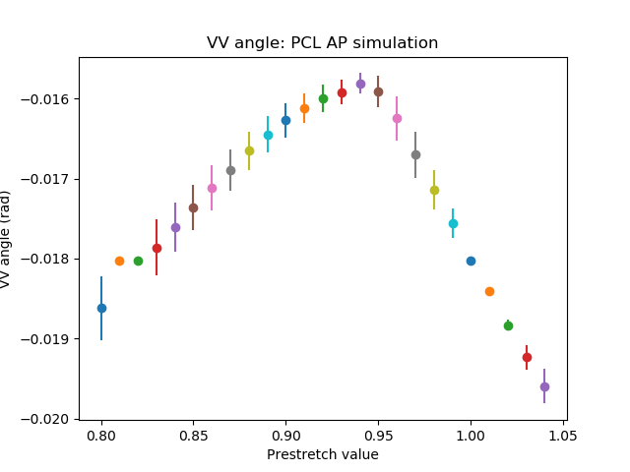
PCL – AP simulation

Slide 17
PCL - IE simulation

Slide 18
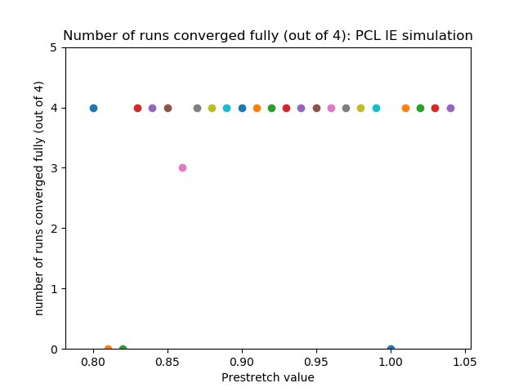
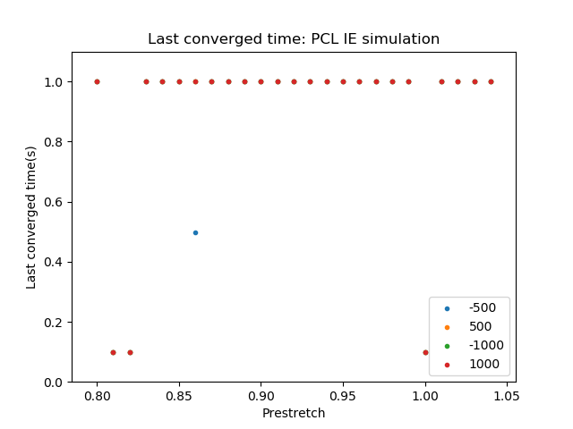
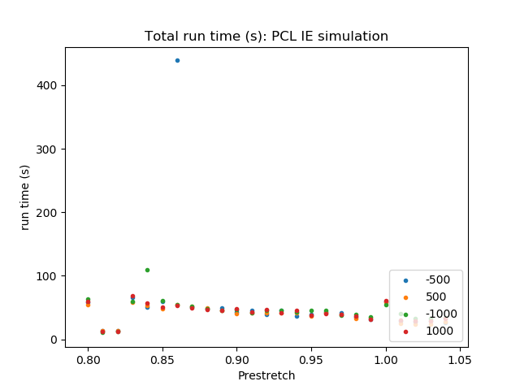
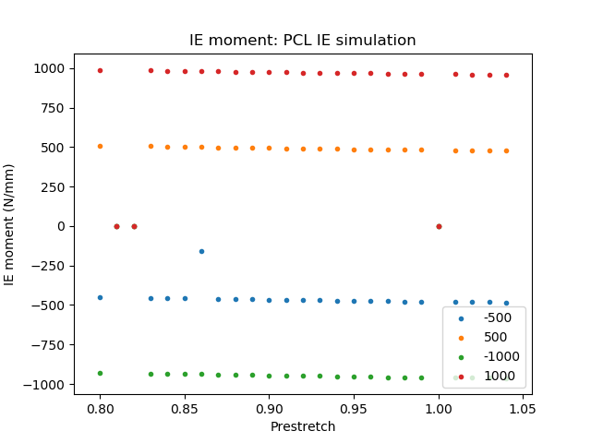
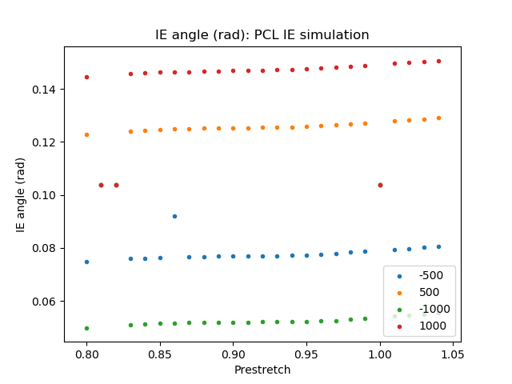
PCL – IE simulation

Slide 19
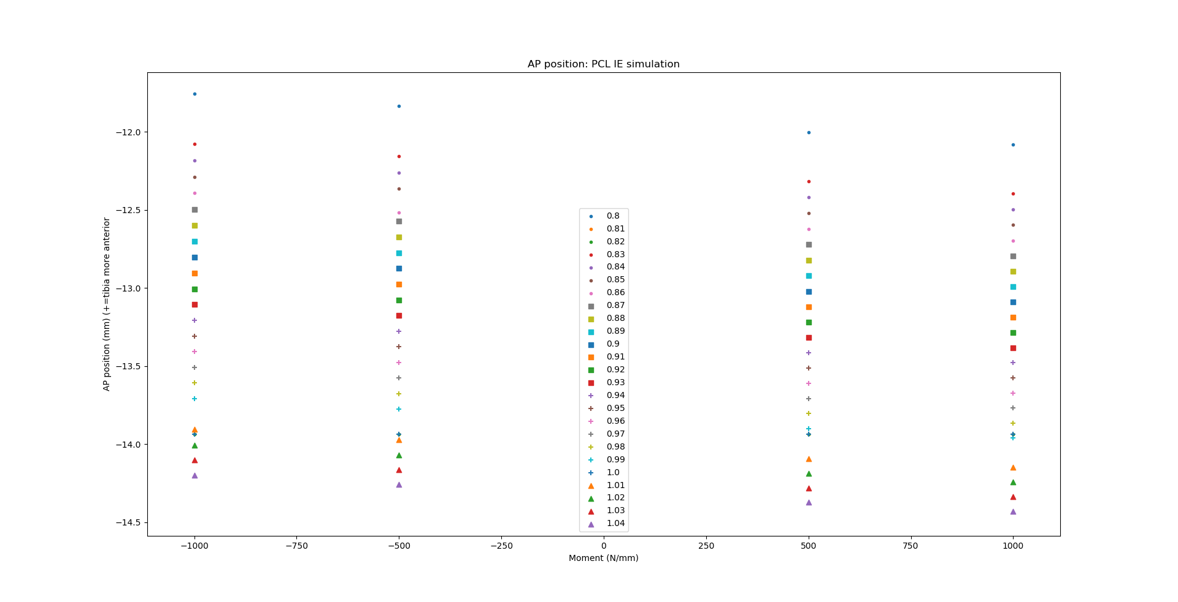
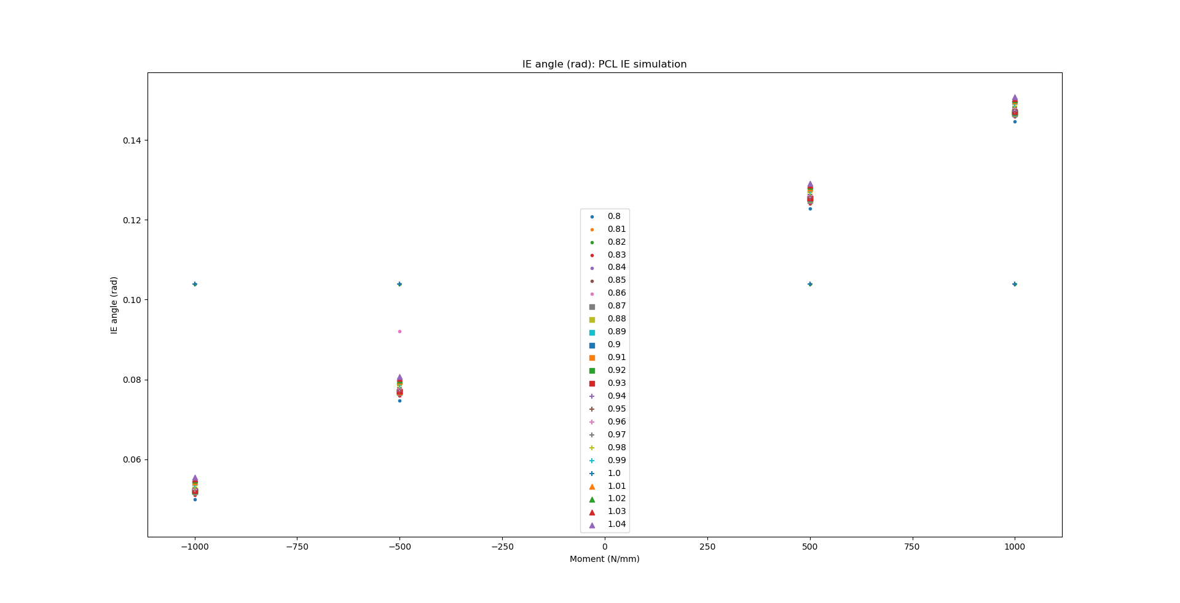
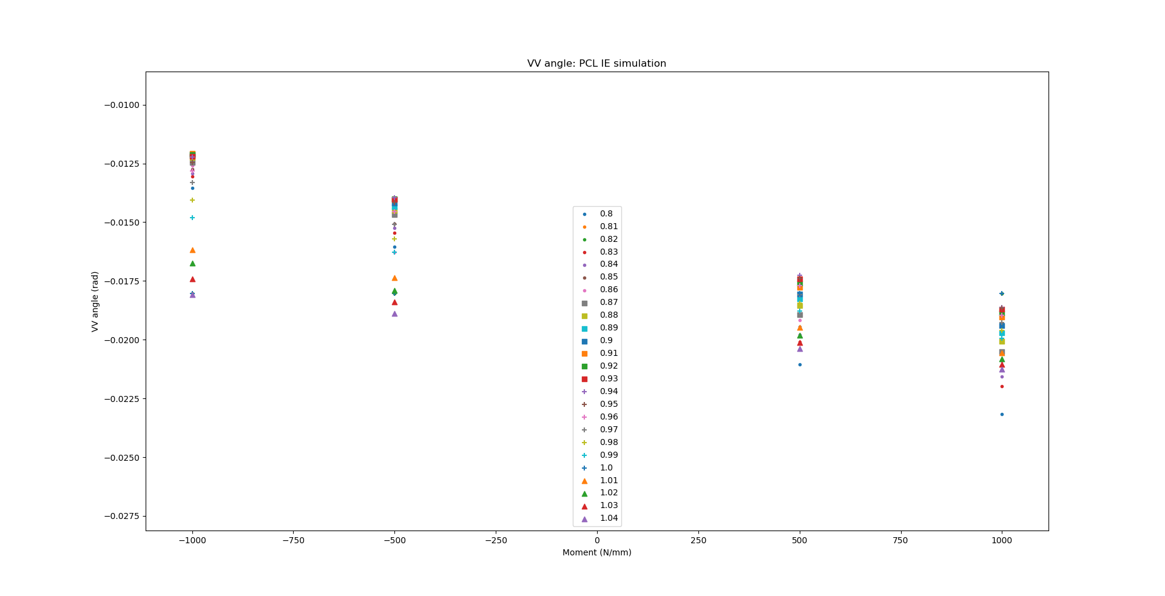
PCL – IE simulation

Slide 20



PCL – IE simulation

Slide 21



PCL – IE simulation

Slide 22
MCL - VV simulation

Slide 23





MCL - VV simulation

Slide 24



MCL - VV simulation

Slide 25



MCL - VV simulation

Slide 26



MCL - VV simulation

Slide 27
MCL – IE simulation

Slide 28





MCL - IE simulation

Slide 29



MCL - IE simulation

Slide 30



MCL - IE simulation

Slide 31



MCL - IE simulation

Slide 32
LCL – VV simulation

Slide 33





LCL - VV simulation

Slide 34



LCL - VV simulation

Slide 35



LCL - VV simulation

Slide 36



LCL - VV simulation

Slide 37
LCL – IE simulation

Slide 38





LCL - IE simulation

Slide 39



LCL - IE simulation

Slide 40



LCL - IE simulation

Slide 41



LCL - IE simulation

