Slide 1
Development and application of automatic force field parameterization methods for molecular simulation
Lee-Ping Wang
Stanford Department of Chemistry
QUADS Seminar, Imperial College, London
April 26, 2012

Slide 2
Outline
Introduction
  Physical chemistry and theoretical chemistry
  The many faces of molecular dynamics simulation
Systematic optimization of force fields for molecular mechanics
  Theory: Objective function, configurational sampling
  Application: Polarizable force field for liquid water
Current challenges related to optimization
  Stochastic approximation for noisy objective function
  Dimensional analysis and regularization
  Robust optimization

Slide 3
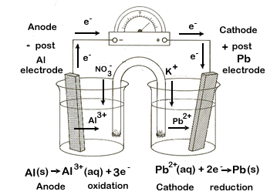

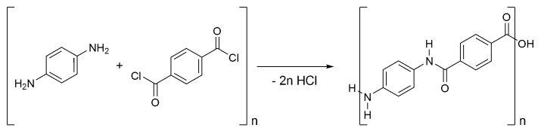
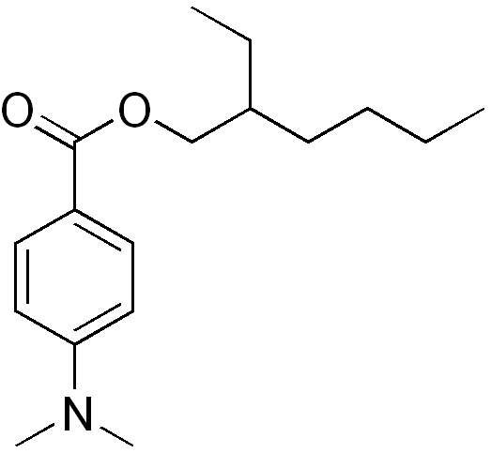

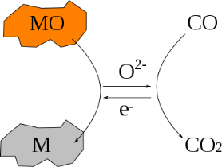
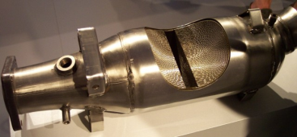
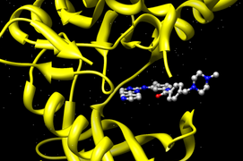
Introduction: Physical Chemistry
Physics helps us to understand chemical processes.
Chemical bonding and reactivity
Molecular interactions with:
Electric potentials (electrochemistry)
Synthesis of new chemical compounds
Basic diagram of
battery operation
Light (photochemistry)
Bulletproof fabric “Kevlar”
OD-PABA,
found in sunscreen
Accelerating chemical reactions via catalysis
Other molecules (noncovalent interactions)
Anticancer drug
“Gleevec” docking
into tyrosine kinase
Catalytic converter

Slide 4
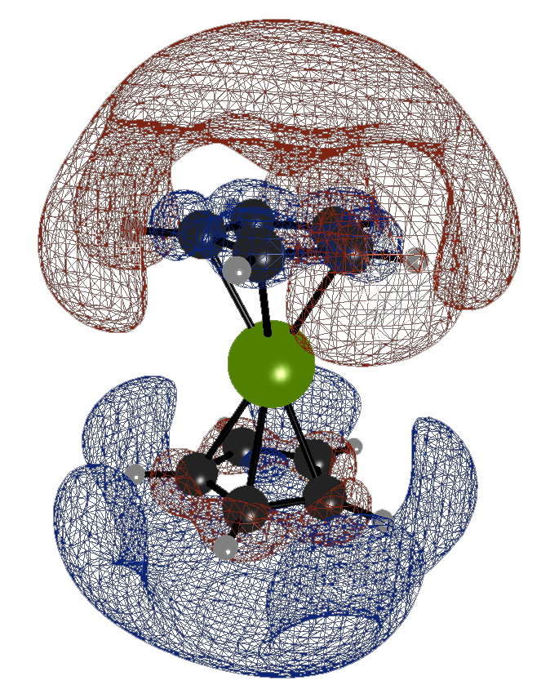
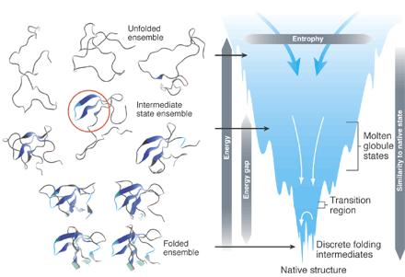
Introduction: Physical Theories
The main tools of physical chemistry are
quantum mechanics and statistical mechanics.
Quantum Mechanics
Statistical Mechanics

Slide 5
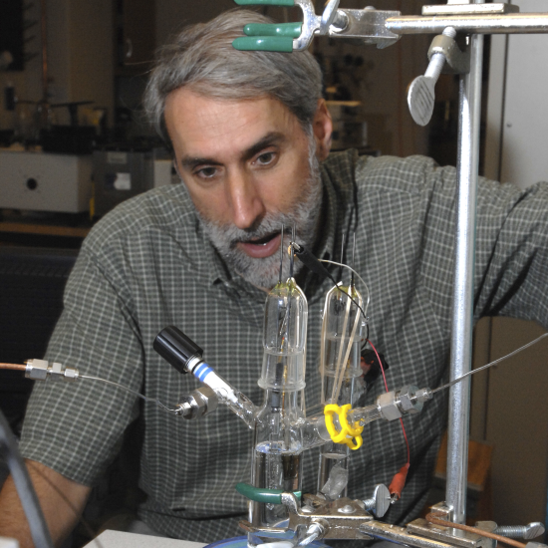
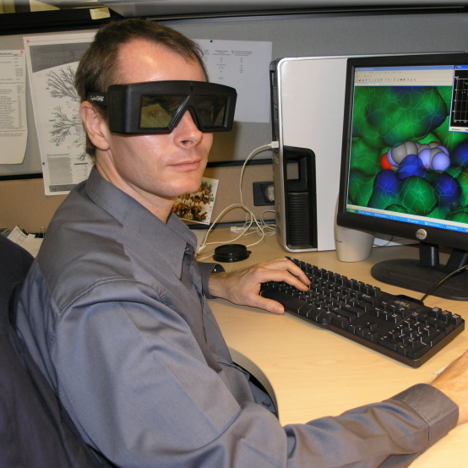
Introduction: Theory and Experiment
Theoretical and computational chemistry can offer explanations and predictions.
Insight into
atomic scale processes
Predictions of
experimental results
Experiment
Theory and Computation
Experimental – Theoretical Collaboration
Observations
needing explanation
Verification of
approximations

Slide 6
The Schrödinger equation
All of quantum chemistry is based on the
time-independent Schrödinger’s equation.
Kinetic energy
operator
Electron
nuclear
attraction
Electron
electron
repulsion
Electron wavefunction
Electronic
energy
Born-Oppenheimer approximation: when solving for the electronic wavefunction, treat nuclei as static external potentials

Slide 7
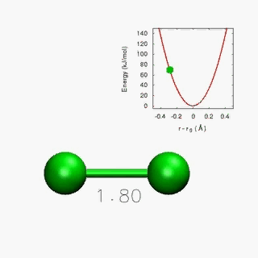
Approximate solutions to Schrödinger equation
Schrödinger’s equation is nearly impossible to solve, so approximate methods are used.
Electron repulsion makes this problem difficult
Approach 1: Use approximate wavefunction forms (Quantum chem.)
Approach 2: Use the electron density as the main variable
Approach 3: Approximate the energy using empirical functions
Slater determinant: Use wavefunction of noninteracting electrons for interacting system
Density functional theory: The ground-state electron density contains all information in the ground-state wavefunction
Molecular mechanics: Use empirical functions and parameters to describe the energy (e.g. harmonic oscillator for chemical bond)

Slide 8
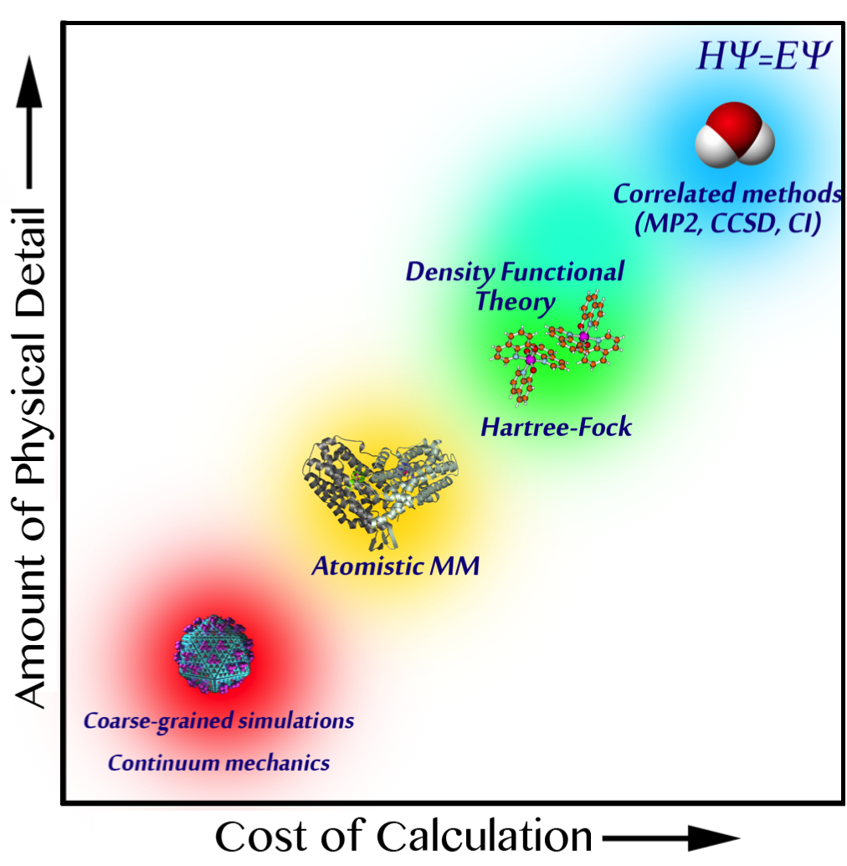

An overview of simulation methods
One calculation for 2-3 atoms
Less detailed theories allow for simulation of larger systems / longer timescales
Detailed theories can describe more complex phenomena and offer higher accuracy
100 fs, 10 atoms: photochemistry
10 ps, 100 atoms: fast chemical reactions
10 μs, 10k atoms: protein dynamics,
drug binding
1 ms+, 1 million atoms: folding of large proteins, virus capsids
Voelz, Bowman, Beauchamp and Pande,
J. Am. Chem. Soc., 2010

Slide 9
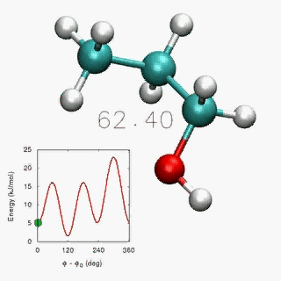
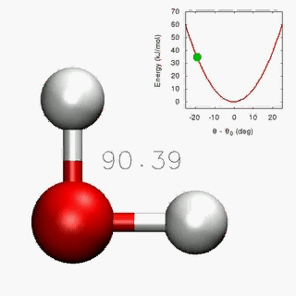
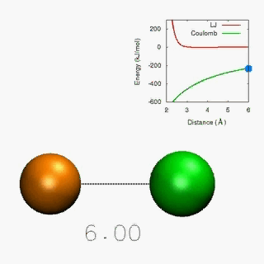
Introduction: Force Fields
Force fields are built from functional forms and empirical parameters
Interactions include bonded pairwise, 3-body, and 4-body interactions…
… as well as non-bonded pairwise interactions
Simulation accuracy depends critically on choice of parameters

Slide 10
Outline
Introduction
  Physical chemistry and theoretical chemistry
  The many faces of molecular dynamics simulation
Systematic optimization of force fields for molecular mechanics
  Theory: Objective function, configurational sampling
  Application: Polarizable force field for liquid water
Current challenges related to optimization
  Stochastic approximation for noisy objective function
  Dimensional analysis and regularization
  Robust optimization

Slide 11
Key Assumptions of Force Fields
Using a force field is equivalent to assuming accurate prior knowledge of the true potential energy surface.
Trends and Issues in force field development and usage:
Parameters fitted to experimental or high-level calculations
Large parameter libraries (e.g. CHARMM, AMBER) are used for many systems without further modification
  Transferring parameters outside traditional domain of applicability can lead to errors
  Force field errors are extremely hard to troubleshoot
  Few parameter sets are available for nonbiological systems

Slide 12
Matching Energies and Forces
Accurate force fields can be obtained by carefully fitting to an accurate ab initio potential surface.
Matching forces and energies to ab initio calculations:
Geometries obtained from sampling the configuration space
Optimize parameters by minimizing objective function χ²
Good atomistic forces should yield good bulk properties
Highly automatic and systematic (in principle)
First introduced in 1994, but not widely used
Ercolessi F., and Adams JB. Europhys. Lett. 1994, 26, 583-588.
Izvekov S., and Voth GA. J. Chem. Phys. 2004, 120, 10896.

Slide 13
Self-Consistent Parameterization
Initial
Parameters:
Start Here
Run MM dynamics for sampling
Extract
Snapshots
{r_{s}}
Converged?
Optimized
Parameters
QM Calculations on Snapshots
ts
Update Parameters k
Reference Data Q(r_{s})
Compute MM data M(r_{s})
New
Parameters
k_{n+1}
Compute χ² and Derivatives
Minimize χ²

Slide 14
Optimization of χ²
The objective function χ² is made from MM quantities M minus reference values Q
Newton-Raphson minimization requires analytic derivatives in parameter space
First and second derivatives of MM energy and force added to custom GROMACS for many interaction types

Slide 15
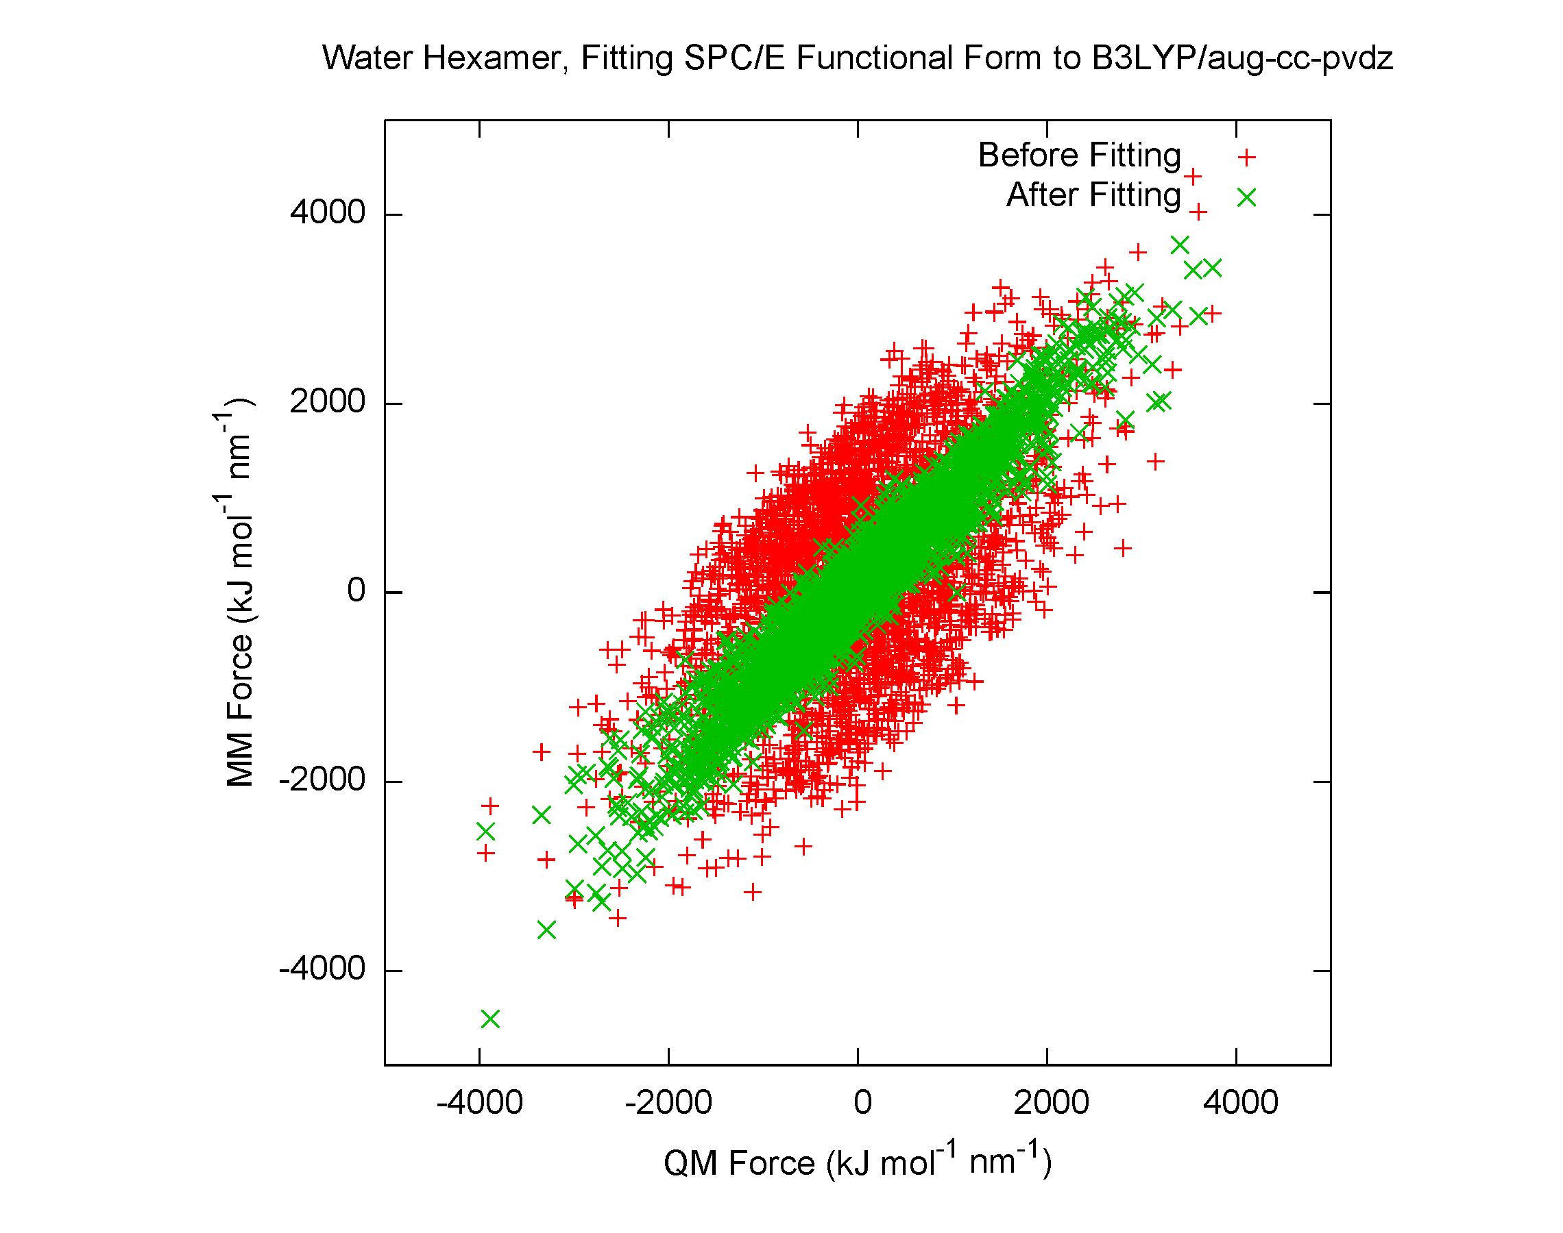
How to Use the Code
Force field parameters are defined in the parameter file (.itp)
Tagging the .itp file triggers computation of derivatives
Python script modifies parameters, calls GROMACS for derivatives, and determines optimization steps using Newton-Raphson
Next-generation force field gives improved fit; used to rerun dynamics
[ van_der_waals ]
H 0.00000e+00 0.00000e+00
O 3.16557e-01 6.50194e-01 ; PARM 4 5
[ bonds ]
H O 0.100000 3.450000e+05 ; PARM 3 4
[ angles ]
H O H 109.470000 383.000000 ; PARM 4 5
[ charges ]
O1 -0.8476 15.9950 ; PARM 1
H2 0.4238 1.0080 ; PARM 1
H3 0.4238 1.0080 ; RPT 1 COULH2 /RPT
--- WELCOME TO ForceBalance! --- =D
Starting Point: Energy Error(kJ) = 44.35910 Force Error = 63.5% Objective = 7.7199e-01
Computing optimal FF parameters using trust-radius Newton Raphson algorithm
Step# Variance(X2) Step Size Direction Max. FErr EErr(kJ) FErr(%) Obj.Func
0 0.00e+00 1.14e-02 V.SH O1 73.77% 32.42 28.02 7.2644e-01
1 1.01e-01 2.71e-02 B.KHO H2 32.37% 11.53 26.60 5.2409e-01
2 1.07e-01 1.00e-01 B.KHO O1 23.16% 6.40 12.19 4.7994e-01
3 1.06e-01 2.00e-01 B.KHO O1 24.52% 8.54 15.08 4.5832e-01
4 1.02e-01 2.86e-01 B.KHO O1 27.43% 8.80 21.23 4.5389e-01
5 9.90e-02 7.09e-02 B.KHO O1 28.66% 8.50 18.15 4.3843e-01

Slide 16
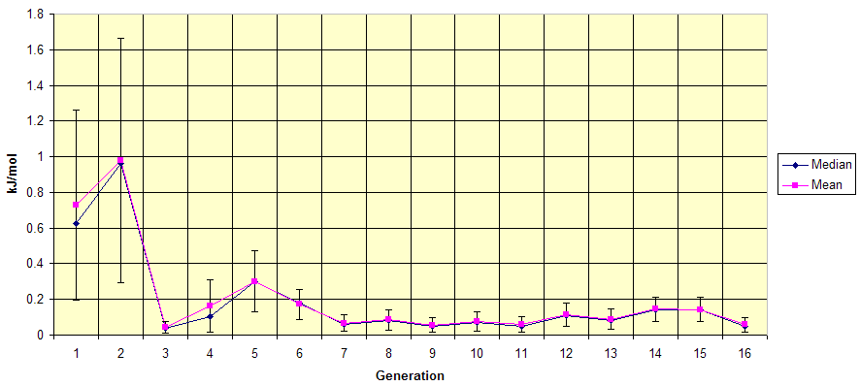
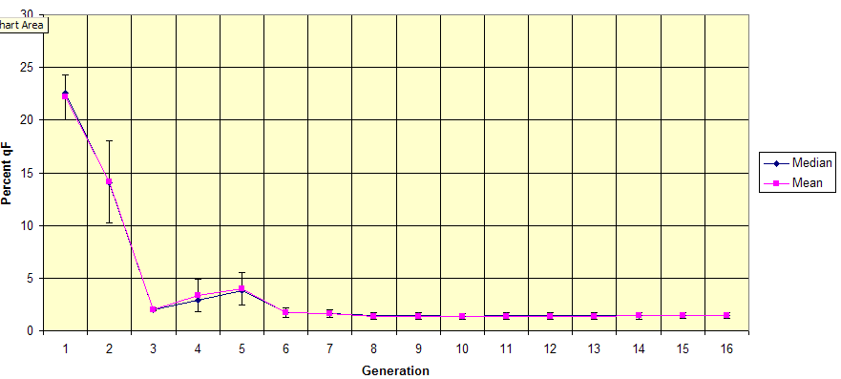
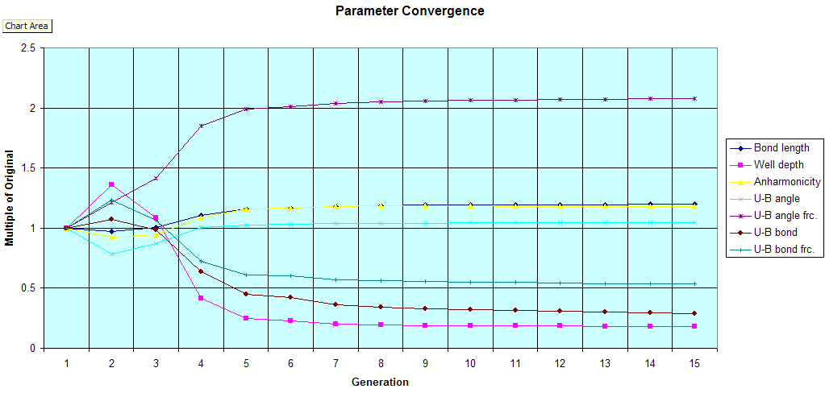
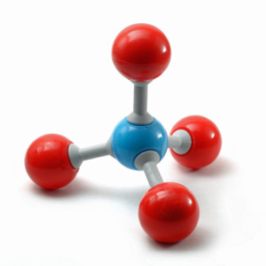
Conceptual Example
Energy Error
Force Error
Parameter Convergence
Sixteen cycles of force matching on methane monomer
Seven parameters in FF:
Morse bonds, Urey-Bradley angles
Very low energy and force errors
(ΔE < 0.1 kJ mol⁻¹, ΔF < 2%)
Parameters converged

Slide 17

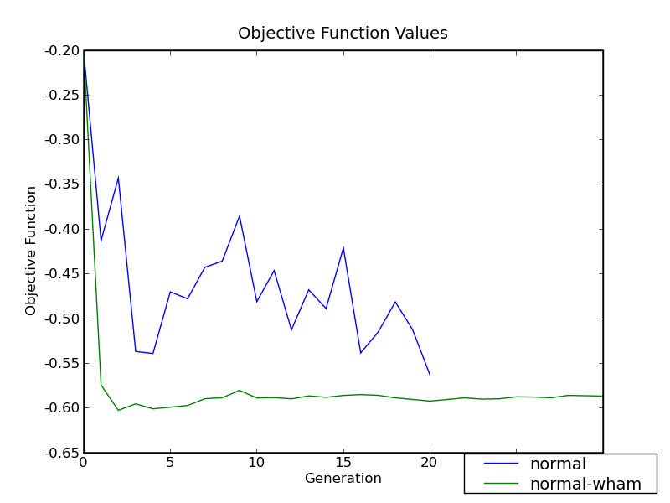
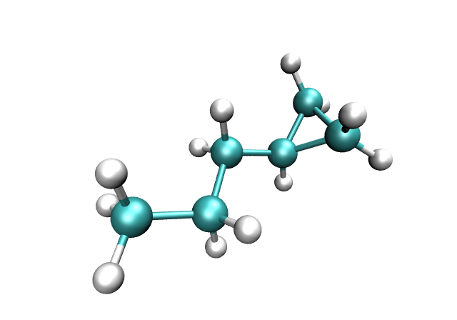
Improving Convergence with WHAM
Each generation of the force field requires a new set of geometries and reference calculations
Weighted Histogram Analysis Method (WHAM) allows us to use reference calculation from previous force field generations
With history information included, fluctuations in χ² are suppressed

Slide 18
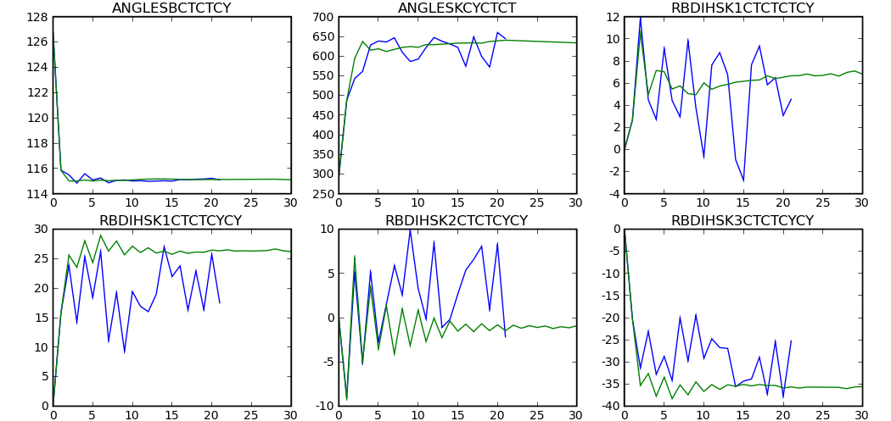
Improving Convergence with WHAM
Above: WHAM (green) suppresses parameter fluctuations (blue) in force field for molecule on right
Collaboration with A. K. Croft and W. Groenewald

Slide 19
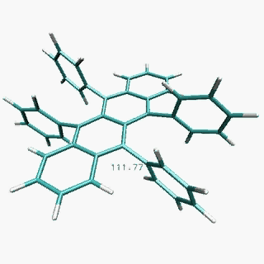
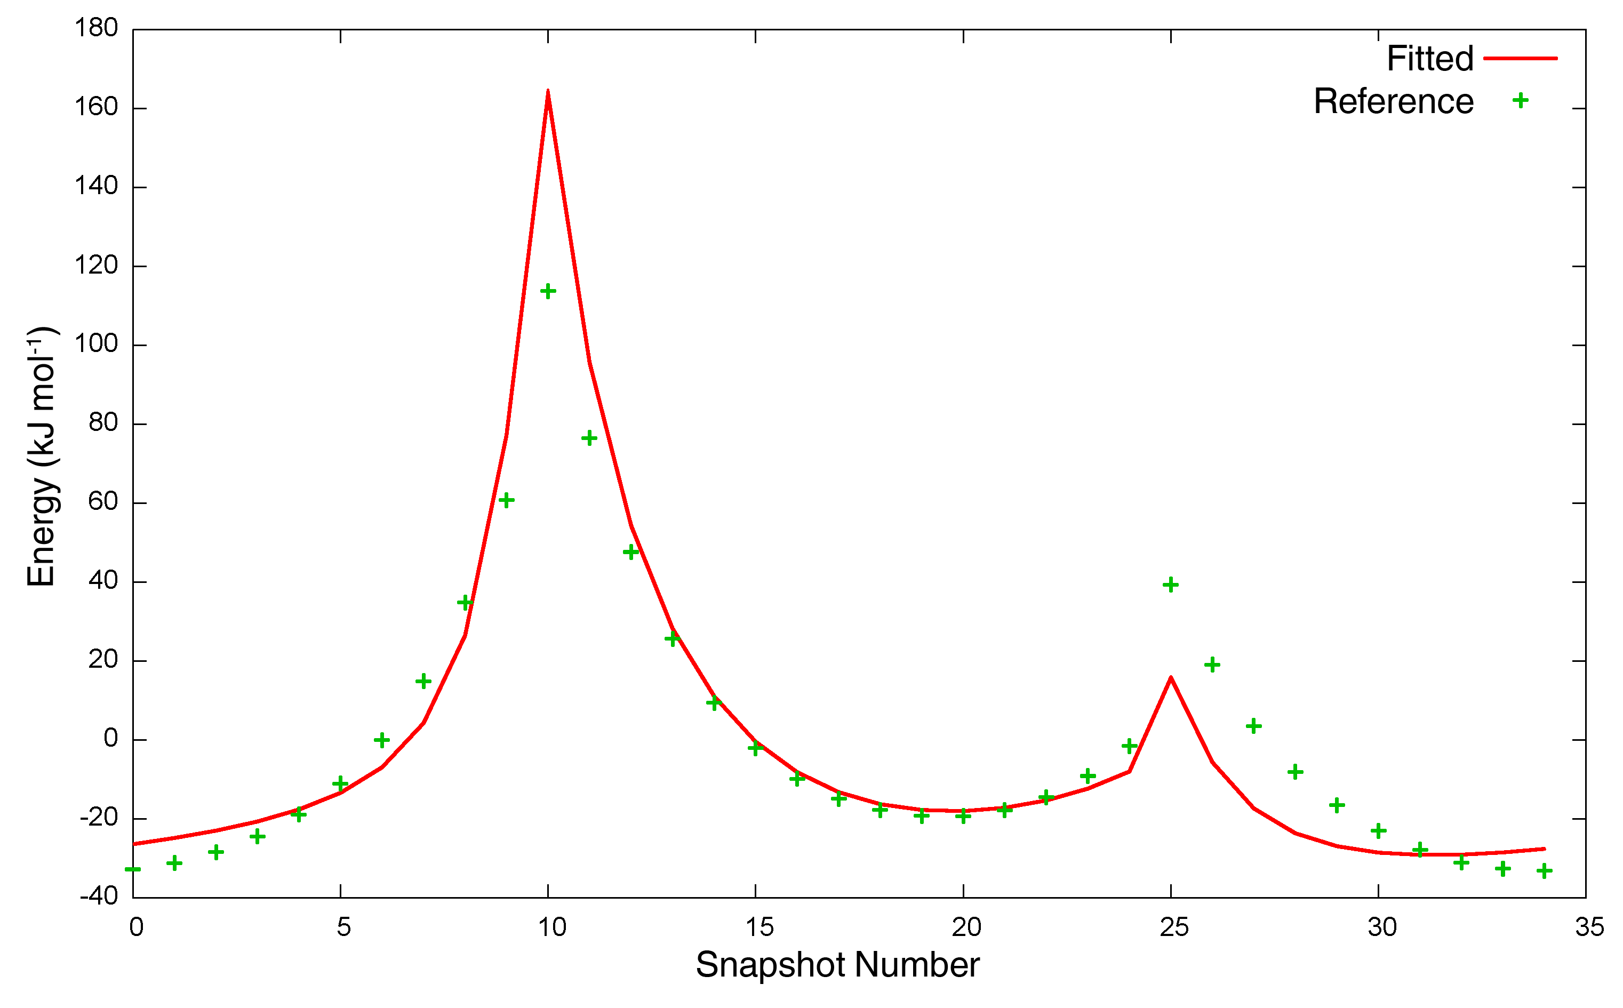
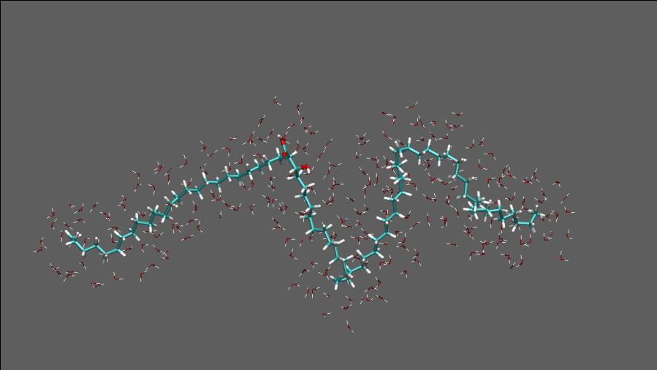
Applications: Patching MM simulations
Existing parameter libraries can be incomplete (e.g. OPLS-AA missing dihedral parameter in rubrene, an organic semiconductor material)
Dihedral angle manually parameterized; force field reproduces crystal structure
Propyl cyclopropane parameters used for mycolic acid with kinks from cyclopropane rings

Slide 20
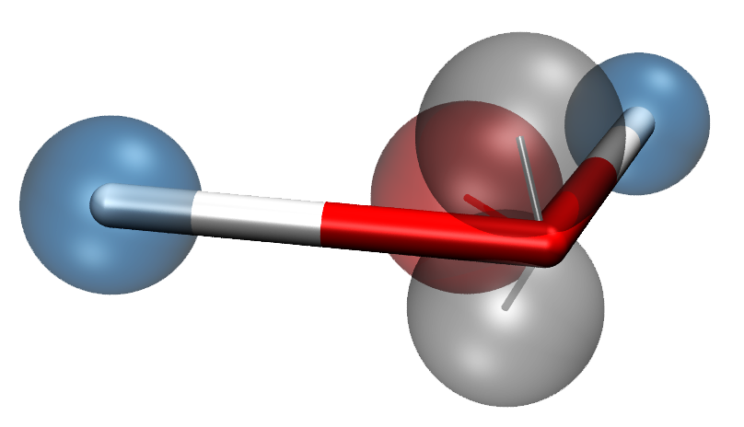
Six-site polarizable water model
Five fluctuating-charge sites
28 adjustable parameters
(3 bonded, 4 angle, 9 electrostatic,
9 VdW, 3 virtual-site positions)
Configurations from running MD on small clusters (6, 9, 12, 15)
QM method: MP2, aug-cc-pVTZ
L. P. Wang, J. Chen and T. Van Voorhis, submitted.

Slide 21
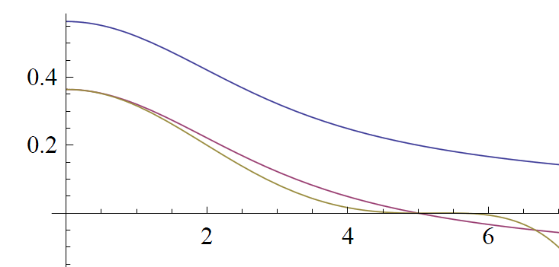
Polarization via fluctuating charge
QTPIE (Chen and Martinez, CPL 2007) is a fluctuating-charge force field
At each time step, charges determined by solving a system of N linear equations
QTPIE (and other fluctuating charge models) implemented into custom GROMACS 4.0
Periodic boundary conditions using smooth cutoffs
J_{ij}(R_{ij})
Blue: Full damped Coulomb interaction
Purple: Cutoff at R=5 by constant shift
Gold: Smoothed-force cutoff at R=5
R_{ij}

Slide 22
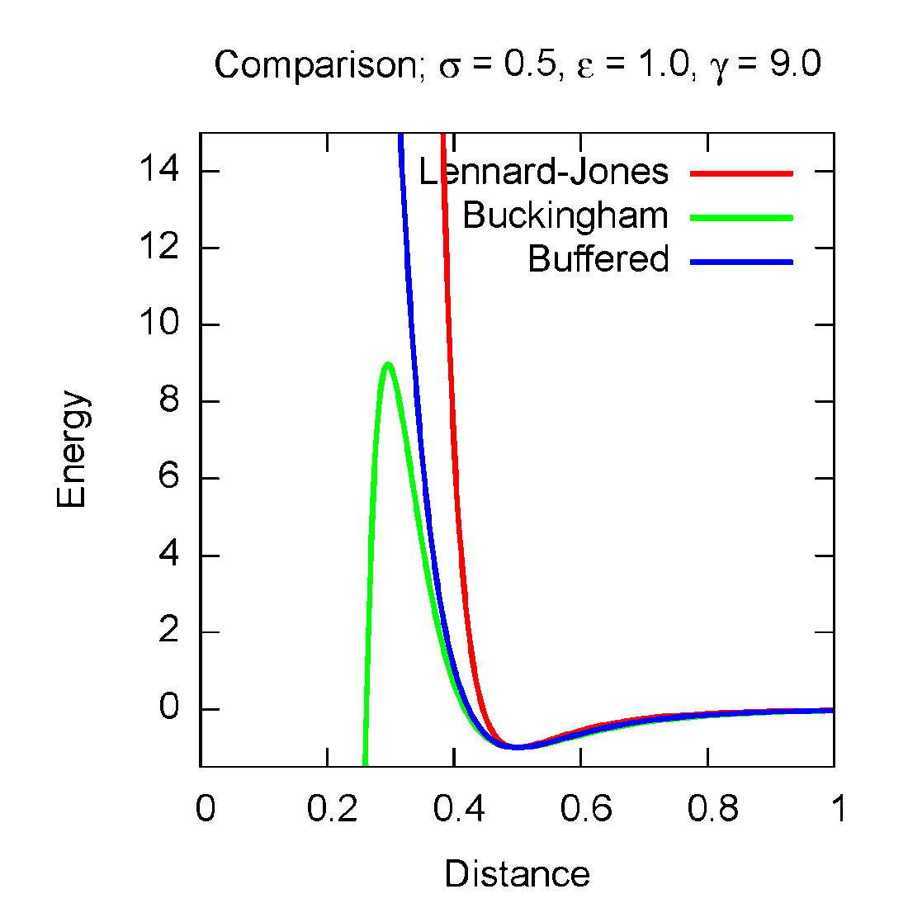
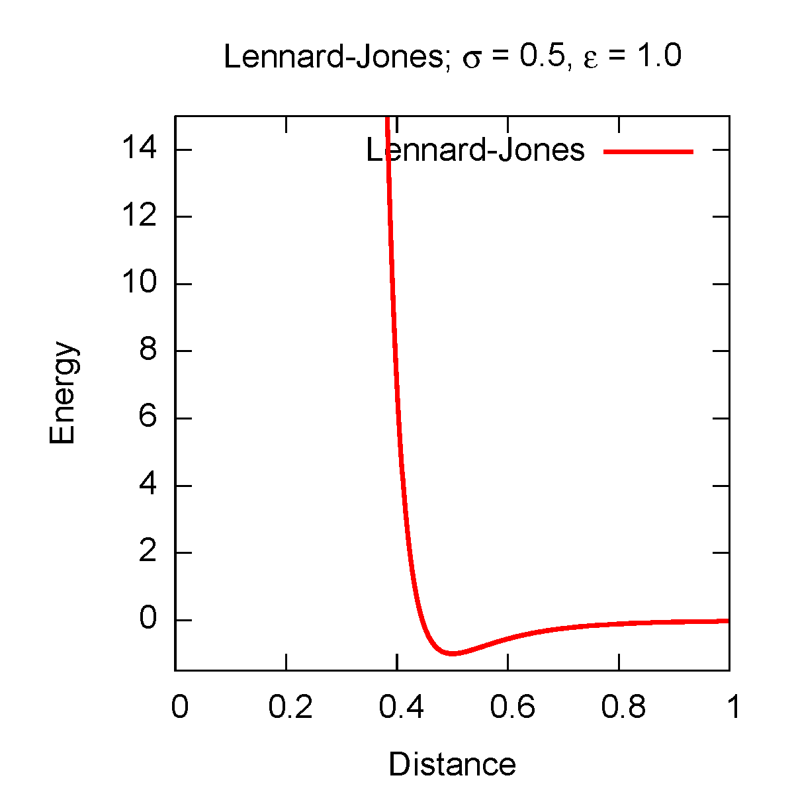
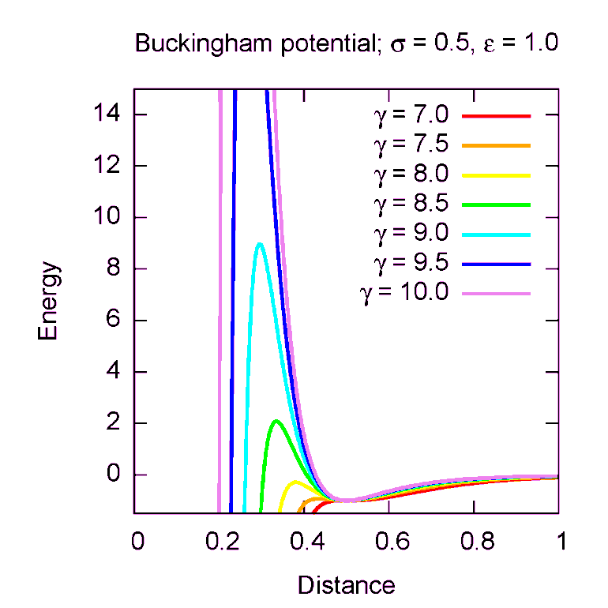
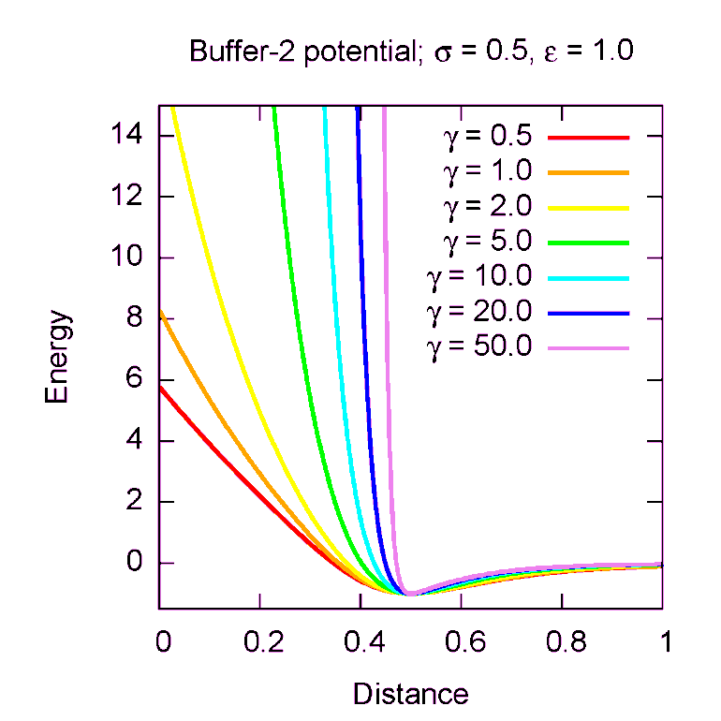
Buffered van der Waals potential
The widely used Lennard-Jones (12-6) interaction is too sharply repulsive
Buckingham potential (exp-6) provides a more physical repulsion
Potential is problematic due to singularity at r=0
No singularity
Same # of parameters
Tunable repulsion

Slide 23
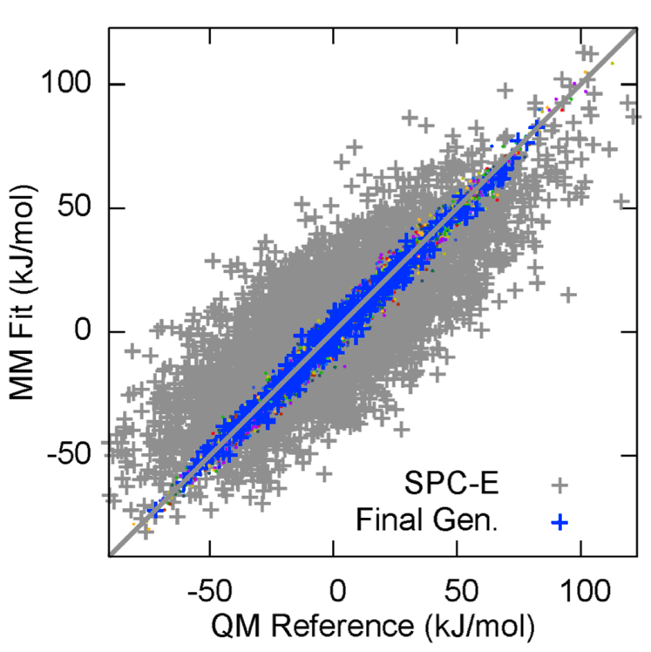
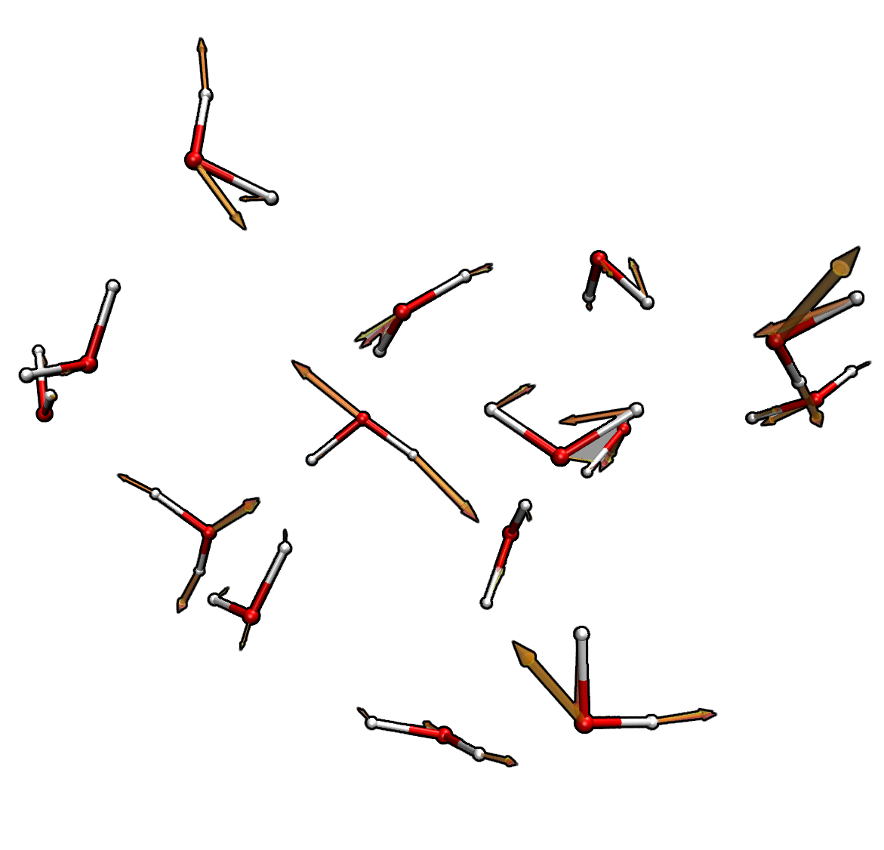
Results: Atomistic energies and forces
17 total cycles of self-consistent energy and force matching (>5,000 RI-MP2 force calcs.)
Include water molecule multipole moments, dipole polarizability in objective function
Energies of water clusters matched to within 1 kcal/mol
Atomistic forces are correct to within 10%
Visually, forces from MM and QM are nearly identical

Slide 24
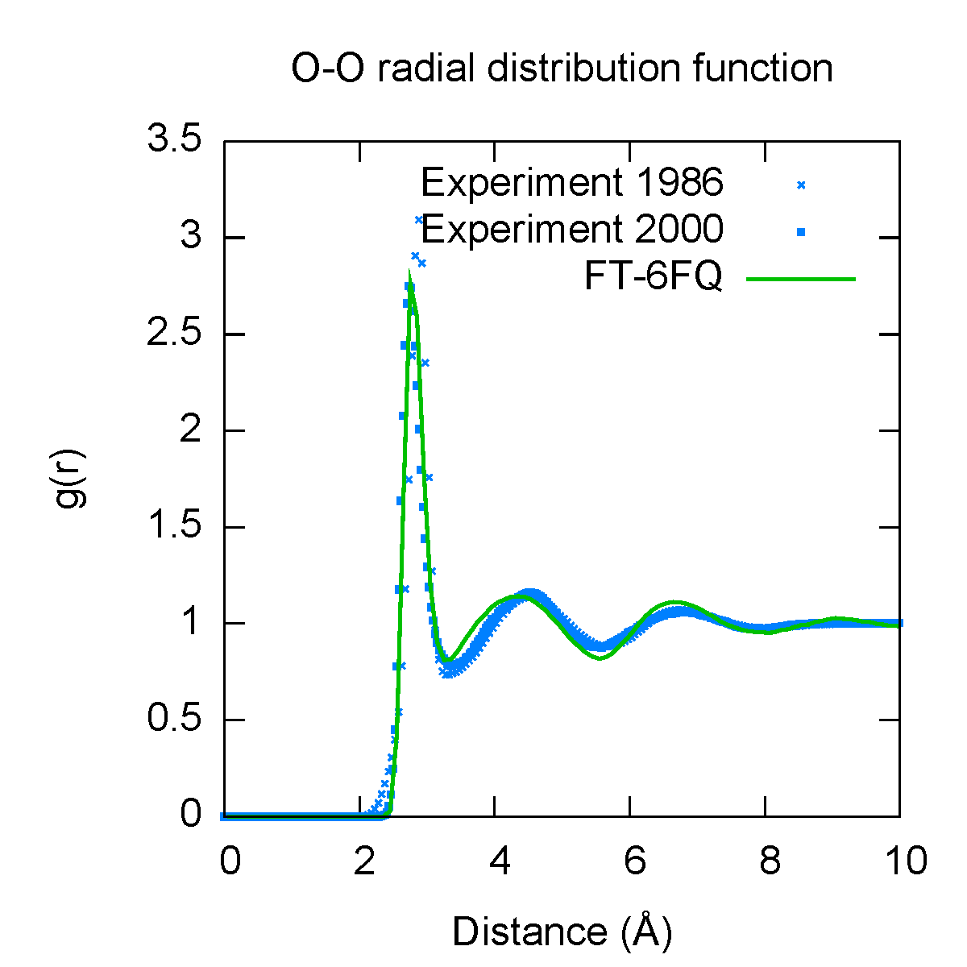
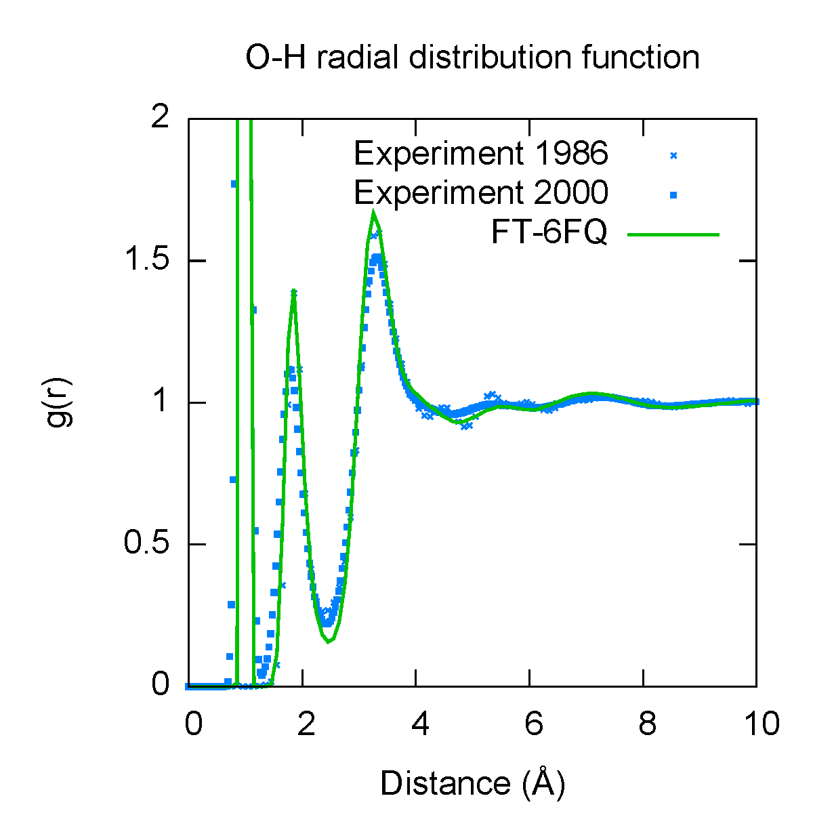
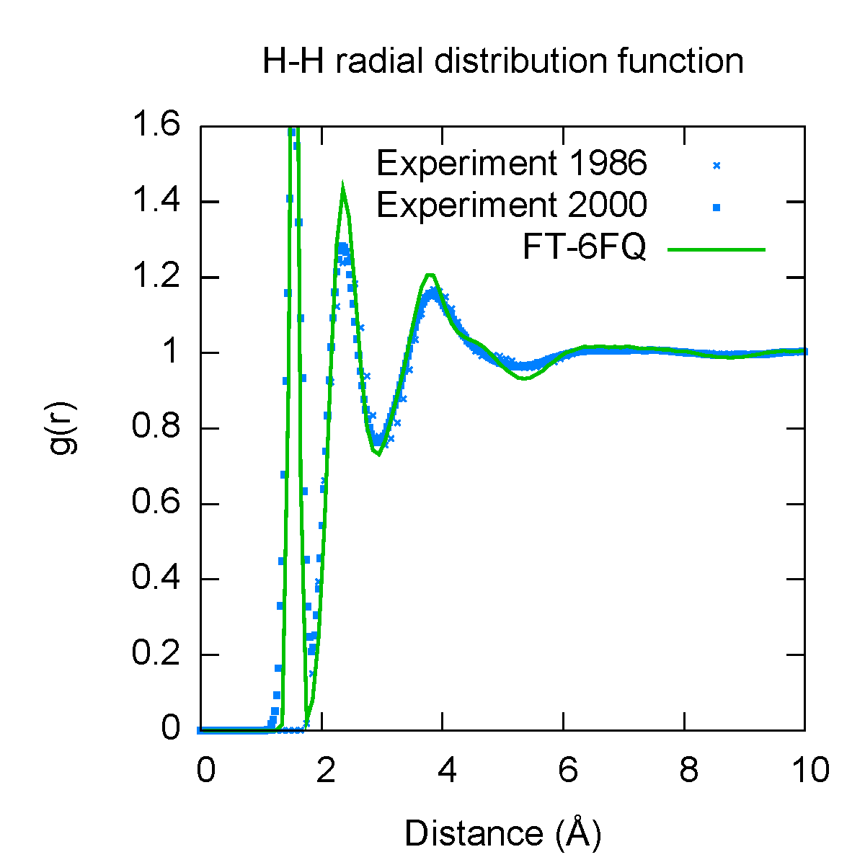
Results: Bulk properties
Property | Calculated | Experiment
Density (kg m⁻³) | 1040 ± 10 | 1000
Dielectric constant | 85 | 78.4
Diffusion constant (10⁻⁵ cm² s-1) | 1.5 | 2.3
Density maximum (ºC) | <6ºC | 4ºC
Solution phase dipole moment (D) | 2.6 | 2.3 – 2.9
Bulk properties were computed to validate force field; not fitted
Calculated radial distribution function (green) agrees with experiment (blue)
Basically accurate density and dielectric constant, diffusion constant underestimated by ~40%

Slide 25
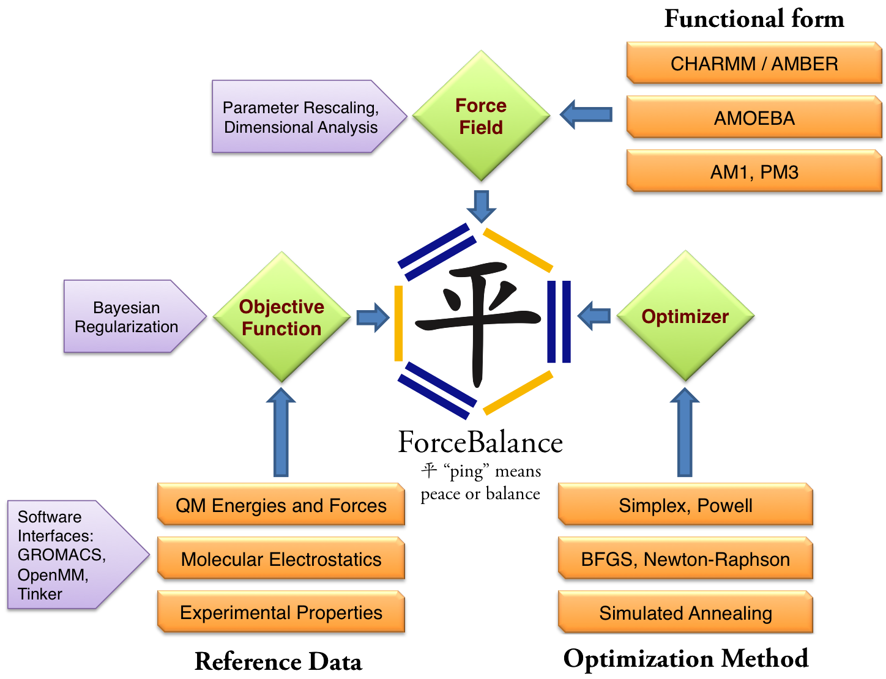
Recent progress: Major rewriting of code
Framework supports fitting of diverse reference data
Source code and installer freely available on the Web

Slide 26
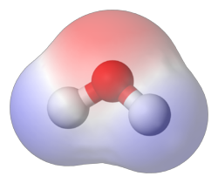
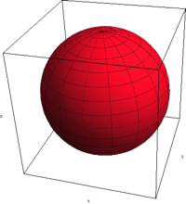
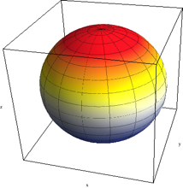
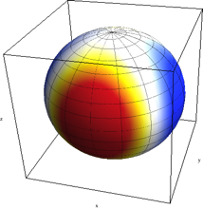
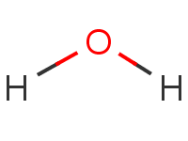
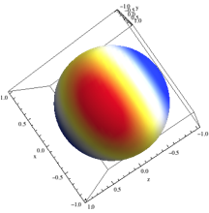
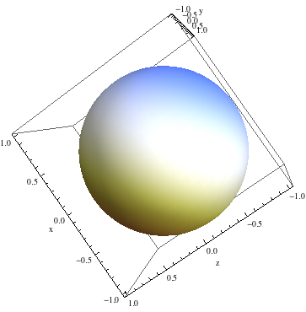
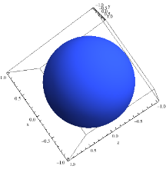
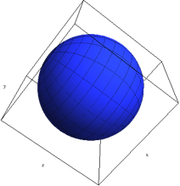
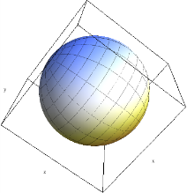
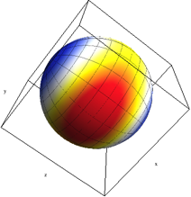
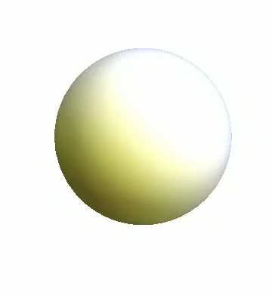
Refitting and improving the AMOEBA force field
We plan to reparameterize the AMOEBA force field. (Collaboration with Teresa Head-Gordon)
Old AMOEBA force field:
Point charge, dipole, and quadrupole on each atom
Polarizable point dipole on each atom with short-range damping
New iAMOEBA force field:
Determine polarizable dipoles from fixed multiples directly (no SCF)

Slide 27
Outline
Introduction
  Physical chemistry and theoretical chemistry
  The many faces of molecular dynamics simulation
Systematic optimization of force fields for molecular mechanics
  Theory: Objective function, configurational sampling
  Application: Polarizable force field for liquid water
Current challenges related to optimization
  Stochastic approximation for noisy objective function
  Dimensional analysis and regularization
  Robust optimization

Slide 28


Challenge: Fitting experimental measurements
We want the force field to reproduce known experimental measurements
Unfortunately, fitting energies and forces doesn’t give correct densities
Goal: Include liquid properties (e.g. density) in objective function
Simulating the liquid density: The size of the periodic simulation cell fluctuates against an external pressure.

Slide 29

Challenge: Fitting experimental measurements
Density simulations are costly (1-2 hours on a high-end GPU processor)
Contributions to the objective function are noisy
Try using simultaneous perturbation stochastic approximation (SPSA)
Finite difference SA: Estimate each element of the objective function’s derivative using finite difference
Simultaneous perturbation SA: Use a single finite difference step to estimate all elements of the objective function’s derivative

Slide 30
Challenge: Dimensional analysis
[ atomtypes ]
H 1.0080 0.0000 A 0.00000e+00 0.00000e+00
O 5.9950 0.0000 A 3.16557e-01 6.50194e-01
[ bondtypes ]
H O 1 0.100000 3.450000e+05
[ angletypes ]
H O H 1 109.470000 383.000000
[ atoms ]
1 O 1 SOL O1 1 -0.8476 15.9950
2 H 1 SOL H2 2 0.4238 1.0080
3 H 1 SOL H3 3 0.4238 1.0080
Eigenvectors of Hessian
Different parameter types have very different sizes
Contour plot of χ² in “physical” parameter space →
Contour plot in “mathematical” parameter space →
Force field parameters have distinct physical units
and their size depends on the unit system.
We treat all force field parameters on the
same footing, so they must be rescaled.
In the rescaled space, we can examine
eigenvectors of the Hessian for linear
dependencies or apply regularization

Slide 31
Challenge: Dimensional analysis
Contour plot of penalty function →
To prevent overfitting we can regularize
our optimization with a Bayesian prior
(penalty function)
With regularization, the optimized result
depends on the choice of rescaling
Thus, choice of rescaling is equivalent to
choice of prior
Are there data-driven ways to find the
most appropriate rescaling?
Optimum

Slide 32


Challenge: Parameter robustness
The robustness of force field parameters is not well characterized
For example, protein force fields have mixed performance when different water force fields are used
Force field validation (above): Each square contains data from 524 simulations using a different protein + water force field (e.g. ff96 / GBSA). Blue indicates better agreement with experimental NMR data.
Illustration of simulating protein in water
(water molecules not shown for clarity)

Slide 33


Challenge: Parameter robustness
Robust optimization methods provide a means for obtaining parameters that are insensitive to perturbations and errors
The method requires a way to estimate the worst-case error
Can we use robust optimization methods to improve force field stability?
Below: Robust optimization algorithms compute the worst-case errors and step away from them.
Illustration of robust optimization; the ‘worst-case cost’ in the bottom figure is minimized, yielding the broad basin in the top figure. (from Bertsimas and Teo)

Slide 34
Conclusions
Force field development is a challenging and interesting application for optimization methods.
What we can do so far:
Flexibility in exploring parameters and functional forms
Accurate, self-consistent matching of QM energies and forces
Future directions:
Include experimental data in force field development
Enable optimization of noisy functions
Improved treatment of overfitting with Bayesian priors
Quantify and improve force field robustness

Slide 35




Acknowledgements
Troy Van Voorhis (MIT)
Vijay Pande (Stanford)
Todd Martinez (Stanford)
Teresa Head-Gordon (Berkeley)
Panos Parpas (Imperial College)
Lorna Smith (Edinburgh)
Simbios Postdoctoral Fellowship
Thank You!

