Slide 1
Development and Application of an Automatic Potential Optimization Method
Lee-Ping Wang
Stanfurd Department of Chemistry
April 13, 2012
UC Berkeley

Slide 2
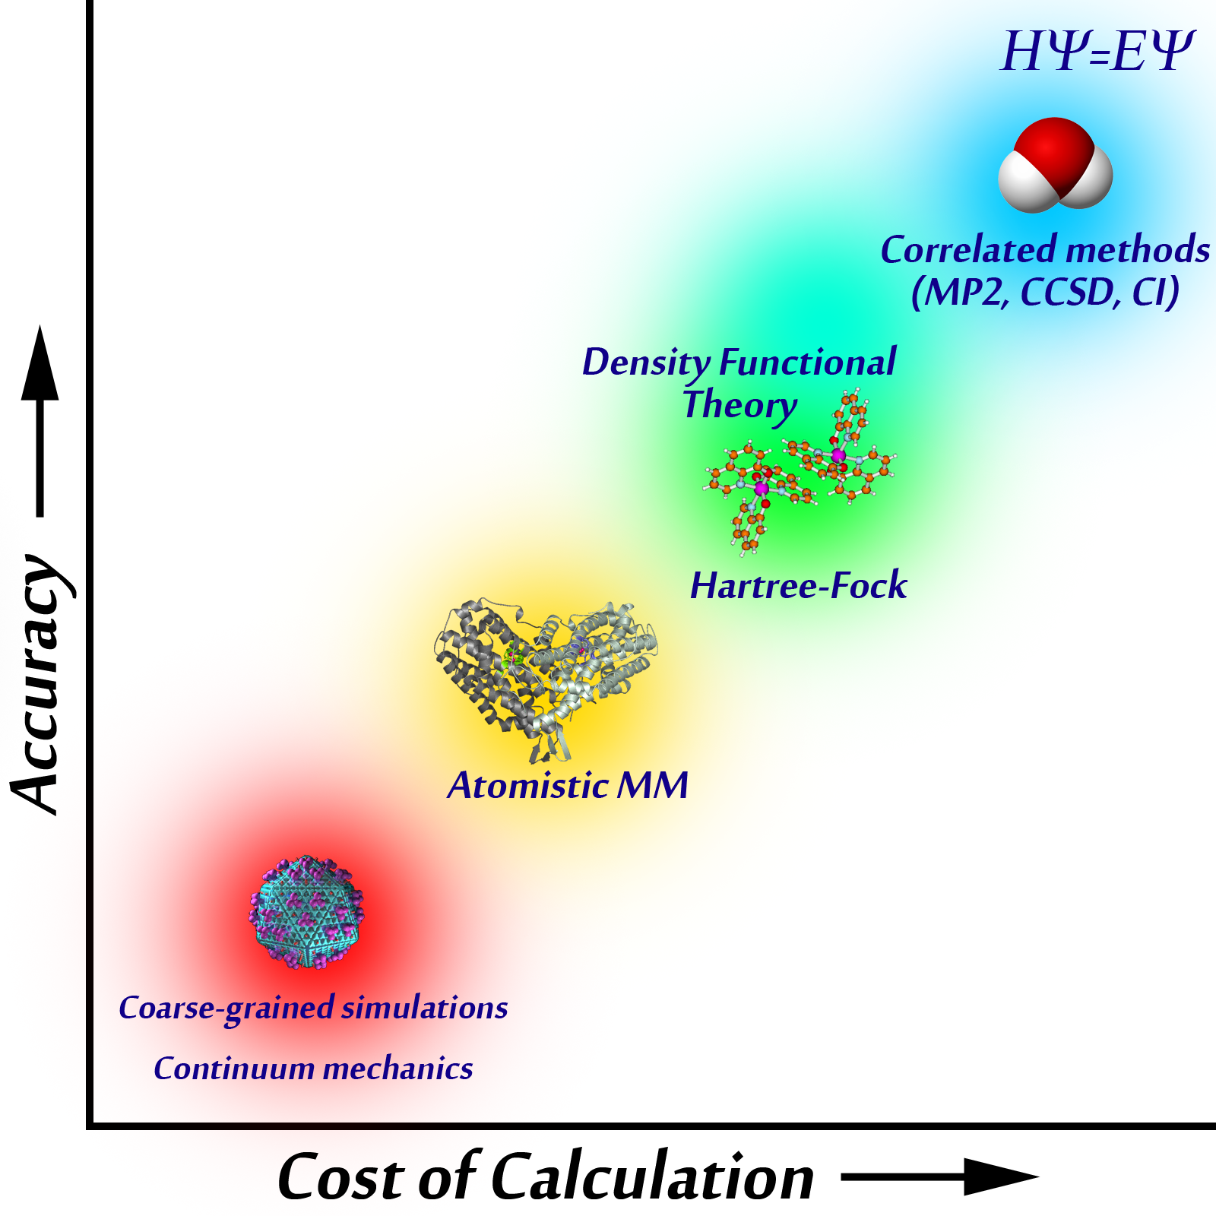
Introduction: Molecular Mechanics
Molecular Mechanics (MM) is a classical molecular simulation method
Within MM, the potential energy of atoms and molecules is described by the empirical force field

Slide 3
Introduction: Force Fields
Force fields are built from functional forms and empirical parameters
Interactions include bonded pairwise, 3-body, and 4-body interactions…
… as well as non-bonded pairwise interactions
Simulation accuracy depends critically on choice of parameters

Slide 4
Assumptions of Force Fields
Using a force field is equivalent to assuming accurate prior knowledge of the true potential energy surface.
Trends and Issues in force field development and usage:
Parameters fitted to experimental measurements or ab initio calculations (e.g. DFT, wavefunction methods)
Large parameter libraries (e.g. CHARMM, AMBER) are used for many systems without further modification
Transferring parameters outside traditional domain of applicability can lead to errors
Relatively few parameter sets are available for nonbiological systems

Slide 5
Matching Energies and Forces
Accurate force fields can be obtained by carefully fitting to an accurate ab initio potential surface.
Matching forces and energies to ab initio calculations:
Geometries obtained from sampling the configuration space
Optimize parameters by minimizing objective function χ²
Good atomistic forces should yield good bulk properties
Highly automatic and systematic (in principle)
First introduced in 1994, but not widely used
Ercolessi F., and Adams JB. Europhys. Lett. 1994, 26, 583-588.
Izvekov S., and Voth GA. J. Chem. Phys. 2004, 120, 10896.

Slide 6
Self-Consistent Parameterization
Initial Parameters: Start Here
Run MM dynamics for sampling
Extract
Snapshots
{r_{s}}
Converged?
Optimized Parameters
QM Calculations on Snapshots
ts
Update Parameters k
Reference Data Q(r_{s})
Compute MM data M(r_{s})
New Parameters k_{n+1}
Compute χ² and Derivatives
Minimize χ²

Slide 7
Optimization of χ²
The objective function χ² is made from MM quantities M minus reference values Q
Newton-Raphson minimization requires analytic derivatives in parameter space
First and second derivatives of MM energy and force added to custom GROMACS for many interaction types

Slide 8
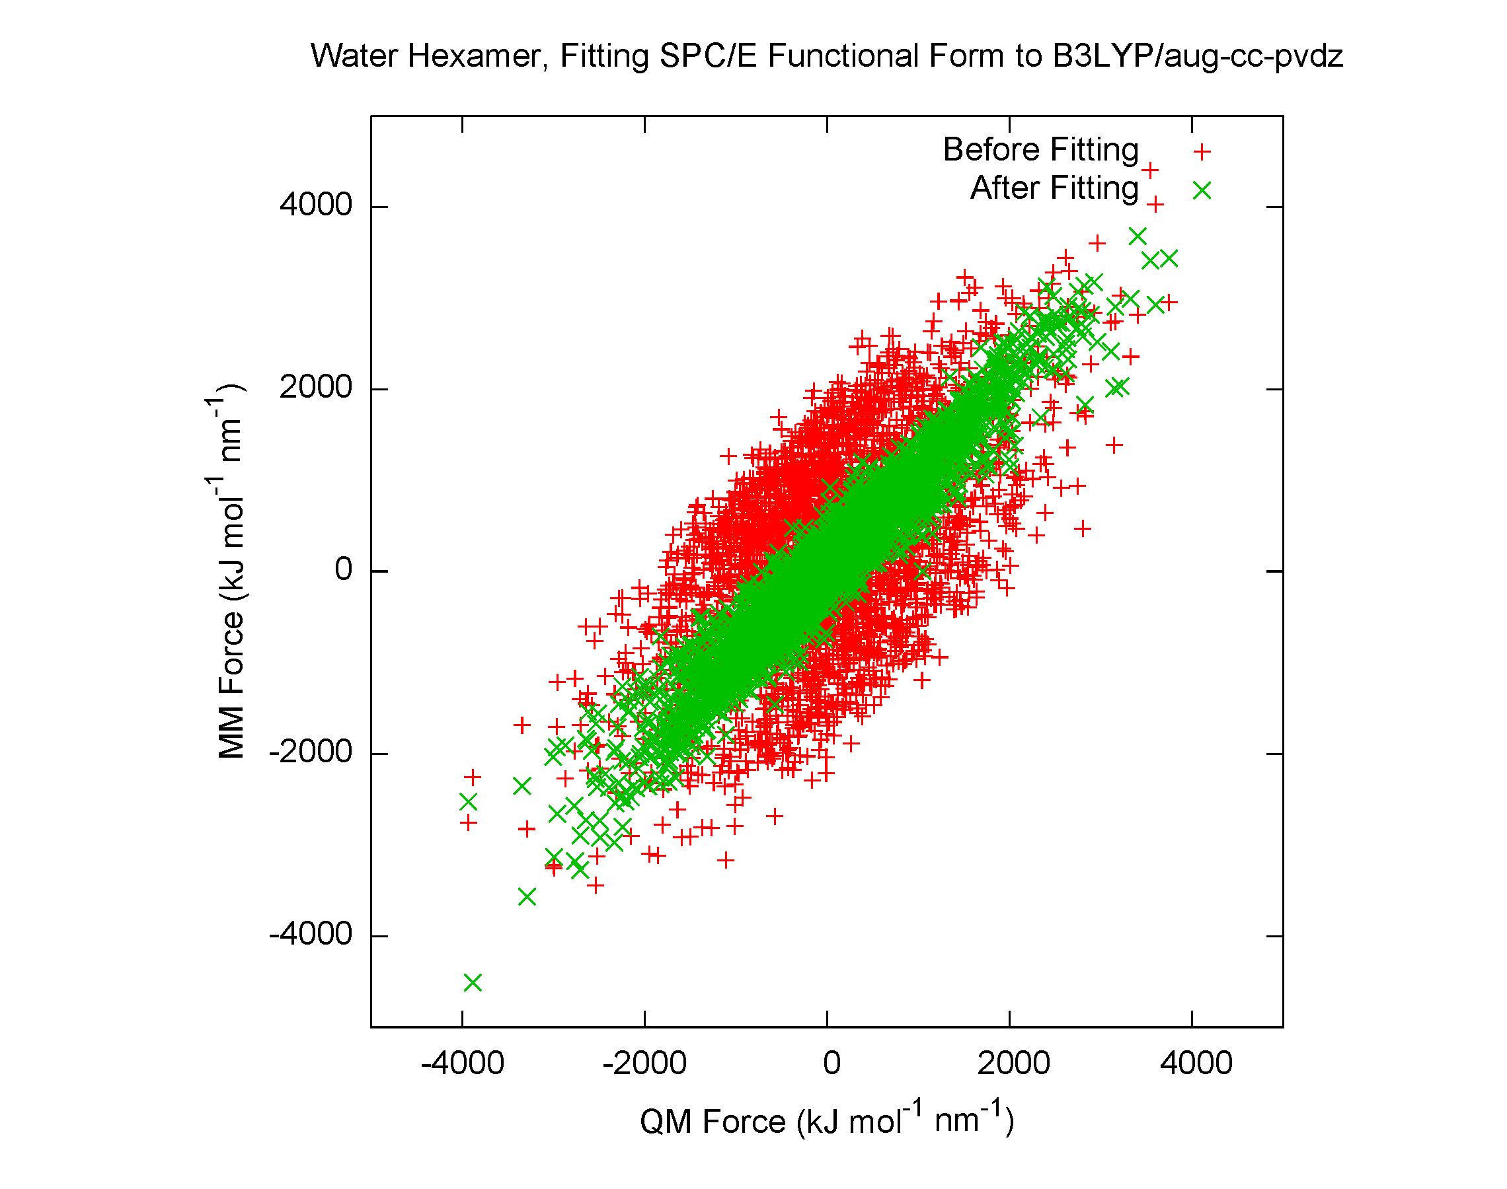
Usage
[ defaults ]
1 2 yes 0.5 0.5
[ atomtypes ]
H 1.0080 0.0000 A 0.00000e+00 0.00000e+00
O 5.9950 0.0000 A 3.16557e-01 6.50194e-01 ; PARM 4 5
[ bondtypes ]
H O 1 0.100000 3.450000e+05 ; PARM 3 4
[ angletypes ]
H O H 1 109.470000 383.000000 ; PARM 4 5
[ moleculetype ]
SOL 3
[ atoms ]
1 O 1 SOL O1 1 -0.8476 15.9950 ; PARM 6
2 H 1 SOL H2 2 0.4238 1.0080 ; PARM 6
3 H 1 SOL H3 3 0.4238 1.0080 ; RPT 6 COULH2 /RPT
[ bonds ]
1 2 1
1 3 1
[ angles ]
2 1 3 1
Force field parameters are defined in the parameter file (.itp)
Tagging the .itp file triggers computation of derivatives
Python script modifies parameters, calls GROMACS for derivatives, and determines optimization steps using Newton-Raphson
Next-generation force field gives improved fit; used to rerun dynamics
--- WELCOME TO ForceBalance! --- =D
Starting Point: Energy Error(kJ) = 44.35910 Force Error = 63.5% Objective Function = 7.7199e-01
Computing optimal FF parameters using trust-radius Newton Raphson algorithm
Step# Variance(X2) Step Size Direction Max. FErr EErr(kJ) FErr(%) Obj.Func
0 0.00e+00 1.14e-02 V.SH O1 73.77% 32.42 28.02 7.2644e-01
1 1.01e-01 2.71e-02 B.KHO H2 32.37% 11.53 26.60 5.2409e-01
2 1.07e-01 1.00e-01 B.KHO O1 23.16% 6.40 12.19 4.7994e-01
3 1.06e-01 2.00e-01 B.KHO O1 24.52% 8.54 15.08 4.5832e-01
4 1.02e-01 2.86e-01 B.KHO O1 27.43% 8.80 21.23 4.5389e-01
5 9.90e-02 7.09e-02 B.KHO O1 28.66% 8.50 18.15 4.3843e-01

Slide 9
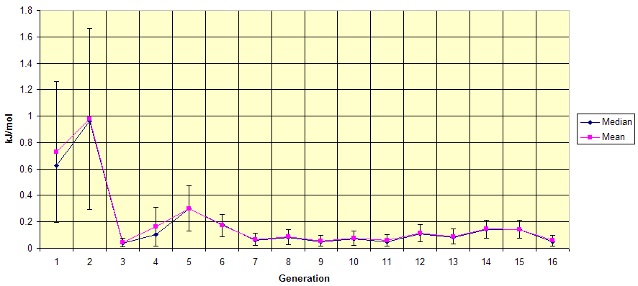
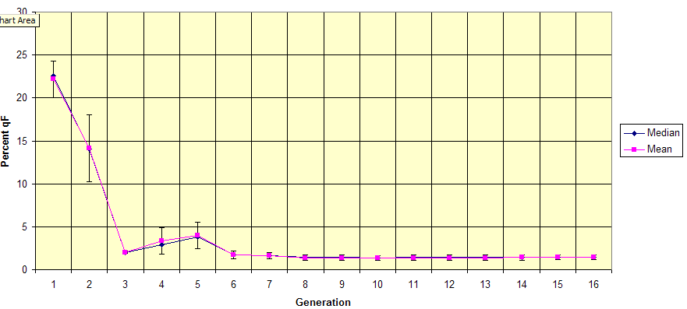
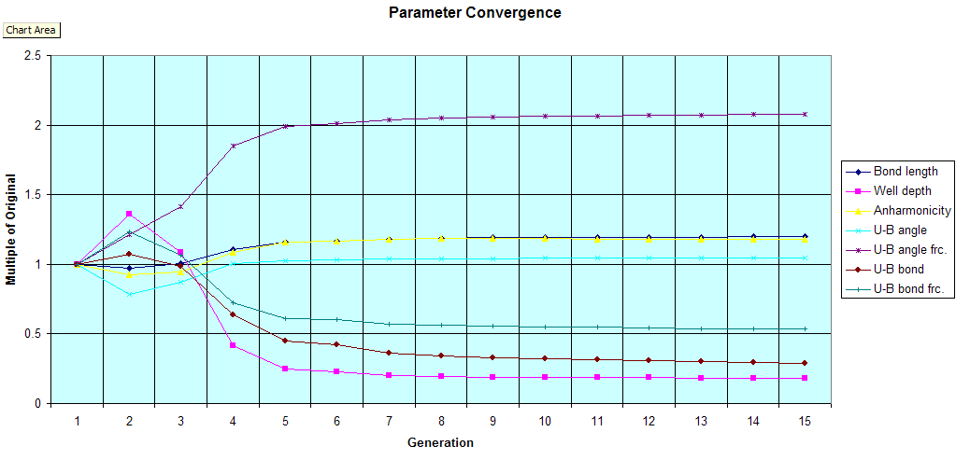
Conceptual Example
Energy Error
Force Error
Parameter Convergence
Sixteen cycles of force matching on methane monomer
Seven parameters in FF: Morse bonds, Urey-Bradley angles
Very low energy and force errors (ΔE < 0.1 kJ mol⁻¹, ΔF < 2%)
Parameters converged

Slide 10
Challenges
Problem: Bad functional form Symptom: poor quality of fit
Problem: Inaccurate reference data Symptom: disagreement with experiment
Problem: Too many or too few fitting parameters Symptom: unphysical parameter values
Problem: Poor sampling of configuration space Symptom: parameters don’t converge

Slide 11
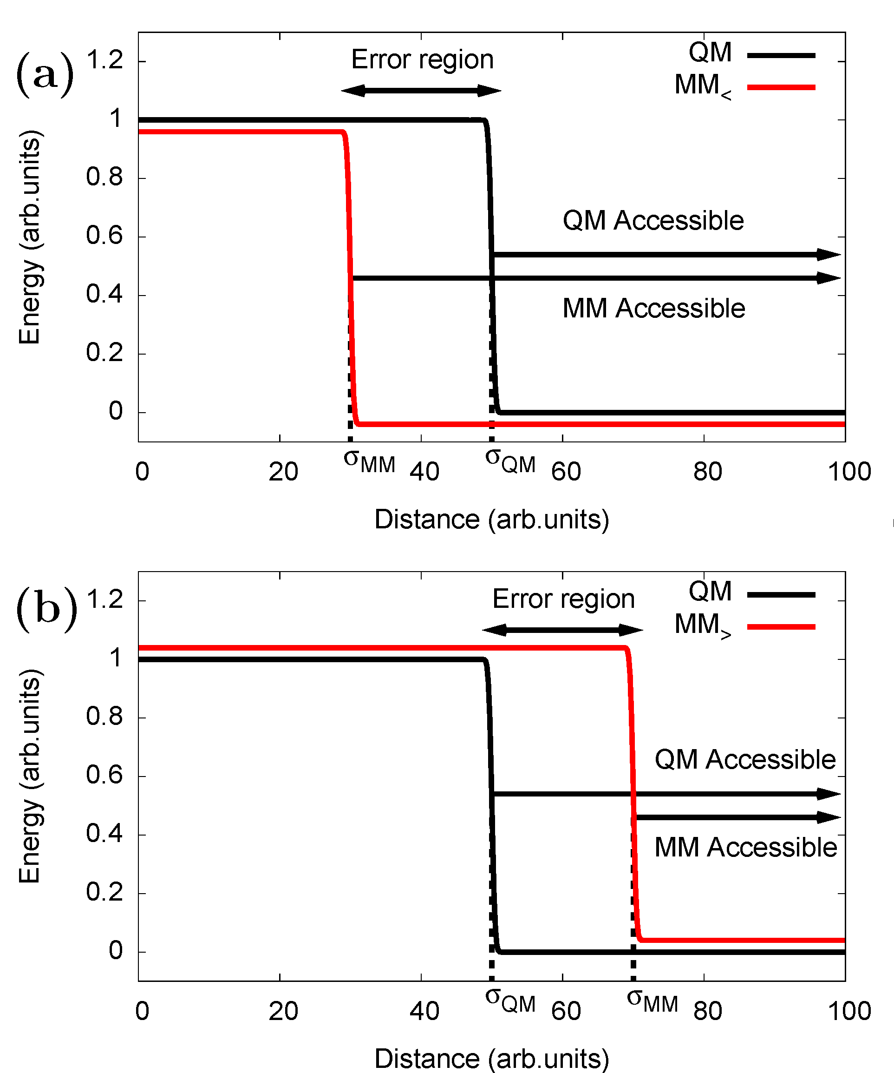
An Infinitely Hard Wall
Consider fitting an infinite hard-wall potential (kT→0)
If MM initially underestimates the wall position (above), the “error region” is only seen by the MM ensemble
In the case of an overestimate (below), the error region is only accessible by the QM ensemble
Conclusion: No single potential surface provides good sampling for force matching

Slide 12
Hybrid Boltzmann Weights
Solution: Create a linear combination of Boltzmann weights from both ensembles
Sampling from different ensembles can be approximated by reweighting the configurations from MM
Hybrid ensemble gives optimal matching in the hard-wall case
L. P. Wang and T. Van Voorhis, J. Chem. Phys. (2010), 133, 231101.

Slide 13
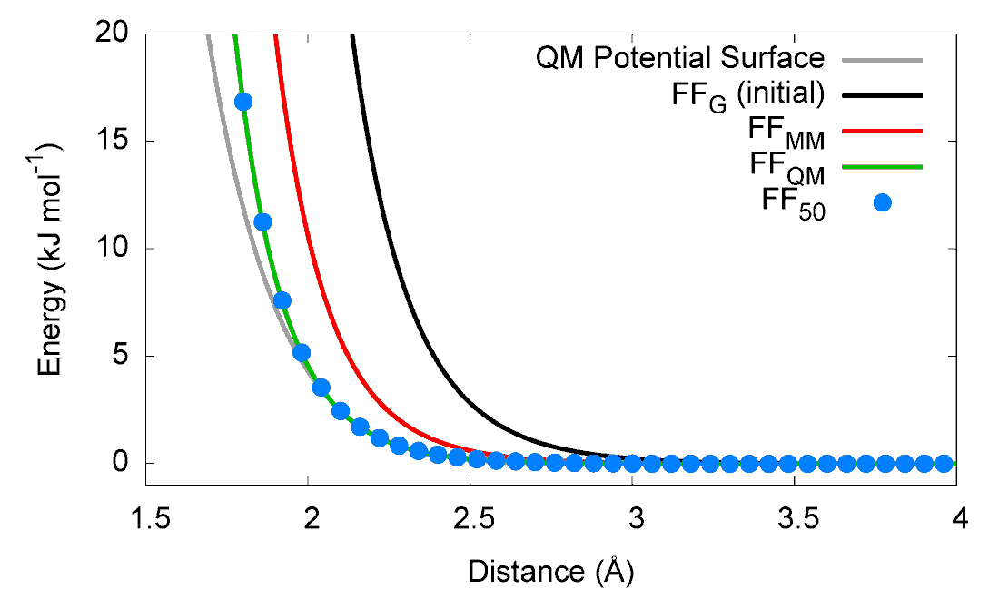
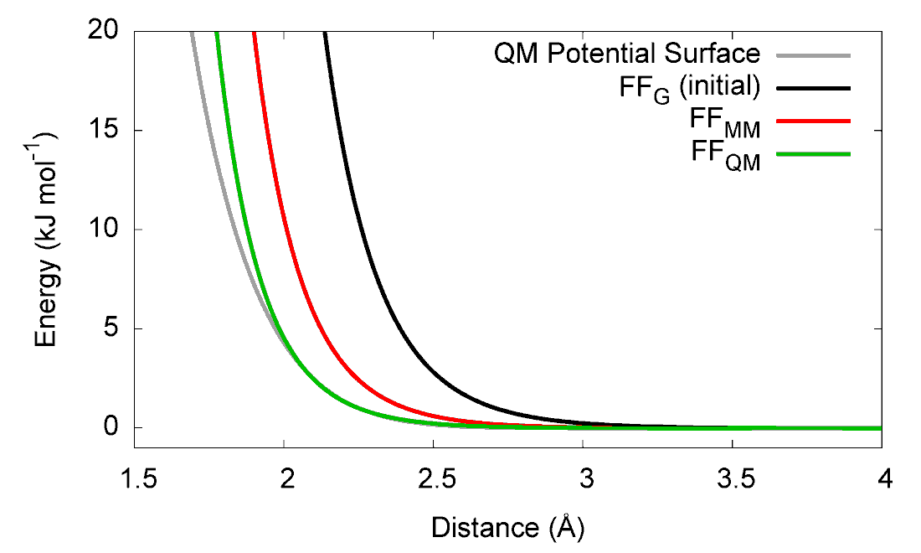
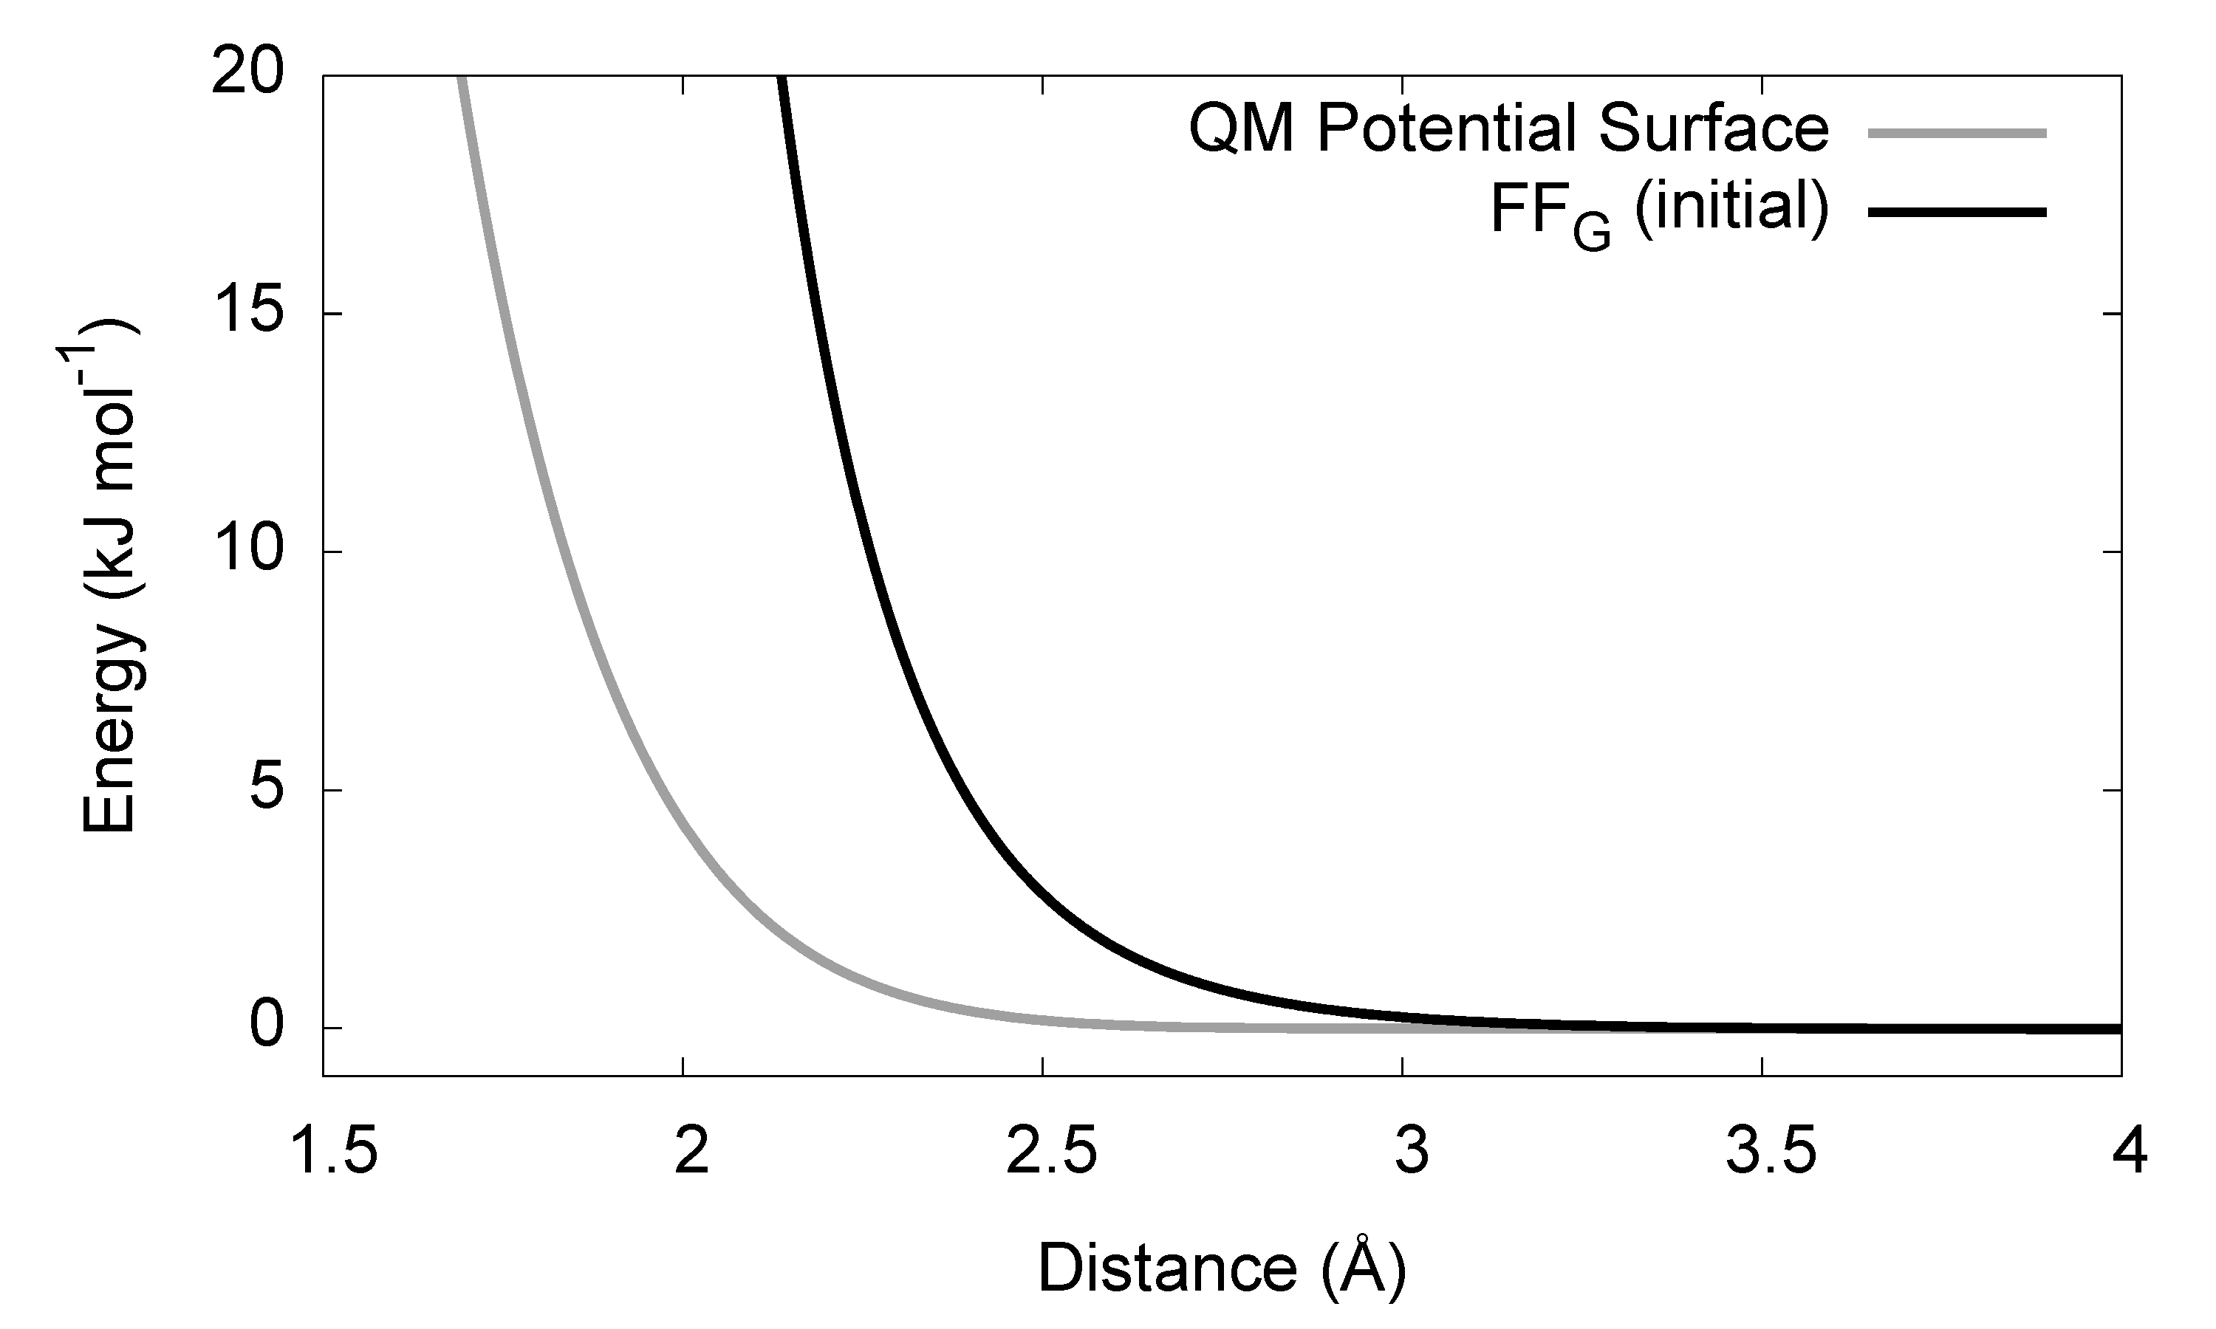
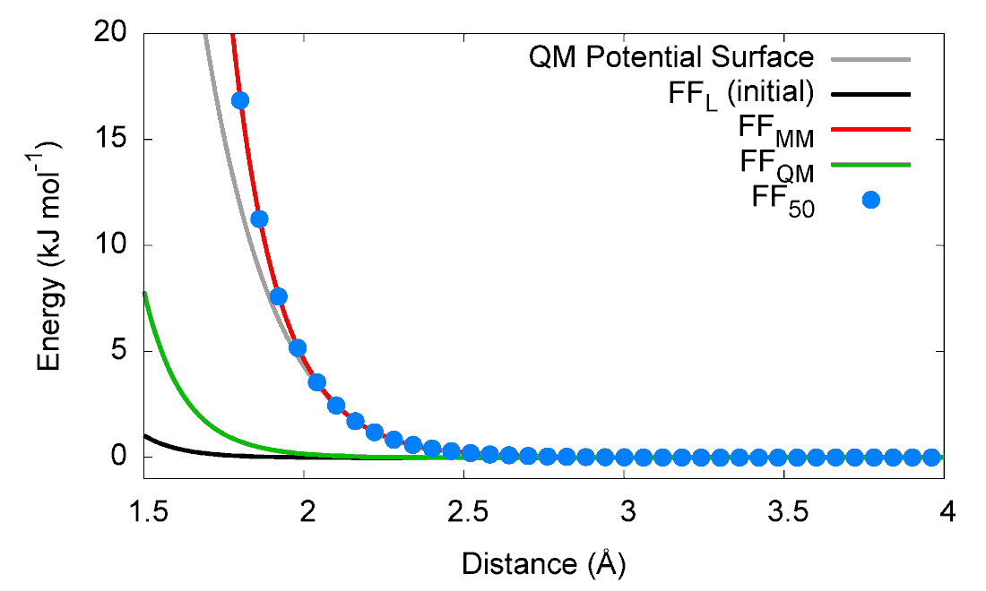
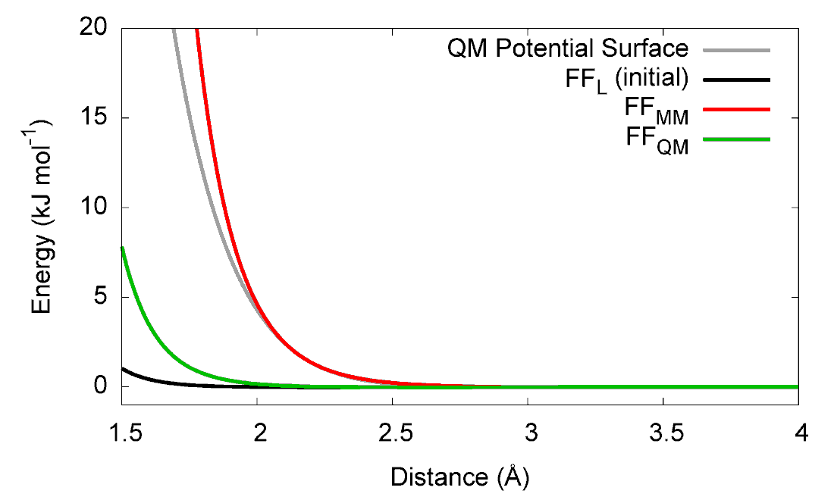
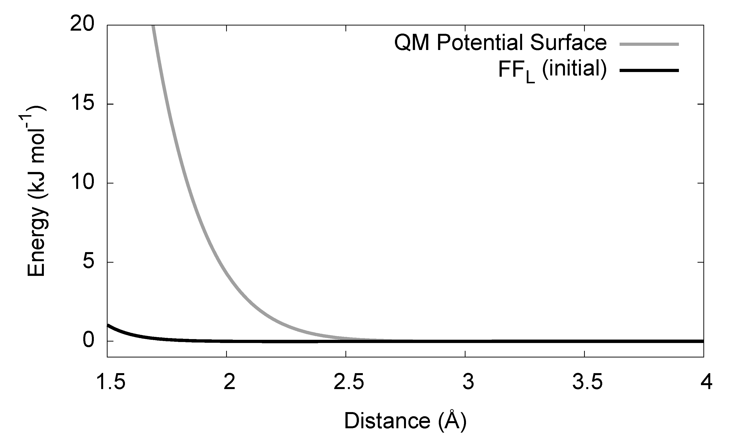
Helium Dimer
Proof of concept example: He₂ (almost purely repulsive)
Only one MM parameter (LJ σ), starting at two initial values
The MM and QM ensembles reach the correct answer in one out of two cases
The hybrid ensemble reaches the correct answer in both cases

Slide 14
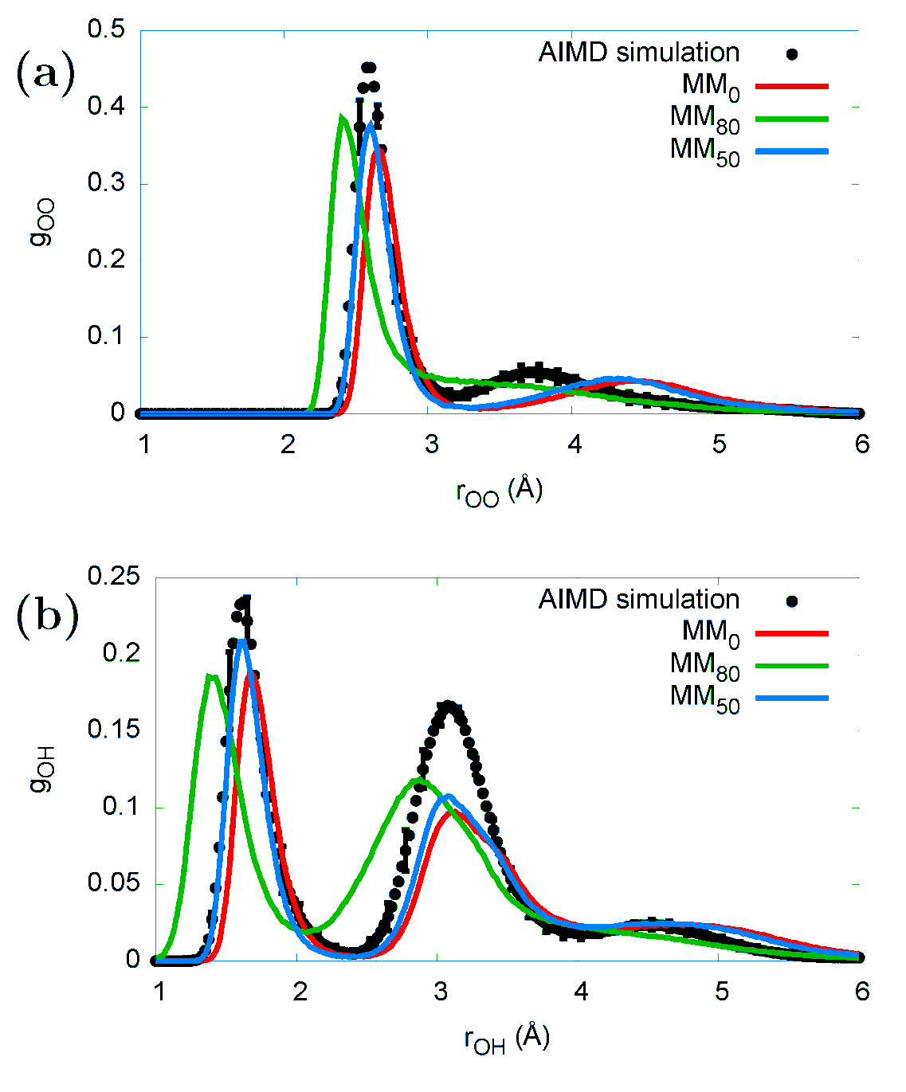
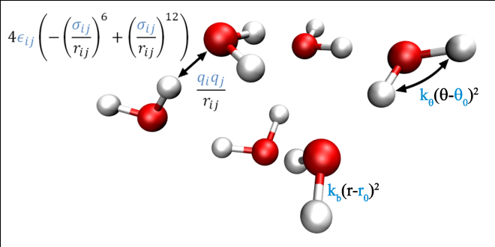
Water Hexamer
The water hexamer; slightly more complicated, harder to disentangle parameters from bulk properties
Three ensembles used: All MM, 50% QM, 80% QM
50% QM ensemble predicts most accurate peak distances and peak heights

Slide 15
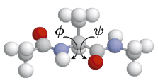
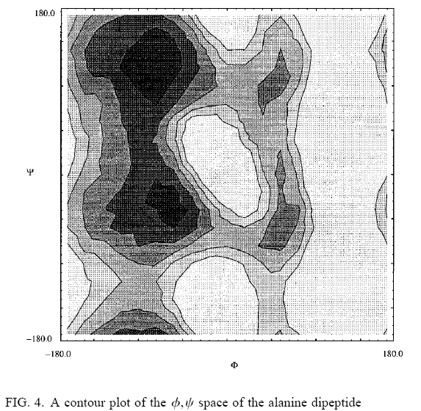
Improving convergence with WHAM
We wish to reuse the reference data from all previous cycles
Each cycle of the potential corresponds to a different sampling
Weighted Histogram Analysis Method (WHAM) uses several different simulations to provide a single free energy profile
We don’t need free energy profiles but WHAM can provide a single consistent set of Boltzmann weights

Slide 16
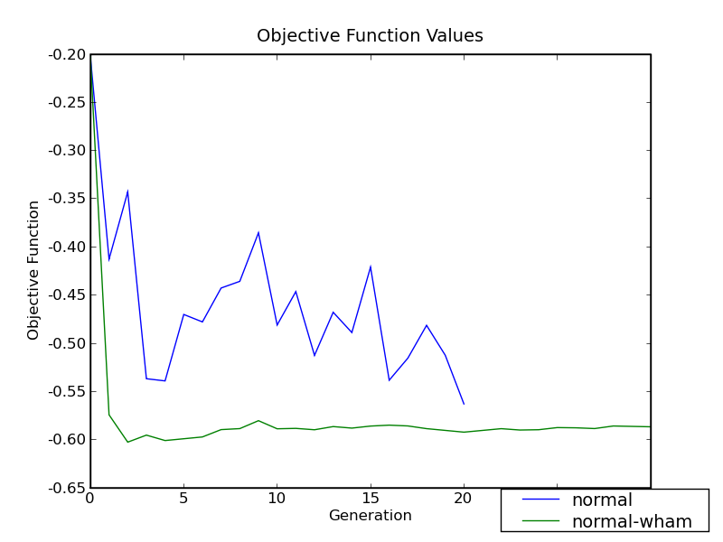
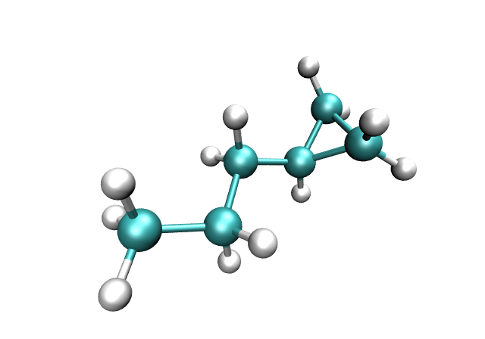
Improving Convergence with WHAM
In WHAM, the thermodynamic weights are determined self-consistently
With history information included, fluctuations in χ² are suppressed

Slide 17
Improving Convergence with WHAM
Above: WHAM (green) suppresses parameter fluctuations (blue) for molecule on right

Slide 18
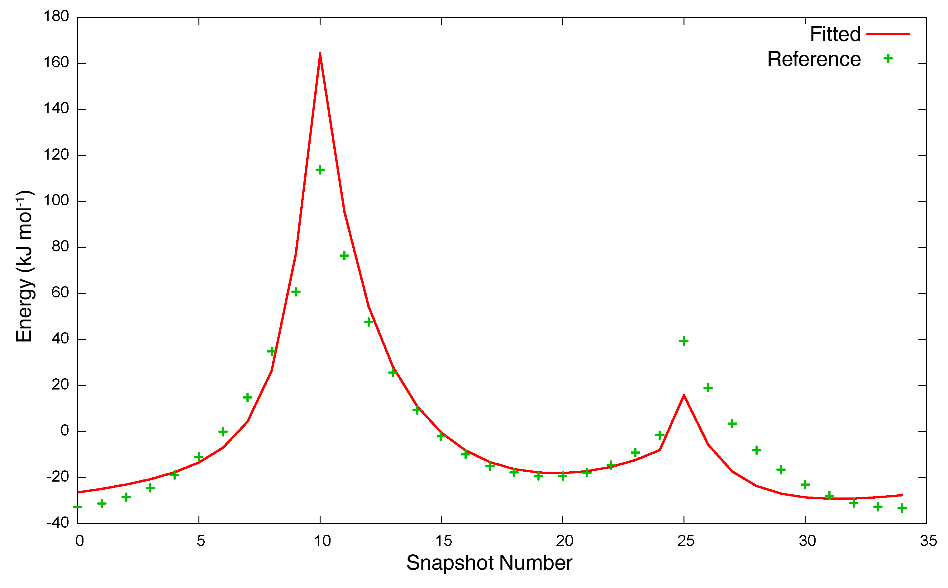
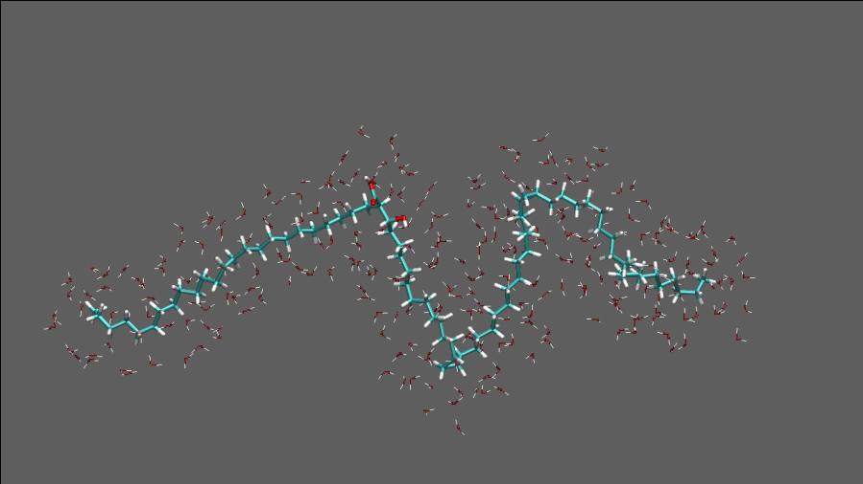
Applications: Patching MM simulations
Existing parameter libraries can be incomplete (e.g. OPLS-AA missing dihedral parameter in rubrene, an organic semiconductor material)
Dihedral angle manually parameterized; force field reproduces crystal structure
Propyl cyclopropane parameters used for mycolic acid with kinks from cyclopropane rings

Slide 19
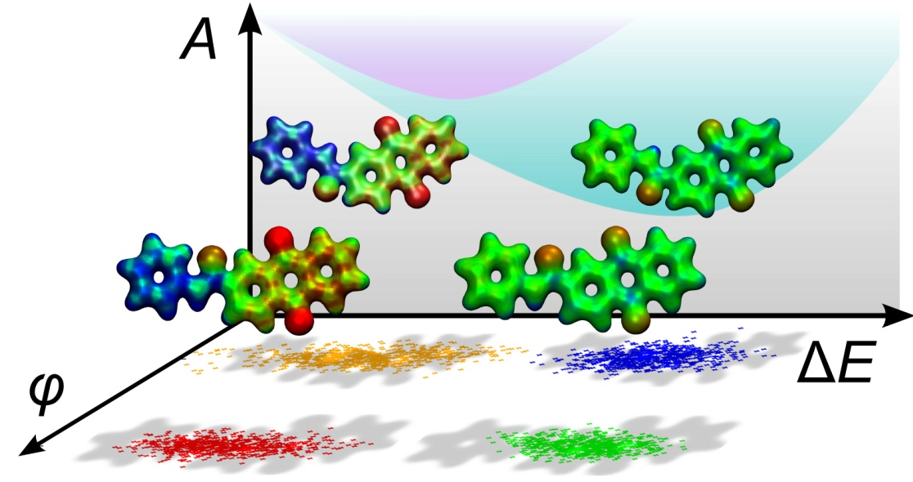
Applications: Multiple electronic states
Force fields created for the ground and CT excited states of the FAAQ molecule
Polarizable QM/MM simulations were seeded from MM simulations
QM/MM sampling of excitation energies and couplings give predictions of CT free energies, recombination rates
Images courtesy of T. Kowalczyk, MIT.
T. Kowalczyk, L. P. Wang and T. Van Voorhis, J. Phys. Chem. B, 2011.

Slide 20
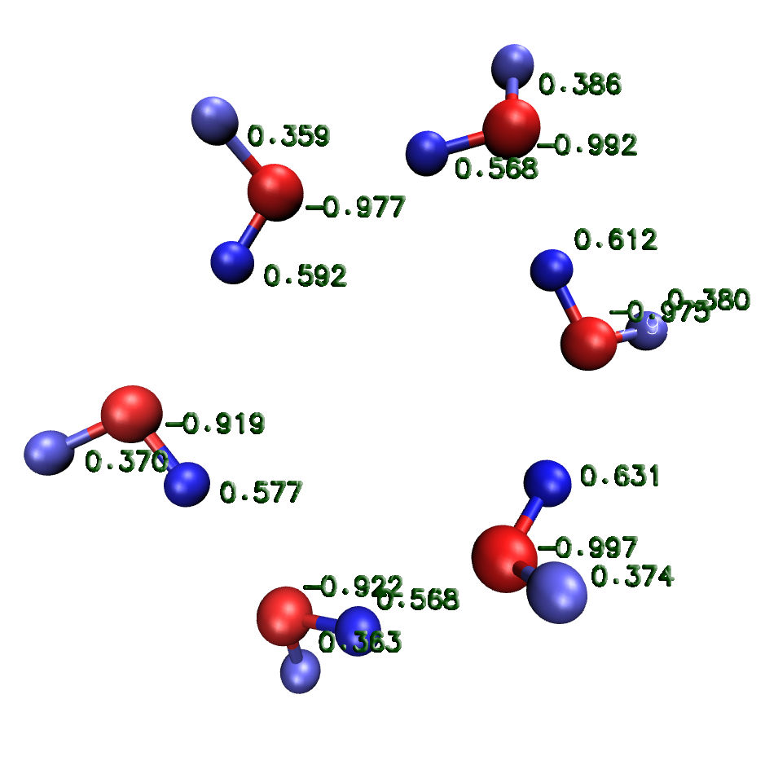
Applications: Fluctuating charge water model
Electronic polarizability is missing from additive force fields
Compensated by increasing atomic point charges
Several treatments of polarizability: Drude particle (charge on spring), inducible dipoles, fluctuating charge
Polarizability is a frontier for force fields in general and automatic parameterization in particular

Slide 21
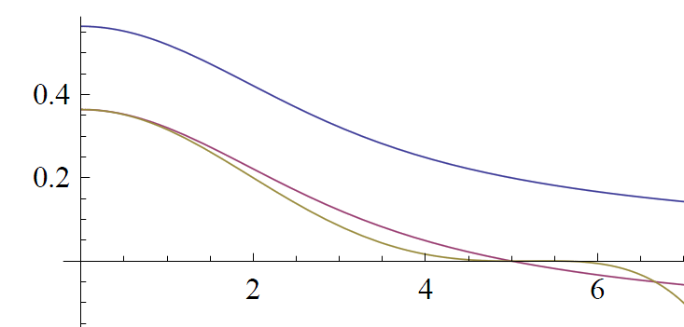
Electrostatics: QTPIE
QTPIE (Chen and Martinez, CPL 2007) is a fluctuating-charge force field
At each time step, charges determined by solving a system of N linear equations
QTPIE (and other fluctuating charge models) implemented into custom GROMACS 4.0
Periodic boundary conditions using smooth cutoffs
J_{ij}(R_{ij})
Blue: Full damped Coulomb interaction
Purple: Cutoff at R=5 by constant shift
Gold: Smoothed-force cutoff at R=5
R_{ij}

Slide 22
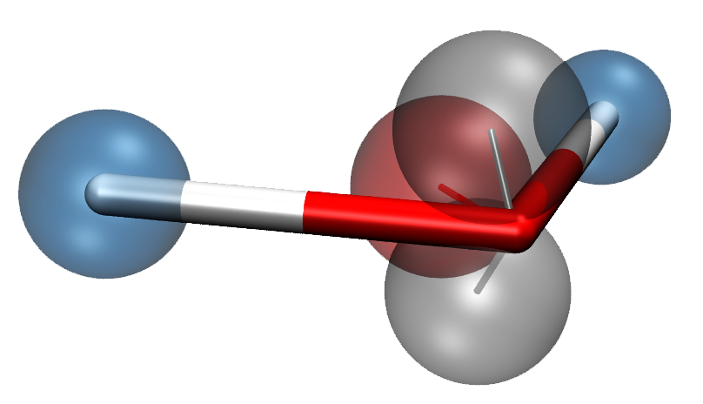
Six-site polarizable water model
Five fluctuating-charge sites
28 adjustable parameters (3 bonded, 4 angle, 9 electrostatic, 9 VdW, 3 virtual-site positions)
Configurations from running MD on small clusters (6, 9, 12, 15)
QM method: MP2, aug-cc-pVTZ
L. P. Wang, J. Chen and T. Van Voorhis, submitted.

Slide 23
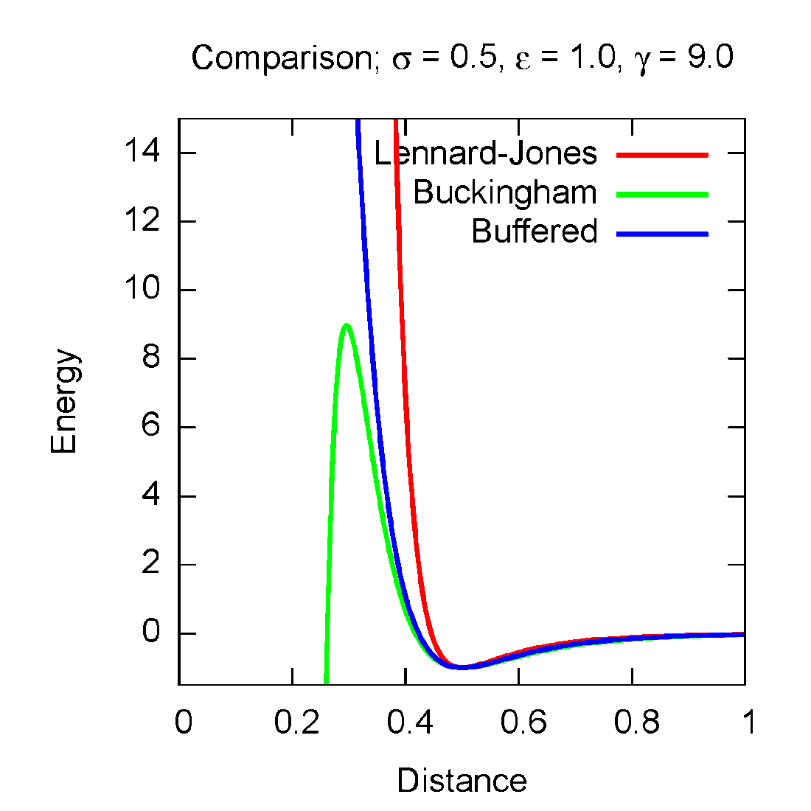
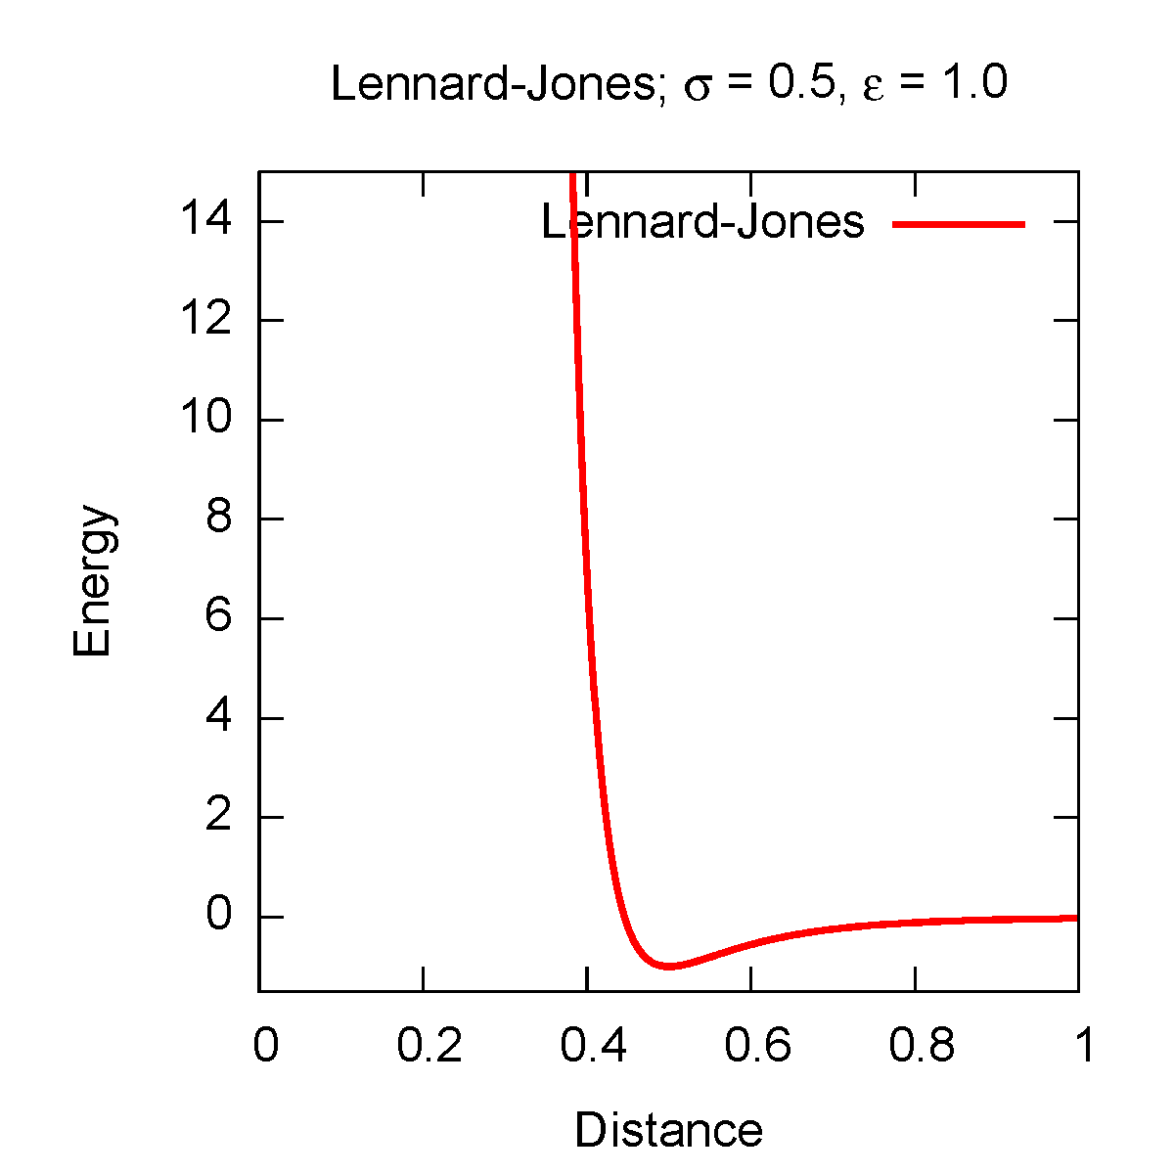
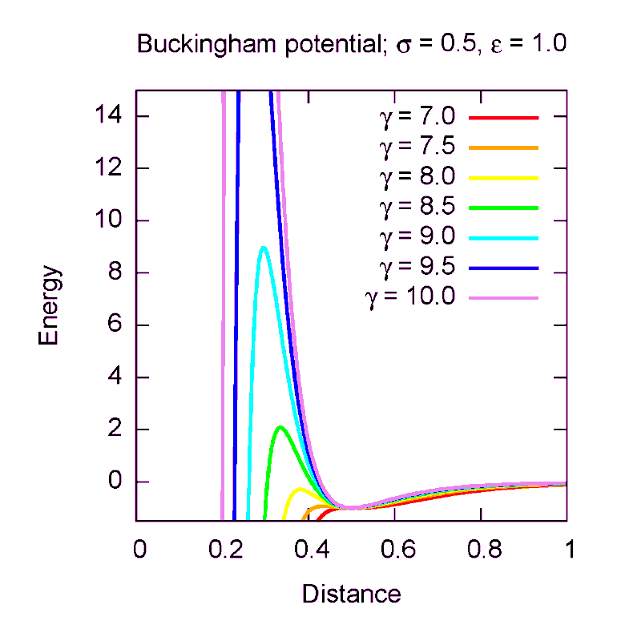
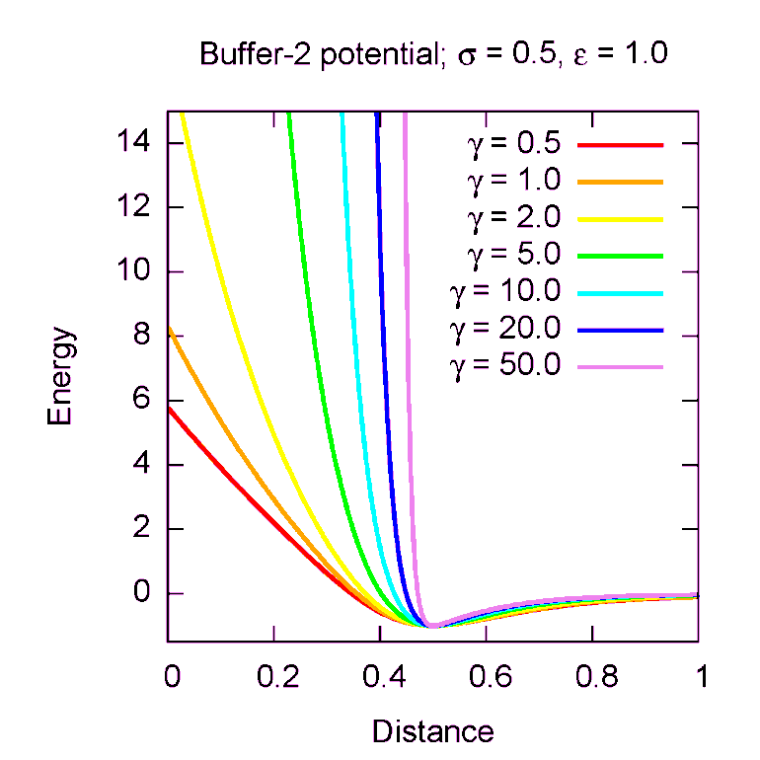
Buffered van der Waals potential
The widely used Lennard-Jones (12-6) interaction is too sharply repulsive
Buckingham potential (exp-6) provides a more physical repulsion
Potential is problematic due to singularity at r=0
No singularity
Same # of parameters
Tunable repulsion

Slide 24
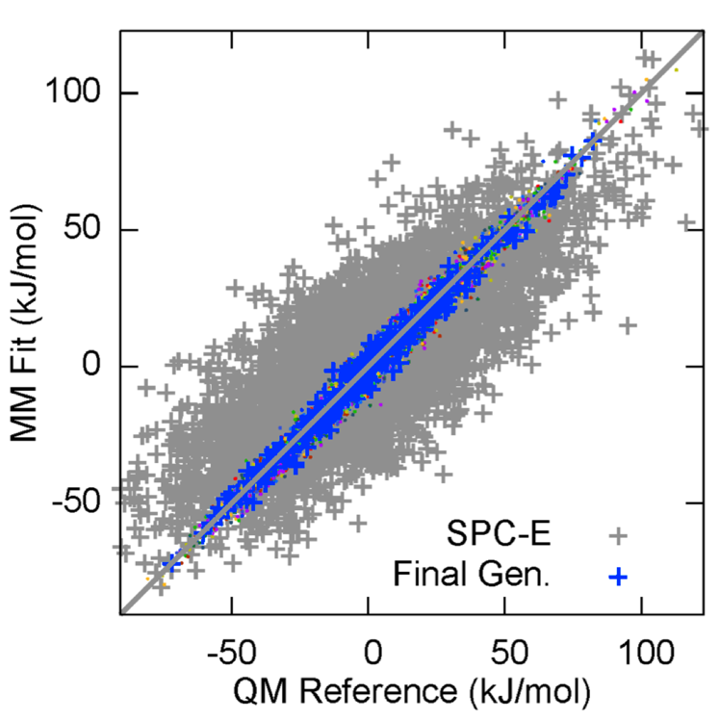
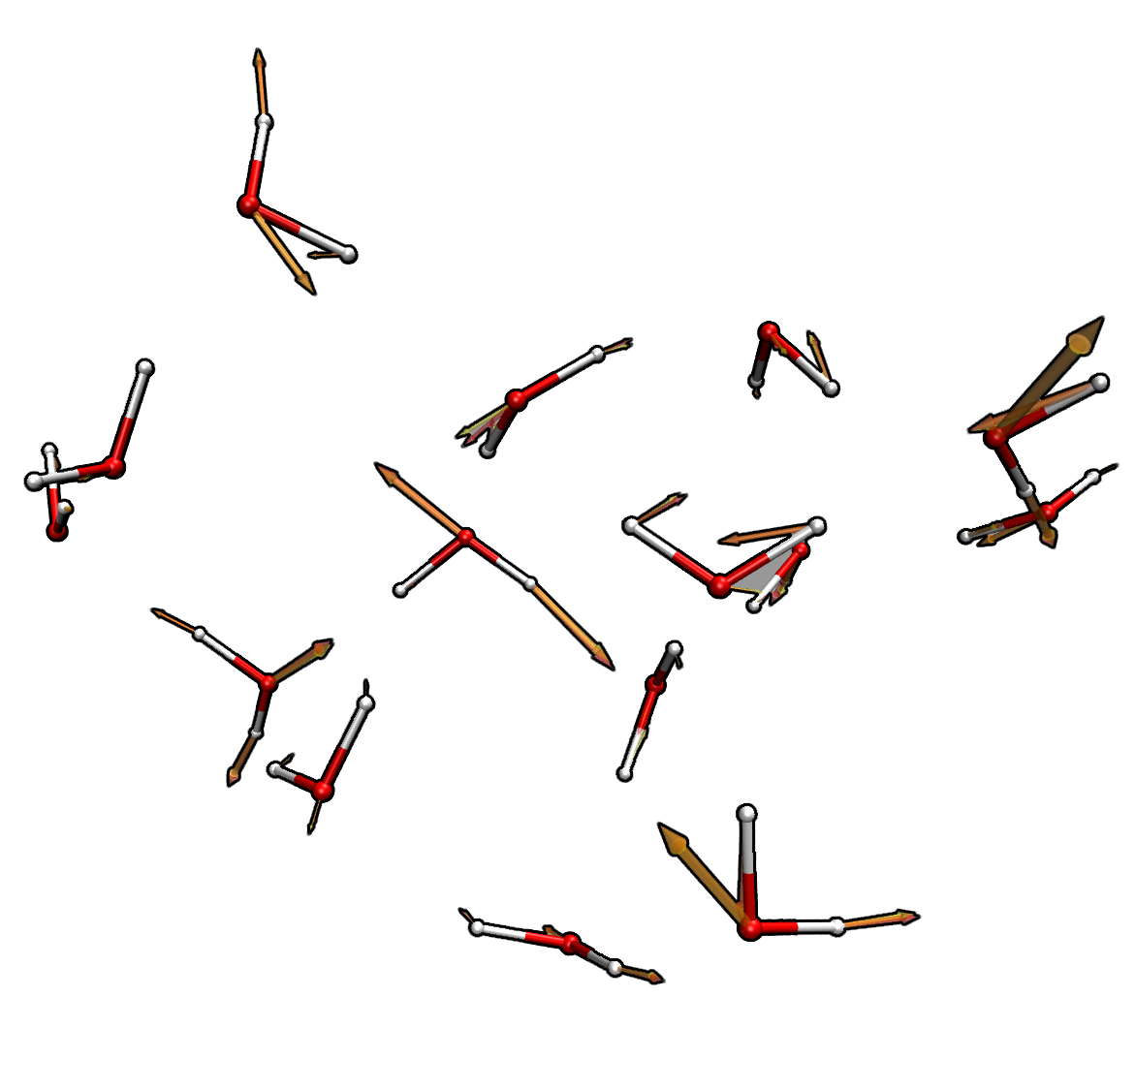
Results: Atomistic energies and forces
17 total cycles of self-consistent energy and force matching (>5,000 RI-MP2 force calcs.)
Include water molecule multipole moments, dipole polarizability in objective function
Energies of water clusters matched to within 1 kcal/mol
Atomistic forces are correct to within 10%
Visually, forces from MM and QM are nearly identical

Slide 25
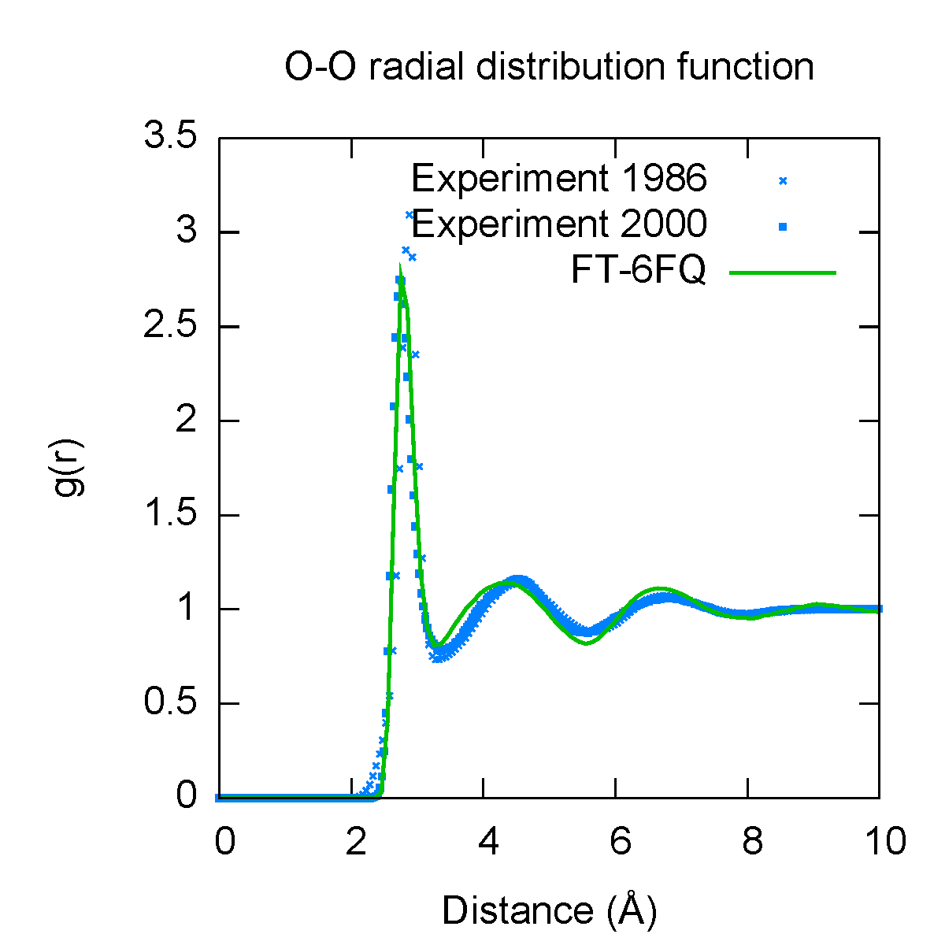
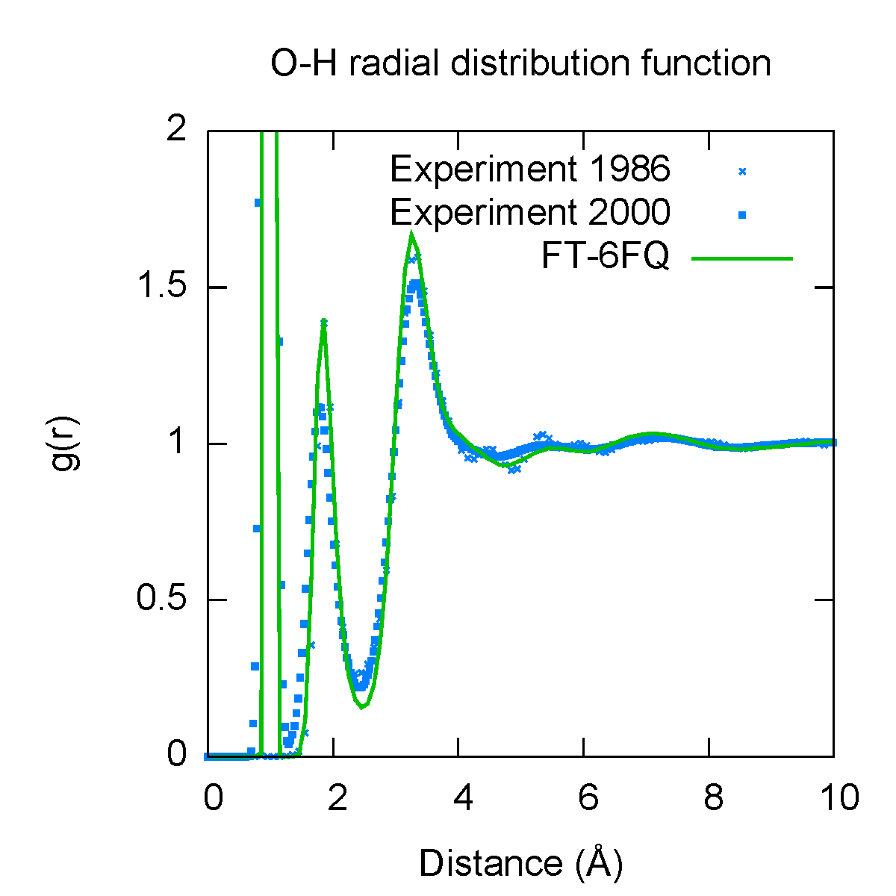
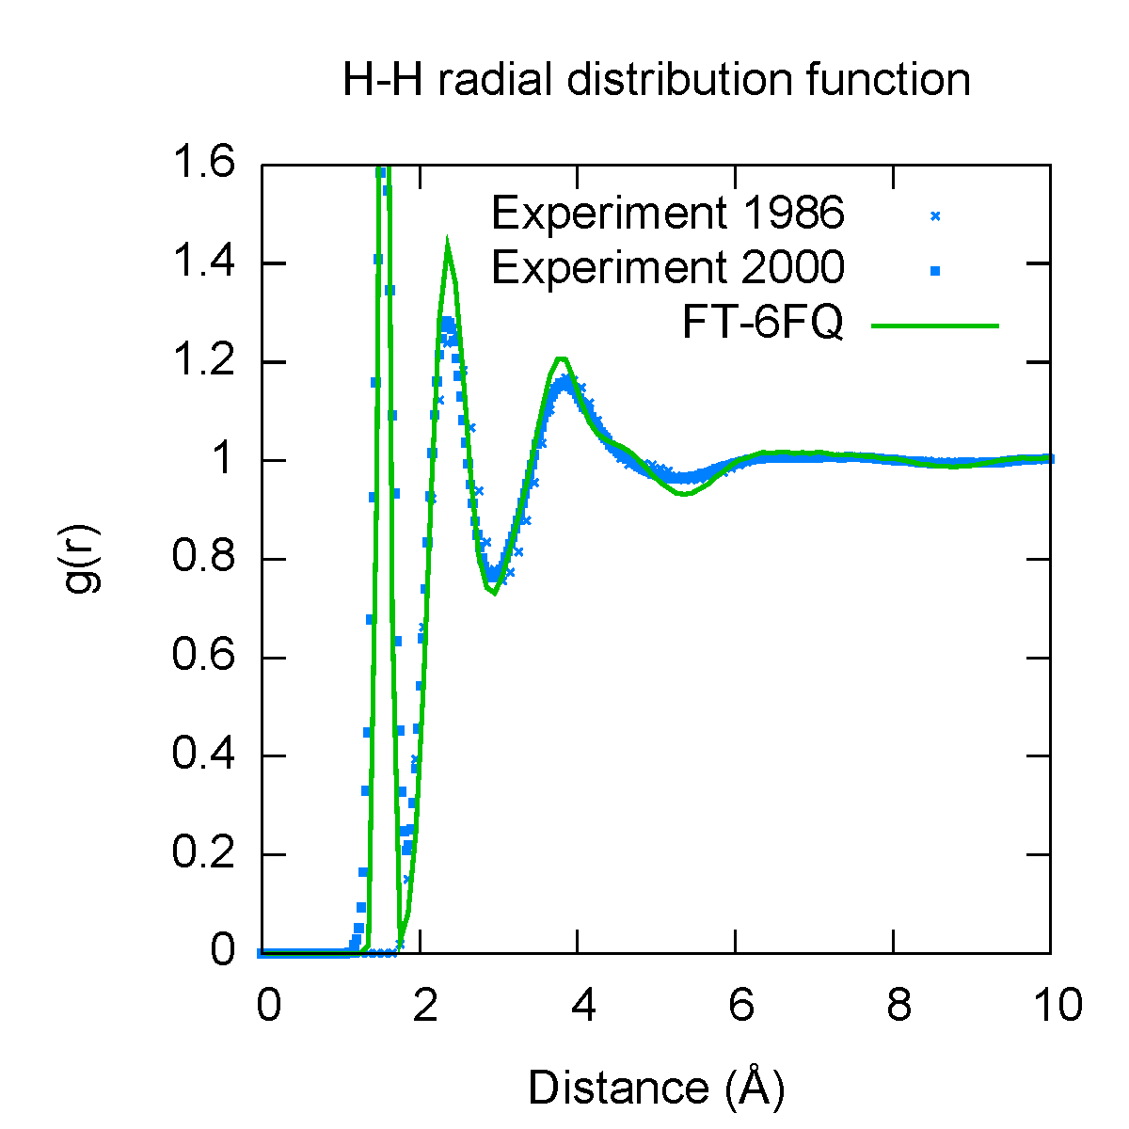
Results: Bulk properties
Property | Calculated | Experiment
Density (kg m⁻³) | 1040 ± 10 | 1000
Dielectric constant | 85 | 78.4
Diffusion constant (10⁻⁵ cm² s-1) | 1.5 | 2.3
Density maximum (ºC) | <6ºC | 4ºC
Solution phase dipole moment (D) | 2.6 | 2.3 – 2.9
Bulk properties were computed to validate force field; not fitted
Calculated radial distribution function (green) agrees with experiment (blue)
Basically accurate density and dielectric constant, diffusion constant underestimated by ~40%

Slide 26
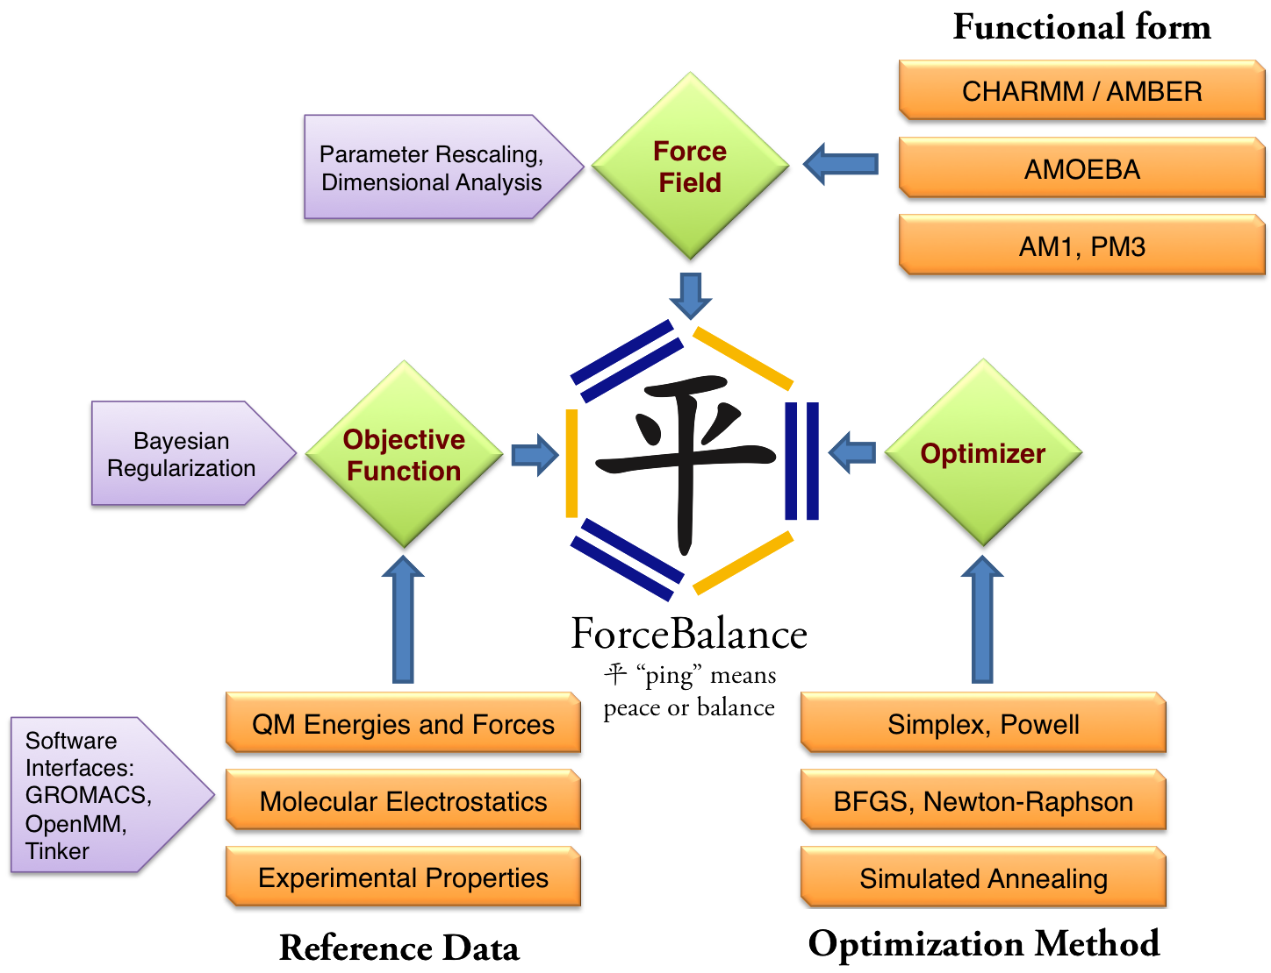
Recent progress: Major rewriting of code
Framework supports fitting of diverse reference data
Source code and installer freely available on the Web

Slide 27
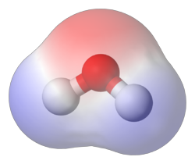
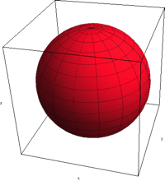
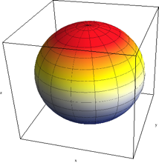
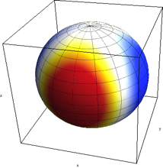
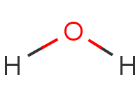
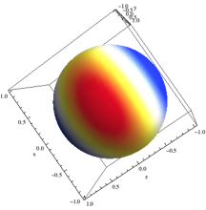
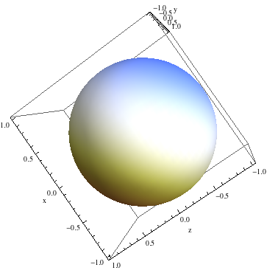
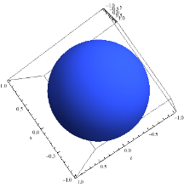
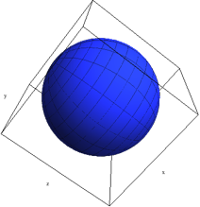
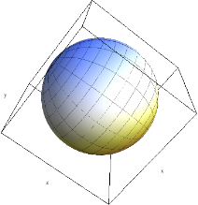
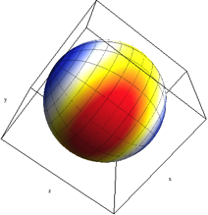
Electrostatics in AMOEBA
We plan to reparameterize the AMOEBA force field. (Collaboration with Teresa Head-Gordon)
Old AMOEBA force field:
Point charge, dipole, and quadrupole on each atom
Polarizable point dipole on each atom with short-range damping
New iAMOEBA force field:
Determine polarizable dipoles from fixed multiples directly (no SCF)

Slide 28
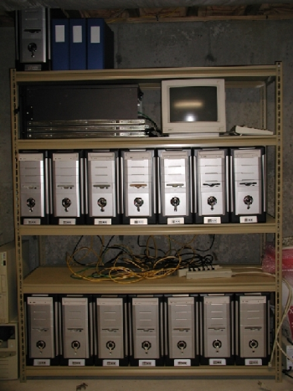
Automatic parameterization
Include experimental density and ∆H_{vap} in objective function
Compute derivatives using numerical finite difference
Dynamics simulations are distributed on GPU clusters
Modify OpenMM XML force field file
X², Finite Difference Derivative
Optimizer
OpenMM Module
Next Parameter Step
Distribute calculation
Cluster

Slide 29
Conclusions
A highly general force field development framework presents many exciting opportunities.
What we can do so far:
Flexibility in exploring parameters and functional forms
Accurate, self-consistent matching of QM energies and forces
Future directions:
Address parameter over / under-fitting issues using energy decomposition (is force decomposition possible?)
Improve accuracy of the QM-MM Hamiltonian
Apply ForceBalance to create improved force fields for zeolites

Slide 30
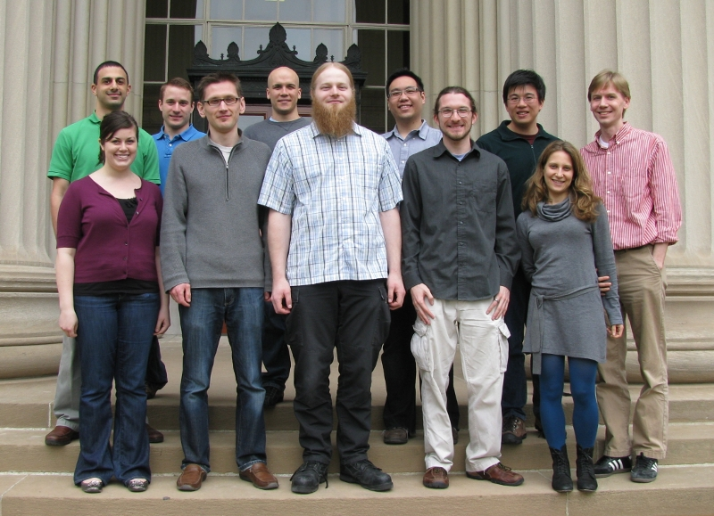
Acknowledgements
Troy Van Voorhis (MIT)
Vijay Pande (Stanford)
Todd Martinez (Stanford)
VV Group Members
Jiahao Chen (collaborator) Tim Kowalczyk (collaborator)
Simbios Postdoctoral Fellowship
You!

