Slide 1
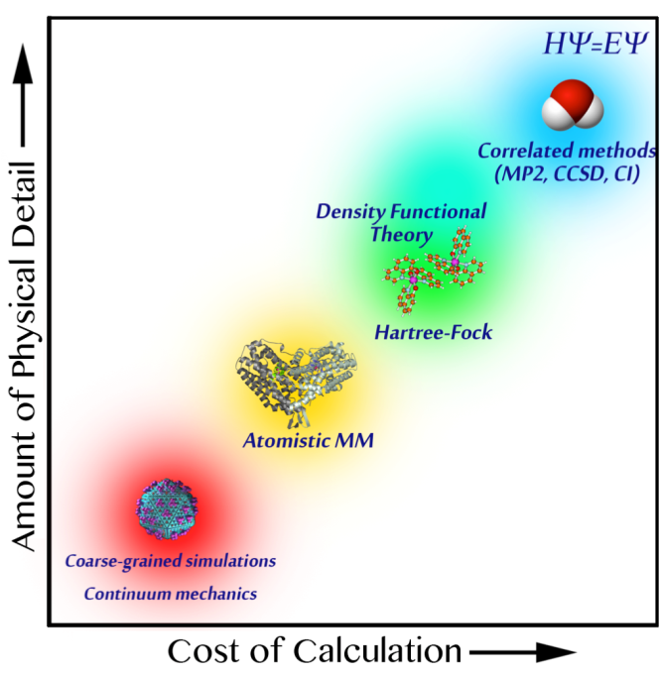
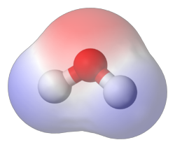




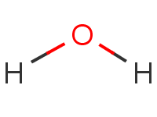






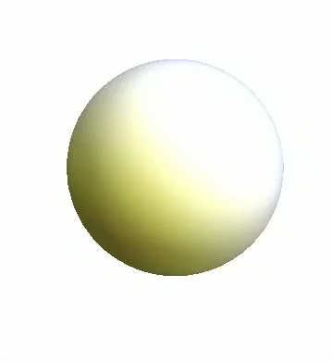
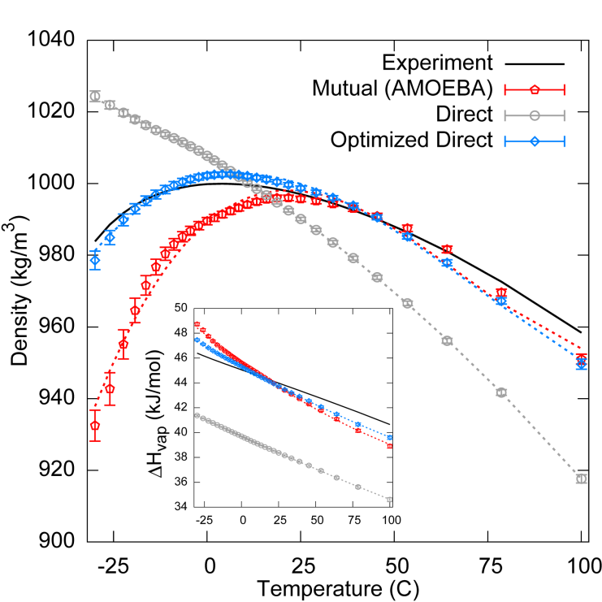
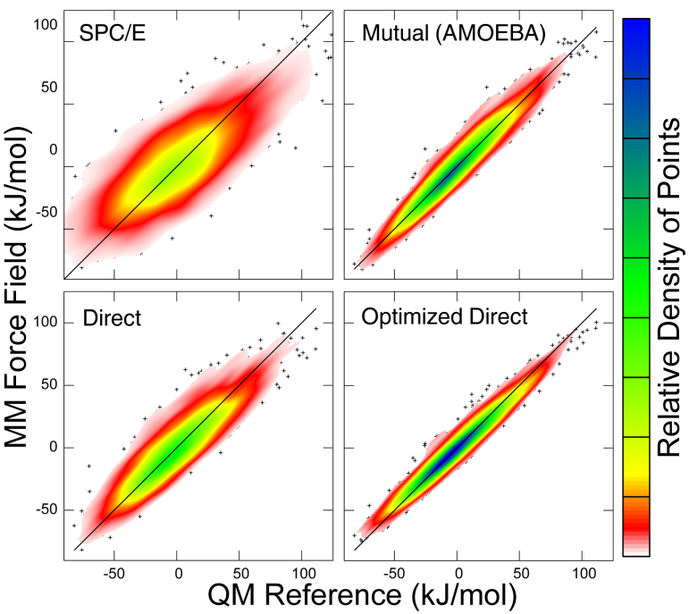
Automatic optimization of force fields
Theoretical Methods
Polarizable Atomic Multipoles
Force fields are the physical foundation of biomolecular simulation
ForceBalance
is a systematic
optimization
software for creating accurate force fields
We applied our method to create an improved force field for liquid water derived from the AMOEBA force field
Our new force field is more accurate than AMOEBA and also five times faster
AMOEBA
Fit to Experimental Data
Fit to Theoretical Calculations
Present work
Present work

