Slide 1
Population Modeling by Examples III
Population Modeling Working Group
popmodwkgrpimag-news@simtk.org
SummerSim 2017
July 9-12 , 2017
Bellevue, WA, USA

Slide 2
Background
The Inter Agency Modeling and Analysis Group (IMAG) hosts a population modeling working group
Initial definition was:
  “Modeling a collection of entities with different levels of heterogeneity“
We created a mailing list and asked people to join and share their research
Their contributions were assembled into review papers
This is the third review paper
Notes:
You may add notes to help the presenter focus on some points, yet focus on slide

Slide 3
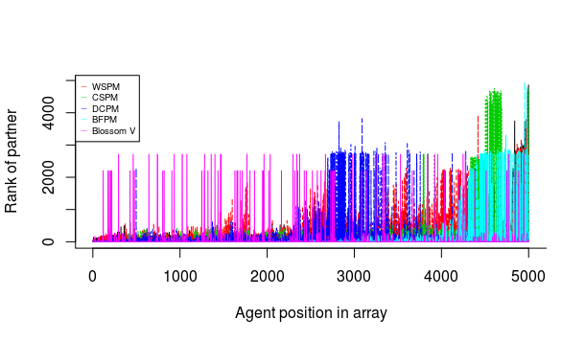
Matching Algorithms
Nathan Geffen, University of Cape Town, South Africa
Researching influence of
  matching algorithms and
  other design decisions on
  epidemiological STI-models.
Tested algorithms range from
  random partner matching to
  more sophisticated matching
  algorithms that consider agent
  Characteristics (e.g. Cluster Shuffle Partner Matching;CSPM).
Results show that in general CSPM has best trade-off between speed and quality matches.
Different matching algorithms, population sizes and behavior rules – ceteris paribus – imply differences in prevalence estimates.

Slide 4
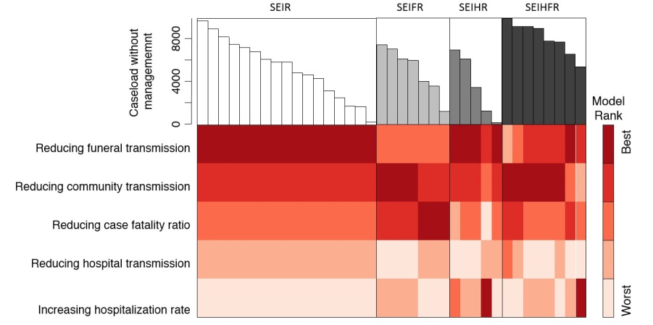
Bayesian Modeling for Epidemiology and Evidence-Based Medicine
Christopher J. Fonnesbeck,
Vanderbilt University
Medical Center
Bayesian methods applied to aid epidemiological decision making under uncertainty
Hierarchical models for meta-analytic models of comparative effectiveness research
Development of Python tools for Bayesian analysis (PyMC3)
Comparison of models for Ebola utbreak dynamics
(Li et al. 2017, PNAS)
Notes:
You may add notes to help the presenter focus on some points, yet focus on slide

Slide 5

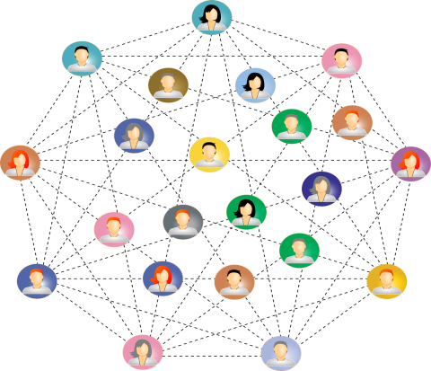


Laboratory for Epidemic Modeling and Analysis
Dan Yamin, Tel Aviv University, Israel
Examples
Optimizing age-specific vaccination strategy
Examples
Modeling the externalities of intervention programs against smoking
Infectious Diseases
Social contagion
Identifying super-spreaders of a product
Exploring user behavior for malware detection
Viral Marketing
Cyber Security
Laboratory for Epidemic Modeling and Analysis, http://dt-ma.com/research/
Notes:
You may add notes to help the presenter focus on some points, yet focus on slide

Slide 6


German-Specific Model of Type 2 Diabetes
Katherine Ogurtsova, German Diabetes Center, Düsseldorf, Germany
German-specific diabetes model to evaluate clinical- and cost-effectiveness of diabetes prevention programs in the life-long prospective and under everyday life conditions.
German-specific data:
population at risk
transition probabilities between diabetes stages
diabetes-related mortality
risk of complications
health utilities
costs
Notes:
You may add notes to help the presenter focus on some points, yet focus on slide

Slide 7

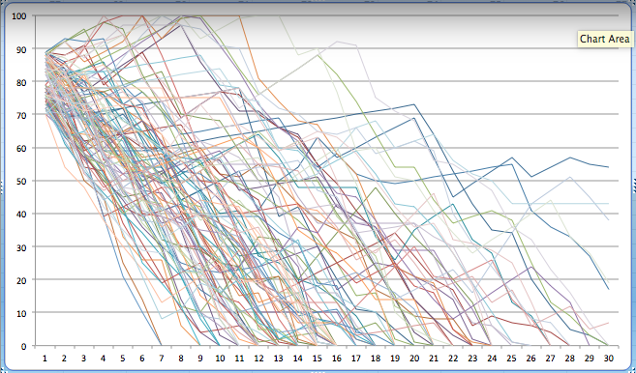
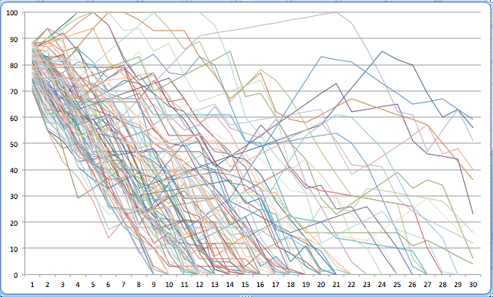
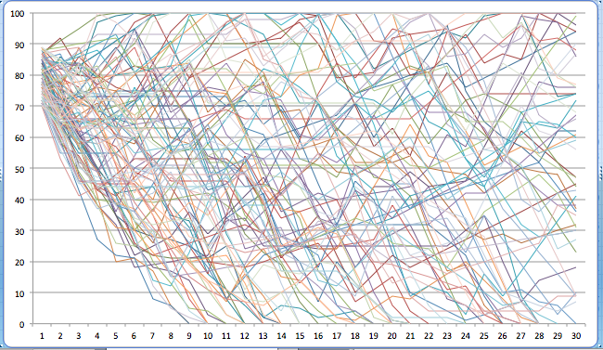

Global Cumulative Treatment Analysis (GCTA)
“Air Traffic Control” for Biomedicine
Jeff Shrager, Cancer Commons & Stanford Symbolic Systems Program
A prospective global Bayesian adaptive clinical trial.
Encompassing every patient and every treatment.
Treat each patient based on best available information.
In equipoise, treat to maximize information gain.
Classical Clinical Trial
Bayesian Adaptive Trial
GCTA
100 patients’ performance score (100=full health; 0=death) over time (~diagnosis ➔ 30 months) under three different experimental protocols. Patients survive longer with greater health in Bayesian and GCTA.
https://youtu.be/p0ua9sMK6V4
Notes:
You may add notes to help the presenter focus on some points, yet focus on slide

Slide 8
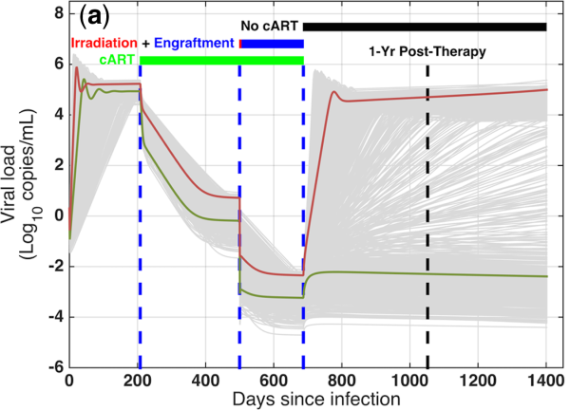
Population Modeling of Disease Course and Stem Cell Transplant in HIV
Feilim Mac Gabhann, Institute for Computational Medicine, Johns Hopkins University
We developed a model of HIV disease course dynamics;
this enabled simulation of complex therapeutic interventions,
e.g. bone marrow transplant
Using longitudinal patient data,
we created virtual patient populations
Virtual Clinical Trial:
identify patients that would
suppress virus (green) or not (red),
and estimate likelihood of cure
across the population
Gain insight into most potent levers
or indicators of treatment success
Hosseini & Mac Gabhann. CPT:Pharmacometrics & Systems Pharmacology (2016) 5:82
Notes:
You may add notes to help the presenter focus on some points, yet focus on slide

Slide 9
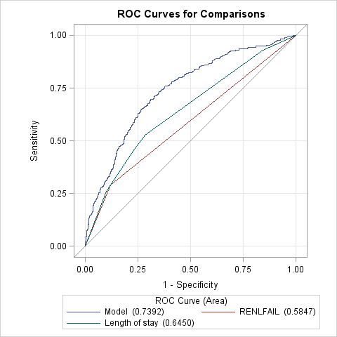
A Prediction Model to Identify Acute Myocardial Infarction (AMI) Patients at Risk for 30-Day eadmission
Carl Asche, University of Illinois, USA
It is feasible to use routine electronic medical record (EMR) data to identify AMI patients at risk of 30-day readmission.
Multi-level interventions could be developed and tailored according to individual risk of readmission using 3,058 AMI admissions at OSF HealthCare, a multi-site healthcare service where the average 30-day readmission rate was 8.9%.
Receiver Operating Characteristic Curves for Comparisons

Slide 10
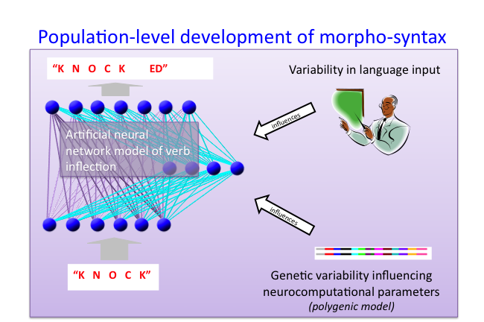
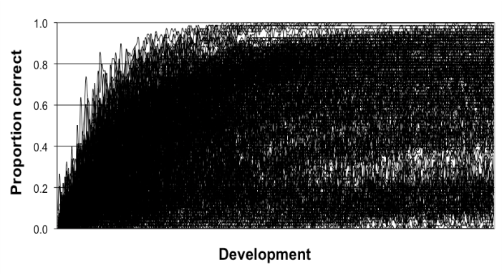
Cognitive Development
Michael Thomas, Birkbeck, University of London, UK
Artificial neural network (ANN) models have been used to simulate mechanisms of cognitive development, e.g., in language, reasoning
  Experience-dependent system exposed to a structured learning environment
Neurocomputational parameters of ANN + richness of learning environment shape developmental trajectories
Vary these factors to simulate populations of learners
Enables us to capture children’s cognitive development and individual differences (intelligence) in a common mechanistic framework
Encoding parameters in a genotype enables simulation of behavior genetic studies, e.g., twin study designs
Work so far: investigation of socio-economic status effects on language development, simulation of genome-wide association studies for behavioural traits, relation of brain structure to intelligence, genetic causes of autism, differences in how children with disorders respond to behavioral interventions (Thomas, Forrester & Ronald, 2013, 2016; Thomas, 2016a,b; Thomas et al., 2016; Thomas et al., submitted)
A population of behavioral developmental trajectories
Notes:
Variability in the neurcomputational properties of developmental mechanisms is captured by small variations in many low level neurocomputational properties, such as, e.g., the level of connectivity between neurons, the number of neurons, the level of processing noise, the plasticity of connections.
References:
Thomas, M. S. C. (2016a). Do more intelligent brains retain heightened plasticity for longer in development? A computational investigation. Developmental Cognitive Neuroscience, 19, 258-269.
Thomas, M. S. C. (2016b). Understanding delay in developmental disorders. Child Development Perspectives, 10(2), 73-80.
Thomas, M. S. C., Davis, R., Karmiloff-Smith, A., Knowland, V. C. P., & Charman, T. (2016). The over-pruning hypothesis of autism. Developmental Science, 19(2), 284–305. doi: 10.1111/desc.12303.
Thomas, M. S. C., Forrester, N. A., & Ronald, A. (2013). Modeling socio-economic status effects on language development. Developmental Psychology, 49 (12), 2325-43. doi: 10.1037/a0032301
Thomas, M. S. C., Forrester, N. A., & Ronald, A. (2016). Multi-scale modeling of gene-behavior associations in an artificial neural network model of cognitive development. Cognitive Science, 40(1), 51–99. doi: 10.1111/cogs.12230.
Thomas, M. S. C., Fedor, A., Davis, R., Yang, J., Alireza, H., Charman, T., Masterson, J., & Best, W. (2017). Computational modelling of interventions for developmental disorders. Manuscript submitted for publication.

Slide 11


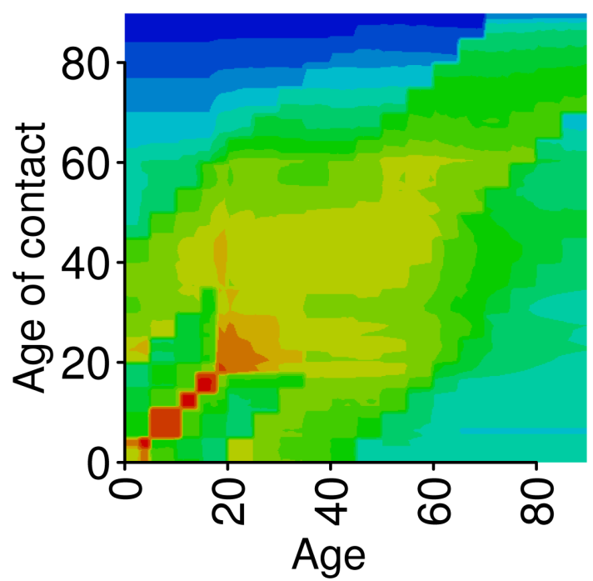
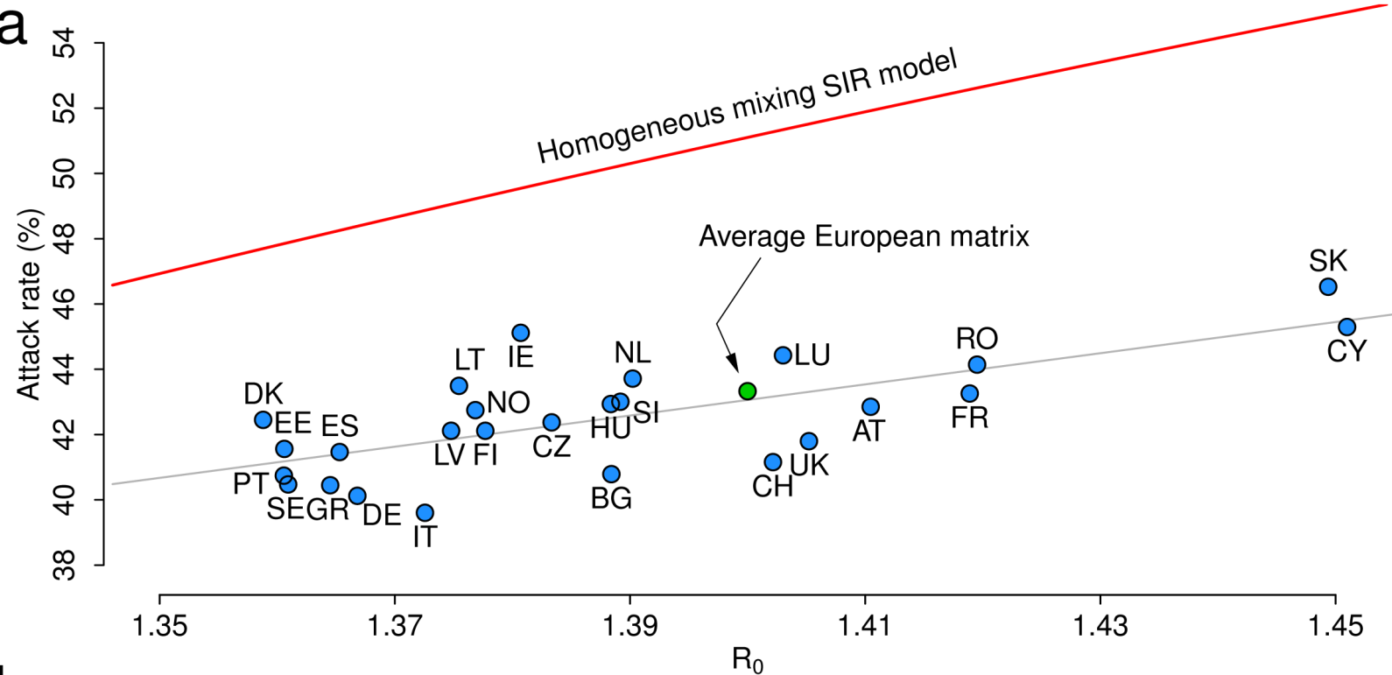
Inferring the Structure of Social Contacts Relevant for Infectious Diseases Transmission
Marco Ajelli, Northeastern University, USA & Bruno Kessler Foundation, Italy
Use country-specific sociodemographic data to build a synthetic population of Europe
Infer age-mixing patterns from interactions between agents of the synthetic population
Quantify the impact of social contacts on the dynamics of airborne diseases
Contact matrix for the UK
Source: Fumanelli et al. Inferring the Structure of Social Contacts from Demographic Data in the Analysis of Infectious Diseases Spread. PLOS Comput Biol, 2012
Notes:
Contact matrix for the UK: This plot represents the average frequency of contacts by age in the simulated population for the UK. The scale goes from blue (low frequency of contacts) to red (high frequency of contacts). (Note that this is a frequency of contacts and not a number of contacts, so I did not put the scale on the slide as it is very hard to interpret). The matrix shows some interesting features:
- School contacts -> small “squares” on the lower part of the main diagonal
- Workplace contacts -> “green/orange” area in the middle of he matrix
- 2 secondary diagonals representing contacts between kids and parents and parents with kids
Final note: the matrix is not symmetric as it represent the “average frequency of contacts”. On the other hand, a matrix showing the absolute frequency would have been symmetric.
Attack rate vs R0: attack rate (i.e., the ration between the total number of infected individuals at the end of the epidemic and the number of individual in the population) vs R0 (basic reproduction number). Each dot represents one European country (standard coding: e.g., SK=Slovak Republic, CY=Cyprus, IT=Italy, etc.). Resutls are obtained by simulating an influenza-like epidemic with an ordinary differential equation model, assuming the same transmission rate in all countries and fully susceptible populations. The plot shows the variability between the different countries both in terms of attack rate and R0 and thus the importance of considering country-specific age mixing patterns.

Slide 12
Modeling the Spread of Polio During an Outbreak in Israel
Amit Huppert, Gertner Institute, Israel
In the case of infectious disease outbreaks (here we give an example from a polio outbreak) the goal is to utilize data in order to first estimate the model parameters. In the second phase, the selected model can be used to study different control methods. To study and characterize the dynamics of the polio outbreak we developed a transmission model and evaluate the effect of the vaccination campaign on the outbreak dynamics.
Conclusions: Models can be useful to aid in designing optimal vaccination policy. Immunization campaigns are essential for interrupting polio transmission, even in a developed country setting with a high vaccine coverage.
Notes:
You may add notes to help the presenter focus on some points, yet focus on slide

Slide 13
PopGen
Ram Pendyala, Mobility Analytics Research Group, Arizona State University
http://www.mobilityanalytics.org/popgen.html
Synthetic population generator for deploying agent-based microsimulation models
Microsample Data
Iterative Proportional Updating (IPU)
Monte Carlo Draws of Households from Sample File
Iterative Proportional Fitting (IPF)
Census Marginal Control Data
Derive Sample Weights
Synthetic Population of Households and Persons
Multivariate Population-Level Joint Distributions
Notes:
PopGen is developed by the Mobility Analytics Research Group at Arizona State University. PopGen is an open source software package for generating a synthetic population in support of agent based microsimulation applications in a number of domains. To date, it has largely been used for simulation of agent behaviors in transportation networks. The procedure uses readily available census sample and marginal distribution data as inputs to the algorithm. PopGen incorporates a special iterative proportional updating algorithm to derive sample (household) weights such that marginal distributions on both household and person level variables are closely replicated in the resulting synthetic population.

Slide 14
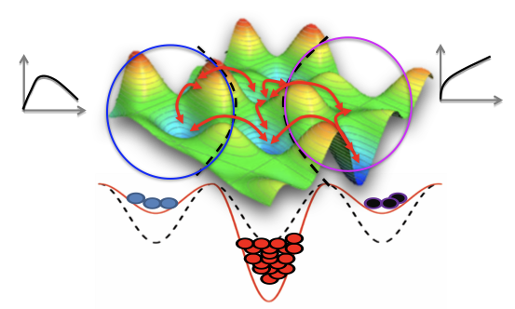
Phenotypic State Transitions As Survival Strategy for Cancer Cells
Bishal Paudel, Dr. Vito Quaranta’s Lab Vanderbilt University
Cells occupy distinct phenotypic states and can transition among states to withstand drug challenge.
A simple model of cell proliferation captures drug response dynamics.
Most cells occupy a non-quiescent state before resistance develops.
Notes:
We view cancer cell populations in an energy landscape—where different cancer cell subpopulations occupy distinct phenotypic states—each exhibiting distinct fitness in drugs. In addition to their own distinct drug responses, these cells can transition among states to withstand drug challenge. Our simple model of cell proliferation and transition can capture the drug response dynamics in our experimental data. Our data shows that most cells under drug perturbation occupy a non-quiescent state of balanced death and division similar to a drug-tolerant state, before they acquire drug resistance.

Slide 15


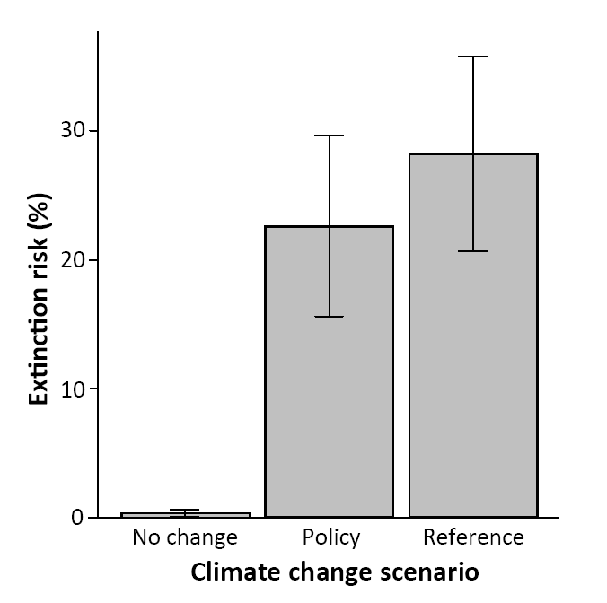
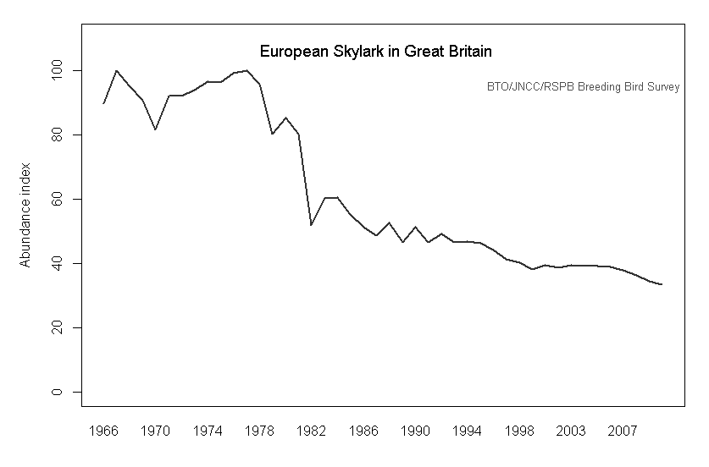
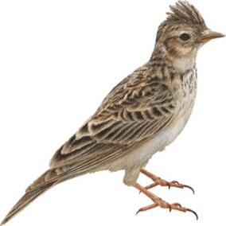
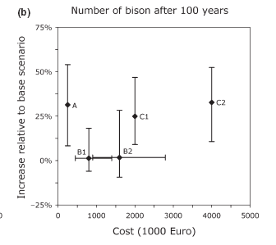

Applied Ecology and Conservation Biology
Resit Akçakaya, Stony Brook University, USA
Predicting Extinction
  Using linked models to estimate extinction risks under climate change.
    Climate Models
    Ecological Niche Models
    Metapopulation Models
  Modeling species interactions with linked predator-prey-disease models
Diagnosing Threats
  Inferring anthropogenic threats from long-term abundance records.
Optimizing Conservation
European Bison
Harvest = 31%
Habitat loss=57%
Notes:
You may add notes to help the presenter focus on some points, yet focus on slide

Slide 16
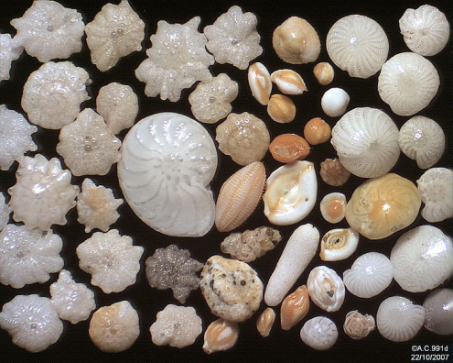
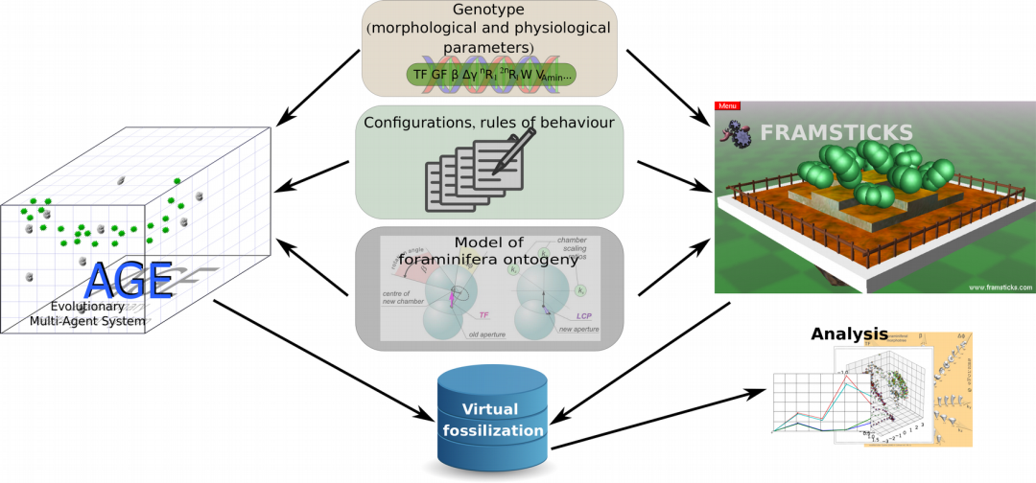
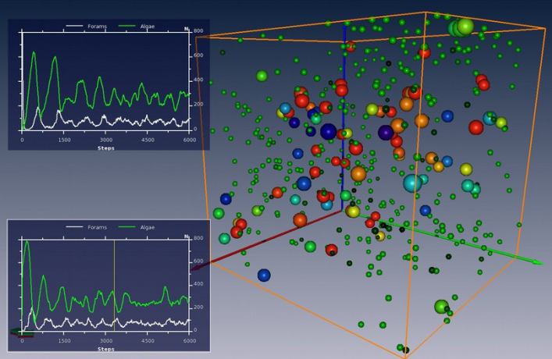
eVOLUTUS: the Simulator of Multiscale Evolutionary Processes Tested on Foraminifera
Paweł Topa, AGH University of Science and Technology, Poland
New algorithmic framework for testing and simulating evolution in defined environments at various spatiotemporal scales.
Foraminifera: - single cellular marine organisms with
  shells made of CaCO3
  two habitats: benthic (bottom sediments) and open water
  two types of reproduction: sexual and asexual
  live on Earth since Cambrian (500 Mya)
  perfectly preserved fossils
Metodology: Individual Based Modelling and Agent Based Modelling
Two implementations:
  EMAS (Evolutionary Multi-Agent Systems) www.age.agh.edu.pl
  Framsticks - www.framsticks.com

Slide 17
Human Centric Systems
Vivek Balaraman, Human Centric Systems Research Group TCS Research – India
Approach
Overall landscape of work
Fine grained agent models
Model elements lie in a behaviour repository
Repository contents mined from literature
Models are then ‘composed’ by a process
And made ready for simulation
Recent work – Modeling organizational behavior
Research Challenges
Human Behavior Modeling
What-if planning during a business continuity crisis
Impact of supervisor support on workplace outcomes
Impact of stress on workplace outcomes moderated by personality
Leaky bucket approach to demand management
Mining empirical results from literature
Domain considerations in composition
Making social science models sim ready
Validation and notions of model goodness
Contact: vivek.Balaraman@tcs.com
Notes:
We are the Human Centric Systems Research Effort and part of TCS Research. TCS or Tata Consultancy Services is one of the world’s largest IT and services organizations.
Our focus is on creating ‘good’ fine grained agent models using model elements which have been mined from social science research papers. These mined elements reside in a repository which acts as a library using which fine grained models for an agent in a situation or context can be composed. Model composition is a difficult enterprise and needs to fulfil several constraints relating to social science, the domain, statistics and then converted to a simulation model. The approach has been used by us to build several models in organization behaviour particularly in the area of Support Services.
The simulation system is part of a larger landscape of work that addresses the spectrum from behaviour data collection to building serious games.
The work has several research challenges from mining results in literature, understanding synonymy and polysemy considerations (called the Jingle Jangle problem in social science), challenges in behaviour composition and in defining and generating objective notions of model goodness.
Our group and work are multi-disciplinary and we have people with a background in psychology, behavioural finance, gaming, machine learning, natural language processing, representation and reasoning and agent based modelling and simulation

Slide 18
simPop (R) for synthetic data generation
Matthias Templ, Vienna University of Technology, Austria
Produce synthetic data from survey data and aggregated information
Model-based (generalized linear models, random forests, etc)
Can calibrate surveys and synthetic data using iterative proportional updating and combinatorial optimization
Can allocate finer geographical details
Can deal with complex data (hierarchical and cluster structures, missing values, finite samples)
Disclosure risk of synthetic data is very low
https://cran.r-project.org/package=simPop
Notes:
You may add notes to help the presenter focus on some points, yet focus on slide

Slide 19
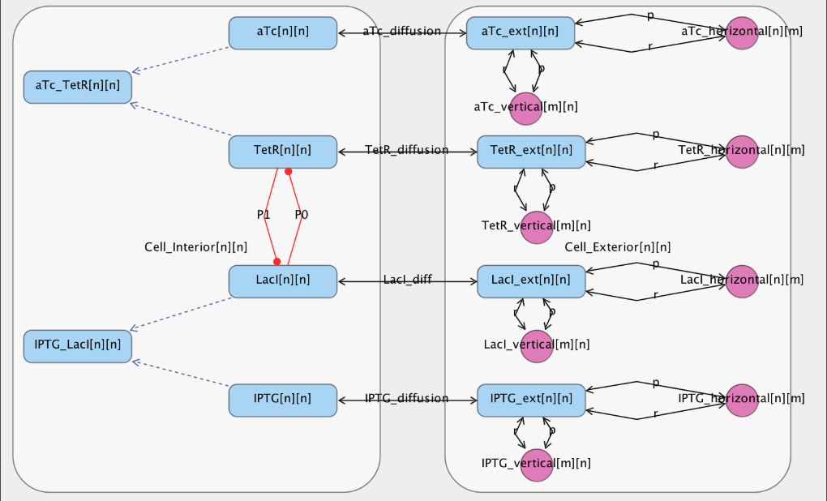
Population Modeling in iBioSim
Leandro Watanabe, Myers Lab, University of Utah
A standard-enabled tool for modeling and simulating biological models.
Supports the Systems Biology Markup Language (SBML).
  De factor modeling standard for reaction-based models.
  Uses package extensions to extend its functionality.
  Arrays package is used to represent regular structures more efficiently.
Using the arrays package, population models can be constructed within iBioSim.
Notes:
The Myers research group is active in standard development and tool development that can be applied towards population modeling. Namely, the iBioSim tool is a tool for modeling and simulating models represented in the Systems Biology Markup Language (SBML) among others. SBML is the defacto modeling standard in the systems/synthetic biology fields for representing mathematical models of reaction-based models. SBML supports extensions that increases the usability of the standard for different applications. The arrays package has been proposed to allow the representation of regular structures more concisely. Here we show an example of a population-based model corresponding to a population of genetic toggle switch where cells interact between each other using the arrays package.

Slide 20
Mapping Population Modeling
 | Epidemiology and public health | Managing disease spread | Resource planning & allocation, economics | Predicting drug effects | Risk assessment | Ecosystem management | Testing theory | Behavior modeling | Tools | Summary of methods
Nathan Geffen | √ | √ |  |  |  |  |  |  |  | Agent based modeling. matching algorithms, equation based models, microsimulation
Christopher Fonnesbeck | √ | √ |  |  |  |  |  |  | √ | MCMC, Baysian models, meta analysis, reinforcement learning
Dan Yamin | √ | √ | √ | √ |  |  |  |  |  | Cost effectiveness, Markov chains, differential equations, game theory
Katherine Ogurtsova | √ |  |  | √ |  |  |  |  |  | Cost effectiveness analysis
Jeff Shrager | √ |  |  | √ |  |  |  | √ | √ | Machine learning, Bayesian methods.
Feilim Mac Gabhann | √ |  |  | √ |  |  | √ |  |  | Differential equations, optimization, population generation
Carl Asche | √ |  | √ |  | √ |  |  |  |  | Cost effectiveness analysis
Michael Thomas | √ |  |  |  |  |  |  | √ |  | Machine learning, Genetic Algorithms
Marco Ajelli | √ |  |  |  |  |  |  |  |  | Agent based models, synthetic populations
Amit Huppert |  | √ |  |  |  | √ |  | √ |  | Predator prey models, Differential equations
Ram Pendyala |  |  | √ |  |  |  |  | √ | √ | Population generation, microsimulation
Bishal Paudel |  |  |  | √ |  |  |  |  |  | Differential equations, MCMC
Resit Akcakaya |  |  |  |  | √ | √ |  |  |  | Coupled niche-demographic models, matrix population models, metapopulation models with dynamic spatial structure
Pawel Topa |  |  |  |  |  | √ | √ |  |  | Agent Based Modeling, Evolutionary Computations
Vivek Balaraman |  |  |  |  |  |  |  | √ |  | Agent Based Modeling, surveys, serious games
Matthias Templ |  |  |  |  |  |  |  |  | √ | Population generation, iterative proportional fitting
Leandro Watanabe |  |  |  |  |  |  |  |  | √ | SBML arrays, stochastic simulation

Slide 21
Discussion
Most modelers now work at the individual level
The map has expanded from previous years
New mapping categories were added:
  Behavior modeling
  Tools
As part of this work population modelers started building new project pages in SimTK

Slide 22


Join the Mailing List or
Read the Mailing List Archives
https://simtk.org/mailman/listinfo/popmodwkgrpimag-news
This presentation is indented for reuse by educators
Please feel free to use this material while acknowledging the authors of slides you use.
Mailing list is powered by simtk.org
Thanks to Joy Ku and the SimTk team

